Slide 1

Gynecology and
Maternity Nursing

Slide 2
Unit 4
Caring of Pregnant Woman with Normal Physiological & Psychological Changes
Antenatal Period

Slide 3
DEFINITIONS
Obstetrics
Field of medicine that deals with pregnancy (prenatal), delivery of baby, and postpartum period(6weeks)
Gravidity:
Total number of pregnancies of any gestation includes current pregnancy, abortions, ectopic pregnancies.
Parity:
Number of pregnancies that have been carried to > 20 weeks
Twins count as one

Slide 4
ANTENATAL PERIOD
1. Maternal physiological and psychological adaptations to pregnancy.
2. Prenatal care.
3. First trimester of pregnancy.
4. Second trimester of pregnancy.
5. Third trimester of pregnancy

Slide 5
DEFINITIONS
Primipara: A woman who had delivered, live born child
Multipara : A woman who has delivered 2,3,4 children
Nulligravida : A woman who has never been pregnant.
Grand multiparity : parity of more than 4 children
Primigravida : A woman who is pregnant for the first time
Multigravida: A woman who has been pregnant previously.

Slide 6
DEFINITIONS
Pregnancy
-Nine calendar months or 10 lunar months
-Forty + two weeks or 280 days
-Divided into trimesters
-Three intervals of three months each. Known as gestational period

Slide 7
Parity Four Letter Description (T P A L)
T: number of term infants delivered (> 37 weeks)
P: number of premature infants delivered (20 to 37 weeks)
A: number of abortions (< 20 weeks)
L: number of living children

Slide 8
Parity Four Letter Description (T P A L)
❏ T1 (First Trimester). 0 to 12 weeks
❏ T2 (Second Trimester): 12 to 28 weeks
❏ T3 (Third Trimester): 28 to 40 weeks
❏ Normal pregnancy term: 37 to 42 weeks

Slide 9
Parity Four letter description (T P A L)
Example G3/P1-0-1-1:
-3rd Pregnancy
-1 Term delivery
-0 Preterm deliveries
-1 Abortion
-1 Living child

Slide 10
Definitions
Abortion:
Loss of pregnancy prior to viability of fetus
< 20 weeks and/or < 500 g fetal weight
Includes induced (therapeutic) and spontaneous (miscarriage)
Stillbirth:
Loss of pregnancy after 20 weeks and/or > 500 g fetal weight
Causes Stillbirth
1-Prematurity
2- Congenital anomalies

Slide 11
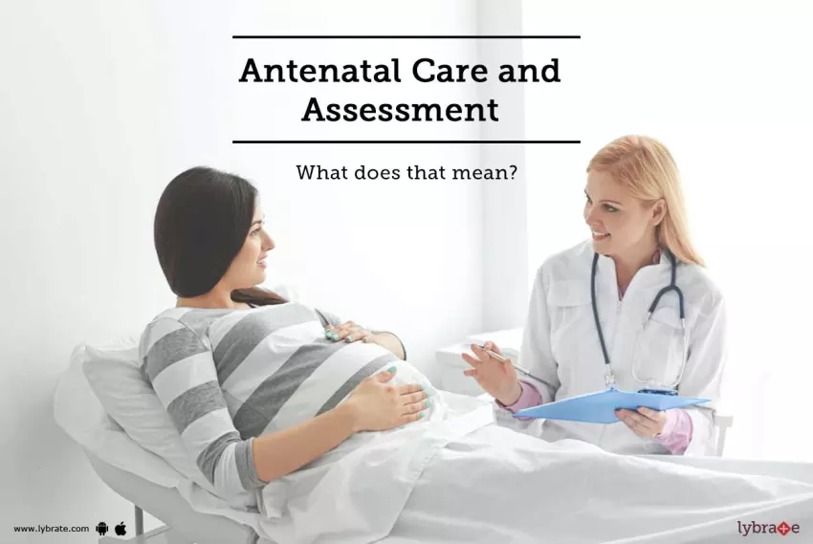

Slide 12
Aims and principles of good antenatal care:
Ensure that pregnancy causes no harm to mother and to keep he fetus healthy during antenatal period.
Provide health education

Slide 13
Antenatal care
Identify complication/ risk factors
Assess fetal condition
Provide health care education
Record and report all pregnancy information

Slide 14
DIAGNOSIS OF PREGNANCY
Classification of Pregnancy Signs and Symptoms
1-Presumptive or Indications :
Subjective signs observed and reported by the woman
2-Probable:
Objective signs observed by examiner
3-Positive:
Those that can be caused only by pregnancy.

Slide 15
Presumptive Signs
First trimester:
1-Amenorrhea: Absence of menstruation.
2-Nausea &vomiting (Morning sickness)
3-Breast changes: begins at 6 week
4-Fatigue and Urinary frequency

Slide 16
Presumptive Signs
Second Trimester:
1-Quickening : fetal movements.
2-Increased skin pigmentation:
Chloasma (Melasma): Dark pigment on the face “mask of pregnancy”.
Linea nigra :line of dark pigment on the abdomen
Striae gravidarum: red streaks on abdomen

Slide 17
Probable Signs of pregnancy
First Trimester:
Chadwick’s sign :
Bluish discoloration of cervix and vagina 6 weeks caused by hormonal imbalance.
Goodell’s sign :
Softening of the cervix : 4-6 weeks caused by hormonal imbalance.
Hegar’s sign :
Softening of the isthmus of uterus : 6-8 weeks caused by hormonal imbalance.

Slide 18
Probable Signs of Pregnancy
First trimester:- Positive HCG
Second trimester:
Enlarged abdomen
Braxton hicks contractions : Presence of Myomas can cause false and painless contractions

Slide 19
Positive Signs
First trimester:
Ultrasound evidence
Second trimester :
1. Fetal heart tones
2. Fetal movements

Slide 20
The First Antenatal Visit
Patient must be treated with kindness and understanding in order to gain her confidence and to ensure her future cooperation and regular attendance.

Slide 21
The Aims of First Antenatal Visit:
History
Physical examination.
Establish duration of pregnancy
Screening tests
Identified high-risk patients

Slide 22
Patients History
-Previous and present obstetric history.
-A medical history.
-HIV status.
-Medication and allergies.
-A surgical history.
-A family history.
-Social circumstances

Slide 23
The Previous Obstetric History
Establish gravidity, parity, miscarriages and ectopic pregnancies
Previous birth weight, gestational age and method of delivery and previous perinatal deaths.
Previous complications of pregnancy or labor:

Slide 24
The Present Obstetric History:
First day of last menstrual period .
Any medical or obstetric problems
Attention must be given to minor symptoms e.g Nausea/ vomiting,

Slide 25
The Medical History
Hypertension.
Diabetes mellitus.
Rheumatic or other heart disease.
Epilepsy.
Asthma.
Tuberculosis.
Psychiatric illness.
Any other major illness.

Slide 26
Medication Taken and A History of Allergy
-Regular use of medication.
-Certain drugs can be Teratogenic (damage the fetus) e.g. retinoid which are used for acne
-Allergies are also important and the patient must be specifically asked if she is allergic to penicillin

Slide 27
Previous Operations:
Caesarean section, Cardiac surgery.
The Family History:
Diabetes,
Multiple pregnancy,
Bleeding tendencies
Mental retardation

Slide 28
The Patient’s Social Circumstances
1-Smoking.
2-Unemployment, poor housing, overcrowding (Malnutrition)
3-Immunizations
4-Domestic Abuse
5-Exercise

Slide 29
A Physical Examination:
1-General appearance
2-Height
3-Weight
4-Breasts and Abdomen Examination
5- Thyroid gland and Lymph nodes in neck, axillae
6- Cardiovascular system.
7- Reproductive system: Examination of uterus and fetus
8- Respiratory system.

Slide 30
Abdomen Examination
A ) Prepare patient for examination
-The patient should have an empty bladder.
-She should lie comfortably on her back with a pillow under her head.
B) Abdomen General appearance
Presence obesity.
Presence or absence of scars.
Size and shape of uterus.
Any other abnormalities.

Slide 31
Abdomen Examination
C) Abdomen palpation
Palpated for enlarged organs or masses : liver, spleen kidneys
The presence of an enlarged organ, or a mass, should be reported

Slide 32
Abdomen Examination
D ) Uterus Palpation
Check whether uterus is lying in midline of abdomen.
Height of fundus above symphysis pubis is measured
Feel wall of the uterus for irregularities usually caused by presence of myomas (fibroids) which usually enlarge during pregnancy and may become painful.
A congenital abnormality such as a bicornuate uterus

Slide 33
Abdomen Examination
E) Determining the size of the uterus before 18 weeks gestation
Anatomical landmarks are used:
The symphysis pubis
The umbilicus.
Gently palpate abdomen with left hand to determine height of funds of uterus
If funds is palpable just above symphysis pubis, the gestational age probably 12 weeks.
If fundus reaches halfway between symphysis and umbilicus, gestational age is probably 16 weeks.

Slide 34
Abdomen Examination
If the fundus is at same height as umbilicus, gestational age is probably 22 weeks (one finger under umbilicus = 20 weeks and one finger above umbilicus = 24 weeks).
F) Determining the height of the fundus from 18 weeks gestation

Slide 35
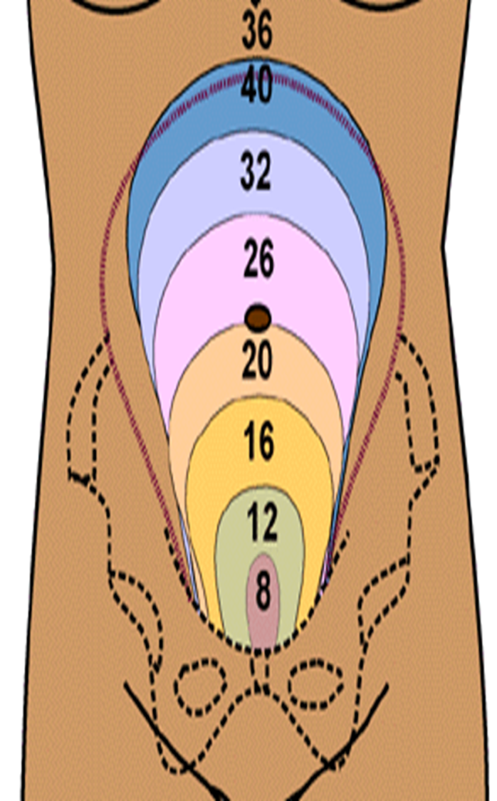
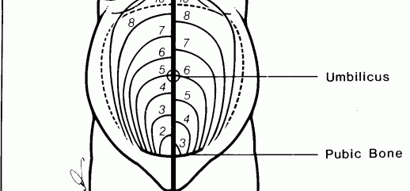

Slide 36
Abdomen Examination
G ) Palpation of the fetus
The lie and presenting part of fetus only becomes important when the gestational age reaches 34 weeks.
The following must be determined:
1-The lie of the fetus.
This is relationship of long axis of fetus to that of mother.
The lie may be longitudinal, transverse, or oblique.

Slide 37
Abdomen Examination
2-The presentation of fetus. (presenting part)
-If there is a breech, it is a breech presentation.
-If there is a head, it is a cephalic presentation.
-If no presenting part can be felt, it is a transverse or oblique lie.
3-The position of back of fetus.
Whether back of fetus is on left or right side of uterus, and will assist in determining position of presenting part.

Slide 38
Abdomen Examination
H) Assessment of the amount of amniotic fluid present:
This is not always easy to feel.
The amount of amniotic fluid decreases as pregnancy nears term.
The amount of amniotic fluid is assessed clinically by feeling the way that the fetus can be moved (balloted) while being palpated.

Slide 39
Abdomen Examination
I )Amount of head palpable above pelvis
The amount of head is assessed by feeling how many fifths of the head are palpable above the brim of the pelvis1/5,2/5, 3/5, 4/5, 5/5.

Slide 40
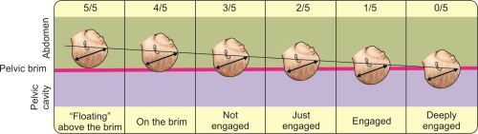
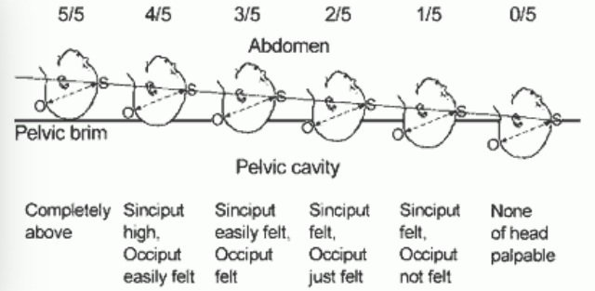

Slide 41
Abdomen Examination
J) Assessment of uterine irritability
Uterus feels tight, or has a contraction, while being palpated.
Uterine irritability normally only occurs after 36 weeks of pregnancy, i.e. near term.

Slide 42
Abdomen Examination
K )Listening to the fetal heart
The fetal heart is most easily heard, by listening over the back of the fetus.
Listening to the fetal heart is done to rule out an intrauterine death.

Slide 43
Abdomen Examination
L) Assessment of fetal movements : fetus makes 2 types of movement:
a. Kicking movements:
Caused by movement of limbs. Usually quick movements.
b. Rolling movements: caused by the fetus changing position.

Slide 44
External And Internal Genitalia Examination
Signs of sexually transmitted diseases
Carcinoma of the cervix is the commonest form of cancer.

Slide 45
Determining the Duration of Pregnancy
The result of an ultrasound examination
Last Menstrual Period.
The duration of pregnancy is calculated from first day of last period.
Date of Birth Calculation : Nagele’s rule
Subtract three months from beginning of last menstrual period (LMP)
Add seven days to date
Add 1year
= Expected Date Of Delivery

Slide 46
Naegels’s Rule
Formula: - 3 months + 7 days + 1 year
Example Last Menstrual Period
April 20 2024
-3 months +7 days +1 year
January 27 2025
EDC: January 27, 2025

Slide 47
Screening Tests
1- Routine Examinations:
A hemoglobin at first visit and again at 28 and 36 weeks.
A urine test for protein and glucose is done at every visit.
2- Special Investigations:
A screening test for syphilis and HIV
Blood group: Rh positive or negative.
Culture urine

Slide 48
Screening Tests
3- Ultrasound Screening:
At 11 to 13 weeks for nuchal thickness,
Screening Down syndrome
Diagnose multiple pregnancies early.
Identify the site of the placenta.
Diagnose severe congenital abnormalities.

Slide 49
Subsequent Visits
General principles:
The subsequent visits must be problem oriented.
The visits at 28, 34 and 41 weeks are more important visits.

Slide 50
Subsequent Visits
For low-risk, uncomplicated pregnancy
Every month until 28 weeks
Every 2 weeks from 28 to 36 weeks
Every week from 36 weeks until delivery.
Primigravids are then seen at 36 weeks and multigravidas at 38 weeks.
Multigravidas are seen at 36 weeks if a breech presentation .
Primigravidae are seen at 40 and 41 weeks
Multigravidas are seen at 41 weeks if they have not yet delivered.

Slide 51
Assessment of Complications in Pregnancy: Symptoms or Signs
Abruption Placenta Symptoms and Signs:
Vaginal bleeding.
Persistent, severe abdominal pain.
Decreased fetal movements
Abruption Placenta Symptoms and Signs:
Vaginal bleeding.
Persistent, severe abdominal pain.
Decreased fetal movements

Slide 52
Assessment of Complications in Pregnancy: Symptoms or Signs
Preeclampsia Symptoms and Signs:
1-Persistent headache.
2-Flashes before the eyes.
3-Sudden swelling of hands, feet or face.
Preterm labour Symptoms and Signs:
Rupture of membranes.
Regular uterine contractions before expected date of delivery

Slide 53
Assessment of Complications in Pregnancy: Symptoms or Signs
Preeclampsia Symptoms and Signs:
1-Persistent headache.
2-Flashes before the eyes.
3-Sudden swelling of hands, feet or face.
Preterm labour Symptoms and Signs:
Rupture of membranes.
Regular uterine contractions before expected date of delivery.

Slide 54
Maternal Physiology Changes During Pregnancy
1- Systemic- Major Body Organs:
Cardiovascular System:
The respiratory system:.
The skeletal system
The renal system:
The hematologic system
The gastrointestinal system
Integumentary System (Skin)
The Endocrine system
2- Local- Reproductive tract

Slide 55
Cardiovascular System:
Cardiac output increases 30-50%
Pulse increases about 15-20 bpm
Systolic murmur/ s3 90% of pregnant women.
Hypotension during 2nd trimester then returns to normal during 3rd trimester
-Pressure on diaphragm displaces the heart.
-Femoral venous pressure slowly rises
  a. Stasis
  b. Dependent edema
  c. Varicoities

Slide 56
The Respiratory System:.
Tidal volume increases 40%
Respiratory rate increases
Shortness of breath (SOB)
Oxygen consumption increases by 20%
Hyperventilation to blow off load of co2 from fetus
Progesterone levels signal hypothalamus to reset acceptable pco2 levels.
Low co2 levels allows for co2 to cross the placenta
Nasal stuffiness, Epistaxsisexcess.

Slide 57
The Hematologic System
Plasma volume increases by about 50%
RBC volume increases by about 30% result in dilutional anaemia of pregnancy",
Average Hemoglobin during pregnancy is 11.5 g/dl
WBC count increases
Platelet count decreases, but stays within normal limits
Pregnancy is a "Hypercoagulable state“ increased levels of Fibrinogen, factor VII-X (7-10) placenta produces a Plasminogen activator inhibitor.
Clinical significance: blood loss is well-tolerated during labour, maternal vital signs do not change for blood loss of up to 1500 cc, vital signs cannot be trusted as an indicator of blood loss.

Slide 58
The Skeletal System
No obvious changes in teeth noted
Pelvis joints and ligaments softening and relax due to hormone relaxin
Waddling gait: in which feet are wide apart and resembles duck walk
Shift in center of gravity

Slide 59
The Renal System:
-Kidneys increase in size and weight,
-Dilatation of ureters (R > L)
-Bladder increases capacity
-GFR increases 50%,
-Plasma flow increases by 75%
-BUN and serum Creatinine decrease by 25%
-Increase reabsorption of sodium
-Total body H2O content increases

Slide 60
The Renal System:
-Excrete waste from mother and fetus
-Increase glucose excretion
-Marked increase in renin and angiotensin levels, but markedly reduced vascular sensitivity to their hypertensive effects
-Frequency increases (10-12x/day)
-Pregnant women are at increased risk for bladder rupture during abdominal trauma

Slide 61
The Gastrointestinal System
Decreased motility, due to influence of progesterone reduced gastric acid secretion
Feel a full stomach even if she has had nothing to eat or drink for several hours
Nausea and vomiting associated with HCG: 50% affected
Changes of taste and smell
Intestines are displaced
Heartburn
Constipation, hemorrhoids
Acidity of stomach decreases
Hypertrophy of gums and gingival bleeding.

Slide 62
Integumentary System (Skin)
Nipples and areola areas of breasts are darker
Striae gravidarum
Linea nigra
Chloasma
Skin: Vascular Changes

Slide 63
The Endocrine System
a-Placenta produces Estrogen, Progesterone, HCG, HPL, Relaxin , Prostaglandins Lead to increased Vascularity ,Hyperplasia, Increased oxygen consumption
b-Pituitary: decreased FSH and LH, Prolactin increases, secretes oxytocin Results in: lactation, increased pigmentation.
c-Pancreas:
Early pregnancy there is a decrease in insulin production r/t increased fetal demands
After 1st trimester: increase in insulin production r/t insulin antagonist properties of estrogen, progesterone

Slide 64
Changes In Weight
Recommended weight gain during pregnancy:
Ranges from 25 to 30 pounds
Pattern of weight gain is important
    1st – 3rd month = 3 - 4 pounds total
    4th – 9th month = 1 pound per week

Slide 65
2- Local- Reproductive Tract: UTERUS
-Pre-pregnancy small semisolid pear shaped (pyriform) 50-70 g; 6-8 cm
-Weight increases from 50Gm to 1000Gm, enlargement primarily a result of hypertrophy of pre-existing myometrial cells
-Development of new fibro-elastic tissue between bands of muscles
-Cells increase as result of estrogen
-Blood flow 15-20ml/min pre-pregnancy, at term 500-700ml/min
-By end of pregnancy 1/6 total maternal blood volume is circulating through uterus that’s why bleeding- serious problem

Slide 66
2- Local- Reproductive Tract: CERVIX
-1 month after conception- experience softening and cyanosis result from increased vascularity ,increased discoloration and edema of entire cervix.
-Hyperplasia and hypertrophy of the cervical glands mucosa of cervix undergoes marked changes
-Endo-cervical cells secrete thick, tenacious mucus which accumulates and forms the mucus plug that Seals the cervical canal to prevent infection . Expelled at start of labor
-Increased mucus leads to increased discharge

Slide 67
2- Local- Reproductive Tract: OVARIES
Cease ovum production related to active feedback mechanism of estrogen and progesterone produced by the corpus luteum and the placenta
Functions maximally during the first 6 to 7 weeks of pregnancy 4 to 5 weeks post ovulation

Slide 68
2- Local- Reproductive Tract:
Fallopian Tubes
Musculature of the fallopian tubes undergoes little hypertrophy
The epithelium of the tubal mucosa becomes flattened

Slide 69
2- Local- Reproductive Tract:
Vagina and Perineum
Increased vascularity and hyperemia احتقانdevelop in skin and muscles of perineum and vulva
Papillae of vaginal epithelium undergo hypertrophy to create a fine, hobnailed مسمر النعلappearance.
Estrogen secretions are acidic> increased growth of candida, ph is acidic 3.5 to 6.
At term vaginal walls are relaxed

Slide 70
2- Local- Reproductive Tract: BREASTS
Increase in size and nodularity
Preparing for lactation
2nd month superficial veins are prominent
More Pigmentation of areola
Sebacious glands enlarge (Montgomery tubercles)
16th week colostrum begin .

Slide 71
PSYCHOLOGICAL CHANGES OF PREGNANCY
Attitudes depends on:
a. Environment
b. Social
c. Cultural
d. Family
e. Individual.
f. Health care provider attitude

Slide 72
PSYCHOLOGICAL CHANGES OF PREGNANCY
First Trimester
Acceptance of pregnancy
50% are surprises pleased, disturbed, disappointed, frightened.
Concerns center on self
Husband response

Slide 73
PSYCHOLOGICAL CHANGES OF PREGNANCY
Second trimester:
1. Acceptance of Baby : Indications are
a. Preparations for new arrival and Start to make plans
b. Resolve old fears / conflicts.
c. Educate: regarding pregnancy and childbirth.
2. Evaluate relationships: Nurse should be good listener and facilitate expressions of feelings
3. Fantasize.

Slide 74
PSYCHOLOGICAL CHANGES OF PREGNANCY
Third Trimester
1-Preparing for Parenthood
2-Nesting
3- Mimicry and role-playing
a. association with other pregnant women or new mothers
b. spend time with own mother.
c. Identifies parenting role she wants to mimic
4-Fantasy: How will it be to be a mother
5-Grief work giving up her current lifestyle as life will never again be the same.

Slide 75
Emotional Responses
Initial reaction Gamut of emotions Need time to adjust
Ambivalence( pleased and not pleased at same time)
Grief
Narcissistic response is an early reaction.
Introversion vs. Extroversion glowing behavior is common
Body image and boundary
Stress
Has difficulty staying focused.
Emotional mood swings are frequent

Slide 76
Father’s Reaction to Pregnancy
Fathers are becoming more involved in childbearing process from pre-natal care to participating in the labor and birth process.
Acceptance is also his major developmental task to be achieved.
Needs to accept the reality of the child.
Need preparation for the changes that will take place for his wife.
Mood swings are common and emotions are unpredictable.
Narcissistic or self-centered response of mother may be misunderstood.

Slide 77
Father’s Reaction to Pregnancy
May feel “left out”.
May have feelings of jealousy.
His childhood background will also influence his preparation.
Needs to also identify a role-model or parenting style he wants to mimic.
Preparation also includes fantasy and grief work.

Slide 78
Concerns of Fathers
Most are still primarily concerned with the financial obligations.
Protective and supportive role

Slide 79
Effects of Pregnancy on Other Children
-Children will need some warning.
-Mood swings of Mom unpredictable response to behavior.
-Mom ‘sick’. Visits to the doctor.
-How soon to tell children depends on their ages and personality of the child.
-The parents reactions and acceptance of the new baby also will influence the children.

Slide 80
Preparing Children for a New Sibling
Preparation by Ages
School-age children should be told when parents know for sure.
Pre-School children should be told when preparation for baby begins.
Toddlers are often most affected and must give up role of “baby of family”
Answering their questions:
-Answer questions honestly and simply depending on age and understanding.
-Answer only what he is asking.

Slide 81
Pregnancy Discomforts
-They are common, but they are not experienced by all pregnant women
-Good nutrition is important for a comfortable and healthy pregnancy.
1-Edema of the lower extremities and varicosities of vulva and rectum. It is a normal physiologic change during pregnancy.
Edema of the upper extremity needs medical evaluation.
Management Edema :
-Elevate legs above hip level
-Wear elastic stockings.
-Elastic bandage application.

Slide 82
Pregnancy Discomforts
2-Morning Sickness
50% of pregnant women experiences nausea and vomiting during the early stage of pregnancy.
It is most apparent early in morning
Start at same time levels of HCG and progesterone are elevated

Slide 83
2-Morning Sickness Results from
-Systemic reaction to high estrogen
-A drop in glucose level (it used by fetus).
-High progesterone level
-Lack of Vitamin B6
-Diminished gastric motility
-Sensitivity to high levels of HCG

Slide 84
2-Morning Sickness: Nausea Managements
 | Eat six small meals per day rather than three. Eat a piece of dry toast or some crackers before getting out of bed. Avoid foods or situations that worsen the nausea.

Slide 85
Pregnancy Discomforts: Backache
Apply local heat.
Avoid long periods of standing.
Stoop to pick up objects.
Wear low-heeled shoes.
Lordosis is common with change in the center of gravity

Slide 86
Pregnancy Discomforts:
Constipation
Increase fiber in the diet.
Drink additional fluids.
Have a regular time for bowel movements.
Difficulty Sleeping
Drink a warm, caffeine-free drink before bed and practice relaxation techniques.

Slide 87
Pregnancy Discomforts:
Fatigue:
-Schedule a rest period daily.
-Have a regular bedtime routine.
-Use extra pillows for comfort.
Faintness:
Move slowly, Lie on the left side when at rest.
Avoid crowds, Remain in a cool environment.

Slide 88
Pregnancy Discomforts:
Headache:
Avoid eye strain, visit ophthalmologist
Rest with a cool cloth on forehead.
Report frequent or persistent headaches to primary care provider.
Heartburn
Eat small, frequent meals
Avoid overeating, as well as spicy, fatty, and fried foods.

Slide 89
Pregnancy Discomforts:
Hemorrhoids: Avoid constipation and straining with a bowel movement. Take a sitz bath. Leg cramps Avoid pointing toes. Straighten leg and dorsiflexion ankle.

Slide 90
Pregnancy Discomforts:
Nasal stuffiness
Use cool air vaporizer or humidifier,
Increase fluid intake,
Place moist towel on the sinuses and Massage the sinuses.
Ptyalism: (salivating)
Use mouthwash
Chew gum or suck on hard candy.

Slide 91
Pregnancy Discomforts:
Round ligament pain
Avoid twisting motions.
Rise to standing position slowly and use hands to support the abdomen.
Bend forward to relieve discomfort.
Shortness of breath
Use proper posture.
Use pillows behind head and shoulders at night.

Slide 92
Pregnancy Discomforts:
Urinary frequency
Void as necessary, at least every 2 hours.
Increase fluid intake. Avoid caffeine.
Practice Kegel exercise.
Varicose veins
Walk regularly and Rest with feet elevated.
Avoid long periods of standing.
Do not cross legs when sitting.
Avoid knee-high stockings and Wear support hosiery

Slide 93
Pregnancy Discomforts:
Carpal tunnel syndrome
It is caused by pressure on the median nerve in the carpal tunnel of the wrist.
Symptoms include numbness, tingling and weakness in the thumb and fingers.

