Slide 1

Gynecology and
Maternity Nursing

Slide 2
Caring of Woman During Normal Childbirth Process (Stages of Labor)
LABOR STAGES: First , second, third and fourth
LABOR COMPLICATION: prolonged labor, laceration, instrumental deliver ,c/s

Slide 3
Normal Labour and Delivery
Labour is the onset of regular painful contractions with progressive cervical effacement and dilatation of cervix accompanied by descent of presenting part.

Slide 4
Criteria of Normal Labour
Spontaneous expulsion, of a single, mature fetus (37- 42 weeks),
Presented by vertex (vaginal delivery)
Within a reasonable time (not less than 3 hours or more than 18 hours),
Without complications to mother or fetus

Slide 5
Theories of Labor Onset:
1-Uterine Stretch Theory: Any hollow body organ when stretched to capacity will necessarily contract and empty
2-Oxytocin Theory
Posterior Pituitary Gland produce Oxytocin during labor. It causes the contraction of smooth muscles of body
3-Progesterone Deprivation (Withdrawal)Theory
It designed to promote pregnancy and to inhibit uterine motility.

Slide 6
Theories of Labor Onset:
4-Prostaglandin Theory –
Release of Arachidonic acid produced by steroid action on lipid precursors.
Arachidonic acid increase Prostaglandin synthesis which in turn causes uterine contractions.
5-Theory of Aging Placenta because of the decrease in blood supply uterus contracts.

Slide 7
Preliminary Signs of Labor:
Lightening –
Settling of fetal head into pelvic brim.
In Primigravida occurs 2 weeks before EDC
In Multigravida occurs on or before labor onset.

Slide 8
Lightening results in:
Increase in urinary frequency
Relief of abdominal tightness and diaphragmatic pressure
Shooting pain down the legs because of pressure on the Sciatic Nerve
Increase in amount of vaginal discharges

Slide 9
Preliminary Signs Of Labor:
b. Increased Activity Level
Due to increased epinephrine secreted to prepare body for coming “work” ahead.
Advise pregnant woman not to use this increased energy for doing household chores
c. Loss of weight
About 2-3 lbs (1-1.5kg), 1 to 2 days before labor onset; due to decrease in Progesterone production leading to decrease in fluid retention.
d. Braxton Hicks contractions
Painless irregular practice contractions

Slide 10
Preliminary Signs f Labor:
e. Ripening of cervix -
An internal sign seen only on pelvic examination.
At term, cervix becomes softer and can be described as butter soft, and it tips forward.

Slide 11
True and False Labor Contractions
False contractions
1-Begin and remain irregular
2-Remain confined to abdomen and groin
3-Disappears with ambulation and sleep
4-No increase in duration frequency or intensity
5-Do not achieve cervical dilation

Slide 12
True And False Labor Contractions
True labor contractions:
1- Begin irregular but become regular and predictable
2-Felt first in lower back and sweep around to abdomen in a girdle-like fashion ( a belt)
3-Increase in duration, frequency and intensity
4-Continue no matter what woman’s level of activity
5-Achieve cervical dilation

Slide 13
SIGNS OF TRUE LABOR:
1.Uterine contractions –
The surest sign that labor has begun is the initiation of effective, productive uterine contractions

Slide 14
Uterine Contractions Pain Results From:
a. Contraction of uterine muscles when in an ischemic state
b. Pressure on nerve ganglia in cervix and lower uterine segments
c. Stretching of ligaments adjacent to uterus and in pelvic joints
d. Stretching and displacement of tissues of vulva and perineum

Slide 15
SIGNS OF TRUE LABOR:
2. Show –
Mucus plug that filled cervical canal during pregnancy is expelled.
The blood, mixed with mucus, takes on a pinked tinge (trace color) .
3. Rupture of the membranes:
It will occur within 4 hours.
Infection can easily set in.

Slide 16
Measures when Membranes Ruptured
Aseptic techniques in all procedures
Decrease obstetric manipulation
Enema is no longer ordered
Temperature should be taken regularly so that fever a sign of infection can be detected

Slide 17
COMPONENTS OF LABOR:
The PASSAGE
The PASSENGER
c. The POWERS of LABOR
d. The PSYCHE

Slide 18
A.) PASSAGE:
The route fetus must travel from uterus through cervix and vagina to external perineum.
For the fetus to pass through the pelvis, the pelvis must be of adequate size.
Diagonal Conjugate: anterior-posterior diameter of inlet
Transverse Diameter of the outlet.

Slide 19
B.) PASSENGER
The passenger is the fetus
The body part of fetus that has widest diameter is head
Fetus is of appropriate size and in an appropriate position and presentation

Slide 20
Structure of the Fetal Skull:
Cranium: upper most portion of the skull, comprises of 8 bones
Important bones in childbirth:
Frontal,
2 Parietal
Occipital bone
-Frontal bone is referred to as the Sinciput (forehead)
-Occipital bone is referred to as the Occiput

Slide 21
Suture lines of the Fetal Skull:
-The bone of the skull meet at suture lines
Sagittal suture,
Coronal suture,
Lambdoid suture
The suture lines are important in birth because they allow cranial bones to move and overlap

Slide 22
Fetal Skull: Fontanelles
Spaces found at the junction of the main suture line.
a. Anterior Fontanelle (Bregma)
Lies at junction of Coronal and Sagittal sutures.
Diamond in shape.
AP diameter is 3 – 4 cm.
Transverse Diameter 2 – 3 cm.

Slide 23
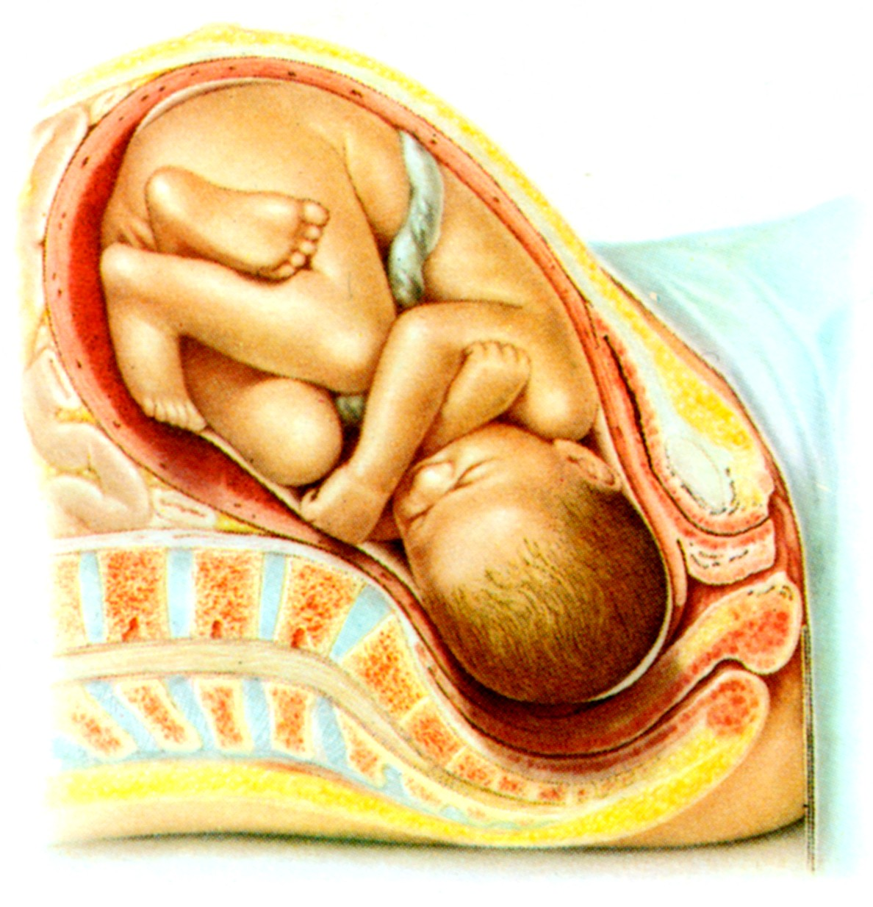
Beginning Labor: Fetal Presentation and Position
1-Attitude
2-Engagement
3-Station
4- Fetal Lie

Slide 24
1-ATTITUDE
The degree of flexion fetus assumes during labor or relation of fetal parts to each other.
1- A fetus in good attitude is in Complete Flexion:
Spinal column is curved forward,
Head is flexed forward that chin touches sternum,
Arms are flexed and folded on chest,
Thighs are flexed onto abdomen, calves are pressed against the posterior aspect of the thighs.

Slide 25
1-ATTITUDE
2-Fetus Moderate Flexion
Chin is not touching chest but is in an alert or military position.
Occipital diameter present to the birth canal
3- Partial Extension presents brow of head to birth canal.

Slide 26
1-ATTITUDE
4-Fetus Complete Extension
A fetus is in poor flexion,
Back is arched,
Neck is extended
Presenting occipito-mental diameter of head to birth canal

Slide 27
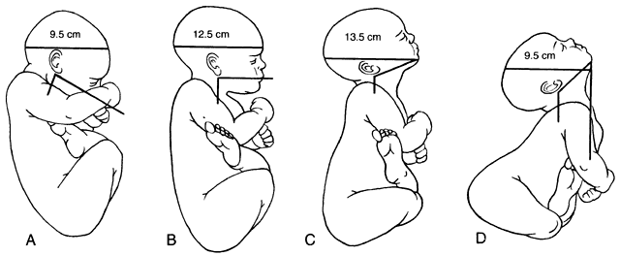
Diameters of the Fetal Skull:

Slide 28
2-ENGAGEMENT
The settling of presenting part of fetus far enough into pelvis to be at level of Ischial spines, a midpoint of the pelvis.
1- Floating: a presenting part that is not engaged
2- Dipping: is descending but has not yet reached iliac spines can be said to be

Slide 29
3-STATION:
The relationship of presenting part of the fetus to level of ischial spines
1- 0 station: Presenting part is at the level of ischial spines
2- (1cm to – 4 cm): above the spines, the distance is measured and described as minus station
3- (+1cm to +4cm): below the spines = plus stations

Slide 30
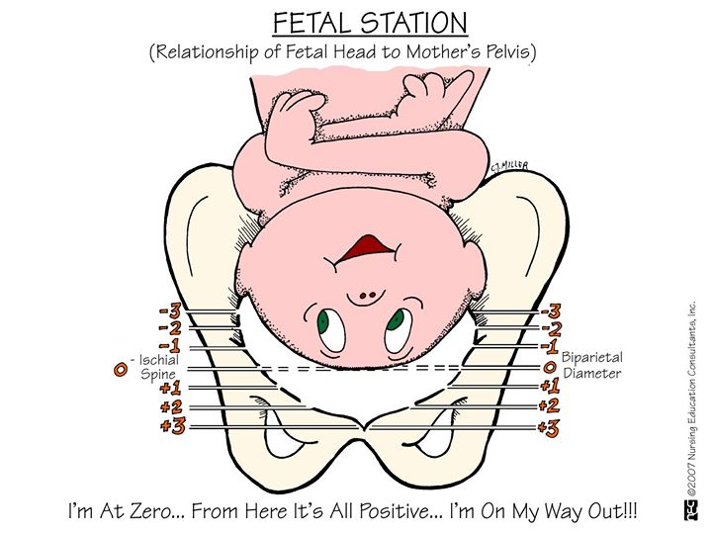

Slide 31
4- Fetal Lie:
Lie is relationship between long axis of fetal body and long axis of woman's body
1- Longitudinal lie (fetal long axis parallel with long axis of woman)
2- Horizontal or transverse lie.

Slide 32
Fetal Presentation:
Fetal body part that will first contact cervix or deliver first
1-Cephalic Presentation: head is the body part that first contacts cervix
Four types of cephalic presentation: 1- Vertex, 2- Brow, 3- Face 4- Mentum (chin)
2- Breech Presentation: buttocks or feet are first body parts to contact cervix (complete, Frank, and footling)

Slide 33
Fetal Presentation:
3-Shoulder Presentation: Fetus is lying horizontally in pelvis so that its long axis is perpendicular to that of mother.
Presenting part may be : Acromion of shoulder, Iliac crest, A hand Elbow

Slide 34
Frequency of Lie and Presenting Part
Lie | Presentation
Longitudinal 99.5% | Vertex 96%
Transverse or oblique 0.5% | Face 0.5%
 | Brow 0.5%
 | Breech 3%
 | Shoulder 0.5%

Slide 35
Fetal Position:
Position :is relationship of presenting part to a specific quadrant of the woman’s pelvis
4 quadrant of the pelvis:
Right anterior,
Left anterior,
Right posterior,
Left posterior

Slide 36
Position Landmarks
1-Vertex: Occipital, Face: Chin or Mentum,
2-Breech: Sacrum,
3-Shoulder: Scapula or acromion
Position is marked by abbreviation of 3 letters.

Slide 37
Position Landmarks Abbreviation
1st letter defines whether landmark is pointing to mothers’ Right or Left.
The middle letters denotes fetal landmark
O for Occiput, M for Mentum, Sa for sacrum, A for acromion process.
Last letter defines whether landmark is pointing Anteriorly, Posteriorly or Transversely.
-Left occipito-anterior (LOA) is the most common fetal position;

Slide 38
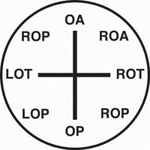
In Vertex Presentation
Left occipito-anterior
Left occipito-transverse
Left occipito-posterior
Right occipito-anterior
Right occipito-transverse
Right occipito-posterior

Slide 39
Methods to Determine Fetal Position and Lie:
1-Combined abdominal inspection and palpation
2-Vaginal examination
3-Auscultation of FH
4-Sonography

Slide 40
COMPONENTS OF LABOR:
c. The POWERS of LABOR: (uterine factors)
A process that causes cervical dilatation and then expulsion of the fetus from the uterus.
Supplied by the Fundus of the uterus
Uterine contractions, begin at a pacemaker point located in the Myometrium near one of the utero-tubal junctions.
Each contraction begins at that point and then sweeps down over uterus as a wave.

Slide 41
Phases of Uterine Contractions
a. Increment (Cresendo)
First phase during which intensity of contraction increases
b. Acme (Apex)
Height of uterine contraction ( strongest)
c. Decrement (Decresendo)
Last phase during which intensity of contraction decreases

Slide 42
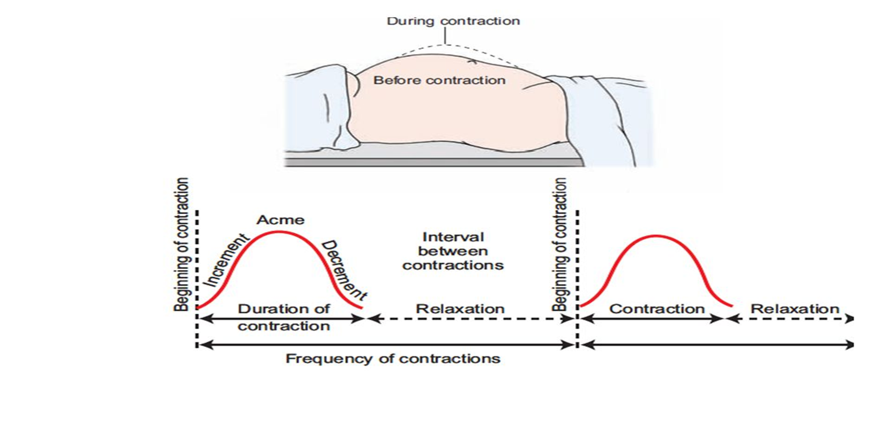

Slide 43
Phases of Uterine Contractions
-Between contractions uterus relaxes
-Relaxation intervals decreases from 10 minutes early in labor to 3 minutes.
-The duration of contractions also changes, increasing from 20-30 seconds to a range of 60-90 seconds

Slide 44
Uterine Changes
As labor contractions progress and become regular and strong. The uterus is gradually differentiated into two distinct portions
a. Upper Uterine Segment: becomes thick and active to expel out fetus
b. Lower Uterine Segment: becomes thin walled, supple(flexible) and passive so that fetus can be pushed out easily

Slide 45
Cervical changes
Dilation
Enlargement of the external cervical os from an opening a few millimeters wide to one large enough to permit passage of fetus.(up to 10 cm ) primarily as a result of uterine contractions and secondarily as a result of pressure of the presenting part.
As dilation begins, there is an increase in the amount of vaginal secretions (show), because it is dislodge.
Minute capillaries in the cervix ruptures

Slide 46
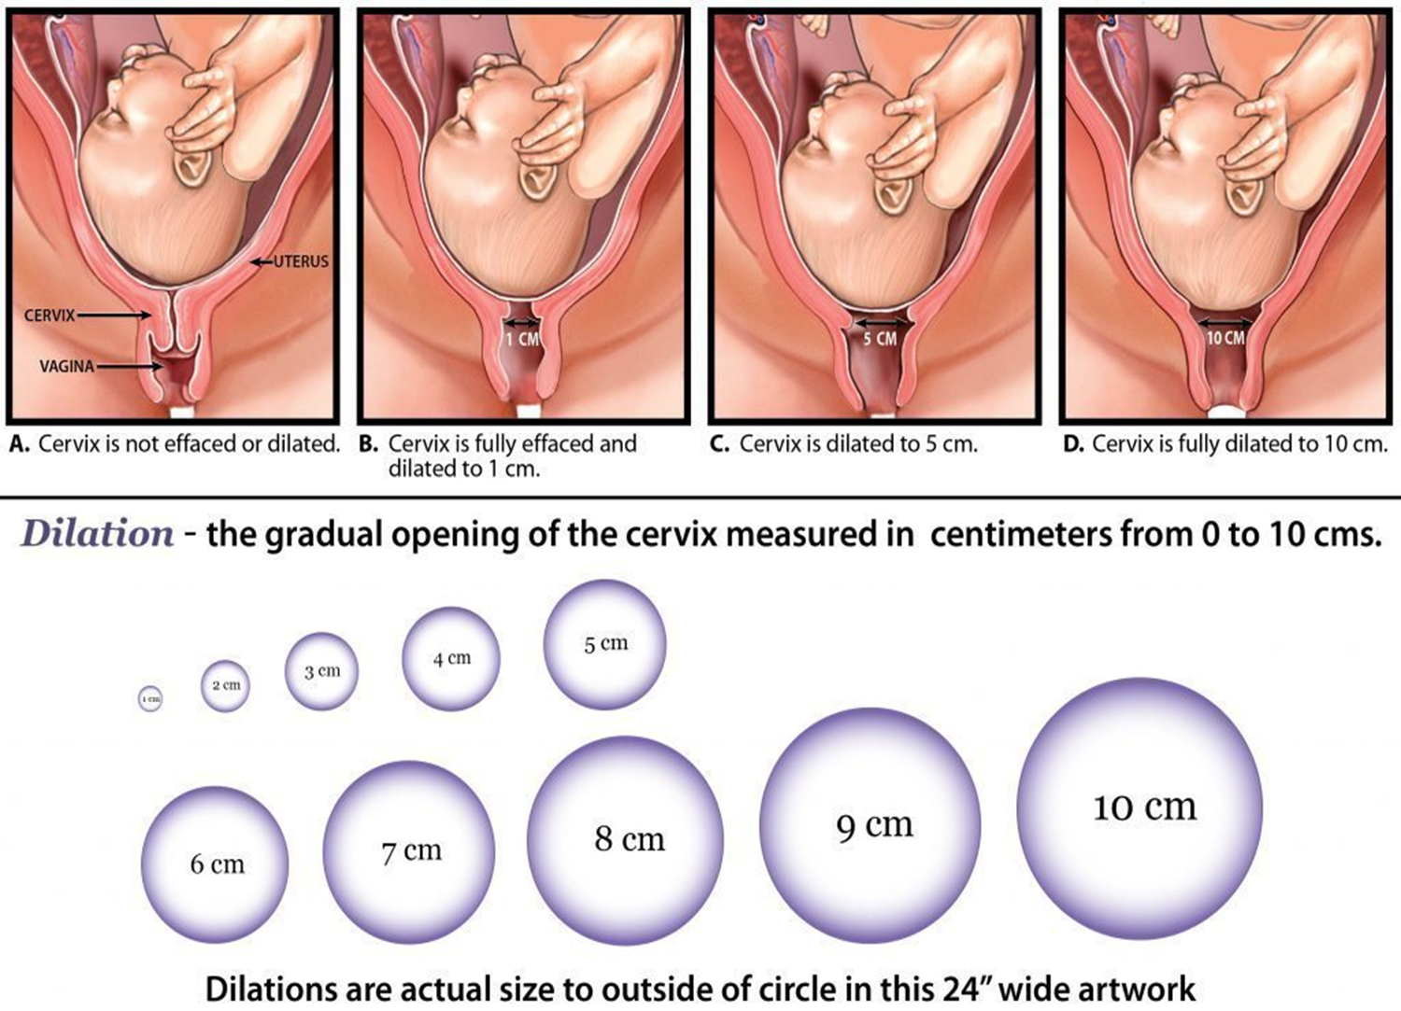

Slide 47
Cervical changes
Effacement
Shortening and thinning of the cervical canal as distinct from the uterus.
It is expressed in percentage.
-In primiparas, effacement is accomplished before dilation begins
-In multiparas, dilation may proceed before effacement is complete

Slide 48
COMPONENTS OF LABOR:
d. The PSYCHE : woman’s attitude.
-Psychological state or feelings that women bring into labor with them.
-A feeling of apprehension or fear.
-A sense of excitement or surprise
-Women who manage best in labor typically are those who have a strong sense of self esteem and a meaningful support person.

Slide 49
STAGES OF LABOR
FIRST STAGE
Starts at onset of regular uterine contractions and ends at full dilatation and effacement.
Divided into three phases:
a-Latent,
b-Active,
c-Transition

Slide 50
FIRST STAGE
a-Latent Phase:
Begins at onset of regularly perceived uterine contractions and ends when rapid cervical dilation begins.
Mother is excited with some degree of apprehension but still with ability to communicate

Slide 51
FIRST STAGE a-Latent Phase
Contractions | Duration of Contractions | Cervical Dilation | Duration
Mild and short | 20 to 40 seconds | 0-3 cm | Nullipara: 6 hours Multipara: 4.5 hours

Slide 52
FIRST STAGE
b- Active Phase:
Cervical dilatation occurs more rapidly and contractions become stronger, frequent and intense
Cervical dilation reaches 4-8cm
Mother fears losing control of himself

Slide 53
FIRST STAGE b- Active Phase:
Contractions | Duration of Contractions | Cervical Dilation | Duration
Stronger, longer & causes true discomfort | 40 to 60 seconds every 3 to 5 minutes | 4 to 7 cm | Nullipara: 3 hours Multipara: 2 hours

Slide 54
Nursing Care: b- Active Phase:
Monitoring and evaluating
1- Uterine contractions : duration, interval, intensity, frequency
2- Blood Pressure
3-Monitoring Fetal Heart Rate(120 – 160 per minute)
4- Meconium-stained amniotic fluid in non-breech presentation
5- Emotional support
6- Health Teachings: bath , ambulation , avoided solid or liquid foods
7-Enema
8-Encourage mother to void every -3 hours
9- Perineal preparation done aseptically
10- Sims Position

Slide 55
FIRST STAGE
3-Transition Period phase :
The contractions reach their peak intensity, cervix to maximum dilatation and to full effacement, mood of woman suddenly changes.
If membranes are still intact, this period is marked by a sudden gush of amniotic fluid as fetus is pushed into the birth canal
Show becomes more prominent

Slide 56
FIRST STAGE
3-Transition Period phase :
There is an uncontrollable urge to push with contractions, a sign of approaching second stage of labor.
Profuse perspirations and distention of the neck veins are seen.
Nausea and vomiting is a reflex reaction due to decreased gastric motility and absorption
-In primis, baby is delivered within 20 contractions (40 minutes); in multis, after 10 contractions (20 minutes)

Slide 57
FIRST STAGE c-Transition Period phase
Contractions | Duration of Contractions | Cervical Dilation | Duration
At peak intensity | 60 to 90 seconds every 2-3 minutes | 8 to 10 cm | Until full cervical dilation

Slide 58
3-Transition Period Phase: Comfort Measures
-Sacral pressure
-Proper bearing down techniques: push with contractions
-Controlled breathing during contractions
-Emotional support.

Slide 59
STAGES OF LABOR
SECOND STAGE: Stage of expulsion
Cardinal Movements of Labor:
1-Descent
2-Flexion
3-Internal Rotation
4-Extension:
5-External Rotation
6- Expulsion:

Slide 60
Cardinal Movements of Labor:
1-DESCENT
Downward movement of fetal head to within pelvic inlet.
Occurs when fetal head extrudes beyond dilated cervix and touches posterior vaginal wall
Occurs because of pressure on fetus by uterine fundus aided by abdominal muscle contractions

Slide 61
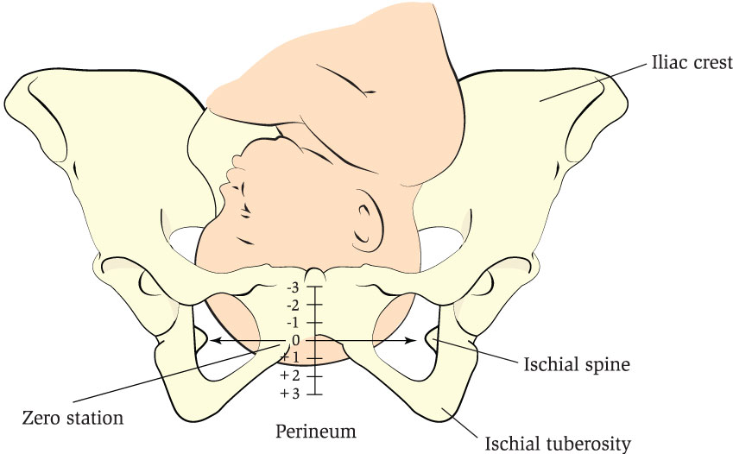
1-DESCENT
Downward movement of biparietal diameter of fetal head to within pelvic inlet.
Occurs when fetal head extrudes beyond dilated cervix and touches posterior vaginal wall
Occurs because of pressure on fetus by uterine fundus aided by abdominal muscle contractions

Slide 62
Cardinal Movements of Labor:
2-FLEXION
Pressure from pelvic floor causes fetal head to bend forward onto chest.
The smallest anteroposterior diameter is one presented to birth canal in this flexed position

Slide 63
Cardinal Movements of Labor:
3-INTERNAL ROTATION
Occiput rotates until it is superior, or just below symphysis pubis, bringing head into best diameter for outlet of pelvis.
This movement brings shoulders, into optimal position to enter inlet or puts widest diameter of shoulders in line with wide transverse diameter of inlet.

Slide 64
Cardinal Movements of Labor:
Crowning
It is clinically evident when head, visible at vulva, no longer withdrawals between contractions.
Complete delivery of head is now imminent

Slide 65
Cardinal Movements of Labor:
4-EXTENSION:
As Occiput is born, back of neck stops beneath pubic arch and acts as a pivot ( axis of rotation) for rest of head.
Head extends, and foremost parts of head, face and chin are born.

Slide 66
Cardinal Movements of Labor:
5-EXTERNAL ROTATION:
Almost immediately after head of newborn is born, the head rotates back to diagonal position or transverse position of early part of labor.

Slide 67
Cardinal Movements of Labor:
6- EXPULSION:
-Once shoulders are born, rest of the baby is born easily and smoothly because of its smaller size.
-This is end of pelvic division of labor
-Begins with complete dilatation of cervix and ends with delivery of baby

Slide 68
SECOND STAGE OF LABOR: Nursing Care:
Put mother’s legs on lithotomy at same time to prevent injury to uterine segments.
As soon as fetal head crowns instruct mother not to push, but to breath.
Hyperventilation is deep and rapid, patient will have lightheadedness, fingers tingling sensation lead to carpopedal spasms because of respiratory alkalosis.

Slide 69
SECOND STAGE OF LABOR
Episiotomy
-Incision made in perineum primarily to prevent lacerations and reduce duration of second stage.
-Types of Episiotomy
1-Median: from middle portion of lower vaginal border directed toward the anus
2-Mediolateral: Begun in midline but directed laterally away from the anus.
3- J- shape

Slide 70
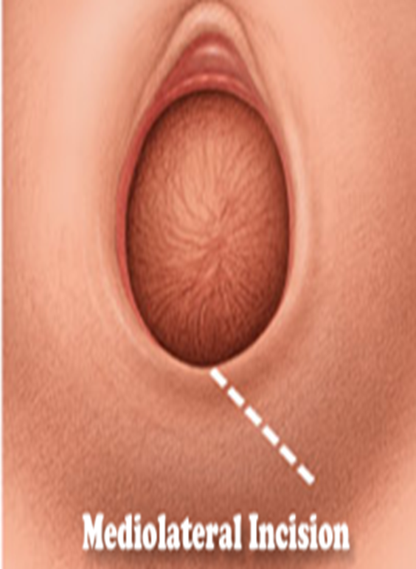
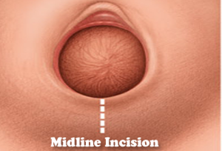
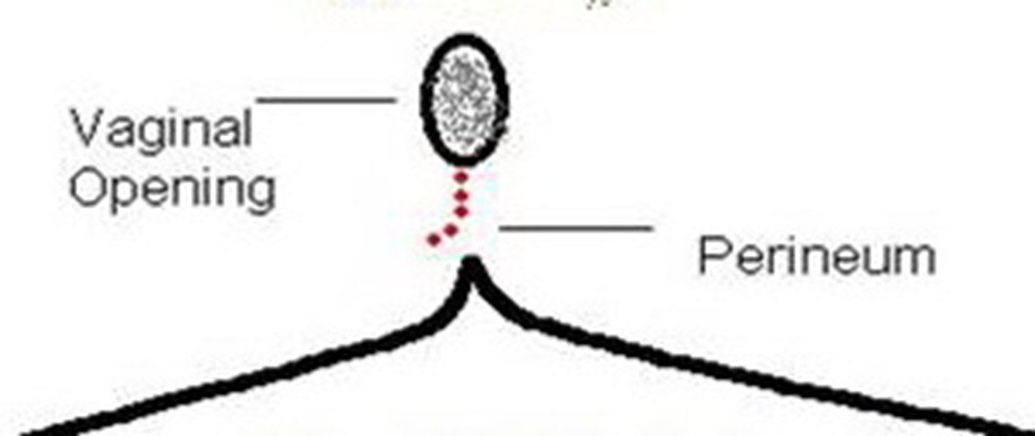
Types of Episiotomy

Slide 71
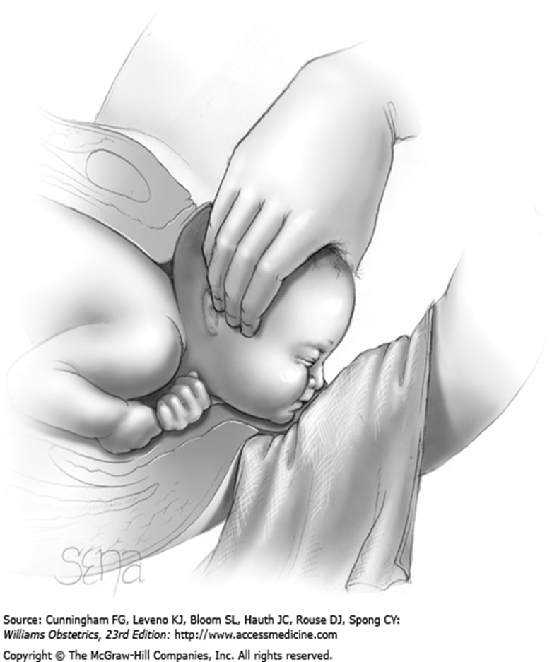
SECOND STAGE OF LABOR: Modified Ritgen’s Maneuver
Cover anus with sterile towel and apply upward and forward pressure on fetal chin, while exerting gentle pressure with two fingers on head to control emerging head.
This will support perineum, prevent lacerations, improve flexion so the smallest diameter of fetal head is presented.

Slide 72
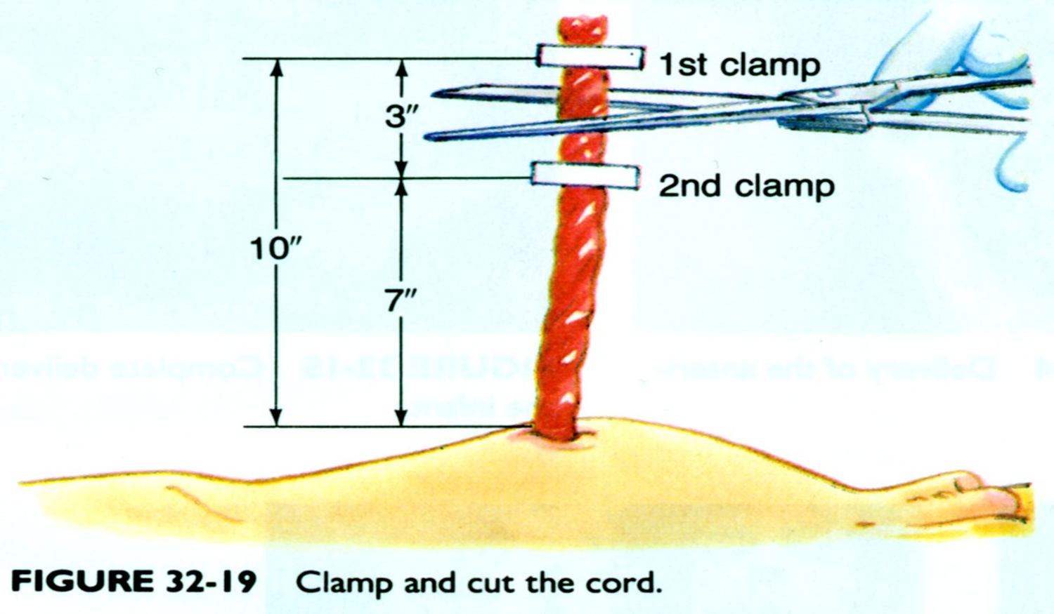
Immediate Newborn Care
Wrap newborn in a warm towel
Suction the airway.
Put the baby on the mothers abdomen.
Cut the cord

Slide 73
THIRD STAGE/ PLACENTAL
-It begins with the birth of the infant and ends with the delivery of the placenta.
-Two separate phases are involved placental separation and placental expulsion.
-After a few minutes, uterus begins to contract again and assumes a discoid shape قرصي.
-It retains this shape until placenta is separated, approximately 15 minutes after birth of the infant.

Slide 74
Sign of Placental Separation
Earliest sign of placental separation is change in shape of uterus
It become round, firm, rising high to level of the umbilicus (Calkin’s sign)
Appearance of the placenta at the vaginal opening.
Sudden gush of blood from the vagina, normal blood loss is 500 mL
Lengthening of the cord .

Slide 75
Types of Placental Delivery
A. ) SCHULTZ:
If placenta separates first at its center and last at its edges, it tends to fold back on itself like an umbrella and presents the fetal surface which is shiny (shiny for Schultz) 80 % of placenta separate in this manner.
B.) DUNCAN:
Placenta separates first at its edges, it slides along uterine surface and presents with maternal surface which is raw, red, beefy, irregular and dirty (dirty for duncan). Only about 20 % of placenta separates this way.

Slide 76
THIRD STAGE/ PLACENTAL: Nursing Care:
Brandt Andrews Maneuver
Do not hurry expulsion of placenta by forcefully pulling out cord or doing vigorous fundal push as this can cause uterine eversion, just watch for sign of placental separation
Tract cord slowly, winding it around clamp until placenta spontaneously comes out, slowly rotating it so that no membranes are left inside uterus
Record the time of placental delivery.
It should be delivered within 20 minutes after delivery of baby.

Slide 77
THIRD STAGE/ PLACENTAL: Nursing Care:
Brandt Andrews Maneuver
Inspect for completeness of cotyledons; any placental fragments retained can cause severe bleeding in mother
Palpate uterus to determine degree of contraction.
If relaxed boggy or non-contracted, first nursing action is to massage gently and properly.
An ice cap over abdomen will help contract uterus.

Slide 78
THIRD STAGE/ PLACENTAL: Nursing Care: Brandt Andrews Maneuver
Oxytocin (Methergin 0.2 mg/ml or syntocinon 10 U/ml) IM to maintain uterine contractions, and prevent hemorrhage.
NOTE: Oxytocin are not given before placental delivery
Inspect the red vaginal bleeding.
Inspect perineum for laceration

Slide 79
Types Pain Relief in Labour
Analgesic drugs (narcotics, e.g. pethidine) IM injection.
Inhalation analgesia (e.g. Entonox).
Regional anesthesia (e.g. epidural, spinal) that blocks the sensory pain pathways.

Slide 80
Monitoring Fetal Heart
Uterine contractions can affect fetal heart rate by increasing or decreasing
Primary mechanisms uterine contractions decrease fetal heart rate are compression of:
1-Fetal head
2-Umbilical cord
3-Uterine myometrial vessels

Slide 81
Methods of Fetal Heart Monitoring
a. Auscultation methods
b. Electronic monitoring Cardiotocography (CTG):
A computerized tracing of FHR pattern and measure uterine contraction.
Used antenatal and during labor
Able to detect fetus in distress
It reflects any physiological and pathological changes to FHR in response to stimuli especially hypoxia

Slide 82
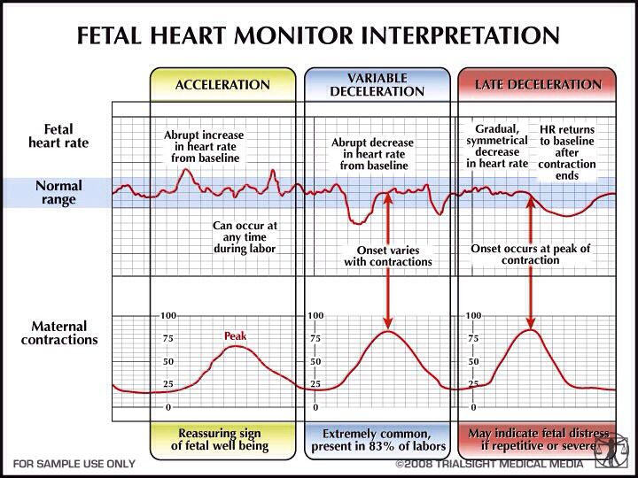
Monitoring Fetal Heart

Slide 83
Recording Progress of Labour: Partogram
1- Patient information: name, gravida, para, hospital number, date and time of admission and time of ruptured membranes.
2-Fetal heart rate: record every half hour.
3-Amniotic fluid: record colour of amniotic fluid at every vaginal examination:
I: membranes Intact;
C: membranes ruptured, Clear fluid;
M: Meconium-stained fluid;
B: Blood-stained fluid.

Slide 84
Recording Progress of Labour: Partogram
4-Moulding:Sutures are
Apposed;
Overlapped but reducible,
Overlapped and not reducible

Slide 85

Recording Progress of Labour: Partogram
5- Labour progress
a. Cervical dilatation: every vaginal examination and marked with a cross (X).
Begin plotting on the partograph at 3 cm.
b. Station : recorded as a circle (O) at every vaginal examination.
c. Contractions: chart every half hour; palpate the number of contractions in 10 minutes and their duration in seconds.
-Less than 20 seconds:
-Between 20 and 40 seconds:
-More than 40 seconds:

Slide 86
Recording the Progress of Labour: Partogram
6- Progress of maternal well being:
a. Oxytocin: record amount of oxytocin every 30 minutes when used.
b. Drugs given: record any additional drugs given – e.g. Pethidine
c. Pulse: record every 30 minutes and mark with a dot (●).
d. Blood pressure: Record every 4 hours and mark with arrows ( )
e. Temperature: Record every 2 hours.
f. Protein, acetone and volume: Record every time urine is passed

Slide 87
Recording the progress of labour: Partogram
6- Progress of maternal well being:
a. Oxytocin: Record the amount of oxytocin every 30 minutes when used.
b. Drugs given: Record any additional drugs given – e.g. Pethidine
c. Pulse: Record every 30 minutes and mark with a dot (●).
d. Blood pressure: Record every 4 hours and mark with arrows ( )
e. Temperature: Record every 2 hours.
f. Protein, acetone and volume: Record every time urine is passed.

Slide 88
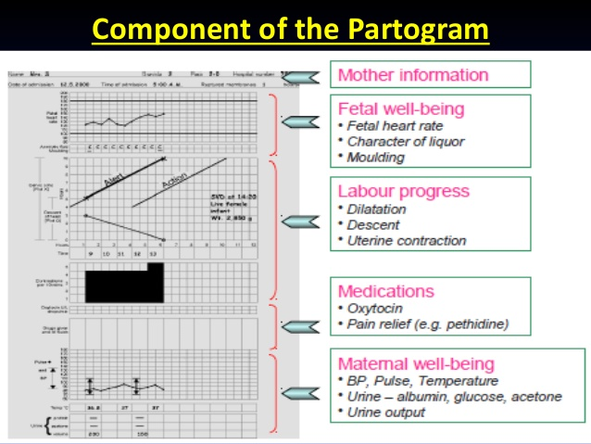

Slide 89
COMPLICATIONS OF LABOUR
A.) Lacerations
The perineum is tissue that lies below vaginal opening and above anus.
It is most likely part to tear during a vaginal birth
Categories of Lacerations:
1- 1st degree tear. : a small tear of perineum. It involves top layer of skin and a small amount of underlying tissue, but no muscle tissue, which generally does not require suturing.

Slide 90
Categories of Lacerations
2- 2nd degree tear.: it involves vaginal skin, underlying tissue and pelvic floor muscles. Usually require stitches to help muscle rejoin and maintain effective functioning of pelvic floor.
3- 3rd and 4th degree tears. It is rare . It extends through vaginal skin, underlying tissue, pelvic floor muscles and to edge of opening of anus, but not go right through to anus.
4- A 4th degree : is similar to a 3rd degree tear except that it extends completely though to the anus.
Both 3rd and 4th degree tears need to be repaired and may require to be transferred to operating room to have a general anesthetic.

Slide 91
COMPLICATIONS OF LABOUR
B.) Prolonged Labor
Occur when combined duration of both first and second stages of labor is more than 18 hours.
It is more common in a first pregnancy and in women over age of 35 years
Causes of Prolonged Labor:
1-Malpresentations
2-Cephalopelvic Disproportion (CPD)
3- Problems with uterine contraction twin pregnancy, tumors like fibroids
4-Use of Sedatives and Anesthesia

Slide 92
Risks of Prolonged Labour
1-Fetal Distress
2- Fetal brain Hemorrhage
3-Increased chances of Cesarian sections.
4- Baby develop cerebral palsy.

Slide 93
Management of Prolonged Labour
1-After 3cms of dilation. If there is lack of dilation for a reasonable period of time, then an Oxytocin Drip is started.
2- Epidosin or Buscopan given to cause softening of cervix.
3- Strict monitoring: FHS, cervix dilation
4- If fetal distress Cesarian Section should be done.

Slide 94
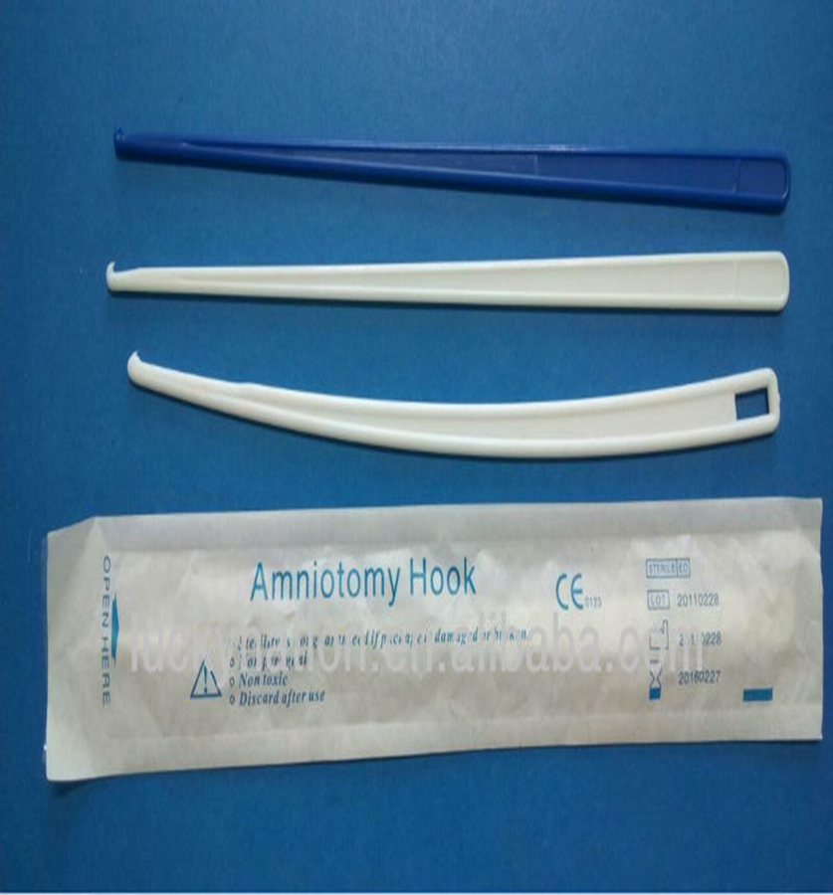
COMPLICATIONS OF LABOUR
C.) Un Ruptured Amniotic Sac
Puncture sac and push it away from baby.
Amniotomy :
Artificial rupture of membranes performed at or beyond 3 cm dilation.
The technique involves perforation of the fetal membranes with a sterile plastic instrument (amnihook) .

Slide 95
COMPLICATIONS OF LABOUR
D.) Umbilical Cord Around Neck
Gently slip cord over infant’s head.
If cord cannot be slipped over head:
a. Clamp in two places
b. Cut between clamps with surgical scissors

Slide 96
COMPLICATIONS OF LABOUR E.) Breech delivery
Presenting part is buttocks or legs
Delivery is same as normal birth.
Support infant as it comes out.

Slide 97
COMPLICATIONS OF LABOUR F.) Limb Presentation
-Uncommon
-This is a true emergency.

Slide 98
COMPLICATIONS OF LABOUR
G.) Prolapsed cord. (cord precedes the fetal presenting part and gets trapped)
-Compresses blood vessels to and from fetus.
-Labor contraction cause further compress the cord
-Transport immediately to hospital
-Cover cord with moist sterile dressing.
-Push cord away from infant’s face.
-C/S

Slide 99
COMPLICATIONS OF LABOUR
H.) Twins
-If mother’s abdomen remains large after first delivery, suspect twins.
-Delivery procedures are same.
-There may be one or two placentas to deliver.
-May need c/s.

Slide 100
COMPLICATIONS OF LABOUR I.) Premature Infants
-Keep the infant warm.
-Carefully observe.
-Give oxygen
-Use infection control measures
-May need neonatal intensive care unit

Slide 101
COMPLICATIONS OF LABOUR J.) Excessive Bleeding
-Massage mother’s uterus to slow down bleeding.
-Treat for shock IV fluid, blood transfusions

Slide 102
COMPLICATIONS OF LABOUR
K.) Ruptured Uterus
Etiology:
Rupture of a previous C-birth scar
Prolonged labor
Injudicious use of Pitocin: overstimulation
Excessive manual pressure applied to the fundus during delivery

Slide 103
COMPLICATIONS OF LABOUR
K.) Ruptured Uterus:
Signs and Symptoms
Sudden sharp abdominal pain, abdominal tenderness
Cessation of contractions
Absence of fetal heart tones
Shock
Therapeutic Interventions:
Deliver the baby / Cesarean Delivery

Slide 104
COMPLICATIONS OF LABOUR
L.) Uterine Inversion-
Rare but potentially life threatening condition
Uterine fundus collapses within endometrial cavity
Severe hemorrhage and shock can lead to maternal death
Discontinue all oxytocic until correction has been established
Johnson maneuver:
Manual correction by pushing inverted fundus through cervical ring with pressure towards umbilicus.
If unsuccessful, surgical intervention may be needed

Slide 105
COMPLICATIONS OF LABOUR
M.) Amniotic Fluid Embolism
Escape of amniotic fluid into maternal circulation, amniotic fluid contains debris, lanugo, vernix, meconium
Signs and Symptoms:
Dyspnea, cyanosis, chest pain, hypotension, frothy sputum, tachycardia,
Mental confusion,,
Hemorrhage

Slide 106
M.) Amniotic Fluid Embolism: Nursing care
Emergency condition,
O2,
Large bore IV,
CPR as needed,
Prepare for CS birth,
Administer blood

Slide 107
COMPLICATIONS OF LABOUR
N.) Hypertonic Labor Dystocia
Increased contraction frequency and uterine resting tone;
Prolonged latent phase
Prolonged pressure on fetal head cause: molding, caput succedaneum, cephalohematoma
Hypertonic Labor Dystocia Therapy:
Bed rest and relaxation measures
Pharmacologic sedation
Oxytocin
Amniotomy.

Slide 108
COMPLICATIONS OF LABOUR
O.) Hypotonic Labor :
Fewer than 3 contractions in 10 min
Usually in active phase after labor already established
Clinical therapy:
Oxytocin,
Amniotomy,
IV fluids

Slide 109
COMPLICATIONS OF LABOUR
P.)Precipitous Labor (less than 3 hours)
Contributing factors:
Multiparty,
Large pelvis,
Previous precipitous labor,
Small fetus,
Strong contractions,
Uterine hyper stimulation from excess Pitocin

Slide 110
COMPLICATIONS OF LABOUR
Q.) Post-term (more than 42 weeks gestation)
Implications:
Probable labor induction
Decreased placental perfusion
Oligohydramnios
Meconium aspiration

Slide 111
COMPLICATIONS OF LABOUR
R.) Macrosomia (infant weight of 4000g)
Predisposing factors:
Male gender,
Large parents,
Maternal diabetes,
Previous large infant,
Grand multiparity.

Slide 112
R.) Macrosomia
Implications:
Dysfunctional labor,
Soft tissue laceration during birth,
Postpartum hemorrhage,
Meconium aspiration,
Shoulder dystocia,
Brachial plexus injury,
Fractured clavicle,
Asphyxia

Slide 113
COMPLICATIONS OF LABOUR
S .) Polyhydramnios
-Greater than 2000ml of amniotic fluid
-Unknown cause but major fetal anomalies are present in 20%
Implications for Mother:
Shortness of breath,
Edema,
Uterine dysfunction,
Abruptio placenta,
Postpartum hemorrhage

Slide 114
COMPLICATIONS OF LABOUR
S .) Polyhydramnios
Implications for fetus:
Malformations,
Preterm birth,
Increases mortality rate,
Prolapsed cord,
Malpresentation .
Treatment
Do an amniocentesis

Slide 115
COMPLICATIONS OF LABOUR
T.) Oligohydramnios:
Amniotic fluid reduced less than 50% of normal or less than 500 ml at term
Found in post-maturity ,
Associated primarily with fetal renal defects, placental insufficiency
Implication:
Dysfunctional labor with slow progress
Umbilical cord compression,
Head compression
May need Amnioinfusion during labor

Slide 116
COMPLICATIONS OF LABOUR
U.) Cephalopelvic Disproportion (CPD)
Causes: Large baby or small pelvis
Symptoms: Station remains the same does not descend
Treatment and Nursing Care:
-Cesarean delivery
-Utilize other measures such as forceps, vacuum extracion, episiotomy.

Slide 117
COMPLICATIONS OF LABOUR
V.) Premature Rupture of Membranes(PROM)
It is spontaneous rupture of membranes
Etiology
Infections
Weak cervix
Fetal abnormalities
Precipitation of labor

Slide 118
V.) Premature Rupture of Membranes
Treatment and Nursing Care:
Wait and watch, bed rest
Betamethasone stimulate fetal lung production of surfactant
Assess time membranes ruptures and if labor started
Check temperature frequently
Describe character of amniotic fluid
Check WBC
Provide psychological support.

Slide 119
COMPLICATIONS OF LABOUR
W.) Preterm Labor
Labor that occurs after 20 weeks but before 37 weeks
Etiology: urinary tract infections, premature rupture of membranes
Goal
Stop the labor
Suppress uterine activity

Slide 120
W.) Preterm Labor: Therapeutic Interventions
Tocolytics : used to stop labor
β-adrenergic agonist: Yutopar (ritodrine)
Magnesium Sulfate: decreases frequency and intensity of uterine contractions.
Calcium Channel Blocker: Nifedipine. Decreases smooth muscle contraction by blocking the slow calcium channels at cell surface.
Prostaglandin synthesis inhibitor: Indomethacin (Indocin) : Inhibits prostaglandin synthesis thus reducing uterine contractions.

Slide 121
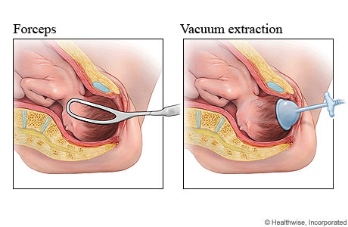
Instrumental Delivery
1.) Vacuum Delivery (vacuum extraction (VE).
2.) Forceps Delivery
3) Caesarian (Section)Delivery

Slide 122
1.) Vacuum Delivery (Vacuum Extraction (VE).
Is a technique of assisting delivery of a baby using Ventouse is a vacuum device
Indications for use of Vacuum:
Prolonged second stage of labor
Maternal exhaustion
Fetal distress in the second stage of labor
Maternal illness (e.g. cardiac conditions

Slide 123
1.) Vacuum Delivery Technique
A suction cup is placed onto head of baby and suction draws skin from scalp into cup.
Correct placement of cup directly over flexion point, about 3 cm anterior from occipital (posterior) fontanelle, is critical to success of a VE.
When baby's head is delivered, device is detached, allowing mother to complete delivery
For proper use of ventouse, maternal cervix has to be fully dilated, head engaged in birth canal

Slide 124
Advantage of Vacuum Delivery
An episiotomy may not be required.
No special anesthesia is required.
The force applied to baby less than that of a forceps delivery
There is less potential for maternal trauma
Disadvantage of Vacuum Delivery:
The baby will have a temporary lump on its head
There is a possibility of cephalohematoma formation, or hemorrhage.

Slide 125
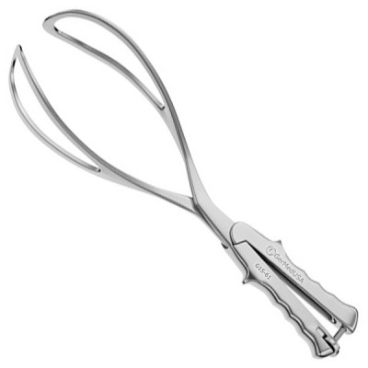
2.) Forceps Delivery
Forceps are a surgical instrument that resembles a pair of tongs and can be used in surgery for grabbing or removing various things within or from the body.
Obstetric forceps consist of two branches that are positioned around fetal head.
The branches usually, cross at a midpoint which is called articulation.
Most forceps have a locking mechanism at articulation
Blade of each forceps branch is curved portion that is used to grasp fetal head.

Slide 126
2.) Forceps Delivery
The forceps should surround fetal head firmly, but not tightly.
The blade normally has two curves, cephalic and pelvic curves.
The cephalic curve is shaped to fit in to fetal head.
The pelvic curve is shaped to fit in to birth canal and helps direct force of traction under pubic bone.
Handles are connected to blades by shanks of variable lengths.
The cervix must be fully dilated and retracted and membranes ruptured.
Urinary bladder should be empty.

Slide 127
2.) Forceps Delivery
Station of head must be at least +2 in lower birth canal.
A mild local or general anesthetic is administered .
Determining precise position of fetal head is vital, by feeling fetal skull suture lines and fontanelles, or by ultrasound
The two blades of forceps are individually inserted, posterior blade first, then locked.
Fetal head is then rotated to occiput anterior position if it is not in that position.
An episiotomy may be performed if necessary.
The baby is then delivered with gentle (maximum 130Newton) traction in the axis of the pelvis

Slide 128
Forceps Delivery Indications
Prolonged second stage
Maternal exhaustion
Maternal illness; such as heart disease
Hemorrhage
Analgesic drug-related inhibition of maternal effort (especially with epidural/spinal anesthesia)
Non-reassuring fetal heart tracing
After-coming head in breech delivery

Slide 129
Advantages of Forceps Delivery
1-Avoidance of C-section,
2-Reduction of delivery time.
Complications of Forceps Delivery
1-Bruising,
2-Deformation
3-Rectovaginal fistula, nerve damage,
4-Skull fractures, and cervical cord injury.

Slide 130
3) Caesarian (Section)Delivery
It is a major abdominal surgery involving 2 incisions (cuts), one through the abdominal wall, second involving uterus to deliver the baby
Types Caesarian Delivery
a) Low transverse incision: is approach of choice.
b) A vertical incision on the uterus (low or high): Used for delivering preterm babies, abnormally positioned placentas, twins pregnancies and in extreme emergencies

Slide 131
Cesarean Childbirth Causes
Repeat cesarean delivery
Lack of labor progression
Abnormal position of the fetus & placental breech , transverse , cord presentation
Emergency situations: if woman is severely ill or has a life-threatening illness
Fetal distress
CS on Request

Slide 132
C-section : Procedure
Preoperative Testing and Preparation
Consent form
Hemoglobin assessment, prepared blood transfusion.
NPO reduce risk of aspiration pneumonitis
Insert an indwelling urinary catheter
Prepare the skin.

Slide 133
C-section : Procedure
In non-emergency C-sections, a horizontal incision across abdomen, just above pubic area.
In an emergency situation, a vertical cut, from below navel to just above pubic area.
The surgeon cuts through amniotic sac. Allowing amniotic fluid to escape.
The surgeon reach into abdominal incision and lifts baby’s head as an assistant push down on upper uterus.

Slide 134
C-section : Procedure
The surgeon will clamp and cut umbilical cord.
Placenta removed
Give a single dose intravenously of prophylactic antibiotics after cord is cut. Ampicillin, Cefazolin
Give oxytocin 20 units in 1 L IV fluids (normal saline or Ringer’s lactate) at 60 drops per minute for 2 hours, to encourage contraction of uterus and to decrease blood loss

Slide 135
Post Op Cesarean Section:
1-IV fluids
2-Vital signs, urine output (for first 24 hours)
3-Monitor wound site for cellulitis and fundus for tenderness it may indicate endometritis
5-No heavy lifting for 6 weeks
6-No driving for 4 weeks

Slide 136
Cesarean Complications
Excessive bleeding
Infection
Urinary function and bladder injury
Bowel function and bowel injury
Prolonged hospital stay
Anesthesia & pain medications complication
Thrombophlebitis, Blood clots
Pulmonary Embolism

