Slide 1

Gynecology and
Maternity Nursing
Unit 5
Identification of High Risk Pregnancy

Slide 2
Identification of High Risk Pregnancy
Caring of pregnant woman with cardiac diseases
Caring of pregnant woman with sexual infectious diseases
Caring of pregnant woman with hematological disorders ( anemia)
Caring of pregnant woman with gestational diabetes mellitus
Caring of pregnant woman RH Incompatibility)
Caring of pregnant woman with pregnancy induced hypertension (PIH).
Caring of pregnant woman with bleeding before 24 weeks of pregnancy (abortions, ectopic pregnancy)
Caring of pregnant woman with bleeding after 24 weeks of pregnancy (placenta diseases)
Pregnancy-Related Complications PROM

Slide 3
1- Caring of Pregnant Woman With Cardiac Diseases

Slide 4
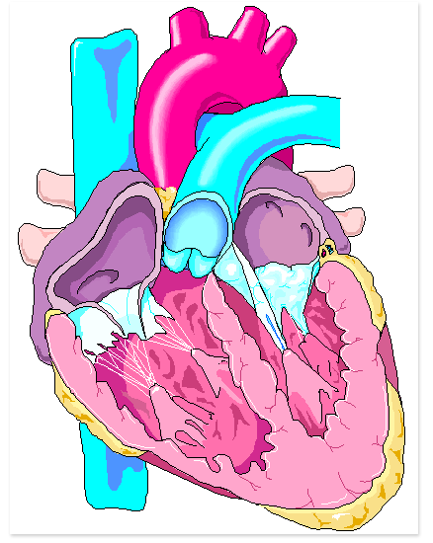
Manifestations Heart Disease in Pregnancy
-Increased levels of clotting factors
-Increased risk of thrombosis
-If woman’s heart cannot handle increased workload, then congestive heart failure results
-Fetus suffers from reduced placental blood flow

Slide 5
Manifestations Heart Disease in Pregnancy
-Persistent cough
-Moist lung sounds
-Fatigue or fainting on exertion
-Difficulty breathing on exertion
Orthopnea

Slide 6
Manifestations Heart Disease in Pregnancy
-Severe pitting edema of the lower extremities or generalized edema
-Palpitations
-Changes in fetal heart rate
-Indicating hypoxia or growth restriction

Slide 7
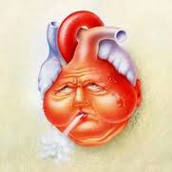
Treatment Heart Disease in Pregnancy
-Under care of both obstetrician and cardiologist
-Priority care is limiting physical activity
-Drug therapy: beta-adrenergic blockers, anticoagulants, diuretics
-normal birth is preferred because it carries less risk for infection or respiratory complications

Slide 8
Heart Valve Disease in Pregnancy
It consists of damage to, abnormality of one or more of the heart valves.
Usually the mitral valve is damaged.
The cause of heart valve disease is almost always rheumatic fever during childhood.

Slide 9
Heart Valve Disease in Pregnancy
Undiagnosed heart valve disease and inadequate treatment may result in serious complications:
Heart failure causing pulmonary oedema which may threaten the patient’s life.

Slide 10
Symptoms of Heart Valve Disease in Pregnancy
-Shortness of breath.
-A cardiac murmur
-Coughing up blood (haemoptysis).
-Some patients with heart valve disease give a history of previous rheumatic fever.

Slide 11
Managements of Heart Valve Disease in Pregnancy
Referral to the high risk antenatal clinic.
Patients should stop work earlier and rest more
Should least be delivered at a secondary level hospital where specialist care is available.

Slide 12
2- Caring of pregnant woman with infectious diseases

Slide 13
TORCH INFECTIONS
Acronym TORCH is used to describe infections that can be devastating to fetus or newborn
Toxoplasmosis
Other infections
Rubella
Cytomegalovirus
Herpes

Slide 14
Viral TORCH Infections
-No effective therapy,
-Immunizations can prevent some infections

Slide 15
Cytomegalovirus (CMV)
Infected baby have
-Mental retardation
-Seizures
-Blindness
-Deafness
-Dental abnormalities
-Petechiae

Slide 16
Cytomegalovirus (CMV) Treatment
-No effective treatment is known
-Therapeutic abortion may be offered if CMV infection is discovered early in pregnancy

Slide 17
Hepatitis B
Transmitted to fetus cross the placenta
or by contact with blood or normal secretions during delivery
Upon delivery, the neonate should receive:
a. A single dose of hepatitis B immune globulin,
b. Followed by the hepatitis B vaccine

Slide 18
Rubella
Mild viral disease
Low fever and rash
If it occurs early in pregnancy, it can disrupt formation of major body systems
If it occurs later in pregnancy, it cause damage to organs already formed

Slide 19
Rubella
-If woman receives a rubella vaccine prior to pregnancy, then she should not get pregnant for at least 3 months
-Not given during pregnancy because vaccine is from a live virus

Slide 20
Rubella Effects on Embryo or Fetus:
-Microcephaly (small head size)
-Mental retardation
-Congenital cataracts
-Deafness
-Cardiac effects
-Intrauterine growth restriction (IUGR)

Slide 21
Types Herpes-virus
Type 1:
Cause fever blisters or cold sores
Type 2:
Cause genital herpes

Slide 22
Herpes-virus
After primary infection, herpes virus lies dormant in the nerves and can reactivate at any time
Infection in first half of pregnancy cause spontaneous abortion, IUGR, and preterm labor

Slide 23
Herpes-virus
Infant can be infected in one of two ways:
1-Virus ascends into the uterus after the membranes rupture
2-Infant has direct contact with infectious lesions during normal delivery
-High mortality rate

Slide 24
Treatment Herpes-virus
-Avoid contact with lesions
-If woman has active genital herpes when membranes rupture or labor begins Cesarean delivery may be required
-Mother and infant do not need to be isolated as long as direct contact with lesions is avoided

Slide 25
Human Immunodeficiency Virus (HIV)
-Virus that causes AIDS
-Cripples the immune system
-No known immunization or curative treatment

Slide 26
Human Immunodeficiency Virus (HIV)
Infant may be infected:
Through contact with infected maternal secretions at birth
Through breast milk

Slide 27
Managements of Human Immunodeficiency Virus (HIV)
-Health Educate
-Breastfeeding is contraindicated for mothers who are HIV positive
-Zidovudine (ZDP) immediately after birth and continue the treatment for 6 weeks.

Slide 28
Non-viral Infections
Toxoplasmosis
-A parasite acquired by contact with cat feces or raw meat
-Transmitted through the placenta

Slide 29
Congenital Toxoplasmosis Signs
-Low birth weight
-Enlarged liver and spleen
-Jaundice
-Anemia
-Inflammation of eye structures
-Neurological damage

Slide 30
Toxoplasmosis Prevention
1-Cook all meat thoroughly
2-Wash hands and kitchen surfaces after handling raw meat
3-Avoid uncooked eggs and unpasteurized milk
4-Wash fresh fruits and vegetables well
5-Avoid materials contaminated with cat feces

Slide 31
Toxoplasmosis Treatment
Therapeutic abortion

Slide 32
Group B Streptococcus (GBS) Infection
-Leading cause of Perinatal infection with high mortality rate
-Organism found in woman’s rectum, vagina, cervix, throat, or skin
-The risk of exposure to the infant is greater if the labor is long or the woman experiences premature rupture of membranes
-GBS significant cause of maternal postpartum infection

Slide 33
Symptoms of Group B Streptococcus (GBS) Infection
-Fever within 12 hours after delivery
-Rapid Heart Rate,
-Abdominal distention
-Can be deadly to the infant

Slide 34
Group B Streptococcus (GBS) Infection
Treatment
Penicillin

Slide 35
Sexually Transmitted Infections:
Chlamydia
Gonorrhea
Syphilis
Herpes Genitalis
Viral Hepatitis
AIDS

Slide 36
SEXUALLY TRANSMITTED INFECTIONS (STI)
Infections whose primary route of transmission is through sexual contact and can be caused by bacteria, viruses or protozoa.
Most STIs affect both men and women.
STIs cause more severe health problems for women.
A pregnant woman can cause serious health problems for the baby.

Slide 37
SEXUALLY TRANSMITTED INFECTIONS (STI)
STI incidence rates remain high in most of the world, despite diagnostic and therapeutic advances.
WHO estimated that more than 1 million people were being infected every day.
People must first be infected before they can have a STD
An Infection means that a germ that can cause sickness is present inside a person’s body. An infected person may feel sick.
A disease means that the infection is actually causing the infected person to feel sick.

Slide 38
Sexually Transmitted Infections STI or Sexually Transmitted diseases STD:
Sexual contact.
Transmission from mother to baby during childbirth or breastfeeding
Skin to skin contact
Sharing equipment’s such as needle after its use by an infected person
Exchange of bodily fluids such as blood transfusion

Slide 39
Complication of STI
Ectopic (pregnancy
Premature birth,
Stillbirth

Slide 40
Types of STIS:
1- Bacterial Infections:
Chlamydia
Gonorrhea
Syphilis
Antibiotics can cure bacterial STDs
2- Viral Infections
Herpes
Hepatitis
HIV / AIDS
Treatment can improve lives of people with viral STDs.
Cannot be cure but can be treated

Slide 41
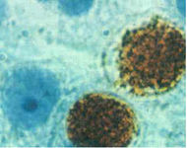
1- CHLAMYDIA
Caused by a bacterium Chlamydia Trachomatis
The most common bacterial STI in the world with 89 million cases per year.
It is with a long lifecycle and relies on the host cell to provide nutrients
Incubation period preceding symptomatic infection can range from 7 - 21 days.
The Chlamydia infection is curable. A person can get the infection again

Slide 42
CHLAMYDIA in Pregnancy
Untreated chlamydial infection during pregnancy cause
Preterm labor,
Premature rupture of membranes,
Low birth weight.
The newborn may also become infected during delivery as the baby passes through the birth canal.
Exposed newborns can develop eye and lung infections.

Slide 43
Treatment of Chlamydia
1-Azithromycin 1 g orally in a single dose
2- Doxycycline 100 mg orally twice a day for 7 days.

Slide 44
Gonorrhea
Is a sexually transmitted disease (STD).
- Caused by neisseria gonorrhea. A gram-negative bacterium.
-It grows and multiplies easily in the mucus membrane of the body.
-It grows in most areas of reproductive tract
-Very short incubation period 2-14 days and as little as 24 hours.

Slide 45
Gonorrhea Mode of Transmission
Gonorrhea
Humans are the only natural host.
Male to female or from Female to male
Perinatal.
-In pregnancy, gonococcus can be transmitted to the fetus at the time of delivery.
-This results in infection of the Conjunctiva.
-This appears 1 to 4 days after birth as severe discharge with marked swelling and redness of the eyelids and conjunctiva.

Slide 46
Treatment of Gonorrhea
*Recommended Treatment
Cefixime 400 mg PO x 1 or
Ceftriaxone (Rocephin) 125 mg IM x 1 or
Ciprofloxicin 500 mg PO x 1 or
Ofloxacin 400 mg PO x 1 or
Levofloxacin 500 mg PO x 1
*PLUS:
Azithromycin 1 g PO x 1 or
Doxycycline 100 mg PO 12hourly for 7 days

Slide 47
SYPHILIS
Syphilis is a systemic human disease caused by bacteria Treponema Pallidum (T. Pallidum).
Do not grow in artificial medium
-Incubation Period around 21 days
-Untreated syphilis is a progressive disease

Slide 48
Transmission of Syphilis
Direct contact with a syphilis sore during sexual contact (90 - 96%).
Via placenta from infected pregnant mother to fetus causes congenital syphilis.
Blood transfusion
Via accidental contact E.g. Medical personnel

Slide 49
Congenital Syphilis
-Usually occurs following vertical transmission of T. Pallidum from the infected mother to the fetus in utero, but neonates may also be infected during passage through the infected birth canal at delivery.
-It is the most distressing and dangerous form of Syphilis
-Depending on how long a pregnant women has been infected, a good chance of stillbirth or a baby who dies shortly after birth.
-If not treated immediately a baby born without symptoms can develop them within weeks
-Developmental delay or even seizures and death

Slide 50
Congenital Syphilis S&S
Bone damage,
Severe anemia,
Enlarged liver and spleen,
Jaundice,
Nerve problems causing blindness or deafness, meningitis, or skin rashes

Slide 51
Treatment of Syphilis
Penicillin G IV for 10-14 days
Benzathine Penicillin 2.4 mU IM q week X 3
Check for penicillin allergy before treatment
Oral hygiene

Slide 52
3- Caring of pregnant woman with hematological disorders ( anemia)

Slide 53
Anemia in pregnancy
Anemia in pregnancy is A haemoglobin concentration of less than 11 g/dl.
-Anemia is the reduced ability of the blood to carry oxygen to the cells

Slide 54
Types Anemia In Pregnancy
a. Two are nutritional:
1-Iron deficiency
2-Folic acid deficiency
b. Two are genetic disorders:
1-Sickle cell disease
2-Thalassemia

Slide 55
Causes Anemia In Pregnancy
1-Blood loss during pregnancy.
2-Acute infections (e.g. pyelonephritis), chronic infections (e.g. tuberculosis.

Slide 56
Nutritional Symptoms of Anemia in pregnancy
-Easily fatigued
-Skin and mucous membranes are pale
-Shortness of breath
-Pounding heart
-Rapid pulse (with severe anemia)

Slide 57
Iron Deficiency Anemia
RBCs are small and pale
Prevention
-Iron supplements
-Vitamin C may enhance absorption
-Do not take iron with milk or antacids
-Calcium impairs absorption

Slide 58
Iron Deficiency Anemia
Treatment
Ferrous Sulphate
Admitted to hospital for a blood transfusion

Slide 59
Folic Acid Deficiency Anemia
Large, immature RBCs
Drug decrease absorption:
Anticonvulsants sulfa drugs
Folate is essential for normal growth and development nervous system
Prevention by daily supplement of 400 mcg (0.4 mg)

Slide 60
Treatment Folic Acid Deficiency Anemia
-Folate deficiency is treated with folic acid supplementation
-1 mg/day (over twice the amount of the preventive supplement

Slide 61
Sickle Cell Anemia
-Autosomal recessive disorder
-Abnormal hemoglobin
-Causes erythrocytes to become distorted and sickle (crescent) shaped during hypoxic or acidotic episodes.
-Abnormally shaped blood cells do not flow smoothly
-Can clog small blood vessels
-Pregnancy can cause a crisis.
-Massive erythrocyte destruction and vessel occlusion

Slide 62
Sickle Cell Anemia
-Risk to fetus if occlusion occurs in vessels that supply the placenta
-Can lead to preterm birth, growth restriction, and fetal demise
-Oxygen and fluids are given continuously throughout labor

Slide 63
Thalassemia
-Genetic trait causes abnormality in one of two chains of hemoglobin
-Pregnancy can cause a crisis
-Massive erythrocyte destruction and vessel occlusion
-Risk to fetus if occlusion occurs in vessels that supply the placenta
-Can lead to preterm birth, growth restriction, and fetal demise
-Oxygen and fluids are given continuously throughout labor

Slide 64
The dangers Anemia in pregnancy
-Heart failure
-Shock which may be caused by a relatively small normal blood loss (ante partum hemorrhage, delivery or postpartum hemorrhage).
-Premature baby .
-Low birth weight baby

Slide 65
4- Caring of pregnant woman with gestational diabetes mellitus

Slide 66
Diabetes Mellitus in Pregnancy
There is inadequate amounts of insulin to keep the blood glucose concentration normal , the blood glucose concentration becomes high.

Slide 67
Gestational Diabetes Mellitus (GDM):
Glucose intolerance with the onset of pregnancy.
Hormones (estrogen and progesterone), insulinase (an enzyme), and increased prolactin levels have two effects:
a. Increased resistance of cells to insulin
b. Increased speed of insulin breakdown

Slide 68
Gestational Diabetes Mellitus (GDM):
GDM present for first time in pregnancy, and may then recover spontaneously after delivery.
The early diagnosis and good management of diabetes in pregnancy will greatly reduce the incidence of complications.

Slide 69
The complications Diabetes mellitus in pregnancy
Maternal Effects
-Spontaneous abortion
-Gestational hypertension
-Preterm labor and PROM
-Polyhydramnios
-Infections (vaginitis, UTI)
-Large for gestational age (LGA) fetus
-Ketoacidosis

Slide 70
Fetal/Neonatal effects complications of Diabetes mellitus
-Congenital abnormalities
-Macrosomia
-Intrauterine growth restriction (IUGR)
-Birth injury
-Caudal regression syndrome
-Delayed lung maturity
-Neonatal: hypoglycemia, hypocalcemia, hyperbilirubinemia/ jaundice and polycythemia
-Perinatal death

Slide 71
Managements of Diabetes Mellitus in Pregnancy
Routinely urine tested for glucose.
A random blood glucose
Glucometer
A fasting blood glucose concentration of less than 6 mmol/l is normal

Slide 72
Treatment Diabetes mellitus in pregnancy
-Insulin.
-Oral Hypoglycemic agents
-Diet
-Monitoring blood glucose levels
-Ketone monitoring
-Exercise
-Fetal assessment

Slide 73
Managements of Neonate of DM Mother
The baby May have the following occur:
-Hypoglycemia
-Respiratory distress
-Injury related to macrosomia
-Blood glucose monitored closely for at least the first 24 hours after birth
-Breastfeeding should be encouraged
-Iv push of dextrose 10%
-Iv D10W

Slide 74
5- Caring of pregnant woman RH Incompatibility

Slide 75
Rh- Incompatibilities
-Rh-positive blood type is a dominant trait
-Rh incompatibility can only occur if the woman is Rh-negative and the fetus is Rh-positive

Slide 76
Rh- Incompatibilities
1-Isoimmunization
The leaking of fetal Rh-positive blood into the Rh-negative mother’s circulation, causing her body to respond by making antibodies to destroy the Rh-positive erythrocytes
With subsequent pregnancy, the woman’s antibodies against Rh-positive blood cross the placenta and destroy the fetal Rh-positive erythrocytes before the infant is born

Slide 77
Rh Incompatibilities
2-Erythroblastosis Fetalis
Occurs when the maternal anti-Rh antibodies cross the placenta and destroy fetal erythrocytes
Requires RhoGAM to be given at 28 weeks and within 72 hours of delivery to the mother

Slide 78
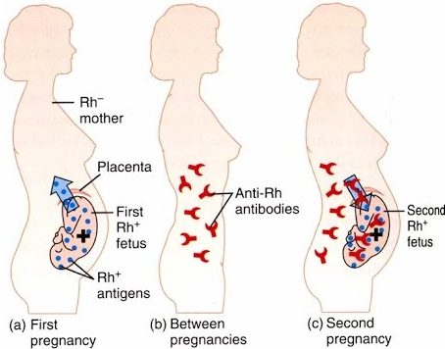

Slide 79
Rh Incompatibilities
2-Erythroblastosis Fetalis
-Also given after amniocentesis, and if woman experiences bleeding during pregnancy
-Fetal assessment tests must be done throughout pregnancy
-An intrauterine transfusion may be done for the severely anemic fetus

Slide 80
6- Caring of pregnant woman with pregnancy induced hypertension (PIH).

Slide 81
Hypertensive Disorders of Pregnancy
Normal blood pressure is >140/90 mm Hg
Hypertension during pregnancy is defined as BP < 140/ 90 mm Hg
Hypertension is often accompanied by edema and proteinuria.
Edema periorbital and hands.
Severity of edema is elicited through pressing the edematous area and measuring the depth of dimple left by the finger

Slide 82
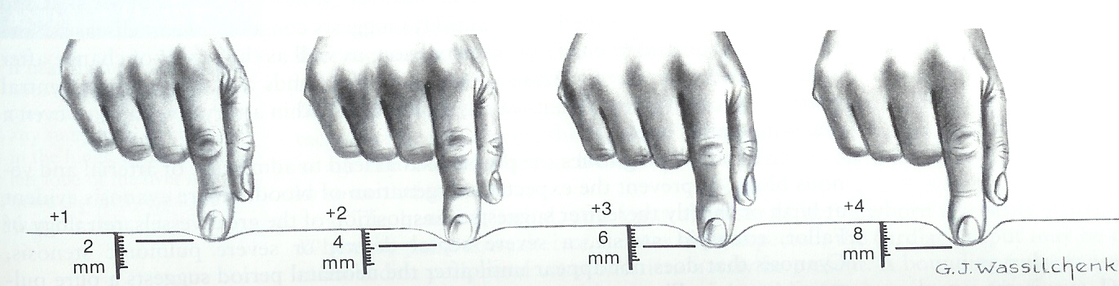
Edema

Slide 83
Hypertensive Disorders of Pregnancy
Proteinuria is an excessive amount of protein in the urine.
Normally urine don not contain protein
A trace of protein in the urine is not abnormal.
Proteinuria during pregnancy is diagnosed when 1+ or more protein as measured with a reagent strip (Uristix).

Slide 84
Hypertensive Disorders of Pregnancy
Grading proteinuria
A trace (0.1g/l) not significant
1+ = 0.3 g/l
2+ = 1.0 g/l
3+ = 3.0 g/l
4+ = 10 g/l

Slide 85
Classification of Hypertensive Disorders of Pregnancy
1) Chronic hypertension,
2) Preeclampsia
3) Eclampsia
4) Gestational hypertension

Slide 86
Elevated Liver Enzymes And Low Platelets HELLP Syndrome:
Is a variant of GH that involves:
H Hemolisis
EL Elevated Liver Enzymes
LP Low Platelets

Slide 87
1.) Chronic Hypertension
Hypertension, with or without proteinuria,
Patient have hypertension during first half of pregnancy.
Or she have it before pregnancy.
Bp more 140/90 mm hg before pregnancy

Slide 88
1.) Chronic Hypertension with overlap pre-eclampsia
Hypertension presenting during first half of pregnancy that is complicated by appearance of proteinuria during second half of pregnancy.
Medication change onto alpha methyldopa (Aldomet) 500 mg 8 hourly.
Other anti-hyper-tensives (i.e. diuretics, beta blockers and ACE inhibitors) must be stopped.

Slide 89
2.) Gestational Hypertension (Pregnancy Induced Hypertension)
GH presents in second half of pregnancy.
It is not accompanied by Proteinuria
Patient should check urine for protein daily at home
No special investigations are indicated.
Treatment of Alpha methyldopa 500 mg 8hr

Slide 90
3.) Pre-eclampsia
It is common and danger causes maternal death and fetus.
It presents in second half of pregnancy with hypertension, edema & proteinuria (>20 weeks
It may present during Pregnancy, Labour or puerperium.

Slide 91
3.) Pre-eclampsia Complications
Maternal death
Intracerebral haemorrhage.
Eclampsia.
Seizures
Pulmonary edema
Acute renal failure
Preterm delivery
Abruptio placentae
DIC

Slide 92
3.) Pre-eclampsia Severity Grading According to
a-The blood pressure
b-The amount of Proteinuria.
c-Signs and symptoms eclampsia.
d-The presence of convulsions.
Patients with pre-eclampsia can be divided into 4 grades of severity:

Slide 93
a-Pre-eclampsia.
A diastolic blood pressure of 90 to 109 mm Hg and Proteinuria,
And/or a systolic blood pressure of 140 to 159 mm Hg, plus Proteinuria and Edema .

Slide 94
2-Severe pre-eclampsia
Any of the following:
A diastolic BP 110 mm Hg or more and/or a systolic BP 160 mm Hg or more on 2 occasions, 4 hours apart, plus Proteinuria.
A diastolic BP 120 mm Hg or more and/or a systolic BP 170 mm Hg or more on 1 occasion, plus Proteinuria and Edema.

Slide 95
3-Imminent eclampsia.:
These patients have symptoms and/or signs that indicate that they are at extremely high risk of developing Eclampsia at any moment.
The diagnosis based on S&S, it does not depend on degree of Hypertension or amount of Proteinuria present.

Slide 96
Symptoms Imminent Eclampsia
Headache.
Visual disturbances or flashes of light seen in front of the eyes.
Upper abdominal pain
Tenderness over the liver.
Increased tendon reflexes, e.g. knee reflexes.
Edema.

Slide 97
4-Eclampsia:
Eclampsia is diagnosed when a patient with any of the grades of pre-eclampsia has a convulsion during pregnancy, labour or the first 7 days of the puerperium.

Slide 98
Management of Pre-eclampsia
Hospitalization may need ICU.
Give Methyldopa (Aldomet)
Magnesium Sulphate to prevent eclampsia
Nifedipine capsules (Adalat) to prevent intracerebral haemorrhage,
Foley’s catheter to monitor urinary output.
Observe and manage convulsions
Prevent aspiration
Administering oxygen.

Slide 99
7- Caring of pregnant woman with bleeding before 24 weeks of pregnancy
(abortions, ectopic pregnancy, Molar Pregnancy)

Slide 100
1.) Abortion
A pregnancy that ends before 20 weeks

Slide 101
a. ) Spontaneous(non-intentional) Abortion
a-Threatened Abortion:
Light spotting; cervix is closed & no tissue is passed
b-Incomplete Abortion: Bleeding dilation of cervix & passage of tissue

Slide 102
a. Spontaneous(non-intentional) Abortion
c-Complete Abortion :Passage of all products of conception, cervix closes and bleeding stops
d-Missed Abortion
Fetus dies in utero but is not expelled, uterine growth stops and septic is possible
e-Recurrent Abortion :2 or more consecutive spontaneous abortions

Slide 103

b. Intentional Abortion
Therapeutic Abortion
Intentional termination of pregnancy before age of viability to preserve the health of the mother
b. Elective Abortion Intentional termination of pregnancy for reasons unrelated to mothers health

Slide 104
2.) Ectopic Pregnancy
-95% occur in the fallopian tube
-The zygote or embryo may die and be absorbed by the body, or the tube could rupture with bleeding into the abdominal cavity .
-This is a surgical emergency.

Slide 105
2.) Ectopic Pregnancy Manifestations
1-Lower abdominal pain, light normal bleeding
2-If tube ruptures:
-May have sudden severe lower abdominal pain
-normal bleeding
-Signs of hypovolemic shock
-Shoulder pain.

Slide 106
2.) Ectopic Pregnancy Treatment
-Pregnancy test
-Trans-normal ultrasound
-Laparoscopic examination
-Priority is to control bleeding
-Treatment with methotrexate to inhibit cell division
-Surgery to remove pregnancy from the tube.

Slide 107
3.) Hydatidiform Mole (Molar Pregnancy) Gestational Trophoblastic Disease
Chorionic villi abnormally increase and develop vesicles
May cause hemorrhage, clotting abnormalities, hypertension, and cancer
More in women at age extremes of the reproductive life.

Slide 108
3.) Hydatidiform Mole (Molar Pregnancy) Manifestations
1-Bleeding
2-Rapid uterine growth
3-Failure to detect fetal heart activity
4-Hyperemesis gravidarum
5-Unusually early development of GH
6-Higher than expected levels of hCG
7-A distinct “snowstorm” pattern on ultrasound with no evidence of a developing fetus

Slide 109
3.) Hydatidiform Mole (Molar Pregnancy) : Treatment
Uterine evacuation
Dilation and Evacuation

Slide 110
8- Caring of pregnant woman with bleeding after 24 weeks of pregnancy (placenta diseases)

Slide 111
Bleeding Disorders of Late Pregnancy
It is any normal bleeding occurs at or after 24 weeks (weight 500 g) and before the birth of the infant.
It can be severe that it endanger life of both mother and fetus.
Most common cause is Abruptio placenta

Slide 112
Bleeding Disorders Of Late Pregnancy: Management
Evaluation and stabilization of patient .
If patient is shocked, she must be resuscitated immediately.
Assess fetus condition. If the fetus is viable but distressed, an emergency delivery is needed.
Diagnose the cause of the bleeding definitive management depending on the cause

Slide 113
Bleeding Disorders Of Late Pregnancy: Management Of Shocked Patient
IV Ringer’s lactate running
Insert a Foley’s catheter to measure urine output.
Give blood if available
Refer to ICU

Slide 114
Bleeding Disorders Of Late Pregnancy: Diagnosing
Assessment of amount and type of bleeding.
1.) Haemorrhage
2.) Blood-stained normal discharge
3.) Show

Slide 115
1.) A haemorrhage:
Any normal bleeding at or after 24 weeks if any of following are present:
a. A sanitary pad is at least partially soaked with blood.
b. History and examination of one of the following:
Abruptio placentae
Placenta praevia..
Haemorrhage of unknown cause

Slide 116
2..)-A Blood-stained normal Discharge
Consist of a discharge mixed with a small amount of blood.

Slide 117
2.)-A Blood-stained normal Discharge and Show: Managements
If organisms identified vaginitis.
2 g metronidazole (Flagyl) once orally.
Metronidazole should not be used in the first trimester of pregnancy it may cause congenital abnormalities in the fetus.

Slide 118
3.)- A ‘show’
Consist of a small amount of blood mixed with mucus.
Will be present on surface of sanitary pad but will not soak it.

Slide 119
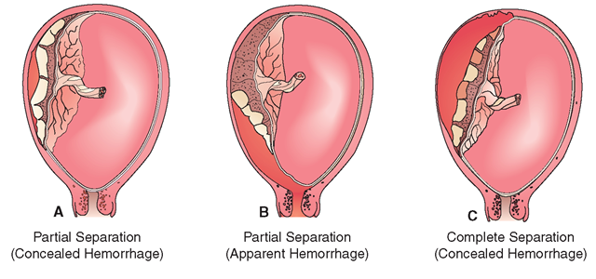
Abruptio Placentae

Slide 120
Abruptio Placentae (Placental Abruption)
Part or all of a normally implanted placenta has separated from uterus before delivery of fetus.
The cause unknown.
Abruptio placentae occurs in about 1% of all pregnancies
Lead to fetal distress or an intra-uterine death

Slide 121
Abruptio Placentae Risk of Factors :
-A history of an abruptio placentae
-Pre-eclampsia.
-Intra-uterine growth restriction.
-Cigarette smoking.
-Poor socio-economic conditions.
-A history of abdominal trauma, e.g. a fall or kick on the abdomen.

Slide 122
Signs and Symptoms of Abruptio Placentae
Haemorrhage with continuous, severe abdominal pain.
Blood is dark red with clots.
Absence of fetal movements and heart beat
Fetal parts cannot be palpated.

Slide 123
Signs and Symptoms of Abruptio Placentae
The uterus is tonically contracted, hard and tender and abdomen rigid.
The uterus is bigger than the patient’s dates suggest.
The haemoglobin concentration is low, indicating severe blood loss.

Slide 124
Classification of abruptio
Extent of separation
Partial
Complete
Location of separation
Marginal
Central

Slide 125
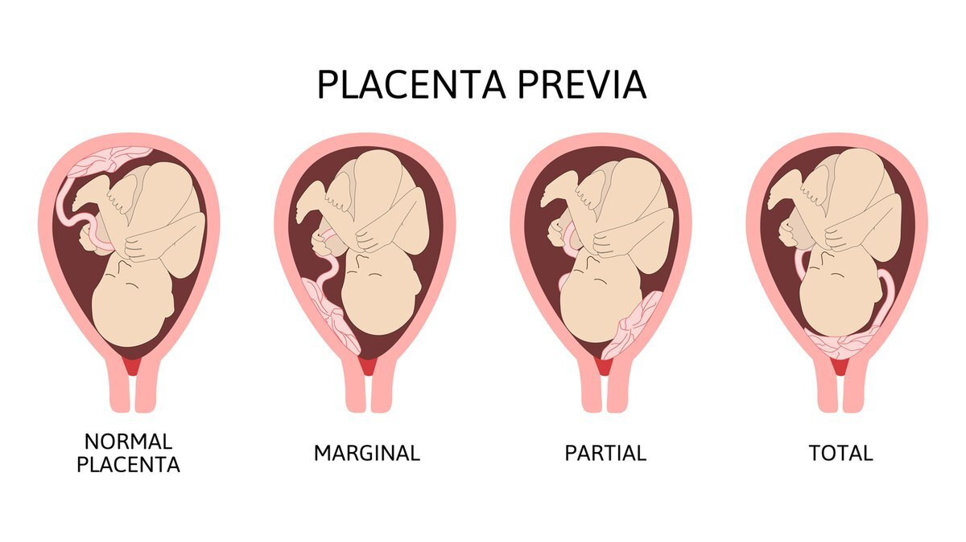

Slide 126
Placenta Praevia
Placenta is implanted either wholly or partially in the lower segment of the uterus.
-1 in 200 deliveries
It may extend down to, or cover internal os of the cervix.

Slide 127
Placenta Praevia
When lower segment starts to form or cervix begins to dilate, placenta becomes partially separated and this causes massive maternal bleeding that threatens woman’s life

Slide 128
Types Placenta Praevia
Complete or total:
Placenta covers 360° of internal cervical os;
(2) Incomplete or partial: 0°-360° of the internal cervical os is covered by placental tissue;
(3) Marginal:
placental tissue does not cover internal cervical os;
(4) Low lying:
edge of placenta lies abnormally close to but does not abut the internal cervical os.

Slide 129
Placenta Praevia high risk
Grande multiparas, para 5 or higher.
A previous caesarean section.
Have a multiple pregnancy.
Had a threatened abortion,.
Have an abnormal presentation

Slide 130
Signs and Symptoms of Placenta Praevia:
Painless bright red bleeding
Fetal movements and fetal heart are present
Patient’s haemoglobin concentration may be normal or low depending on the amount of blood loss.
Uterus is soft and not tender to palpation.
Uterus is not bigger than it should be for patient’s dates.
Fetal parts can be easily palpated

Slide 131
Diagnosis of Placenta Praevia:
Sonography is the test of choice to confirm placenta previa

Slide 132
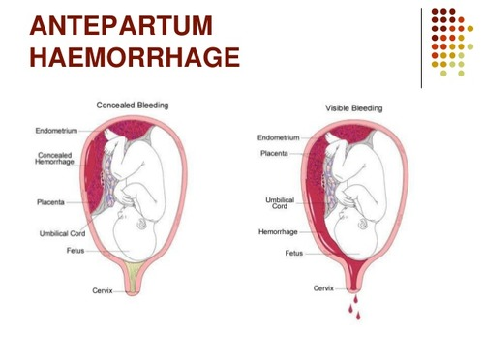
3. An antepartum haemorrhage of unknown cause

Slide 133
3. An antepartum haemorrhage of unknown cause
Unknown reason for the haemorrhage can be found.
Patients who have following factors:
1-Mild antepartum haemorrhage when there are no signs of shock and the fetal condition is good.

Slide 134
3. An antepartum haemorrhage of unknown cause
2-When history and examination do not suggest a severe abruptio placentae.
3-When local causes of bleeding have been excluded on a speculum examination.
4-When placenta praevia has been excluded by an ultrasound examination.

Slide 135
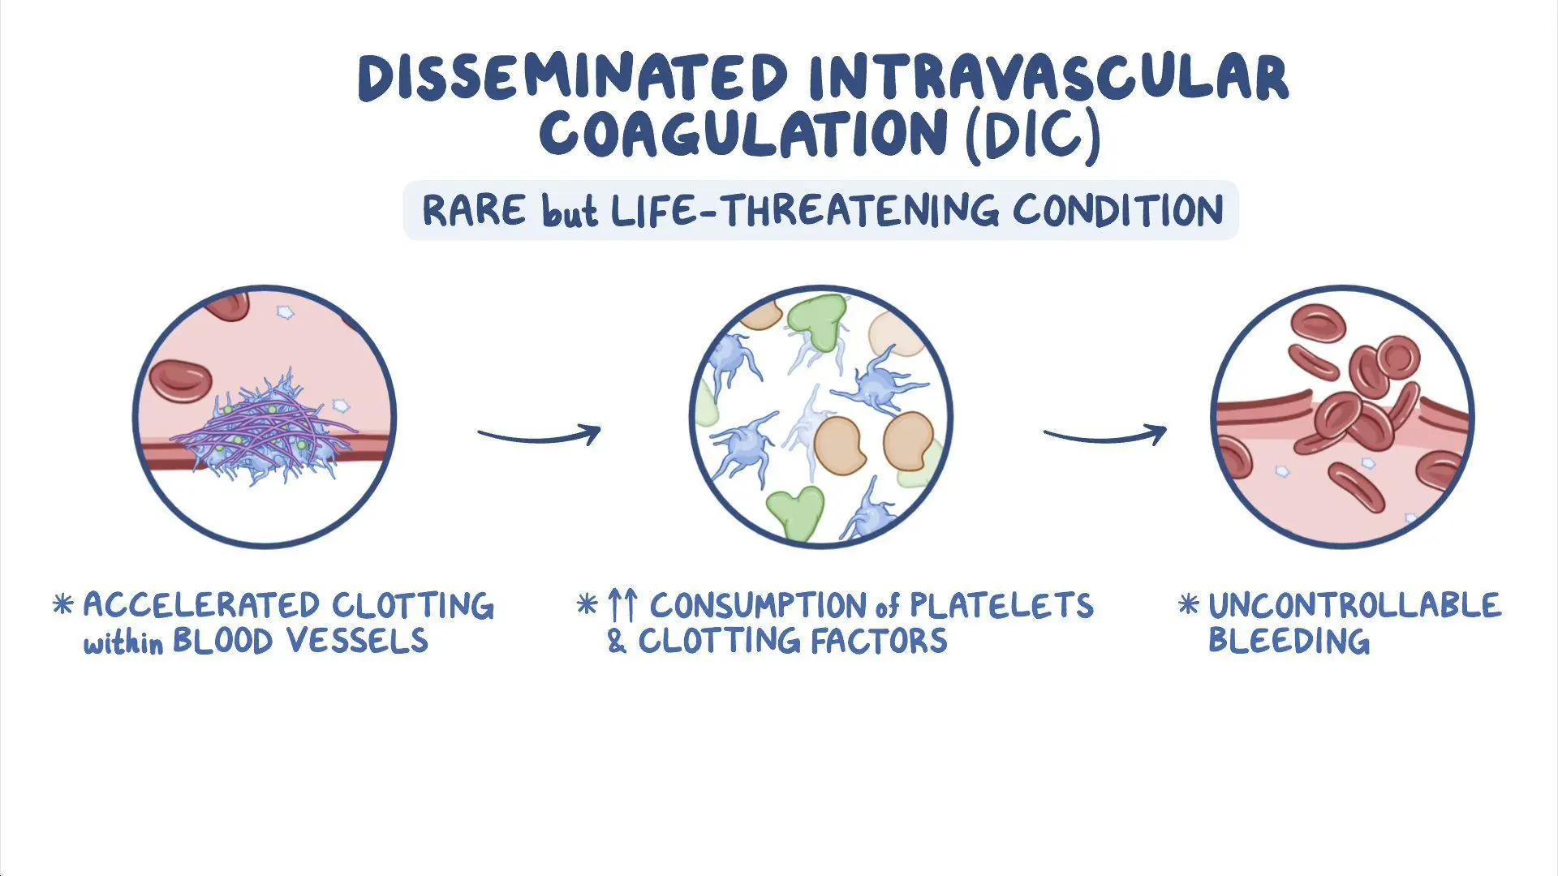
D.) Disseminated Intravascular Coagulation (DIC)

Slide 136
Disseminated Intravascular Coagulation (DIC)
A Pathologic form of coagulation in which clotting factors are consumed to such extent that generalized bleeding can occur

Slide 137
Disseminated Intravascular Coagulation (DIC)
Usually associated with:
Abruptio placentae,
Eclampsia,
Intrauterine fetal demise,
Amiotic fluid embolism
Hemorrhage..

Slide 138
Disseminated Intravascular Coagulation (DIC)
1-The clot formation and anticoagulation (destruction of clots) occur simultaneously through out the body
2-Bleeding may occur from mouth, nose, incisions or venipuncture sites because clotting factors are depleted.
3-These patients are also at risk for Postpartum (PP) hemorrhage because the uterus does not effectively clamp down the blood vessels

Slide 139
Disseminated Intravascular Coagulation (DIC) Treatment
-Emergency C/S
-Clotting factors
-An emergency hysterectomy could die from excessive bleeding. ,
-Massive amounts of blood.

Slide 140
Pregnancy-Related Complications

Slide 141
Hyperemesis Gravidarum HG
Excessive Nausea /vomiting of unknown cause.
HG can lead to :
-Electrolyte/acid base imbalance
-Significant weight loss
-Decreased turgor
-Decreased urine output
-High hematocrit
Treatment GH
Correct dehydration and inadequate nutrition.

Slide 142
Preterm Labour and Preterm Rupture of the Membranes
Preterm Labour :
Are defined as regular uterine contractions before 37 weeks of pregnancy, together with either of the following:
-Cervical effacement and/or dilatation.
-Rupture of the membranes.

Slide 143
Preterm Labour and Preterm Rupture of the Membranes
Preterm Rupture of Membranes
Is defined as the membranes rupture before 37 weeks, in the absence of uterine contractions.

Slide 144
Preterm Labour and Preterm Rupture of the Membranes
Pre-labour rupture of membranes
Is defined as rupture of the membranes for at least one hour before the onset of labour in a term pregnancy.
Preterm labour and preterm rupture of the membranes are major causes of Perinatal death because:

Slide 145
Preterm Labour and Preterm Rupture of the Membranes
1-It’s commonly results in birth of premature newborn with hyaline membrane disease.
2- Accompanied by bacterial infection of membranes and placenta, that cause complications for both mother and fetus.

Slide 146
Causes Preterm Labour and Preterm Rupture of the Membranes
1- Unknown
2-Commonest cause is Infection of the membranes and placenta
3-Infection causes an acute inflammation of the placenta, membranes and decidua.
This condition is called Chorioamnionitis.
4-Bacteria from the cervix and vagina spread through the endocervical canal to infect the
membranes and placenta.
Later these bacteria may colonize the liquor, from where they may infect the fetus.

Slide 147
The clinical presentation of Chorioamnionitis
-Usually asymptomatic
-Fetal tachycardia.
-Maternal pyrexia and/or tachycardia.
-Tenderness of the uterus.
-Drainage of offensive liquor, if the membranes have ruptured

Slide 148
Complication of Chorioamnionitis
Congenital pneumonia
Congenital septicaemia
Puerperal sepsis (genital tract infection ) if not treated correctly, may result in septicaemia, need for hysterectomy, and possibly in maternal death.

Slide 149
Complication of Chorioamnionitis
It can be prevented by starting a course of broad-spectrum antibiotics intravenous Ampicillin and Metronidazole

Slide 150
Other factors that can lead Preterm labour and preterm rupture of the membranes

Slide 151
Maternal factors:
1-Pyrexia, e.g. acute pyelonephritis or malaria.
2-Uterine abnormalities Septate or Bicornuate uterus) and uterine Myomas (fibroids).
3-Incompetence of internal cervical os (‘cervical incompetence’).

Slide 152
Fetal factors:
-A multiple pregnancy.
-Polyhydramnios
-Congenital malformations of the fetus.
-Syphilis.

Slide 153
Placental factors
-Placenta praevia.
-Abruptio placentae.

Slide 154
Risk factors Preterm labour and preterm rupture of the membranes
-Past history of preterm labour.
-No antenatal care.
-Poor socio-economic status .
-Smoke, alcohol drugs abuse
-Malnutrition.

Slide 155
Diagnosis of Preterm Labour and Preterm Rupture of the Membranes
Preterm labour contractions are:
-Regular, at least one per 10 minutes.
-Painful.
-Increase in frequency and duration.
-Cause effacement and dilatation of the cervix.
-Drainage of liquor
- normal smear pH alkaline confirm present of liquor

Slide 156
Preterm Labour and Preterm Rupture of Membranes Managements
Avoid normal examination it increase risk of infection.

Slide 157
Preterm Labour and Preterm Rupture of Membranes Managements
-If patient is less than 34 weeks pregnant.
Contractions should be suppressed with:
Nifedipine (Adalat).
Or Salbutamol (Ventolin)

Slide 158
Preterm Labour and Preterm Rupture of Membranes Managements
-Infants born between 34 and 36 weeks can usually be cared for in a level 1 hospital.
-Infants between 28 and 33 weeks, should be referred to a level 2 or 3 hospital with a neonatal intensive care unit.

