Slide 1

Gynecology and
Maternity Nursing
Unit Eight
Family Planning

Slide 2
Methods of Contraception
There are many types of contraception
No method of contraception is completely effective
Each method has its advantages and suits special cases and choice of contraception depends on needs of patients

Slide 3
Types of Contraception
Natural contraception
Mechanical contraception
Hormonal contraception
Surgical contraception

Slide 4

A.) Natural Family Planning Methods
1- Rhythm method
2-Basal body temperature
3- Cervical mucous method
4- Sympto-thermal method
5-Lactational amenorrhea method

Slide 5
1-Rhythm Method
This method can be used for patients with regular cycles only.
Depending on exact knowledge of ovulation day and avoiding intercourse during the days before and after ovulation; for example in a regular period that occurs every 28 days exact day of ovulation should be day 14 so intercourse should be avoided 4-5 days before and after this days.

Slide 6
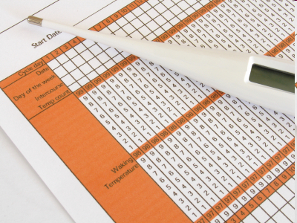
2. Basal Body Temperature (BBT)Method
A woman’s temperature rises between 0.4 F and 0.8 F on day of ovulation and stays elevated until next menstrual period.

Slide 7
3. Cervical Mucus Method:
Right before ovulation, cervical mucus changes from being cloudy and small to being clear and smooth
After the ovulation, the mucus tends to dry up again.

Slide 8
4-Symptothermal method
It is combined with the use of cervical mucus and BBT method.
The woman takes her temp and observe for mucus changes.

Slide 9
5-Lactational Amenorrhea Method
-As long as woman is breast feeding an infant, there is some natural suppression of ovulation.
-But may ovulate but not menstruate
-As a rule after 6 months, the breastfeeding women are advised to choose another method of contraception.

Slide 10
Advantage of Natural Methods
-Have no medical side effects
-Immediate return to fertility
Disadvantages of Natural Methods:
-High failure rate
-No protection from STI’s/HIV
-May be difficult to detect ovulation time .

Slide 11
B.) Mechanical Family Planning Methods
1.Male condoms
2.Female condoms
3.Diaphragms
4.Spermicidal
5. Intrauterine devices (IUD)

Slide 12
1-Male Condom
A thin latex or plastic sheath used by man to trap sperm.
Effectiveness: 94%-98% .
Advantages:
Protect against sexually transmitted infections

Slide 13
2-Female Condom (Femidom)
A Thin Polyurethane Sheath placed inside vagina to stop sperm
Effectiveness: 95%
Advantages:
Protect Against Sexually Transmitted Infections, including HIV/AIDS.

Slide 14
3-Diaphragms/Cervical Cap
Is a dome of rubber which is fitted over cervix.
It acts as a barrier to stop sperm getting through to uterus.
Effectiveness: 92%-96%

Slide 15
4- Spermicides:
Creams, gels, contain a chemical that kills sperm.
Increase effectiveness of certain barrier methods of contraception such as a diaphragm.
They don't provide reliable contraception when used alone

Slide 16
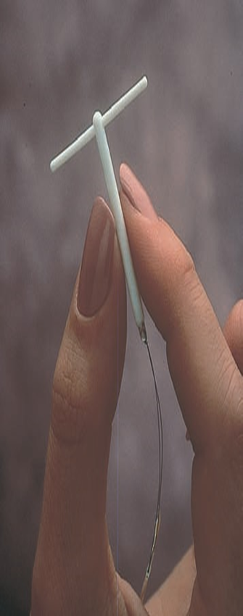
5. Intrauterine Devices (IUD)
A small plastic and copper device, usually shaped like a 'T', which is fitted into the uterus by a doctor using a simple procedure.
It works by preventing an egg from settling in uterus.
IUD can stay in place for five years - sometimes for 10.
Effectiveness: 98%-99%.
Advantages: It last for a long time
Disadvantage: It may cause heavier, more painful periods.

Slide 17
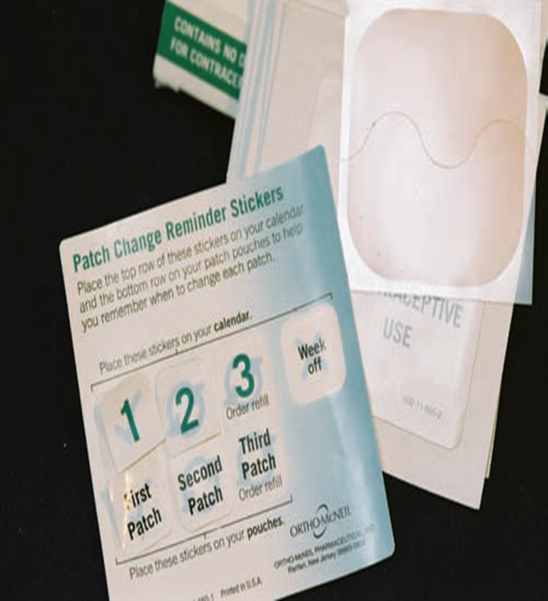
C.) Hormonal Family Planning Methods
Skin patch
Pills ( Combined & Minipill )
Injection
Implant

Slide 18
1-Contraceptive Skin Patch
Looks like a square band-aid.
It is applied to abdomen, buttocks, upper arm, or upper torso.
Patch is changed each week for a schedule of 3 weeks on and 1 week off.
It works by slowly releasing a combination of estrogen and progestin hormones through skin. These hormones prevent ovulation and thicken cervical mucus, creating a barrier to prevent sperm from entering uterus.
Effectiveness: It’s about 99% effective

Slide 19
2-Combined Pill
The most common type.
Contains two hormones Estrogen and Progesterone which prevent an ovum from being released.
It is not reliable if taken over 12 hours late or if have vomiting and diarrhea.
Some drugs like antibiotics can affect its reliability.
-Effectiveness: 99%.
Advantages:
a-Reduce pre-menstrual syndrome (PMS) and period pain.
b-Protect against cancer of uterus and ovaries.

Slide 20
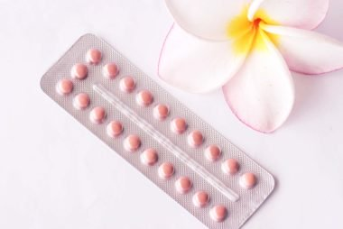
3-Progesterone Only Pill (Mini Pill)
Contains only progesterone hormone
Works by thickening cervical mucus, which acts as a barrier to stop sperm entering uterus
Makes lining of womb thinner, to prevent it implanting a fertilized egg.
It is good for:
Breast-feeding women
Older women,
Smokers
Who cannot use the combined pill.

Slide 21
3-Progesterone Only Pill (Mini Pill)
-It must be taken at the same time each day or at most within three hours of that time.
-It will not work if taken over three hours late, or if have vomiting and diarrhea
-It can cause irregular bleeding and periods may stop altogether
-Effectiveness: 98%

Slide 22
4-Contraceptive Injection (Depo-Provera)
Injection of hormones that provides a longer-acting alternative to pill.
It works by slowly releasing hormone progesterone into the body to stop ovulation.
Each injection lasts for 8-12 weeks.
Effectiveness: 99%.

Slide 23
4-Contraceptive Injection (Depo-Provera)
Advantages
Reduce heavy or painful periods
Protection against cancer of the uterus.
Disadvantage
Periods can become irregular or stop altogether.
It can take over a year for fertility to return to normal after stopping contraceptive injections.

Slide 24
5-Contraceptive Implant
A small stick containing progesterone hormone which is inserted under skin in arm.
Hormone is slowly released into body, preventing ovum from being released from the ovaries, ovum settling in the womb
Effectiveness: 99%.
Advantages: It lasts for three years.
Disadvantages: Periods can become irregular or stop altogether.

Slide 25
Side Effects Of Hormonal Family Planning Methods
Nausea
Weight gain
Headache
Breast tenderness
Breakthrough bleeding
Vaginal infections
Mild hypertension
Depression

Slide 26
Contraindications of Hormonal Family Planning Methods
Breast feeding
Family history of CVA or coronary artery disease (CAD)
History of Thromboembolic disease
History of liver disease
Undiagnosed vaginal bleeding

Slide 27
Contraindications of Hormonal Family Planning Methods
Age > 40 years Breast or reproductive tract malignancy DM Elevated cholesterol and triglyceride High blood pressure Mental depression | Migraine and other types of vascular headache Obesity Pregnancy Seizure disorders Sickle cell Smoking .

Slide 28
D.) Surgical Family Planning Methods (Sterilization)
1-Vasectomy (Male)
2-Tubal ligation (Female)
Surgery may be done by a. Mini-laprotomy or b. Laparoscopy

Slide 29
1-Male Sterilization
Division or occlusion of vas deference prevents passage of sperms.
The success of procedure is verified by absence of sperms from two consecutive samples of ejaculate collected at least 4 weeks apart.

Slide 30
2-Female Sterilization
Surgically blocking both fallopian tubes by three ways:
a. Laparotomy,
b. Mini-laparatomy ,
c. Laparoscopy

Slide 31
Female Sterilization Methods of Tubal Occlusions
a. Ligation by absorbable or non-absorbable sutures
b. Electrocautery
c. Falope ring of silicone or rubber is placed over a loop of the tube
d. Clips: stainless steel and polycarbonal clip, silicon rubber.
e. Laser divides tube very cleanly but may allow a high incidence of recanalization(spontaneous restoration).

Slide 32
Rights of Clients
1-Information about all the methods / services available.
2-Knowledge of benefits and risks / side effects of all the contraceptive methods / to make an independent decision.

