Slide 1
2. Concept and Theories of Personality Development
Al-Zaytoonah University
Psychiatric and Mental Health Nursing
( Theory )
By Dr: Hasan Abualruz RN, MSN, PhD

Slide 2
Outline
Personality
Personality wellness dimensions
Measures to improve personality dimensions
Psychosexual theory
Developmental theory
Cognitive theory
Humanistic theory

Slide 3
Learning Outcomes
To define personality.
To list and describe personality dimensions.
To discuss the measures to improve personality dimensions wellness.
To discuss Freud psychosexual theory.
TO discuss Erickson developmental theory.
To discuss Piaget cognitive theory.
To discuss Maslow humanistic theory.

Slide 4
Personality
* Personality: is an ingrained, enduring pattern of behaving and relating to the self, others, and the environment; it includes perceptions, attitudes, and emotions...
* A person is usually not consciously aware of his or her personality.
* Person's wellness is commonly viewed as many dimensions. Each dimension contributes to our own sense of wellness or quality of life.

Slide 5
Personality Wellness dimensions
Physical
Social
Emotional
Intellectual
Spiritual
Environmental
Occupational

Slide 6
1.Physical Dimension
* It means learning about and identifying symptoms of disease, getting regular medical checkups, and protecting from injuries and harm.
* Encompasses a variety of healthy behaviors including adequate exercise, proper nutrition, and abstaining from harmful habits such as drug use and alcohol abuse.

Slide 7
Measures to improve physical wellness
Exercise daily
Get adequate rest
Use seat belts, and other protective equipment
Learn to recognize early signs of illness
Eat a variety of healthy foods
Control your meal portions
Stop smoking and protect yourself against second-hand smoke

Slide 8
2. Social Dimension
Social wellness refers to our ability to interact successfully in our community and to live up to the expectations and demands of our personal roles.
This means learning good communication skills, developing intimacy with others, and creating a support network of friends and family members.

Slide 9
Measures to improve social wellness
Cultivate healthy relationships
Get involved
Contribute to your community
Share your talents and skills
Communicate your thoughts, feelings, and ideas

Slide 10
3.Emotional Dimension
Means understanding how we feel, accepting our feelings, and learning how to express and cope with our emotions.
It means having the ability to love and be loved and achieving a sense of fulfillment in life.
Emotional wellness encompasses optimism, self-esteem, self-acceptance, and the ability to share feelings.

Slide 11
Measures to improve emotional wellness
Tune-in to your thoughts and feelings
Cultivate an optimistic attitude
Seek and provide support
Learn time management skills
Practice stress management techniques
Accept and forgive yourself

Slide 12
4.Intellectual Dimension
Is characterized by the ability to make decisions and to think critically.
It includes openness to new ideas; motivation to master new skills; and a sense of humor, creativity.
An intellectually well person uses the resources available to expand one's knowledge, solve problems and improve skills.

Slide 13
Measures to improve intellectual wellness
Take a course or workshop
Learn (or perfect) a foreign language
Seek out people who challenge you intellectually
Read
Learn to appreciate art

Slide 14
5.Spiritual Dimension
Spiritual wellness involves beliefs, principles, or values that help give direction to one's life.
It encompasses a high level of hope, and commitment to your individual beliefs that provide a sense of meaning and purpose.

Slide 15
Measures to improve spiritual wellness
Explore your spiritual core
Be fully present in everything you do
Listen with your heart and live by your principles
Allow yourself and those around you the freedom to be who they are

Slide 16
6.Environmental dimension
It consists of maintaining a way of life that maximizes harmony with the earth and minimizes harm to the environment.
It includes being involved in socially responsible activities to protect the environment.

Slide 17
Measures to improve environmental wellness
Conserve water and other resources
Minimize chemical use
Renew your relationship with the earth

Slide 18
7.Occupational Dimension
It may include the actual work that you do, the roles that you play and/or the responsibilities that you have as a full time parent or student.
Being occupationally well means seeking opportunities to grow professionally and to be fulfilled in your "JOB" .

Slide 19
Measures to improve occupational wellness
Create a vision for your future
Choose a career that suits your personality, interests, and talents
Visit a career planning/placement office and use the available resources
Be open to change and learn new skills

Slide 20
Theories of Personality Development

Slide 21
Theories of Personality Development
Psychosexual or psychoanalytical theory……………………………..Freud
Developmental theory ............Erickson
Cognitive theory………............Piaget
Humanistic Theory………….….Maslow

Slide 22
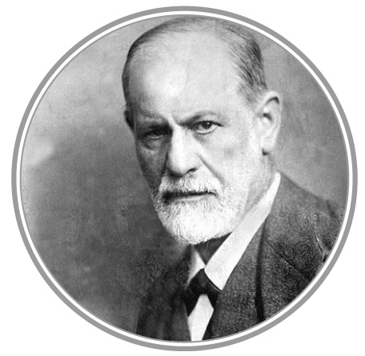
1. Freud psychosexual theory
* Sigmund Freud: 1856-1939, the father of psychoanalysis.
* Many theorist and clinicians
do not agree much with Freud
theory and developed their own
theories.
* Freud theory still used rarely
now in practice.

Slide 23
Freud’s
Three-Part Personality Structure
Id
Ego
Superego

Slide 24
Id, Ego, and Superego
According to Freud, each individual has a fixed amount of psychic energy that can be used to satisfy basic urges and to grow psychologically.
As a child develops, this psychic energy is divided among 3 components of personality.

Slide 25
Id, Ego, and Super Ego
* The id: is the part of one’s nature that reflects basic or innate desires such as pleasure-seeking behavior, aggression, and sexual impulses.
* The superego: is the part a person’s nature that reflects moral and ethical concepts, values, and parental and social expectations; therefore, it is in direct opposition to the id.
* The ego: is the balancing or mediating force between the id and the superego. The ego represents mature and adaptive behavior that allows a person to function successfully in the world.

Slide 26
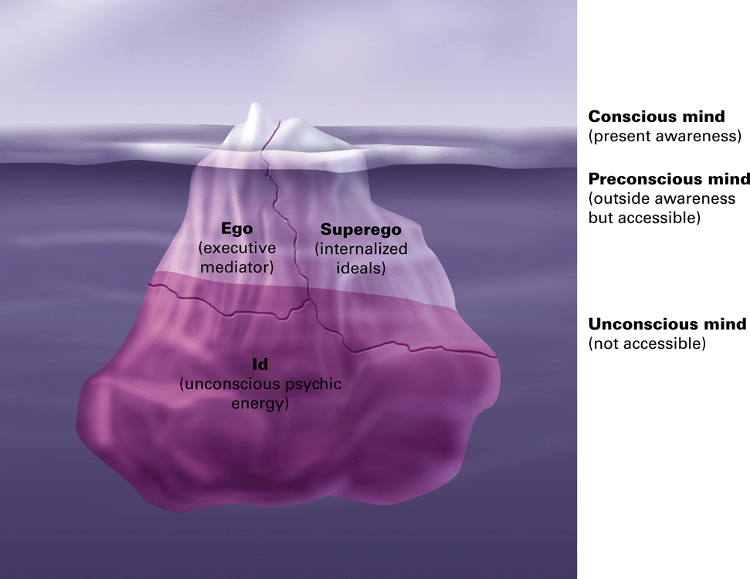

Slide 27
Behavior Motivated by Subconscious Thoughts and Feelings
Freud believed that much of what we do and say is motivated by our subconscious thoughts or feelings (those in the preconscious or unconscious level of awareness).

Slide 28
Behavior Motivated by Subconscious Thoughts and Feelings
Freud believed that the human personality functions at
three levels of awareness:
Conscious: refers to the perceptions, thoughts, and emotions that exist in the person’s awareness, such as being aware of happy feelings or thinking in a loved one.
Preconscious: thoughts and emotions are not currently in the person’s awareness, but can recall them with some effort, such as an adult remembering what he or she did, thought, or felt as a child.
Unconscious: is the realm of thoughts and feelings that motivates a person even though he or she is totally .
unaware of them.

Slide 29
Psychoanalysis treatment
Freud believed that much of what we do and say is motivated by our subconscious thoughts or feelings (those in the preconscious or unconscious level of awareness).
Freud believed that a person’s subconscious have significant meaning, though sometimes the meaning is hidden or symbolic.

Slide 30
Psychoanalysis: Terms
Transference: unconscious redirection of feelings for one person ( patient) to another (including the therapist).
Counter transference: redirection of therapist’s feelings for the patient.
Therapeutic alliance: therapist and patient trust.
Resistance: ideas unacceptable to conscious; prevents therapy from proceeding.

Slide 31
Transference
The transference definition: is when a client redirects their feelings from a significant other or person in their life to the clinician.
Transference examples:
- The client places unrealistic demands on you.
- A client admires you and tells you how much you remind them of their best friend.
- A client displaces anger onto you when talking about his abusive parent.
Pros and cons
As a clinician, you can utilize the transference as a tool to help the client gain insight into their strength to handle situations outside of the session. You can help your client to see their reality of the event they are dealing with.
If you become activated during transference and react negatively or defensively, it can stop the growth process. For example, if the client speaks to you in anger as they would to their partner and you personalize it, then you may miss an opportunity to help your client.

Slide 32
Counter-transference
Counter-transference: is when you as the clinician transfer your feelings onto your client. Often clinicians don’t realize when this happens. The counter-transference definition can be thought of as the clinician’s response to a client’s transference.
Counter-transference examples:
- A clinician offers advice versus listening to the client’s experience.
- A clinician inappropriately discloses personal experiences during the session.
- A clinician doesn’t have boundaries with a client.
A crucial area to be aware of is erotic countertransference which is when the clinician experiences attraction, love, or sexual feelings towards a client. With strict ethical and legal guidelines, relationships with clients are prohibited.

Slide 33
Psychoanalysis Techniques
* Analysis of transference
* Dream analysis: a primary technique used in psychoanalysis, involves discussing a client’s dreams to discover their true meaning and significance. However, Psychoanalysis is still practiced today but on a limited basis.
* Hypnosis

Slide 34
Psychoanalysis treatment
* Free association: in which the therapist tries to uncover the client’s true thoughts and feelings by saying a word and asking the client to respond quickly with the first thing that comes to mind. Freud believed that such quick responses would be likely to uncover subconscious or repressed thoughts or feelings.
* A Freudian slip, or parapraxis: is a verbal or memory mistake that is believed to be linked to the unconscious mind. These slips supposedly reveal secret thoughts and feelings that people hold. Typical examples include an individual calling their spouse by an ex's name, saying the wrong word, or even misinterpreting a written or spoken word.

Slide 35
Defense Mechanisms (Ego defense Mechanisms)
Defense mechanisms: are psychological strategies that are unconsciously used to protect a person from anxiety arising from unacceptable thoughts or feelings.
* Why do we need Ego defense mechanisms?
We use defense mechanisms to protect ourselves from feelings of anxiety or guilt, which arise because we feel threatened, or because our id or superego becomes too demanding.

Slide 36
The most Common Defense mechanisms
Example | Explanation | Type
have you ever had a really bad day at work and then gone home and taken out your frustration with family and friends?- Rather than arguing with your boss. | involves taking out our frustrations, feelings, and impulses on people or objects that are less threatening. | 1. Displacement
People living with drug or alcohol addiction often deny that they have a problem. | protect the ego from things with which the person cannot cope. | 2. Denial
Unconscious removal of child abuse memory. | un-conscious blocking unwanted thoughts memories and impulses. | 3. Repression
conscious removal of child abuse memory. | conscious blocking unwanted thoughts memories and impulses. | 4. Suppression
if you have a strong dislike for someone, you might instead believe that they do not like you. | taking your own unacceptable qualities or feelings and ascribing them to other people. | 5. Projection

Slide 37
The most Common Defense mechanisms
Example | Explanation | Type
person who is turned down for a date might rationalize the situation by saying they were not attracted to the other person anyway. | involves explaining an unacceptable behavior or feeling in a rational or logical manner, avoiding the true reasons for the behavior. | 6. Rationalization
might cry or sulk upon hearing unpleasant news. | returning to an earlier stage of development. | 7. Regression
treating someone you strongly dislike in an excessively friendly manner in order to hide your true feelings. | reduces anxiety by taking up the opposite feeling, impulse, or behavior | 8. Reaction Formation
instead of telling someone you are angry with them, you might yell at them or throw something against the wall. | engaging in actions rather than acknowledging and bearing certain feelings. | 9. Acting out
rather than discuss a problem with someone, you might simply start avoiding them altogether so you don't have to deal with the issue. | Refusing to deal with or encounter unpleasant objects or situations. | 10. Avoidance

Slide 38
The most Common Defense mechanisms
Example | Explanation | Type
someone who feels insecure academically might compensate by excelling in athletics. | Overachieving in one area to compensate for failures in another. | 11. Compensation
cracking a joke in a stressful or traumatic situation. | Pointing out the funny or ironic aspects of a situation | 12. Humor
Instead of telling someone that you are upset, for example, you might give them the silent treatment. | Indirectly expressing anger. Instead of telling someone that you are upset. | 13. Passive -aggression
Students???? | Forecasting future danger in small steps to cope with the danger gradually | 14. Anticipation
Students???? | Taking on the characteristics of some one viewed as a successful. | 15. Identification

Slide 39
Psychosexual development in Freud theory
* Freud proposed that children progress through five
stages of psychosexual development that are the
driving force of human behaviors.
* Psychopathology results when a person has difficulty
making the transition from one stage to the next or
when a person remains stalled at a particular stage or
regresses to an earlier stage.

Slide 40
Five Psychosexual Stages
Oral Stage (birth to 18 months)
Anal Stage (18 months to 3 years)
Phallic Stage (3 to 6 years)
Latency Stage (6 years to puberty)
Genital Stage (puberty to adulthood)

Slide 41
Freud’s Psychosexual States of Personality Development
Stage (age range) | Erogenous Zone | Activity Focus
Oral (birth to 1½ years) | Mouth, lips, and tongue | Sucking, biting, and chewing
Anal (1½ to 3 years) | Anus | Bowel retention and elimination
Phallic (3 to 6 years) | Genitals | Identifying with same-sex parent to learn gender role
Latency (6 years to puberty) | No erogenous zone | Cognitive and social development
Genital (puberty to adulthood) | Genitals | Development of sexual relationships,

Slide 42
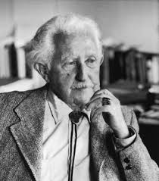
2. Erikson Developmental theory
* Erik Erikson (1902–1994). He is psychoanalyst.
* Erikson extended Freud’s work on personality
development across life span while focusing on social and
psychological development in the life stages.
* He described 8 stages. In each stage, the
person must complete a life task that is
essential to the well-being and mental health.
* psychosocial growth occurs in sequential
phases and each stage is dependent on
completion of the previous stage and life
task.

Slide 43
Erikson’s eight psychosocial stages
Stage | Psychosocial Crisis | Important évent
Stage 1: Birth – 18 months (Infancy). Infant needs to form the 1st trusting and love relationship with caregivers. | Trust vs mistrust | Feeding
Stage 2: 2-3 years (Toddlerhood). Children’s energy are directed to development of physical skill. | Autonomy vs shame, doubt | Toilet training
Stage 3 : 3y – 5 years (Pre-school). Children would be more initiative. | Initiatives vs guilt | Independence

Slide 44
Erikson’s eight psychosocial stages
Stage | Psychosocial criss | Important évent
Stage 4: 6 – 11 years (School age). Children need to cope with new social and academic demands. | Industry vs inferiority school | Ability to learn how things work and organize. Enjoy responsibilities and confident in their ability to complete the tasks assigned.
Stage 5: 12-18 years (Adolescence) Teens needs to develop a sense of self and personal identity. | Identity vs identity confusion | Peer relationship

Slide 45
Erikson’s eight psychosocial stages
Stage | Psychosocial criss | Important évent
Stage 6 : 19-40 years (Young Adulthood). Young adults need to form intimate, loving relationships with other people. | intimacy and solidarity vs isolations | Love relationship
Stage 7 : 40-65 years (Middle Adulthood) Adults need to nurture things that will outlast hem eg : having children | Generative vs stagnation | Work and Parenting
Stage 8 : > 65 years (Maturity) Older adults need to look back on life and feel a sense of fulfillment. | Integrity vs despair | Reflection on and acceptance of one’s life

Slide 46
 | الثقة مقابل عدم الثقة | السنة الأولى
 | أزمة الاستقلال مقابل الشعور بالخجل | السنة الثانية
 | أزمة المبادرة في مقابل الشعور بالذنب | الطفولة المبكرة
 | أزمة الكفاية مقابل الشعور بالنقص | الطفولة المتوسطة والمتأخرة
 | أزمة الهوية مقابل اضطراب الدور | المراهقة
 | المودة و الألفة مقابل العزلة | الشباب المبكر
 | الإنتاجية مقابل الركود | أواسط العمر
 | تكامل الذات مقابل اليأس | الرشد المتأخر
 |  | مرحلة دنو الأجل

Slide 47
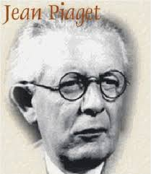
3. Piaget Cognitive theory
* Jean Piaget (1896–1980).
* Piaget explored how intelligence and
cognitive functioning develop in children.
* He believed that human intelligence progresses through
a series of stages based on age, with the child at each
successive stage demonstrating a higher level of
functioning than at previous stages.
* Piaget strongly believed that biologic changes and
maturation were responsible for cognitive development.

Slide 48
3. Piaget Cognitive theory
Piaget’s theory suggests that individuals reach cognitive maturity by middle to late adolescence.
Some critics of Piaget believe is that: cognitive development is less rigid and more individualized than his theory suggests.
Piaget’s described four stages of cognitive development as follows:
A: Sensorimotor phase
B: Preoperational Phase
C: Concrete operations Phase
D: Formal operations Phase

Slide 49
3. Piaget Cognitive theory
A: Sensorimotor phase (birth to 2 years)
- The child develops a sense of self as separate from the
environment.
He or she begins to form mental images.
B: Preoperational Phase—2 to 6 years
- The child develops the ability to express self with
language.
Understands the meaning of symbolic gestures.
Begins to classify objects.

Slide 50
3. Piaget Cognitive theory
C: Concrete operations Phase (6 to 12 years)
- The child begins to apply logic to thinking.
- Understands spatiality and reversibility.
Increasingly social and able to apply rules.
However, thinking is still concrete.
D: Formal operations (12 to 15 years and beyond)
- The child learns to think and reason in abstract terms.
- Develops logical thinking and reasoning.
- Achieves cognitive maturity.

Slide 51
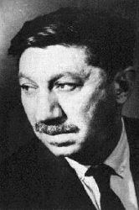
4. Humanistic theory
Humanistic theory–
Abraham Maslow : humanist whose views differed from behaviorists and psychoanalysts.
Maslow humanistic psychology theory, observed human needs in different settings and used these to construct a ‘hierarchy of needs’

Slide 52
Maslow’s Hierarchy of Needs
Self-Actualization
Self-
Esteem
Social
Safety
Physiological

Slide 53
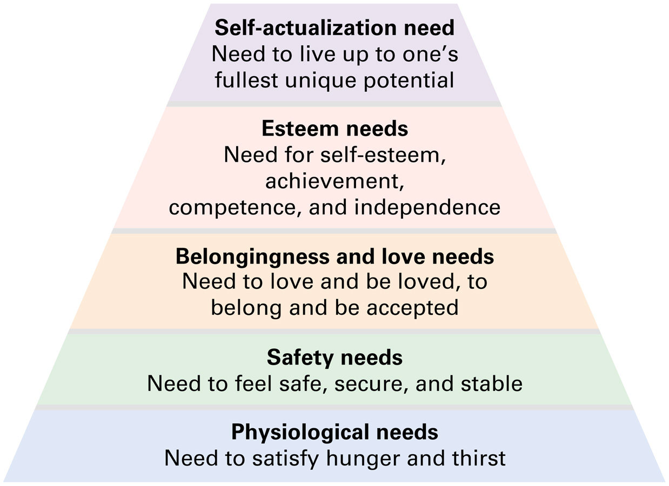
Maslow’s Hierarchy of Needs

Slide 54
4. Humanistic theory
Humanistic psychology: the subjective study of human experience and needs.
Humanistic psychologists do not deny the existence of an objective external reality, but are concerned with individual perceptions and interpretations which are influenced by social and cultural meanings and past experiences.
They would argue that there is no single truth, no single ‘right’ way of doing things, and no ‘one size fits all’ treatment for emotional problems.
54
Notes:
Humanistic counselling is quite different from psychodynamic counselling in that the therapist makes no attempt to interpret the client’s problems or direct a course of action.

Slide 55
Thank You

