Slide 1
3. Neurobiology of Mental Disorders
Al-Zaytoonah University
Psychiatric and Mental Health Nursing
( Theory )
By Dr: Hasan Abualruz RN, MSN, PhD

Slide 2
Outline
Introduction/ Nervous system .
Central nerves system components and functions.
Peripheral nervous system components and functions.
Neurotransmitters:
- Dopamine
- Noradrenalin
- Serotonin
- Acetylcholine
Relationships between neurotransmitters and psychiatric illnesses.

Slide 3
Learning Outcomes
To understand the exact function of the nervous system.
To acknowledge the components of central nervous system and exact function for each component.
To acknowledge the components Peripheral nervous system and exact function for each component.
To understand the process of neurotransmissions.
To list the most common neurotransmissions and discuss its functions.
To understand the relationships between neurotransmitters and psychiatric illnesses.

Slide 4
Introduction
* The Nervous system composed of:
1- Central nervous system (CNS):
Consists of brain, spinal cord, meninges and the associated nerves that control the voluntary movements.
2- Peripheral Nervous System (PNS)
Consists of cranial nerves, spinal nerves, and autonomic nervous system (control involuntary body functions).

Slide 5
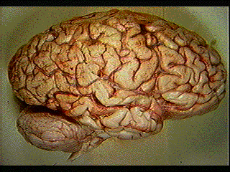
1.Central Nervous system
* Central Nervous System consists of:
A. Brain B. Spinal cord C. Meninges
_________________________________________________________
A. Brain: a mass tissue of nerves protected by membranes
(meninges).
* The brain consists of:
1. Cerebrum
2. Cerebellum
3. Brainstem
4. Limbic System

Slide 6
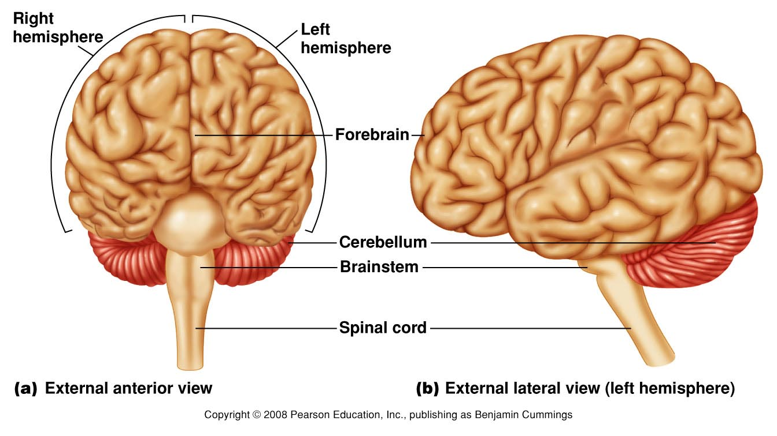
Brain Strucutre

Slide 7
1.Central Nervous system
A) Brain
1. Cerebrum:
Largest section of the brain.
The cerebrum is divided into two hemispheres, each hemisphere consists of 4 lobes ( frontal, temporal, partial, and occipital).
The left hemisphere controls the right side of the body and is the center for logical reasoning and analytic functions such as reading, writing, and mathematical tasks.
- The right hemisphere controls the left side of the body and is the center for creative thinking, intuition, and artistic abilities.

Slide 8
1.Central Nervous system
A) Brain
1. Cerebrum:
- The frontal lobes control the organization of thought, body movement, memories, emotions, and moral behaviors. Enables problem solving and decision-making.
* abnormalities in the frontal lobes are associated with schizophrenia, (ADHD), and dementia.
- The parietal lobes interpret sensations of taste and touch and assist in spatial orientation.
- The temporal lobes are centers for the senses of smell and hearing and for memory and emotional expression.
- The occipital lobes assist in coordinating language generation and
visual interpretation, such as depth perception.

Slide 9
1.Central Nervous system
A) Brain
2. Cerebellum
Is located below the cerebrum and is the center for coordination of movements and postural adjustments.
3. Brainstem
* Consists of three parts: Midbrain, Pons, and Medulla oblongata.
- Medulla oblongata : contains vital centers for respiration and cardiovascular functions.
- Pons: conduct messages to other parts of brain (Reflexes chewing, production of saliva).
- Midbrain: Conducting impulses between brain parts.

Slide 10
1.Central Nervous system
A) Brain
4) Limbic system
* The limbic system is an area of the brain located above the brain stem that includes: Thalamus, Hypothalamus, hippocampus, and amygdala.
- Thalamus: regulates activity, sensation, and emotion.
- Hypothalamus: is involved in temperature regulation, appetite control, endocrine function, sexual drive, and impulsive behavior.
Hippocampus and Amygdala: involved in emotional arousal and memory.

Slide 11
1.Central Nervous system
A) Brain
4) Limbic system
* Disturbances in the limbic system have been implicated in a variety of mental illnesses, such as the memory loss that accompanies dementia and the poorly controlled emotions and impulses seen with psychotic or manic behavior.

Slide 12
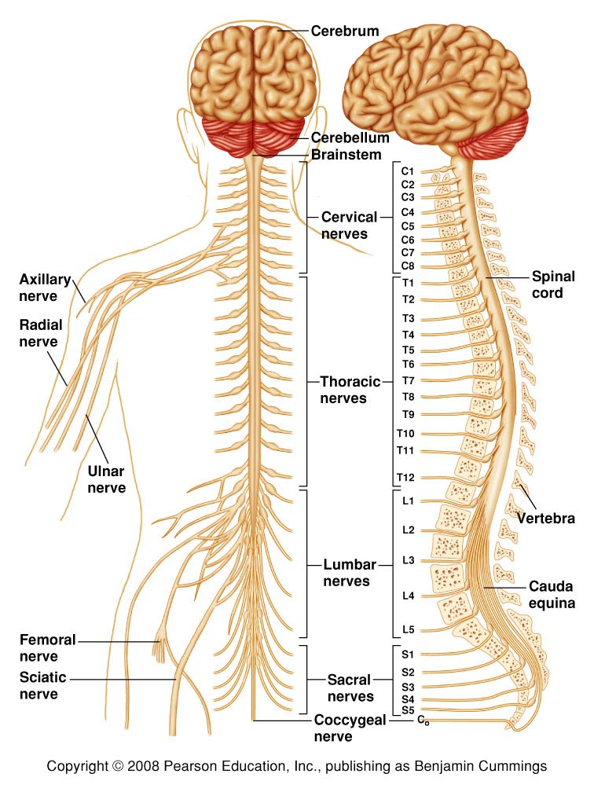
1.Central Nervous system
B) Spinal Cord
Goes down back of body from Medulla Oblongata.
Surrounded and protected by vertebrae.
Responsible for reflex actions.
Carries sensory and motor messages.

Slide 13
1.Central Nervous system
C. Meninges
Covers and protects the brain and spinal cord
Consists of 3 membranes:
- A. Dura mater: (thick, tough outer layer).
- B. Arachnoid membrane: (middle delicate web like layer).
- C. Pia mater: (inner most layer with blood vessels to nourish nerves).

Slide 14
Cerebrospinal Fluid (CSF)
Circulates continuously.
Serves as shock absorber to protect brain and spinal cord.
Carries nutrients to parts of brain and spinal cord.
Helps remove metabolic products & wastes.
After circulation, absorbed into the blood vessels of the dura mater.

Slide 15
2)Peripheral Nervous System
Peripheral nervous system Consists of:
A- Cranial nerves.
B- Spinal nerves.
C- Autonomic Nervous System.
________________________________________________________
A) Cranial nerves:
- 12 pairs & their branches.
- Each nerve is responsible about sensation or movement, or both of them.
B) Spinal nerves.
Consists of 31 pairs & their branches: ( 8 cervical, 12 thoracic, 5 lumber, 5 sacral, and 1 coccygeal).
They carry messages from and to the spinal cord.

Slide 16
2)Peripheral Nervous System
C) Autonomic Nervous System
Allows the body to react in times of emergency..
Control involuntary body functions.
It is divided into sympathetic and parasympathetic nervous systems.

Slide 17
2)Peripheral Nervous System
C) Autonomic Nervous System
Parasympathetic | Sympathetic
- Counter acts the sympathetic ns after the emergency. | - Acts in emergency
- Decrease heart rate. | - Increase heart rate.
- Decrease Blood pressure. | - Increase Blood pressure.
- Decrease respiratory rate. | - Increase respiratory rate.
Increase digestive system activities. | - Decrease digestive system activities.

Slide 18
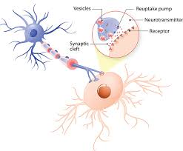
Neurotransmitters

Slide 19
Neurotransmitters
Approximately 100 billion brain cells form groups of neurons, or nerve cells, that are arranged in networks.
These neurons communicate information with one another by sending electrochemical messages from neuron to neuron, a process called neurotransmission.
Neurotransmitters: are the chemical substances manufactured in the neuron that aid in the transmission of information throughout the body.
They either excite or stimulate an action in the cells (excitatory) or inhibit or stop an action (inhibitory).

Slide 20
Neurotransmitters and Psychiatric Diseases
Major neurotransmitters have been found to play a role in psychiatric illnesses as well as in the actions and side effects of psychotropic drugs.
Studies showed differences in the amount of some neurotransmitters available in the brains of people with certain mental disorders compared with those who have no signs of mental illness.
Abnormal neurotransmission causing some mental disorders because of excess transmission or excess responsiveness of receptors.

Slide 21
Neurotransmitters
* The are approximately 50 identified neurotransmitters.
* The following are the most common neurotransmitters that affect the mental health of people:
Dopamine
Noradrenalin ( Nor-epinephrine)
Serotonin
Acetylcholine
Histamine (role in mental illness is under investigation).
Glutamate
GABA (Gamma-aminobutyric acid)
* Dopamine and Noradrenalin are excitatory neurotransmitters, serotonin is inhibitory neurotransmitter, and acetylcholine can be either excitatory or inhibitory neurotransmitter.

Slide 22
Effect | Action | Neuro-transmitter | No
Controls complex movements, motivation, cognition; regulates emotional response. | Excitatory | Dopamine | 1
Causes changes in attention, learning and memory, sleep and wakefulness, mood. | Excitatory | Noradrenalin | 2
Controls food intake, sleep and wakefulness, temperature regulation, pain control, sexual behaviors, regulation of Emotions. | Inhibitory | Serotonin | 3
Controls sleep and wakefulness cycle; signals muscles to become alert. | Excitatory or inhibitory | Acetylcholine | 4
Modulates other neurotransmitters. | The major Inhibitory | GABA | 5

Slide 23
Neurotransmitters
1. Dopamine
Dopamine is an excitatory neurotransmitter located primarily in the brainstem.
It is involved in the control of complex movements, motivation, cognition, and regulation of emotional responses.
It has been found that dopamine is increased in Patients with schizophrenia, and mania; decreased in patients with Parkinson and depression.

Slide 24
Neurotransmitters
1. Dopamine
Dopamine is available as an intravenous medication acting on the sympathetic nervous system, producing effects such as increased heart rate and blood pressure.
However, because dopamine cannot cross the blood-brain barrier, dopamine given as a drug does not directly affect the central nervous system.
To increase the amount of dopamine in the brains of patients with diseases such as Parkinson's disease and dopa-responsive dystonia, L-DOPA (the precursor of dopamine) is often given because it crosses the blood-brain barrier relatively easily.

Slide 25
Neurotransmitters
2.Nor epinephrine (Nor adrenalin)
Is the most prevalent neurotransmitter in the nervous system, it is excitatory and located primarily in the brain stem.
Nor-epinephrine plays a role in changing attention, learning and memory, sleep and wakefulness, and mood regulation.
It has been found that Noradrenalin is increased in Patients with Anxiety, Mania, and Schizophrenia, and decreased in patients with Depression.

Slide 26
Neurotransmitters
3. Serotonin
* The function of serotonin is mostly inhibitory, and it is involved in the control of food intake, sleep and wakefulness, temperature regulation, pain control, sexual behavior, and regulation of emotions.
* It has been found that Serotonin is increased in Patients with Anxiety and Mania, and decreased in patients with Depression.

Slide 27
Neurotransmitters
4. Acetylcholine
Acetylcholine is a neurotransmitter found in the brain, spinal cord, and peripheral nervous system.
It can be excitatory or inhibitory neurotransmitter, It affect the sleep–wake cycle and to signal muscles to become active.
It has been found that Acetylcholine is decreased in patients with Alzheimer and Parkinson, and increased in patients with depression.

Slide 28
Neurotransmitters
5. GABA
Is the major inhibitory neurotransmitter in the brain and has been found to modulate other neurotransmitter systems rather than to provide a direct stimulus.
Drugs that increase GABA function, such as benzodiazepines, are used to treat anxiety and to induce sleep.
Decreased in patients with anxiety and schizophrenia.

Slide 29
Psychiatric illnesses and neurotransmitters
Neurotransmitter | Psychiatric illness
Increased dopamine , noradrenalin; and decreased GABA. | 1. Schizophrenia
Decreased noradrenalin, serotonin, dopamine; and increased acetylcholine. | 2. Depression
Increased noradrenalin , serotonin, and dopamine. | 3. Mania
Increased noradrenalin and serotonin; decreased GABA. | 4. Anxiety
Decreased dopamine and acetylcholine. | 5. Parkinson
Decreased acetylcholine. | 6. Cognitive disorder ( Alzheimer…)

Slide 30
Thank You

