Slide 1
5. Stress and Stress Management Techniques
Al-Zaytoonah University
Psychiatric and Mental Health Nursing
( Theory )
By Dr: Hasan Abualruz RN, MSN, PhD

Slide 2
Outline
Introduction to stress.
Stress in nursing.
Stressors in human life.
Stressors in nursing.
Factors that impacts stress.
The effect of stress.
Fight or flight response.
Stress management techniques.
Additional recommendations to manage stress.
Stress test.

Slide 3
Learning Outcomes
To define stress appropriately.
To define stress in nursing environment.
To identify the stressors in human life.
To discuss stressors in nursing work environment.
The discuss the factors that affect stress.
To understand fight and flight responses.
To discuss stress management techniques.
To acknowledge the additional recommended strategies to mange stress.
To test your stress level using DASS-21.

Slide 4
Introduction
* Stress can be defined as our mental, physical, emotional, and behavioral reactions to any perceived demands or threats.
* Stress is defined as "a relationship between the person and the environment that is appraised by the person as taxing or exceeding his or her resources and endangering his or her well-being" (Lazarus & Folkman, 1984, P. 21).

Slide 5
Introduction
* The term 'Stress' is usually used and defined in the literature in negative meanings only, although it has positive meanings and responses.
* Donkor (2013) explained the term 'Eustress‘: as the positive part and responses of stress, while the term 'Distress' :is the negative part and responses of stress.
* Stress is highly subjective, because what cause stress for a person may not cause it for another one. Thus, stress is categorized and perceived in different dimensions as stimulus or antecedents, responses or consequences, or as interactions(Donkor, 2013).

Slide 6
Stress in nursing
Nursing by its nature is a strenuous and stressful profession (Sarafis et al., 2016).
Stress in nursing is seen as the negative psychological and physiological responses of nurses that resulting when the work requirements are higher than nurses capabilities (Al Rasasi, 2015).
The prevalence of stress among nurses is at significant high level (Khodadadi et al., 2016).
In a national survey in the United States among 744 nurses from different hospitals, 80 % of the nurses had stress symptoms (Mealer et al., 2012).

Slide 7
Stressors
* Stressors - events or environmental stimulus that cause a person to feel tense or aroused. In another words stressors are the causes of stress.
* Stressors in human life:
Situations that have strong demands.
Situations that are imminent.
Life transitions.
Timing (e.g., deviation from the “norm”).
Ambiguity.
Desirability.
Controllability.

Slide 8
Stressors in nursing work environment
Workload.
Lack of autonomy.
Violence.
Organizational restructuring.
Shortage of nurses.
Patients' acuity levels.
Advanced technology.
Restricted policies.
Ethical issues.
Dealing with dying patients.
Shifting in population age.
The presence of new critical diseases.
Public awareness toward quality in health

Slide 9
Factors that Impact Stress
Duration
Intensity
Frequency
Familiarity
Controllability
Personality

Slide 10
The effect of stress on humans
* Frequent and long exposures to stress might lead to:
Physiological problems: such as sleep disturbances and fatigue.
Psychological problems: such as burnout, compassion fatigue, emotional exhaustion, sleeping disorder, post traumatic stress disorder ( PTSD), substance abuse, anxiety, fatigue, and depression.
Unfavorable consequences: such as turnover, intent to stay, performance, and quality of care.

Slide 11

The “Fight or Flight” Response
When situations seem threatening to us, our bodies react quickly to supply protection by preparing to take action. This physiological reaction is known as the "fight or flight" response.
The physiological response to a stressor is known as reactivity
Physiological responses can accumulate and result in long-term wear on the body
Notes:
In the days of the cavemen, the fight or flight response was key to their survival. When faced with a threatening tiger, for instance, a caveman had two main choices. He could fight the tiger or he could run away. Either way, his body had to prepare quickly to respond. The caveman's heart began to race, his breathing rate increased, his pupils dilated, his muscles became tense, and his mind processed information rapidly. This natural response to danger helped the cavemen to protect himself and to survive.

Slide 12
Stress Management techniques
* Many Stress management techniques had been
developed in last few decades.
1. Physical:
Nutrition
Exercise
Sleep
Biofeedback
Massage
Progressive Relaxation

Slide 13
Stress Management techniques
2. Cognitive (thoughts):
Self-talk
Meditation
Imagery
Refocusing Strategies
Systematic Relaxation

Slide 14
Stress Management techniques
3. Behavioral:
Assertiveness
Time-management
Support Groups
Segmentation
The Breath

Slide 15
Stress Management
The following are another recommended suggestions to decrease stress

Slide 16

Suggestions for Reducing Stress
1. Find a support system. Find someone to talk to about your feelings and experiences.
Notes:
Speak to friends, family, a teacher, a minister, or a counselor. Sometimes we just need to "vent" or get something "off our chest." Expressing our feelings can be relieving, we can feel supported by others, and it can help us work out our problems.

Slide 17
Suggestions for Reducing Stress
2. Change your attitude. Find other ways to think about stressful situations.
"Life is 10% what happens to us, and 90% how we react to it."
Notes:
Talk to yourself positively. Remember, "I can handle it, " "this will be over soon," or "I have handled difficult things before, and I can do it again." Also, practice acceptance. We need to learn to accept things we cannot change without trying to exert more control over them.

Slide 18
Suggestions for Reducing Stress
3. Be realistic. Set practical goals for dealing with situations and solving problems.
Develop realistic expectations of yourself and others.
Notes:
Setting our expectations or goals high may seem like a useful way to push ourselves and get things done, but we may also set ourselves up for disappointment and continued stress. Find the courage to recognize your limits

Slide 19
Suggestions for Reducing Stress
4. Get organized and take charge. Being unorganized or engaging in poor planning often leads to frustration or crisis situations, which most always leads to feeling stressed.
Plan your time, make a schedule, establish your priorities.
Notes:
Do this regularly until it becomes a productive habit. Take responsibility for your life. Be proactive. Problem solve and look for solutions rather than worry.

Slide 20
Suggestions for Reducing Stress
5. Take breaks, give yourself "me time." Learn that taking time to yourself for rejuvenation and relaxation is just as important as giving time to other activities.
At minimum, take short breaks during your busy day.
Notes:
You might purposely schedule time in your day planner just for yourself so that you can recharge for all the other things you need to do. Learn your "red flags" for stress, and be willing to take time to do something about it.

Slide 21

Suggestions for Reducing Stress
6. Take good care of yourself. Eat properly, get regular rest, keep a routine. Allow yourself to do something you enjoy each day.
Paradoxically, the time we need to take care of ourselves the most, when we are stressed, is the time we do it the least.
Notes:
When we feel overwhelmed we tend to eat poorly, sleep less, stop exercising, and generally push ourselves harder. This can tax the immune system and cause us to become ill more easily. If we take good care of ourselves to begin with, we will be better prepared to manage stress and accomplish our tasks in the long run.

Slide 22
Suggestions for Reducing Stress
7. Learn to say "no." Learn to pick and choose which things you will say "yes" to and which things you will not.
Protect yourself by not allowing yourself to take on every request or opportunity that comes your way.
Notes:
It is okay to decline a request for a favor. Saying "no" does not mean you are bad, self-centered, or uncaring. Learn skills of assertiveness so that you can feel more confident and have effective ways of saying "no."

Slide 23



Suggestions for Reducing Stress
8. Get regular exercise. Exercising regularly can help relieve some symptoms of depression and stress, and help us to maintain our health.
Notes:
Exercise can build confidence, self-esteem, and self-image.
It is also a great way to take time for yourself, blow off steam, and release physical tension.

Slide 24

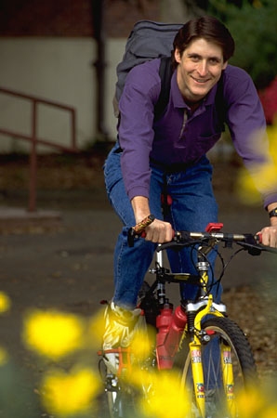

Suggestions for Reducing Stress
9. Get a hobby, do something different. For a balanced lifestyle, play is as important as work.
Notes:
Leisure activities and hobbies can be very enjoyable and inspiring, and they can offer an added sense of accomplishment to our lives. For ideas on new hobbies, browse through a bookstore or a crafts store, surf the internet, look up local organizations, see what classes or courses are available in your community or from a nearby college or university. Don't quickly dismiss new opportunities.

Slide 25

Suggestions for Reducing Stress
10. Slow down. Know your limits and cut down on the number of things you try to do each day, particularly if you do not have enough time for them or for yourself.
Be realistic about what you can accomplish effectively each day.
Monitor your pace. Rushing through things can lead to mistakes or poor performance. Take the time you need to do a good job.

Slide 26
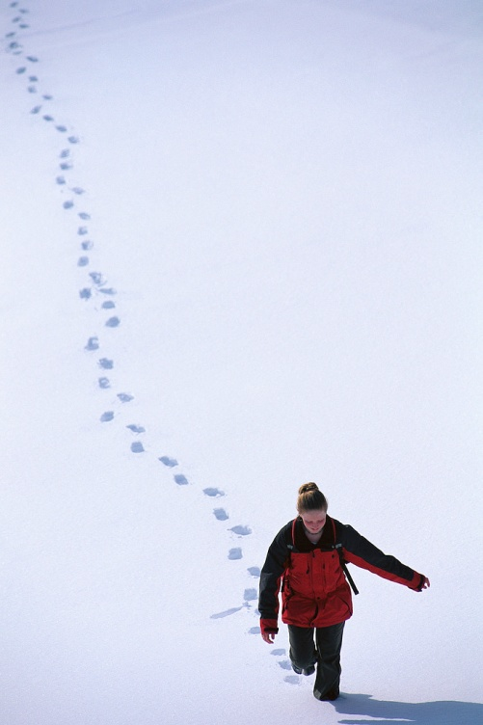
Suggestions for Reducing Stress
11. Learn to relax. Develop a regular relaxation routine.
Try yoga, meditation, or some simple quiet time.
Notes:
Relaxation techniques are skills that need to be developed with patience and practice so that we can use them effectively during difficult times of stress later on.

Slide 27
Test your stress level DASS-21
total | 3 | 2 | 1 | 0 | Item
 |  |  |  |  | I found it hard to wind down
 |  |  |  |  | I tended to over-react to situations
 |  |  |  |  | I felt that I was using a lot of nervous energy
 |  |  |  |  | I found myself getting agitated
 |  |  |  |  | I found it difficult to relax
 |  |  |  |  | I was intolerant of anything that kept me from getting on with what I was doing
 |  |  |  |  | I felt that I was rather touchy
Interpretation:
0-14: Normal
15-18: Mild Stress
19-25: Moderate
26-33: Severe
34+: Extremely severe

Slide 28
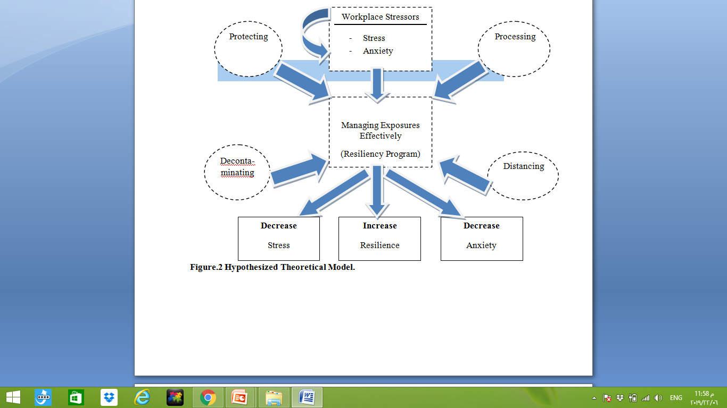
The new concept of resilience in facing workplace stress and stressors

Slide 29
* Resilience is about:
Protecting: building emotional and cognitive barrier against stressors and adversities.
processing: relief the impact of workplace stressors and adversities.
Decontaminating: removing the influence of workplace stressors.
Distancing: to be physically away from the stressors and adversities environment.

Slide 30
1) Protecting
A) Developing a shell: cognitive and
emotional shell.
B) Disengaging and depersonalizing.
C) Using Humuor.
D) Getting Help.

Slide 31
2- Processing
A- Rationalizing
B- Reflection
C- Taking About it
D- Avoiding Rumination
E- Debriefing

Slide 32
3-Decontaminating
A- Developing Relationships at work.
B- Fostering Relationships outside the work.
C- Engaging in meaningful activities.

Slide 33
4. Distancing:
A: Distancing from the bedside.
B: Distancing from the Unit.
C: Planning an Exit strategy.

Slide 34
Thank You

