Slide 1
8-Nursing Care of Patients with Anxiety Disorders, PTSD, and OCD
Al-Zaytoonah University
Psychiatric and Mental Health Nursing
( Theory )
By Dr: Hasan Abualruz RN, MSN, PhD

Slide 2
Outline
Introduction.
Anxiety symptoms vs disorders
Etiology.
Levels of Anxiety.
Types of anxiety Disorders.
Treatment of anxiety disorders
Nursing care plan for patients with anxiety disorders
Anxiety related disorders.

Slide 3
Learning Outcomes
Define anxiety disorders.
Identify anxiety levels.
Acknowledge the possible causes of anxiety.
Differentiate between anxiety disorders.
Discuss treatment modalities that are used. with patients with anxiety disorders.
Apply nursing care plan for patients with anxiety disorder.
Discuss PTSD and OCD as anxiety related disorders.

Slide 4
Introduction
Anxiety: is a vague feeling of dread or apprehension; it is a response to external or internal stimuli that can have behavioral, emotional, cognitive, and physical symptoms.
Anxiety is distinguished from fear, which is feeling afraid or threatened by a clearly identifiable external stimulus that represents danger to the person.
Anxiety is seen as a result of long exposure to stress.

Slide 5
Introducation
Does Anxiety have positive impacts??
Anxiety is unavoidable in life and can serve many positive functions such as motivating the person to take action to solve a problem or to resolve a crisis ( mild anxiety).

Slide 6
When does anxiety become a disorder?
Anxiety disorders are diagnosed when anxiety no longer functions as a signal of danger or a motivation for needed change but becomes chronic and permeates major portions of the person’s life, resulting in maladaptive behaviors and emotional disability.
Anxiety disorders: comprise a group of conditions that share a key feature of excessive anxiety with ensuing behavioral, emotional, cognitive, and physiological responses.
Patients with anxiety disorder experience significant distress over time, and the disorder significantly impairs their daily routines, social lives, and occupational functioning.
Clients suffering from anxiety disorders can demonstrate unusual behaviors such as panic without reason, unwarranted fear of objects or life conditions, or unexplainable or overwhelming worry.

Slide 7
Anxiety Disorder Prevalence
Anxiety disorders have the highest prevalence rates of all mental disorders for both children and adults.
Nearly one in four adults is affected.
Anxiety disorders are more prevalent in women, people younger than 45 years of age, people who are divorced or separated, and people of lower socioeconomic status.

Slide 8
Etiology/ causes
1) Biological
Genetic: Anxiety has inherited component.
Neurotransmitters: Gamma-aminobutyric acid (GABA) dysfunctional (decreased); Increased noradrenalin and serotonin.
2) psychodynamics: unconscious over use of defense mechanisms to deal with stress and stressors.
3) Interpersonal: problems in interpersonal relationships.
4) Behavioral: as being learned through experiences.

Slide 9
Levels of Anxiety
Anxiety has both healthy and harmful aspects, depending on its level and duration as well as on how well the person copes with it.
There are 4 common anxiety levels, in each level there are common physiological and psychological responses. The 4 anxiety levels are:
Mild
Moderate
Severe
Panic

Slide 10
1. Mild Anxiety
Associated with the tension of daily living and makes a person alert and increases the person's perceptual field. For example, it helps students focus on studying for an examination.
Physiological responses include: Restlessness, Difficulty sleeping, Hypersensitivity to noise.
Psychological responses include: Wide perceptual field, Sharpened senses, Increased motivation, Effective problem-solving, Increased learning ability, Irritability.
Anxious patient with mild anxiety doesn’t need specific nursing interventions.

Slide 11
2. Moderate Anxiety
* Patient focus on immediate concerns and Block out the periphery. It narrows the person‘s Perceptual filed.
* Psychological responses include: perceptual field narrowed to immediate task, Cannot connect thoughts or events independently, Increased use of automatisms.
* Physiological responses include: Muscle tension, Pounding pulse, Headache, Dry mouth, High voice pitch, Faster rate of speech, GI upset, Frequent urination.
* Patients with moderate anxiety may have some difficulties in concentrations, nurses need to use simple language and make sure that patients understand instructions.

Slide 12
3. Severe Anxiety
Greatly reduces a person's perceptual field. The person tends to focus on a specific detail and not think about anything else.
* Psychological responses include: Behavior geared toward anxiety relief and is usually ineffective.
Physiological responses include: Severe headache, Nausea, vomiting, and diarrhea, Trembling, Vertigo, Pale, Tachycardia, Chest pain.
Patients with severe anxiety can no more pay attention, nurses need to lower anxiety level. Stay with patient, walk with patient, talk in low voice pitch in calm place.

Slide 13
4. Panic Anxiety
Is associated with awe, dread, and terror.
* Psychological responses include: Doesn’t respond to redirection, Feels awe, dread, Loss of rational thought, Doesn’t recognize potential danger, Can’t communicate verbally Possible delusions and hallucination, May be suicidal.
Physiological responses include: May bolt and run or totally immobile, and mute, Dilated pupils, Increased blood pressure and pulse, Flight, fight, or freeze.
The primary concern for nurses is the safety, nurses shall take patients to a quit, non stimulating environment. Attack might stay from 15-30 minutes.

Slide 14
Types of Anxiety Disorders
Anxiety disorders are diagnosed when anxiety no longer functions as a signal of danger or a motivation for needed change but becomes chronic and permeates major portions of the person’s life, resulting in maladaptive behaviors and emotional disability.
Types of Anxiety Disorders:
Panic Disorder.
Phobia ( social phobia, agoraphobia, and Specific phobia).
General Anxiety Disorder ( GAD).
* Post traumatic stress disorder (PTSD), its no longer classified as anxiety disorder in DSMV.
* Obsessive compulsive disorder (OCD), it is no longer classified as anxiety disorder in DSMV.

Slide 15
1. Panic disorder
Panic disorder is composed of discrete episodes of panic attacks, that is, 15-30 minutes of rapid, intense, escalating anxiety in which the person experiences great emotional fear as well as physiological discomfort.
During a panic attack: the person develop four or more of the following symptoms: palpitations, sweating, tremors, shortness of breath, sense of suffocation, chest pain, nausea, abdominal distress, dizziness, paresthesias, chills, or hot flashes.
Panic disorder is diagnosed when the person has recurrent, unexpected panic attacks followed by at least 1 month of persistent concern or worry about future attacks or their meaning or a significant behavioral change related to them.

Slide 16
1. Panic disorder
Half of those with panic disorder have accompanying agoraphobia.
Agoraphobia: fear of the marketplace” or fear of being outside. person becomes homebound or stays in a limited area near home.
Agoraphobia can also occur alone without panic attacks ( Specific Phobia).

Slide 17
2. phobia
phobia: is an illogical, intense, and persistent fear of a specific object or a social situation that causes extreme distress and interferes with normal functioning.
The diagnosis of a phobic disorder is made only when the phobic behavior significantly interferes with the person’s life by creating marked distress or difficulty in interpersonal or occupational functioning.
There are three categories of phobias:
A. Social phobia: is anxiety provoked by certain social or
performance situations.
B. Specific phobia: which is an irrational fear of a particular object or a situation.
C. Agoraphobia ( Discussed earlier)

Slide 18
A. Social phobia
Person becomes severely anxious to the point of panic or incapacitation when confronting situations involving people.
Examples: making a speech, attending a social engagement alone, interacting with the opposite sex, and making complaints. The fear is rooted in low self-esteem and concern about others’ judgments.

Slide 19
B. Specific Phobia
Specific phobia: is an irrational fear of a particular object or a situation.
Types of specific phobia:
- Natural environmental phobias: fear of storms, water, heights, or other natural phenomena.
Blood–injection phobias: fear of seeing one’s own or others’ blood.
Situational phobias: fear of being in a specific situation such as on a bridge or in a tunnel, elevator, small room, hospital, or airplane.
Animal phobia: fear of animals or insects.
Other types of specific phobias: for example, fear of getting lost.

Slide 20
Unofficial types of specific phobia
( are not included in DSM-V)
Acrophobia: fear of heights
Aerophobia: fear of flying
Arachnophobia: fear of spiders
Astraphobia: fear of thunder and lightning
Autophobia: fear of being alone
Claustrophobia: fear of closed spaces
Hydrophobia: fear of water
Ophidiophobia: fear of snakes

Slide 21
C. Agoraphobia
It might be associated with panic attack, or without panic attack.

Slide 22
3.General Anxiety Disorder (GAD)
A person with GAD worries excessively and feels highly anxious at least 50% of the time for 6 months or more.
Has three or more of the following symptoms: uneasiness, irritability, muscle tension, fatigue, difficulty thinking, and sleep alterations.

Slide 23
Treatment of Anxiety Disorders
Combination of medications and psychotherapy are used to treat anxiety disorders.
1) Psychopharmacology (Anxiolytics- anti anxiety)
2) Psychotherapy includes: Cognitive behavioral therapy (CBT) including assertive therapy, flooding, relaxation technique…

Slide 24
Psychiatric medications
* The main classification of psychiatric drugs include:
1. Antipsychotic drugs.
2. Antidepressants drugs.
3. Mood stabilizer
4. Anti-Anxiety/Anxiolytic.

Slide 25
1) Anxiolytic drugs:
Benzodiazepines: ( diazepam, alprazolam, lorazepma, colnazepam).
Non-benzodiazepines: (Buspirone, meprobamate).
* Mainly used to treat anxiety, it might be used in combination with anti-depressant for better effect.

Slide 26
Mechanism of Action
GABA receptor channels selectively admit the neurons. Benzodiazepines produce their effects by binding to a specific site on the GABA receptor.
Buspirone is believed to exert its anxiolytic effect by acting as a partial agonist at serotonin receptors, which decreases serotonin turnover.

Slide 27
Common indications
Anxiety
MDD
Bipolar
OCD
Schizophrenia
Sleepwalking disorder
Restless leg syndrome
Muscle spasm
Seizure
Insomnia
Alcohol withddrawl

Slide 28
Side effects
* Side effects of benzodiazepines are primarily related to the general sedative effects including drowsiness, fatigue, dizziness and psychomotor impairment.

Slide 29
Administration
All anti anxiety medications may be taken orally.
Antacids interfere with the absorption of these medications and should not be taken until several hours later.
Some medications may be administered IM or IV.
Benzodiazepines should not be discontinued abruptly because of the risk of withdrawal symptoms. They should be gradually reduced very carefully.

Slide 30
Treatment of Anxiety Disorders
2) Psychotherapy :
* Includes: Cognitive behavioral therapy (CBT) including assertive therapy, flooding, relaxation technique…

Slide 31
Nursing care plan for patients with anxiety disorders
Assessment:
History
General appearance: anxious or not??
Mood and affect: anxious, worried, tens??
Thought process and content: organized?
Intellectual process: confused, oriented??
Judgment and insight: good or bad ??
Self concept??
Roles and relationship??
Self-care??

Slide 32
Nursing care plan for patients with anxiety disorders
2. Diagnosis: according to symptoms, assessment, anxiety level, and anxiety type. Consider priority ( Safety).
Risk for injury
• Anxiety
• Situational low self-esteem (panic attacks)
• Ineffective coping
• Powerlessness
• Ineffective role performance
• Disturbed sleep pattern

Slide 33
Nursing care plan for patients with anxiety disorders
3- plan of care and interventions.
A: Promoting Safety and Comfort : stay with pt, quiet environment…)
B: Using Therapeutic Communication: simple and calm communication..
C: Managing anxiety: relaxation, deep breath, CBT…..
D: patient and family education: about disease, symptoms, management, relapse prevention….
4- Evaluation:
Ongoing assessment provides data to determine whether the client’s outcomes were achieved.

Slide 34
Anxiety related disorders
1. Obsessive Compulsive Disorder (OCD)
2. Post Traumatic Stress Disorder (PTSD)

Slide 35
1. Obsessive Compulsive Disorder (OCD)
Obsessions: are recurrent, persistent, intrusive, and unwanted thoughts, images, or impulses that cause marked anxiety.
* Compulsions: are ritualistic or repetitive behaviors
or mental acts that a person carries out continuously
in an attempt to neutralize anxiety.
Example: repetitive hand wash, prayer…
* OCD interfere with interpersonal, social, or occupational function.

Slide 36

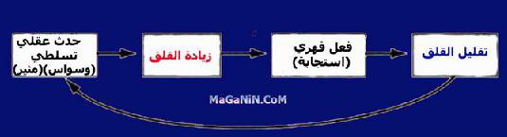

Slide 37
OCD Treatment
1. medications:
Antidepressant
Anti psychotic
2. Behavioral therapy.

Slide 38
OCD Nursing Interventions
• Offer encouragement, support, and compassion.
• Be clear with the client that you believe he or she can change.
• Encourage the client to talk about feelings and obsessions.
• Gradually decrease time for the client to carry out ritualistic behaviors.
• Assist the client in using exposure and response techniques.
• Encourage the client to use techniques to manage anxiety responses.
• Assist the client in completing daily routine and activities.
Encourage the client to develop and follow a written schedule with
specified times and activities.

Slide 39
2. Post Traumatic Stress Disorder (PTSD)
PTSD: is a disturbing pattern of behavior demonstrated by someone who has experienced, witnessed, or been confronted with a traumatic event.
The person persistently re-experiences the trauma through Memories, dreams, flashbacks, or reactions to external cues about the event.
The victim feels a numbing of general responsiveness and shows persistent signs of increased arousal such as insomnia, hyperarousal or hypervigilance, irritability, or angry outbursts.
See life events that cause PTSD in next slide.

Slide 40
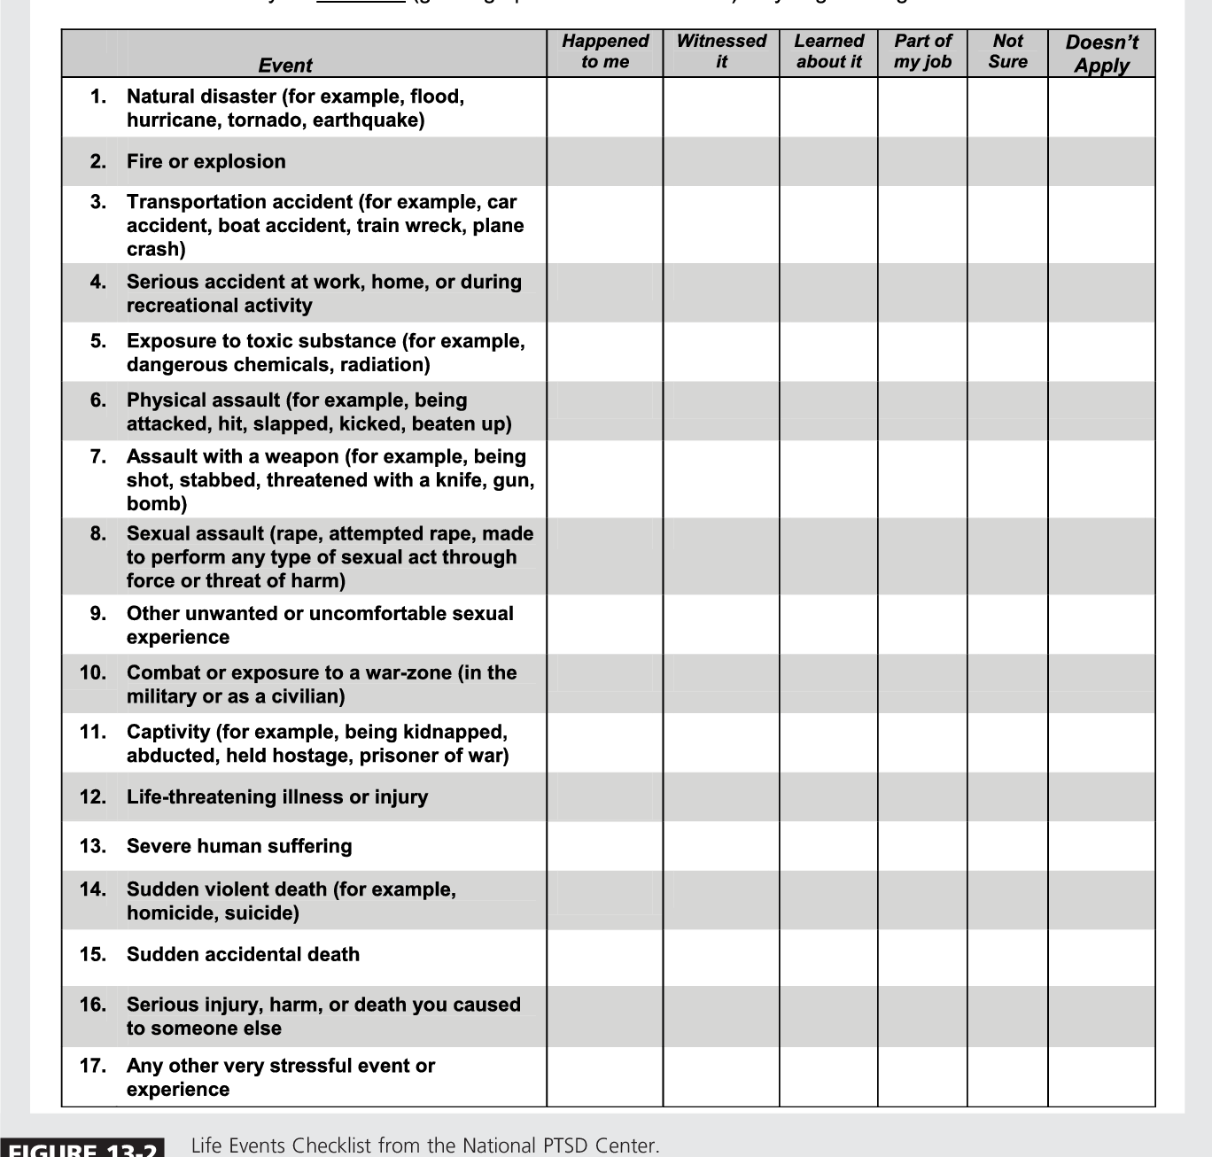

Slide 41
2. Post Traumatic Stress Disorder (PTSD)
Symptoms occur 3 months or more after the trauma, symptoms lasts 3 days up to 1 month. The onset can be delayed for months or even years.

Slide 42
PTSD Treatment
Combination of medications and psychotherapy is required to treat patients with PTSD.

Slide 43
Nursing Interventions
Promote desensitization through gradual exposure to event or situation similar to the event.
Teach relaxation techniques.
Provide individual therapy to address loss of control issues.
Encourage use of support groups.

Slide 44
Thank You

