Slide 1











“Nutrition in Health and Illness” Second Semester 2022-2023 Unit Two
Carbohydrates
Dr. Malakeh 1

Slide 2


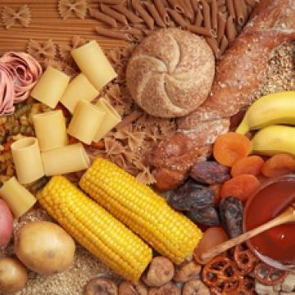
Sugar and starch come to mind when people hear the word “carbs,” but carbohydrates are so much more than just table sugar and bread.
Carbohydrates are the major components of most plants.

Slide 3
Foods containing carbohydrates can be empty calories, nutritional powerhouses, or something in between. Globally, carbohydrates provide the majority of calories in almost all human diets.

Slide 4




Nutrition of Carbohydrates
*Provide 4 calories per gram
*Main source of body’s energy. Carbohydrate
may provide 60-65% of total calories.
*Body uses carbs before calories from protein
and fat.
*Carbohydrate also provide fiber.

Slide 5

Carbohydrate Classifications
Carbohydrates (CHO) are comprised of the elements carbon, hydrogen, and oxygen arranged into basic sugar molecules.
They are classified as either:
Simple sugars or
Complex carbohydrates.

Slide 6
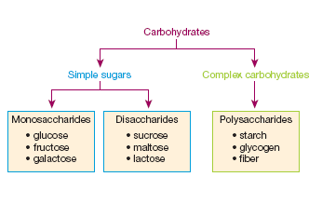

Slide 7
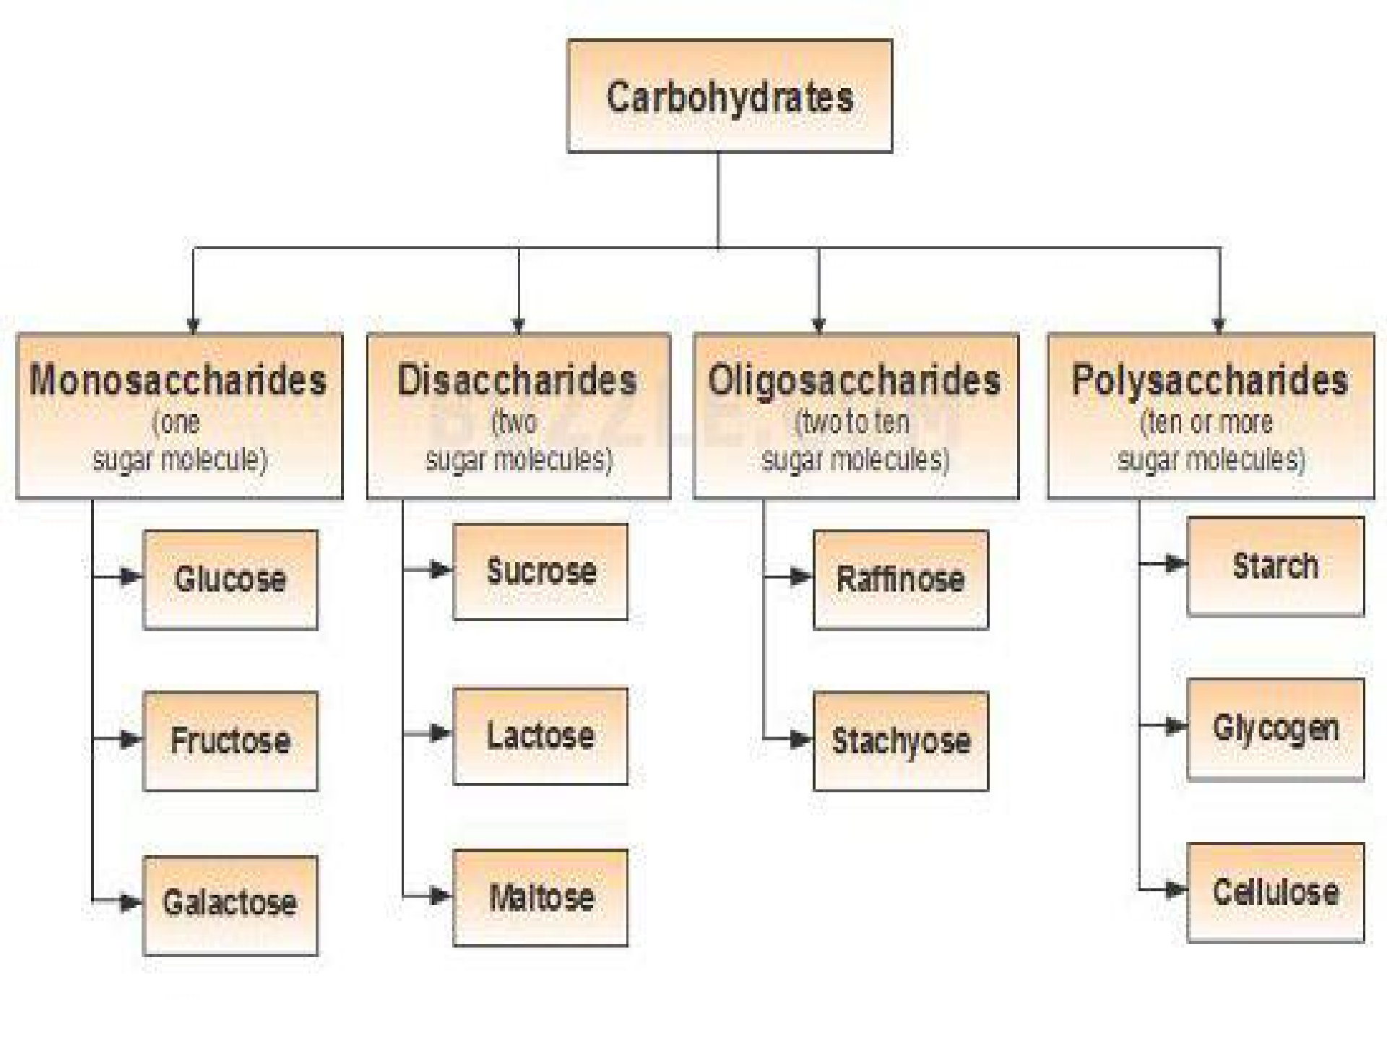

Slide 8


1) Simple Sugars
A classification includes monosaccharides and disaccharides.
Commonly referred to as sugars.
Names of sugars usually end in –ose.

Slide 9

Monosaccharides
Are the simplest of all sugars. Composed of single or one (mono) molecules of sugar (saccharide).
Examples, glucose, fructose, and galactose.
As basic units, these sugar molecules are absorbed “as is” without undergoing digestion.
Monosaccharide's are the building blocks of complex carbs.

Slide 10


Monosaccharides
Glucose (also called dextrose)
Body’s main source of energy
Body converts other sugars into glucose for use by the body
Found in fruits, vegetables, honey, corn syrup, cornstarch

Slide 11




Monosaccharides
Fructose (Fruit Sugar) Sweetest natural sugar Found in honey and fruit
Galactose
Not found alone in nature
Linked to glucose to make lactose (milk sugar)

Slide 12

Disaccharides
“Double sugar” composed of two (di) monosaccharides.
They are split into their component monosaccharides before being absorbed.
Examples, sucrose, maltose, lactose.

Slide 13



Disaccharides
Sucrose (Table sugar)
Cane sugar (sucrose is refined & granulated). Combination of glucose and fructose.
Occur naturally in some fruits and vegetables. Sweeter than glucose but not as fructose.

Slide 14



Disaccharides
Maltose
Does not occur in nature.
Combination of two joined glucose molecules.
Lactose (Milk Sugar)
Natural only in milk
Combination of glucose and galactose
It enhances the absorption of calcium and promotes the growth of friendly intestinal bacteria that produce vitamin K.

Slide 15
2) Complex Carbohydrates
Polysaccharides : are composed of hundreds to thousands of glucose molecules linked together.
Starch, glycogen, and fiber are types of polysaccharides.
Do not taste sweet.

Slide 16

Starch
Made up of many glucoses linked together
Found only in plant foods
Found in grains
Wheat, corn, rice, rye, barley, and oats
Thickens liquids when heated (gelatinization)

Slide 17

Glycogen
Animal (including human) version of starch.
A stored carbohydrate available for energy as needed.
Humans have a limited supply of glycogen stored in
the liver and muscles.
Liver glycogen breaks down and releases glucose into the blood stream between meals to maintain normal blood glucose and provide fuel for tissue.
Muscles use it for their own energy needs.
No dietary source of glycogen.

Slide 18

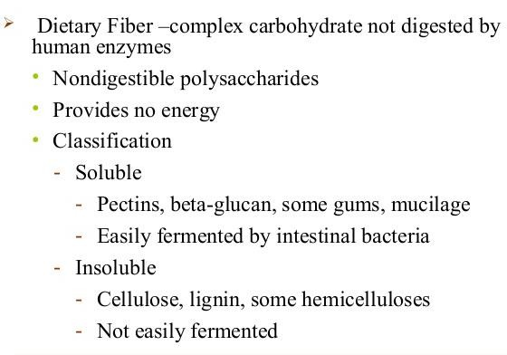
Fiber

Slide 19
Found in dried beans, peas, lentils,
Also found in the peelings of fruits and vegetables.
Found in whole grains.

Slide 20
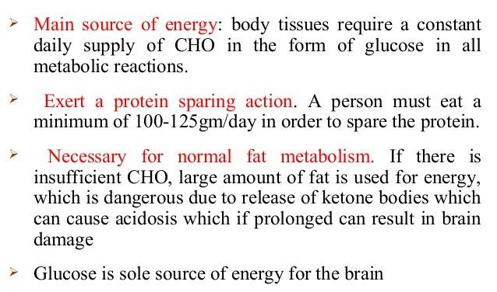
Functions of Carbohydrate
(Preventing Ketosis)
Dr. Malakeh 20

Slide 21
Functions of Carbohydrate
Pentoses are constituents of several compounds e.g., nucleic acids.
Synthesis of non-essential amino acids.
Energy supply for muscle. The muscle glycogen is broken down to lactic acid to provide energy for muscle contraction.
Lactose remains in the intestine longer than other
disaccharides and thus encourages the growth of beneficial bacteria. These bacteria help in synthesis of certain vitamins.

Slide 22
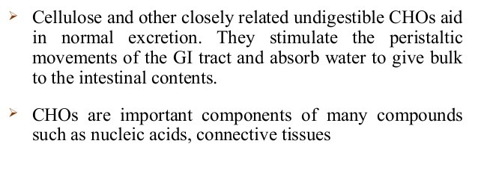
Functions of Carbohydrate

Slide 23

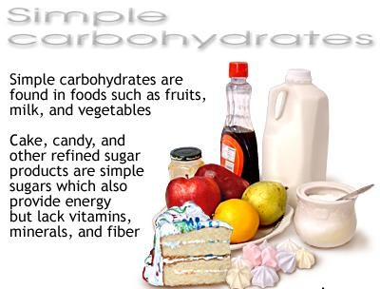
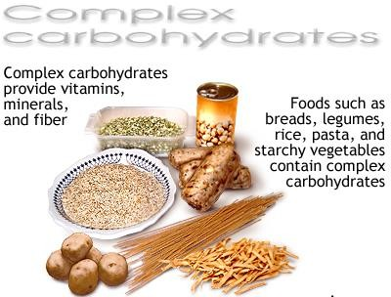
Sources of Carbohydrate
Natural sugars in fruit and milk; starch in grains, vegetables, legumes, and nuts; and added sugars in foods with empty calories.

Slide 24

Carbohydrate Metabolism
Carbohydrates are more easily and quickly digested than protein and fat.
Ninety percent of carbohydrate intake is digested. This percentage decreases as fiber intake increases.

Slide 25


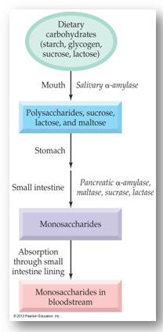
Digestion of Carbohydrates
Carbohydrate (CHO) digestion begins in the mouth where salivary α- amylase breaks down polysaccharides into smaller polysaccharides and disaccharides.
Limited CHO digestion occurs in the stomach as α-amylase is inactivated
by stomach acid.

Slide 26


1) Digestion of Carbohydrates
Continues in the small intestine where pancreatic α-amylase together with maltase, sucrase and lactase released from the mucous lining hydrolyzes polysaccharides into monosaccharides (mainly glucose, fructose and galactose), which enter the bloodstream and transport to the cells.

Slide 27
Carbohydrate Metabolism
The liver stores glucose and regulates its entry into the blood. Hormones, especially insulin and glucagon, are responsible for keeping serum glucose levels fairly constant during both feasting and fasting.

Slide 28
Carbohydrate Metabolism
Through a glucose to water.
series of provide
steps, cells oxidize (burn)
energy, carbon dioxide, and
Depending on a person's state of energy balance, the period between when carbohydrate is consumed and when it is used for energy may vary from minutes to months or longer.
Glucose is converted to glycogen and stored (glycogenesis).

Slide 29


The Recommended Dietary Allowance (RDA)
RDA is 130 grams each day for children and adults. The median carbohydrate intake among adult men is 200-330 g/day and among women, 180 to 230g/day.
Use sugars in moderation.
Women need at least 38 grams of carbohydrates from fiber a day.
Men need at least 25 grams of carbohydrates from fiber a day.

Slide 30









Carbohydrates in Health Promotion
Getting Enough fiber
Reduce sugar
Preventing dental caries

Slide 31
Fiber Health Benefits
Soluble fibers
Slow gastric emptying and may delay the absorption of some nutrients
Helps reduce serum cholesterol
Improve appetite control
Normalize blood glucose
- May help protect against colon cancer
Insoluble fibers
o Relieves constipation
- Most plant foods contain both soluble and insoluble
31

Slide 32
Dietary Fiber
Benefits
Helps lower the risk of:
Bowel irregularity
Obesity
Heart disease
Cancer
Diabetes mellitus
Adverse effects
Too much fiber depresses the iron, Ca P, Mg utilization and increases intestinal flatulence

Slide 33

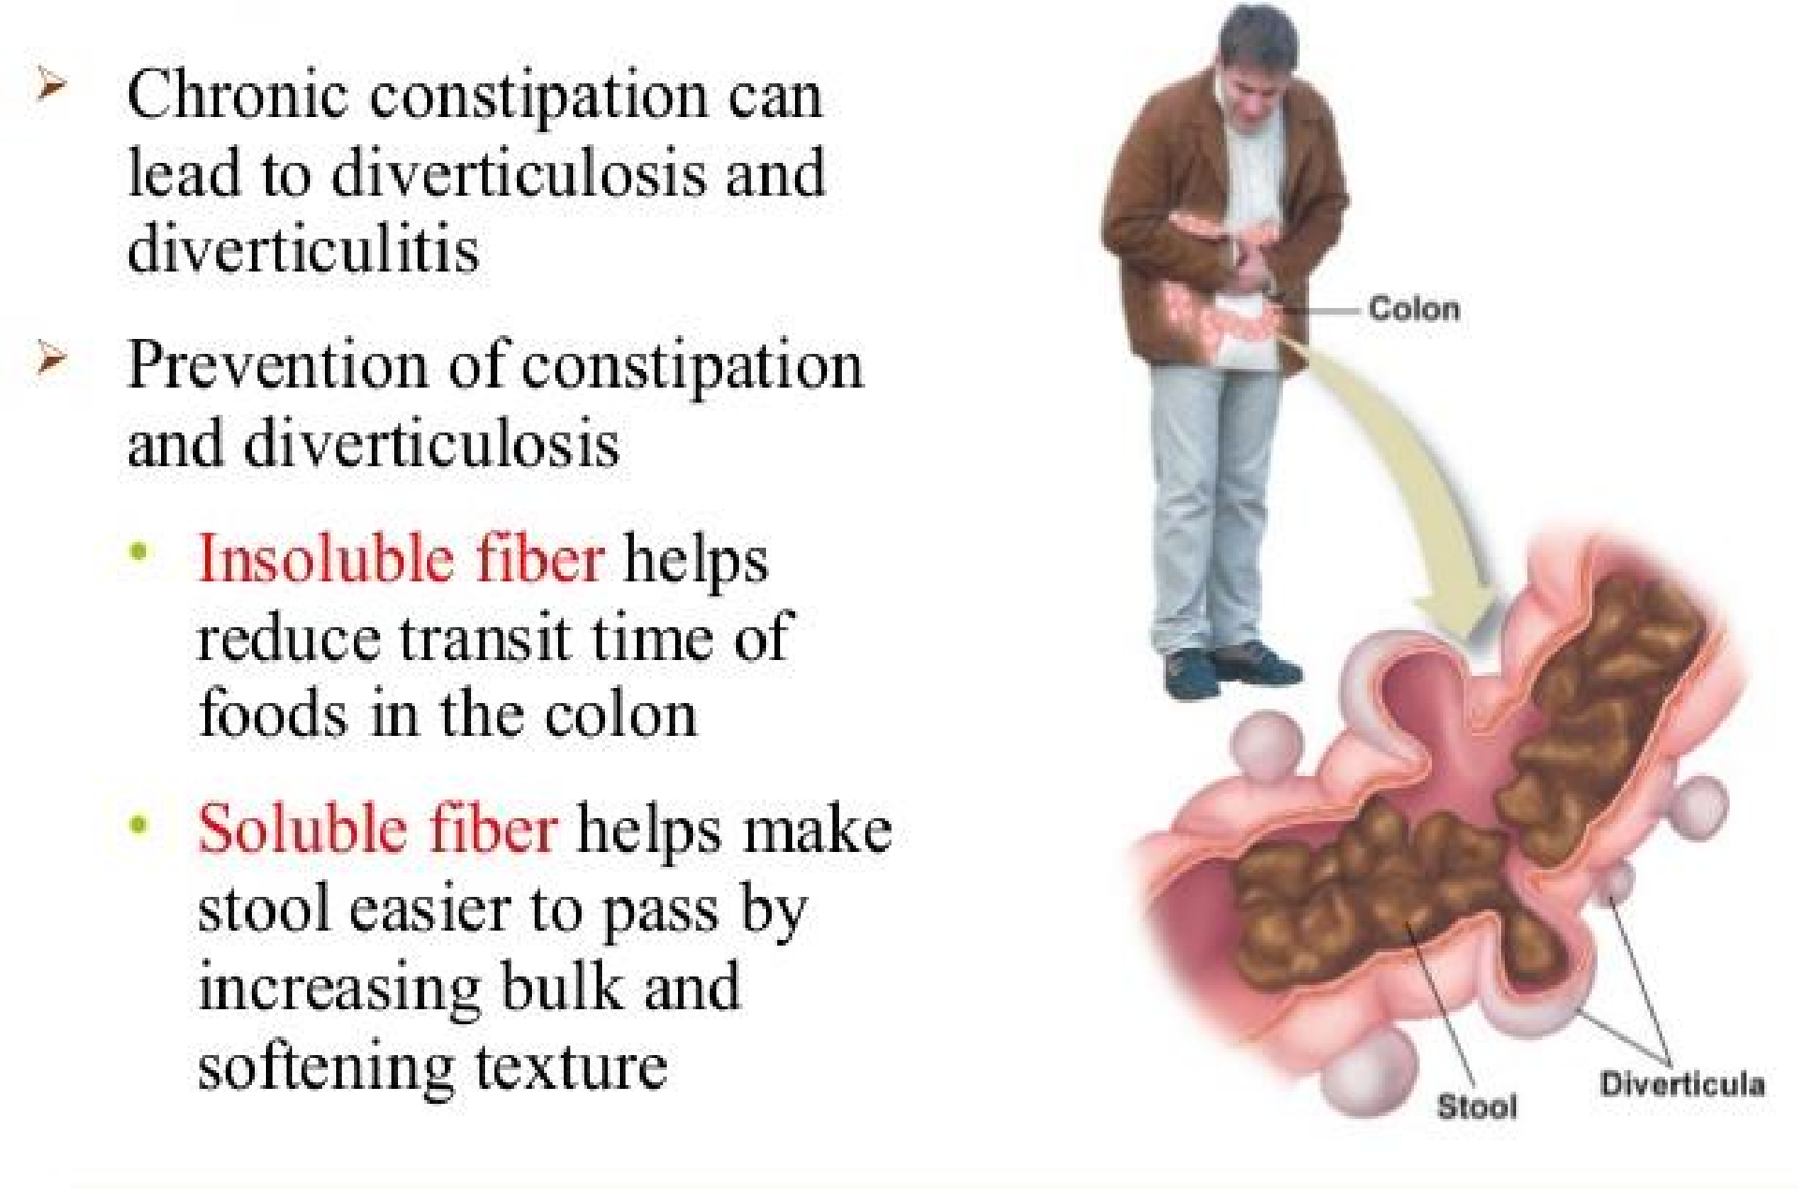

Slide 34
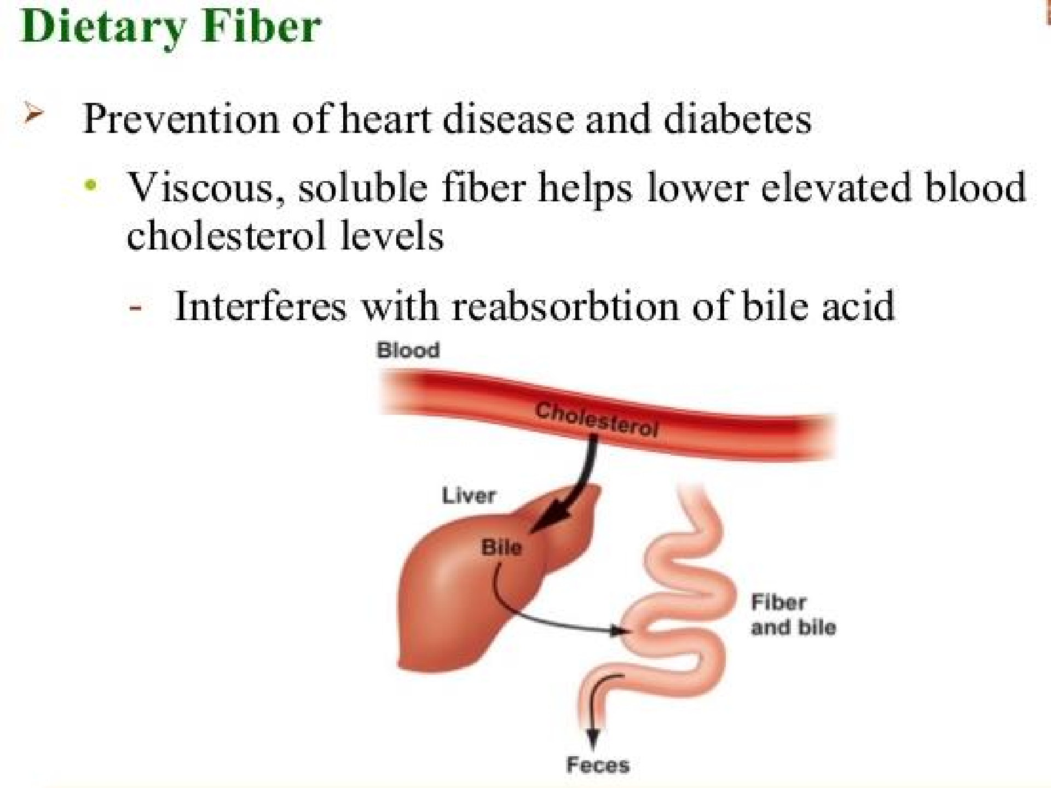

Slide 35

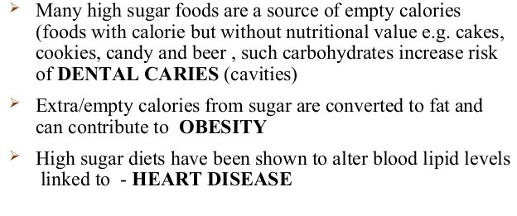

Slide 36
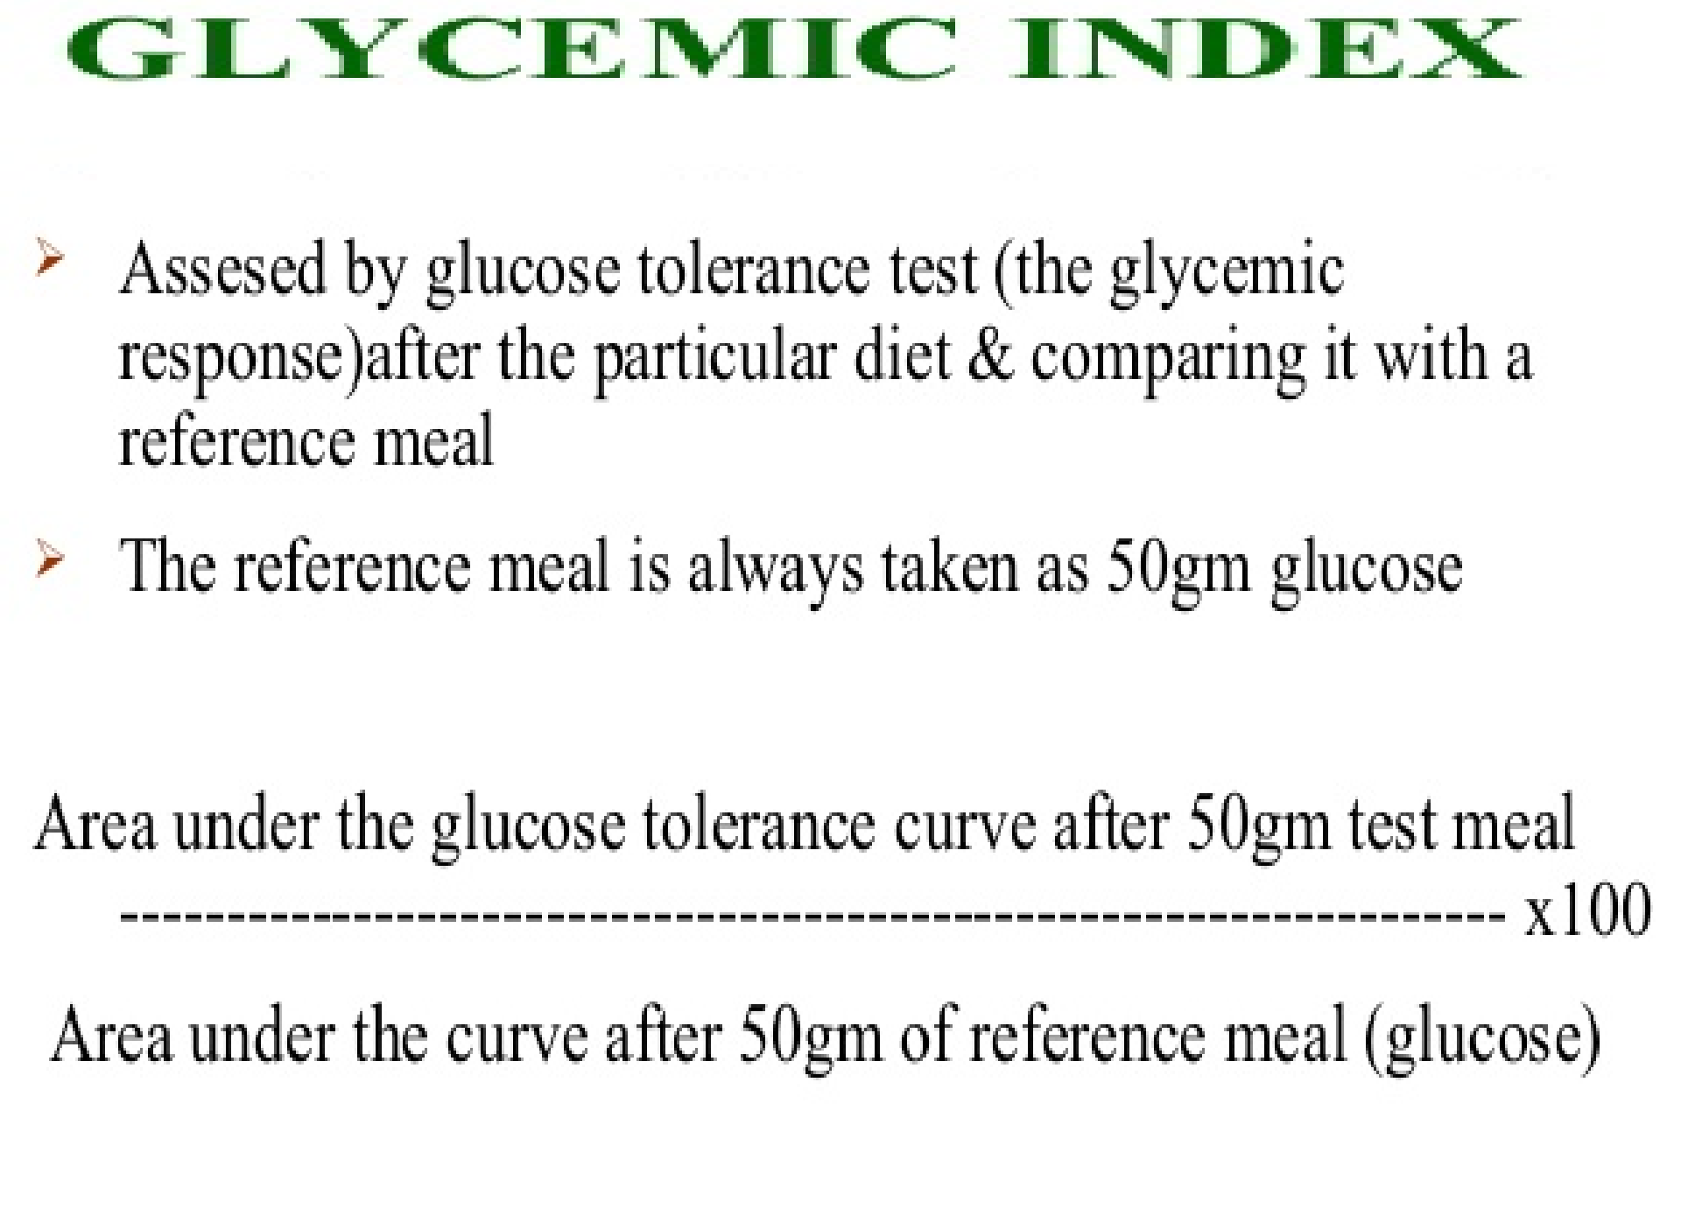

Slide 37

