Slide 1
Protein

Slide 2
Protein #1
A component of every living cell
Accounts for 20% of adult weight
Immune to the controversy over optimal intake

Slide 3
Protein #2
Amino acids
  Basic building blocks of protein
  Composed of carbon, hydrogen, oxygen, and nitrogen atoms
  Twenty common amino acids
    Nine are considered essential because the body cannot make them—indispensable; they must be consumed through food.
    Eleven are considered nonessential because they can be made by the body—dispensable.

Slide 4
Protein #3
Essential Amino Acids
Histidine
Isoleucine
Leucine
Lysine
See Box 4.1.
Methionine
Phenylalanine
Threonine
Tryptophan
Valine

Slide 5
Protein #4
Nonessential Amino Acids
Alanine
Arginine
Asparagine
Aspartic acid
Cystine (cysteine)
Glutamic acid
Glutamine
Glycine
Proline
Serine
Tyrosine

Slide 6
Protein #5
Protein structure
  Most contain several dozen to several hundred amino acids.
  Shape determines function.
  It is designed to end with a peptide bond.

Slide 7
Protein #6
Functions of protein
  Major structural and functional component of every living cell
  Body structure and framework
  Enzymes
  Other body secretions and fluids
  Acid–base balance
  Transport molecules

Slide 8
Protein #7
Functions of protein—(cont.)
  Other compounds
  Some amino acids have specific functions within the body
  Fueling the body
  See Box 4.2

Slide 9
Question #1
Amino acids, the building blocks of protein, are classed as either essential or nonessential. Which of these is an essential amino acid?
Glycine
Aspartic acid
Tyrosine
Leucine

Slide 10
Answer to Question #1
d. Leucine
Rationale: There are 20 common amino acids, 9 of which are classified as essential or indispensable because the body cannot make them. They must be supplied through the diet. These essential amino acids include histidine, leucine, phenylalanine, and tryptophan.

Slide 11
Protein #8
How the body handles protein
  Digestion
    It begins in the stomach.
    Hydrochloric acid converts pepsinogen to the active enzyme pepsin.
    Small intestine is the principal site of protein digestion.
    Enzymes located on the surface of the cells that line the small intestine complete the digestion.

Slide 12
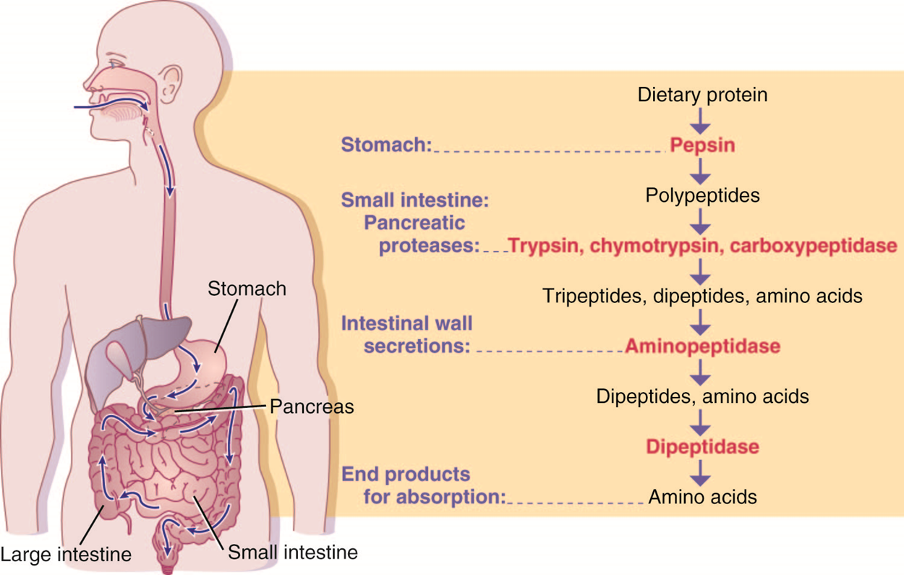
Protein #9

Slide 13
Protein #10
How the body handles protein—(cont.)
  Absorption
    Amino acids, and sometimes a few dipeptides or larger peptides, are absorbed through the mucosa of the small intestine.
  Metabolism
    Liver acts as a clearinghouse.
      Retains amino acids to make liver cells, nonessential amino acids, and plasma proteins such as heparin, prothrombin, and albumin
      Regulates the release of amino acids into the bloodstream

Slide 14
Protein #11
How the body handles protein—(cont.)
  Metabolism—(cont.)
    Liver acts as a clearinghouse.—(cont.)
      Removes the nitrogen from amino acids
      Converts protein to fatty acids which form triglycerides for storage in adipose tissue
      Forms urea from the nitrogenous wastes of protein

Slide 15
Protein #12
Protein synthesis (anabolism)
  Complicated but efficient process that quickly assembles amino acids into proteins the body needs
  Part of what makes every individual unique is the minute differences in body proteins
  Important concepts
    Protein turnover, metabolic pool, and nitrogen balance

Slide 16
Protein #13
Important Concepts
Protein turnover
Metabolic pool
Contains supply of each amino acid
Consists of recycled amino acids from body proteins that have broken down and also amino acids from food
In a constant state of flux
Continuous process
Body proteins vary in their rate of turnover

Slide 17
Protein #14
Important Concepts cont.
Nitrogen balance
  Reflects the state of balance between protein breakdown and protein synthesis
  Determined by comparing the amount of nitrogen consumed (intake) with the amount of nitrogen excreted (output)
  Healthy adults are in neutral nitrogen balance

Slide 18
Protein #15
Nitrogen balance—(cont.)
  Positive nitrogen balance: when protein synthesis exceeds protein breakdown
  Negative nitrogen balance: an undesirable state that occurs when protein breakdown exceeds protein synthesis

Slide 19
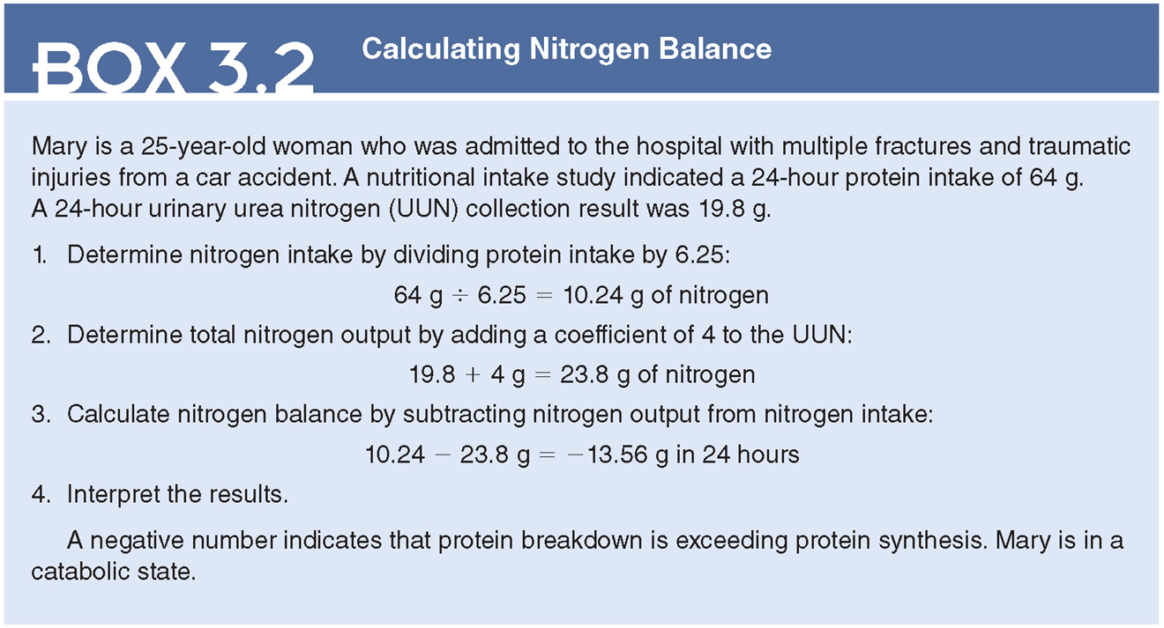
Protein #16

Slide 20
Protein #17
Protein catabolism for energy
  If insufficient carbohydrate and fat are available, dietary and body proteins are sacrificed to provide amino acids that can be burned for energy.
  Over time, loss of lean body tissue occurs.
  Loss of 30% of body protein causes
    impaired breathing
    altered immune function
    altered organ function
    ultimately death

Slide 21
Question #2
Is the following statement true or false?
Healthy adults are in a positive state of nitrogen balance.

Slide 22
Answer to Question #2
False
Rationale: A neutral nitrogen balance, or state of equilibrium, exists when nitrogen intake equals nitrogen excretion, indicating protein synthesis is occurring at the same rate as protein breakdown. Healthy adults are in neutral nitrogen balance.

Slide 23
Sources of Protein #1
Protein quality
  It differs based on content of essential amino acids.
  Terms that refer to protein quality are complete and incomplete.
  See Table 4.3.

Slide 24
Sources of Protein #2
Complete and incomplete proteins
  Complete proteins
    High biologic value
    Provide adequate amounts and proportions of all essential amino acids needed for protein synthesis necessary to support tissue growth and repair
    Animal proteins and soy protein are complete proteins

Slide 25
Sources of Protein #3
Complete and incomplete proteins—(cont.)
  Incomplete proteins
    They lack adequate amounts of one or more essential amino acids.
    All plants are sources of incomplete proteins.
    Gelatin is also an incomplete protein.
  Complementary proteins
    Two proteins that when combined provide adequate amounts and proportions of all essential amino acids needed to support protein synthesis.
    See Box 4.4.

Slide 26
Dietary Reference Intakes #1
Recommended Dietary Allowance (RDA)
For healthy adults is 0.8 g/kg
  Acceptable macronutrient distribution range for protein for adults is 10% to 35% of total calories.
When the RDA does not apply
  Intended for healthy people only
    See Table 4.2.
    See Box 4.5.

Slide 27
Dietary Reference Intakes #2
Protein deficiency
  Protein–energy malnutrition (PEM) or protein–energy undernutrition (PEU)
    It is a calorie deficit due to a deficiency of all macronutrients-carbohydrates, protein, and fat.
    Accompanying deficiencies of micronutrients are common.
    It can occur from simply poor intake or secondary to conditions or drugs that alter nutrient intake, absorption, utilization, or requirements.

Slide 28
Dietary Reference Intakes #3
Protein deficiency—(cont.)
  Common forms of PEM in children
    Kwashiorkor
      resulting from a deficiency of protein or infections
    Marasmus
      resulting from severe deficiency or impaired absorption of calories, protein, vitamins, and minerals

Slide 29
Dietary Reference Intakes #4
Signs and Symptoms of PEM
  Affects all body organs and many body systems
  Apathy and irritability are common
  Work capacity is impaired
  Temporary lactose deficiency
  Diarrhea
  Muscle and fat wasting
  Increases the risk of infection
  Wound healing is impaired
  Hip fractures and pressure ulcers in the older client

Slide 30
Dietary Reference Intakes #5
With acute or chronic severe PEM
  Cardiac output decreases, blood pressure falls, and respiratory rate decreases
  Hypothermia
  Anemia
  Edema
  Jaundice and petechiae
  Liver, kidney, or heart failure

Slide 31
Dietary Reference Intakes #6
Treatment
  Treatment is determined by the severity of PEM.
    Mild or moderate PEM can be treated with a balanced diet, preferably oral.
      Liquid supplements are useful if solid food intake is inadequate.
      Lactose is restricted if diarrhea persists.
      Multivitamin supplements are given.

Slide 32
Dietary Reference Intakes #7
Treatment
  In severe PEM or chronic starvation.
  Correcting fluid and electrolyte imbalances.
  Infections are treated.
  In children with diarrhea, feeding may be delayed for 24 to 48 hours to avoid worsening diarrhea.
    It is usually not necessary to delay feeding in adults.
  Oral or enteral feedings.
  Intake progresses as tolerated.
  Multivitamin supplements.

Slide 33
Dietary Reference Intakes #8
Protein excess
  No proven risks from eating an excess of protein
  Conflicting data as to whether high-protein diets increase the risk of
    osteoporosis
    renal stones
    see Box 4.6

Slide 34
Question #3
Sometimes, the RDAs do not apply to a diet. Why is this true?
Not everyone conforms to what is considered “normal.”
When a body is in protein excess, the RDAs do not need to be adhered to.
The RDAs are intended for healthy people and also people at risk of chronic disease.
The RDAs were designed to help sick people get well.

Slide 35
Answer to Question #3
c. The RDAs are intended for healthy people and also people at risk of chronic disease.
Rationale: The RDAs are intended for healthy people and also people at risk of chronic disease.

Slide 36
Protein in Health Promotion #1
Dietary Guidelines for Americans urge people to consume a healthy eating pattern that includes a variety of protein foods in nutrient-dense forms.
  Meat and poultry should be consumed fresh, frozen, or canned forms instead of processed products, and that choices be lean or low fat.
  See Box 4.6.
The American College of Cardiology/American Heart Association recommendations for the primary prevention of cardiovascular disease suggests that adults consume lean vegetable or animal protein, fish, and minimize the intake of red and processed meats.

Slide 37
Protein in Health Promotion #2
The American Cancer Society recommends limiting processed meat and red meat.
The American Institute for Cancer Research advises consumers to limit consumption of red meats to moderate amounts and to eat little, if any, processed meat.

Slide 38
Protein in Health Promotion #3
Food Protein Group
  Protein foods refer to a set of foods that provide significant protein as well as fat and/or carbohydrates and micronutrients.
  Subgroups within the protein food group include meats, poultry, and eggs; seafood; nuts, seeds, and soy products; and beans, peas, and lentils.
    While Americans eat enough of the nutrient protein and come close to the target amounts for the protein food group, many people do not meet recommendations for specific protein subgroups.

Slide 39
Protein in Health Promotion #4
Food Protein Group—(cont.)
  Seafood
    Provides the omega-3 fatty acids
    Other nutrients including protein, selenium, iron, zinc, iodine, vitamin B₁₂, and vitamin D
    Healthy eating patterns that include a focus on fish are recommended to lower atherosclerotic cardiovascular disease
      recommend Americans consume at least eight ounces of seafood/week
        Recommended to limit exposure to methylmercury

Slide 40
Protein in Health Promotion #5
Vegetarianism
  Plant-based eating patterns that restrict animal foods (e.g., meat, poultry, seafood, dairy, eggs) and products made with them (See Box 4.7)
  Benefits come from
    eating less of certain substances
    eating more of others
    or a combination of the two
  Plant-based foods are also low in calorie density

Slide 41
Protein in Health Promotion #6
Vegetarianism—(cont.)
  Properly planned vegan, lacto-vegetarian, and lacto-ovo vegetarian eating patterns
    are healthful and are nutritionally adequate during all phases of the life cycle
      including pregnancy, lactation, infancy, childhood, and adolescence, older adulthood, and athletes
    Improve several modifiable risk factors for
      heart disease
        including abdominal obesity, blood pressure, serum lipids, and blood glucose as well as lowered C-reactive protein

Slide 42
Protein in Health Promotion #7
Vegetarianism—(cont.)
  Can provide health benefits in the prevention and treatment of certain health conditions
    ischemic heart disease, type 2 diabetes, and certain cancers.
  Compared to meat eaters, vegetarians eat less total fat, saturated fat, and cholesterol and more fiber.
  Reciprocal increases in the intake of healthy foods, such as legumes, vegetables, fruits, and grains, are also significant.

Slide 43
Protein in Health Promotion #8
Vegetarianism—(cont.)
  Eating patterns are not automatically healthier than nonvegetarian patterns.
  Poorly planned vegetarian eating patterns may lack certain essential nutrients.
  Fat and cholesterol intake can be excessive.
  See Box 4.8.

Slide 44
Protein in Health Promotion #9
Nutrients of concern
  Most vegetarian diets meet or exceed the RDA for protein and are nutritionally adequate across the life cycle.
  Iron, zinc, calcium, vitamin D, omega-3 fatty acid, and iodine are nutrients of concern.
  Vitamin B12 is of concern because it does not occur naturally in plants.
  See Table 4.5.

Slide 45
Protein in Health Promotion #10
Protein for muscle building
  Building muscle is not simply a matter of increasing protein intake.
  To increase muscle mass, both resistance training and an adequate overall intake are necessary.
  Recommendations for protein intake typically range from 1.2 to 2.0 g protein/kg/day.
    This amount of protein can generally be met through food alone, without the need for protein or amino acid supplements.

Slide 46
Protein in Health Promotion #11
Protein for muscle building—(cont.)
  An even distribution of protein intake after exercise and throughout the day may optimize muscle protein synthesis.
  Vitamin and mineral supplements are unnecessary for athletes who consume adequate calories from a variety of nutrient-dense foods.
  The use of sports supplements is a personal choice and is controversial.

