Slide 1















“Nutrition in Health and Illness”
Second Semester 2022-2023
7) Guidelines for Healthy Eating
Dr. Malakeh. Z. Malak
Presented by:
Dr. Majdi Alhadidi
1 Dr. Malakeh
4/7/2023

Slide 2


Introduction
A healthy diet provides enough of all essential nutrients to avoid deficiencies but not excessive amounts that may increase the risk of nutrient toxicities or chronic diseases.
It should include a wide variety of nutritious foods for sufficient intake of all nutrients, including vitamins and minerals.
Healthy eating and regular exercise are essential for reducing the risk of chronic disease
2

Slide 3
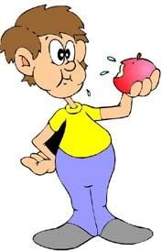
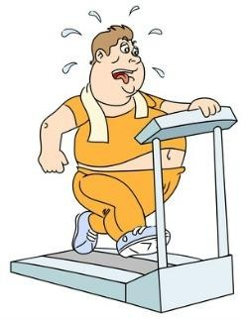
The importance of healthy food
4 of the 10 leading causes of death in the United States are associated with dietary excesses ( heart disease, cancer, stroke, and diabetes).
3

Slide 4
Adequate Diet Selection
An adequate diet provides a balanced intake of all essential nutrients in appropriate amounts. However, what constitutes an adequate diet is less obvious. Tools for planning or evaluating a diet for adequacy include:
Dietary Reference Intakes (DRIs).
Healthy People 2020.
Dietary Guidelines for Americans.
MyPlate.
Intake recommendations from leading health agencies.
4

Slide 5


1) Dietary Reference Intakes
A set of four nutrient-based reference values used to
plan and evaluate diets.
Includes four separate reference values:
Updated RDAs
Estimated Average Requirement (EAR)
Adequate Intake (AI)
Tolerable Upper Intake Level (UL)
5

Slide 6
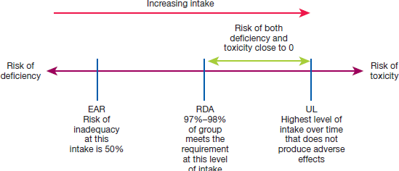
6 Dr. Malakeh
4/7/2023

Slide 7

Recommended Dietary Allowances (RDAs)
The average daily dietary intake level sufficient to meet the nutrient requirement of 97% to 98% of healthy individuals in a particular life stage and gender group.
Estimated Average Requirement (EAR)
Values are used to determine RDA values; they are not used as a stand-alone reference. The EAR is the amount of a nutrient that is estimated to meet the requirement of half of healthy people in a lifestyle or gender group.
7

Slide 8

Adequate Intake (AI)
Is set when an RDA cannot be determined due to lack of sufficient data on requirements.
Tolerable Upper Intake Level (UL)
The highest average daily intake level of a nutrient likely to pose no danger to most individuals in the group.
8

Slide 9

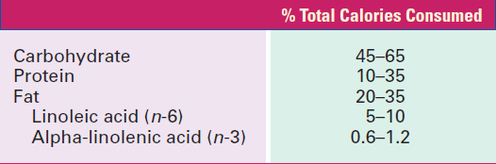
The Acceptable Macronutrient Distribution Ranges
The AMDRs for adults are as follows:
9

Slide 10
Healthy Eating Guidelines
Many government and health agencies issue healthy eating guidelines based on a food group approach to eating. i.e., Healthy People 2020
In practice, the most prominent tools to assist in making wise food choices are:
Dietary Guidelines for Americans and its companion tool.
MyPlate.
The American Heart Association.
10

Slide 11



2) Healthy People 2020
States that Americans who eat a healthful diet:
Eat a variety of nutrient-dense foods within and across food groups, especially whole grains, fruits, vegetables, low-fat or fat-free milk and milk products, and lean proteins.
Limit the intake of saturated fat, trans fat, cholesterol, added sugars, sodium, and alcohol.
Balance calorie intake with calorie needs.
11

Slide 12



3) Dietary Guidelines for Americans 2010
Comprise 23 key recommendations with 6 additional recommendations for specific population groups.
An underlying principle is that nutrient needs should be primarily met by eating food.
The major themes are to maintain calorie balance to achieve and maintain healthy weight and to focus on eating nutrient-dense food

Slide 13


Summary of Dietary Guidelines for Americans 2010
Balancing Calories to Manage Weight.
Foods and Food Components to Reduce: Salt
Foods and Nutrients to Increase. Whole grain, fruit &veg
Recommendations for Specific Population Groups:
Women Capable of Becoming Pregnant .
Women Who Are Pregnant or Breastfeeding .
Individuals Ages 50 Years and Older.
Building Healthy Eating Patterns

Slide 14
Guidelines for Physical Activity
Engage in regular physical activity and reduce sedentary activities to promote health, psychological well-being, and a healthy body weight.
Achieve physical fitness by including cardiovascular conditioning, stretching exercises for flexibility, and resistance exercises for muscle strength and endurance.

Slide 15






Food groups to encourage include:
Consume a sufficient amount of fruits and vegetables, milk and milk products, and whole grains, while staying within energy needs.
Choose a variety of fruits and vegetables each day from all vegetable subgroups.
Choose at least half the grain selections from whole grains.

Slide 16

Guidelines for fats include
Consume less than 10% of calories from saturated fatty acids and less than 300 mg/day of cholesterol, and keep trans fatty acid consumption as low as possible
Keep total fat intake between 20% and 35% of calories, with most fats coming from sources of polyunsaturated and monounsaturated fats, such as fish, nuts, and vegetable oils.
Choose lean, low-fat, or fat-free meats, poultry, dry beans, and milk or milk products.

Slide 17
Guidelines for Carbohydrates include
Choose fiber-rich fruits, vegetables, and whole grains often.
Choose and prepare foods with little added sugars or caloric sweeteners.

Slide 18
Guidelines for Fruits and Vegetables include
Consume sufficient amount of fruits and vegetables while staying within energy needs. Two cups of fruit and 2½ cups of vegetables per day are recommended for a reference 2000-calorie intake, with higher or lower amounts depending on the calorie level.
Choose a variety of fruits and vegetables each day. In particular, select from all five vegetable subgroups (dark green, orange, legumes, starchy vegetables, and other vegetables) several times a week.

Slide 19
Guidelines for Sodium and Potassium include
Consume less than 2300 mg (approximately 1 teaspoon of salt) of sodium per day.
Choose and prepare foods with little salt.
Consume potassium-rich foods, such as fruits and vegetables.

Slide 20


4) MyPlate
MyPlate: In early 2011, replaced MyPyramid as the new graphic by which the Dietary Guidelines for Americans are translated into food choices for healthy individuals older than 2 years.
As a total diet approach, it covers all aspects of the diet, from calories and fat to particular types of vegetable subgroups and whole grains.
20

Slide 21






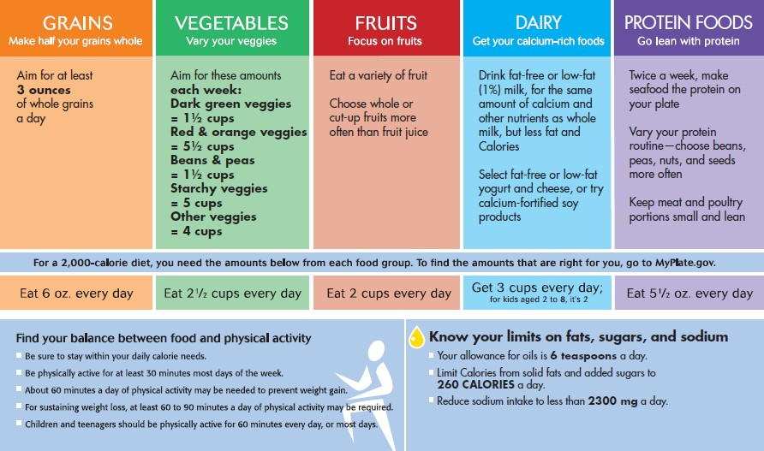
MyPlate’s 2000-Calorie daily food plan
21

Slide 22
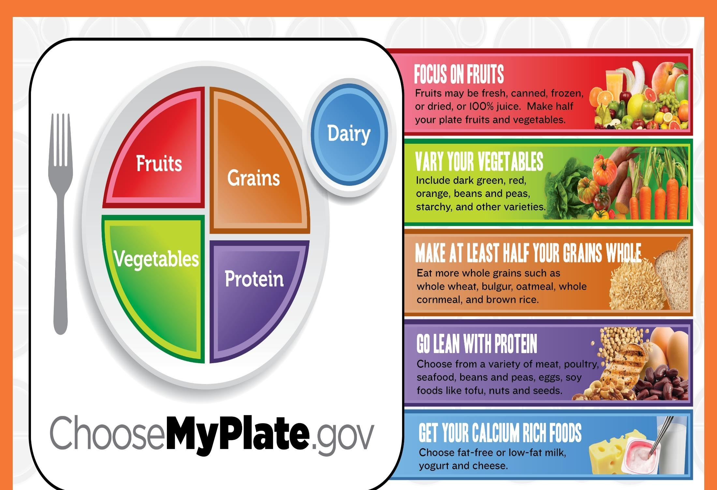
22

Slide 23



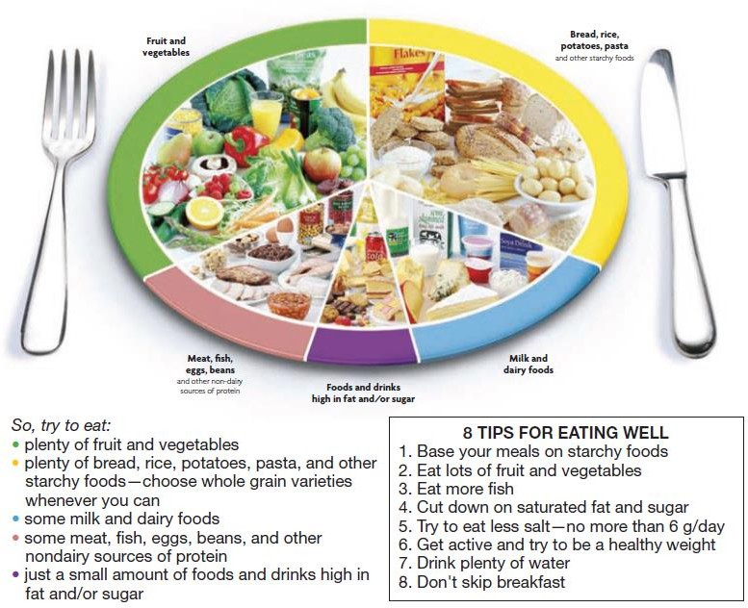
The eatwell Plate
23

Slide 24

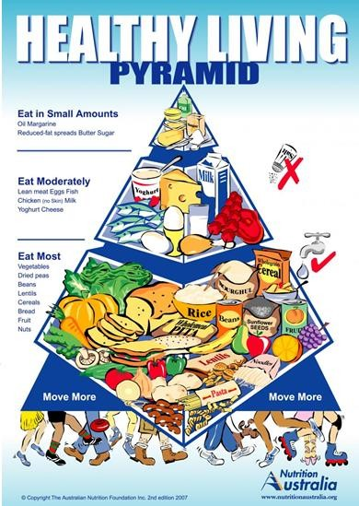
Food Pyramid
24

