Slide 1





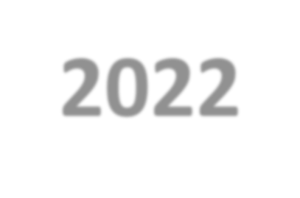




“Nutrition in Health and Illness” Second Semester 2022-2023
9) Energy Balance
Dr. Malakeh. Z. Malak
Presented by:
Dr.Majdi Alhadidi
Dr. Malakeh
1

Slide 2

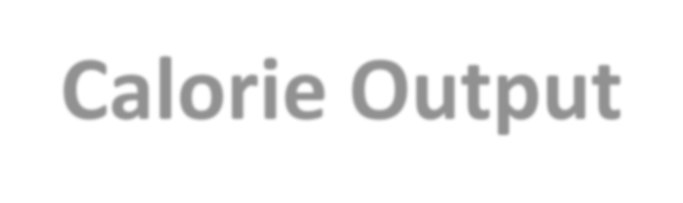
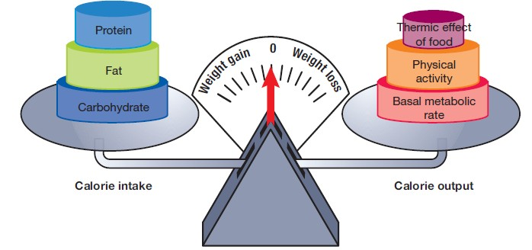
Energy Balance: Calorie Intake versus Calorie Output

Slide 3


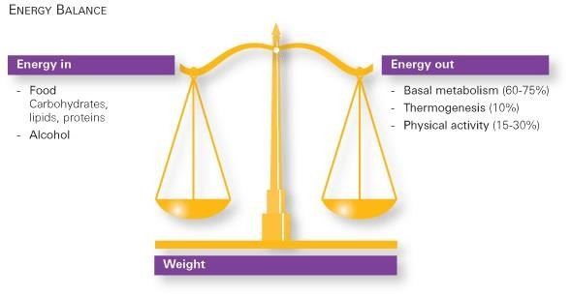
Energy Balance: Calorie Intake versus Calorie Output

Slide 4



Introduction
A calorie is the amount of energy required to raise the temperature of 1 kg of water by 1°C.
In nutrition, calories are the measure of the amount of energy in a food or used by the body to fuel activity.
Energy balance is a function of calorie intake versus calorie output.

Slide 5

ENERGY INTAKE
*Calories come from carbohydrates, protein, fat, and alcohol.
*The total number of calories in a food or diet can be estimated:
multiply total grams of these nutrients by the appropriate calories per gram.
Multiply the number of servings by the average amount of calories in a serving and then add the calories from each group to get an approximation of
D^{t}r^{h}. Mealak^{t}eºh
tal calories consumed.₅

Slide 6

ENERGY EXPENDITURE
*The body uses energy for involuntary activities and purposeful PA.
*The total of these expenditures represents the number of calories a person uses in a day.
*Include:
- Basal metabolic rate.
Physical activity.
Thermic effect of food.

Slide 7


1) Basal Metabolic Rate (BMR)
*Basal Metabolism: The amount of calories required to fuel the involuntary activities of the body at rest after a 12-hour fast.
*For most people, the BMR accounts for approximately 60% to 70% of total calories expended.
*Can be estimated by multiplying healthy weight (in pounds) by 10 for women, and 11 for men.

Slide 8
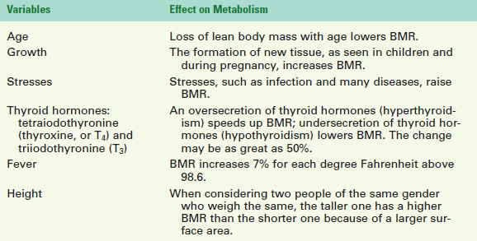
8

Slide 9


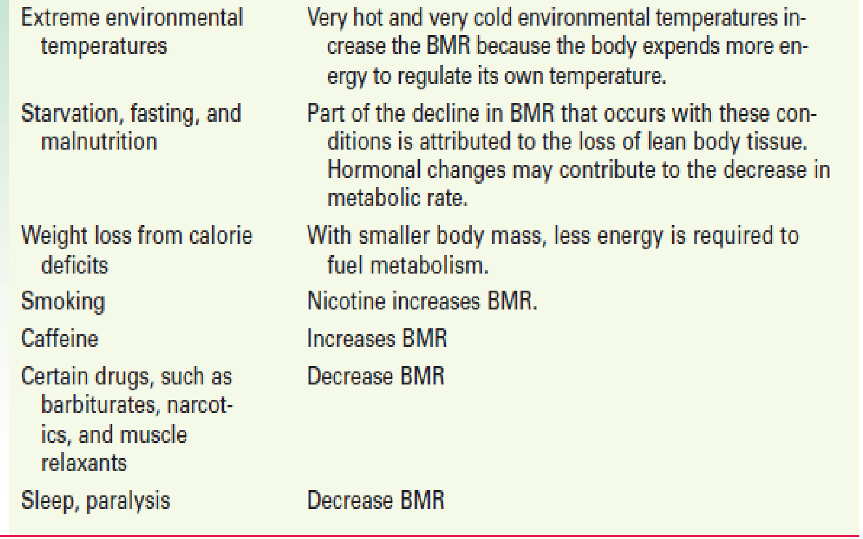

9

Slide 10


2) Physical Activity
*Physical Activity: voluntary muscular activity, accounts for approximately 30% of total calories used, although it may be as low as 20% in sedentary people and as high as 50% in people who are very active.
*The actual amount of energy expended on PA
depends on the intensity and duration of the activity and the weight of the person performing the activity.
10

Slide 11




3) Thermic Effect of Food
*Thermic Effect of Food: an estimation of the amount of energy required to digest, absorb, transport, metabolize, and store nutrients.
11

Slide 12

Estimating Total Energy Expenditure
*Total calorie needs can be imprecisely estimated by using predictive equations, of which more than 200 have been published. calorie needs; all yield estimates, not precise measurements.
Use a simple formula of calories per kilogram of body weight, such as 25 cal/kg to 30 cal/kg, which is often used for non obese adults.
Use a standard reference that lists estimated daily calorie needs based on gender, age, and activity.
12

Slide 13
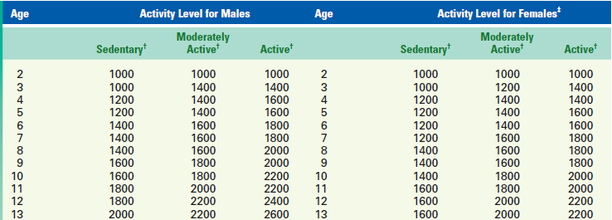
Dr. Malakeh
13

Slide 14

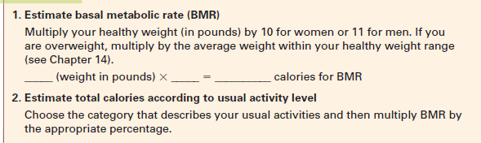
Estimating Total Energy Expenditure
Use the rules
14

Slide 15
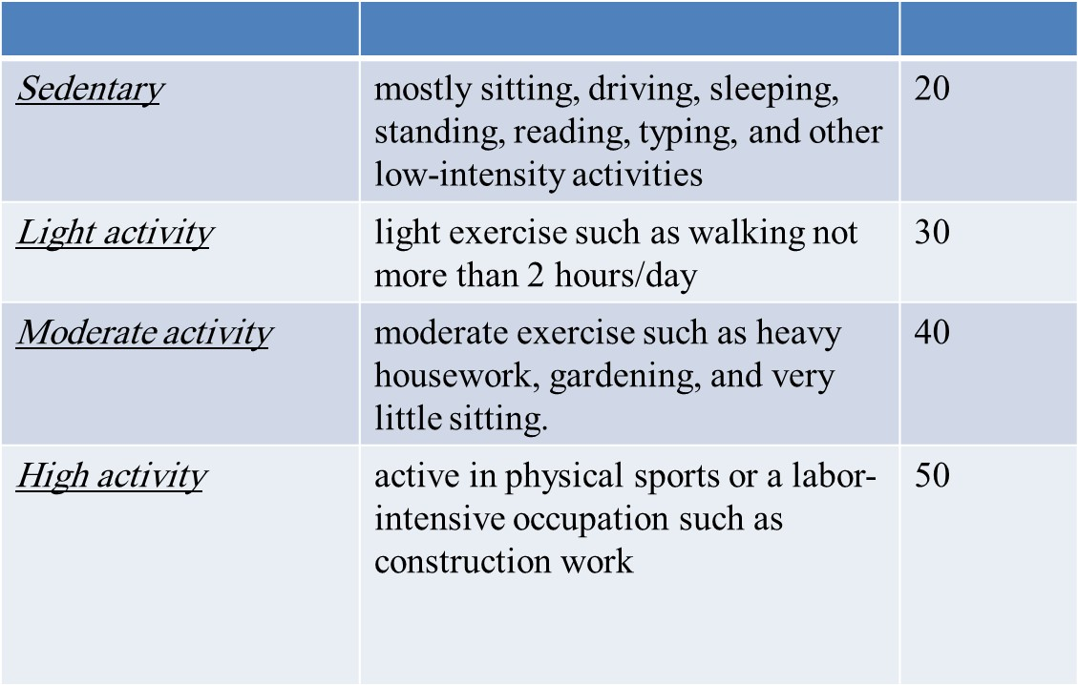
15

Slide 16
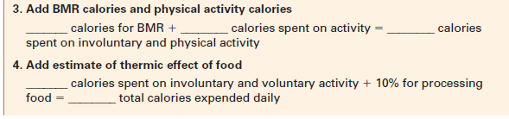
Estimating Total Energy Expenditure
Use the rules

Slide 17

Evaluating Weight Status
Ideal Body Weight
Body Mass Index
Waist Circumference

Slide 18
1)Ideal Body Weight
For women: 100 pounds for the first 5 feet of height+ 5 pounds for each additional inch of height.
For men:106 pounds for the first 5 feet of height+ 6 pounds for each additional inch of height.
2) Body Mass Index

Slide 19
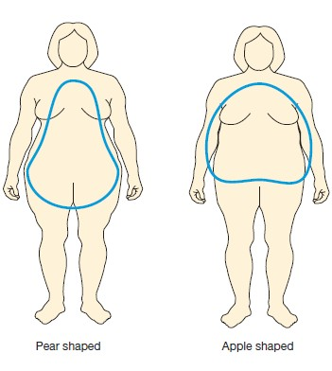
*(i.e., “apples”) have a greater relative health risk
3) Waist Circumference: Regardless of gender, people with a high distribution of abdominal fat
than people with excess fat in the hips and thighs (i.e., “pears”).
*The current waist circumference recognized as abdominal obesity in the United States is 40 inch or
more for men and 35 inch or more for women
19

Slide 20

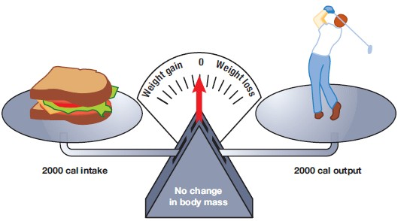
Energy Balance in Health Promotion
The state of energy balance is the relationship between the amount of calories consumed and the amount of calories expended.
20

Slide 21
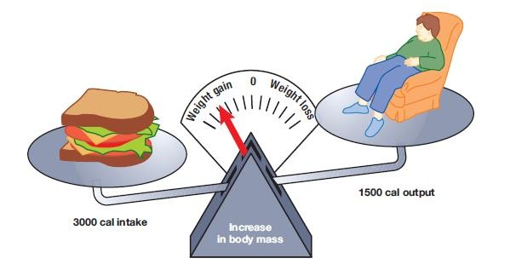
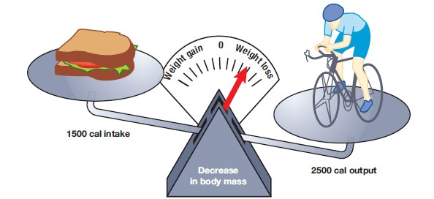
21

Slide 22

Food Choices
Choose Nutrient-Dense, Not Calorie-Dense Items
Eat Only to Relieve Hunger
Maintain a Consistent Eating Pattern.
Right Portion Sizes
22

Slide 23

Food Choices
Foods strongly associated with weight gain |  | Foods inversely associated with weight gain
Potato chips Potatoes Sugar-sweetened beverages Unprocessed red meats Processed meats lakeh 23 |  | Vegetables Whole grains Fruits Nuts Yogurt
Dr. Ma

Slide 24
Activity Choices: Move More, Sit Less
Physical Activity (PA) Guidelines
*Adults should do at least 150 mints (2 hrs & 30 mints) a week of moderate-intensity or 75 mints (1 hr & 15 mints) a week of vigorous-intensity aerobic PA.
*Adults
should increase their aerobic PA to 300
minutes (5 hrs) a week of moderate-intensity or 150 mints a week of vigorous-intensity aerobic PA.
* Adults should also do muscle-strengthening activities that are moderate or high intensity and involve all major muscle groups on 2 or more days a week.
Dr. Malakeh
24

Slide 25

Calories/Hour Expended in Common PA
Moderate Physical Activity | Approximate Calories/Hour for a 70 kg Person
Hiking | 370
Light gardening/yard work | 330
Dancing | 330
Golf (walking and carrying clubs) | 330
Bicycling (<10 mph) | 290
Walking (3.5 mph) | 280
Weight lifting (general light workout) | 220
Dr. Malakeh _{Stretching} 25 | 180

Slide 26

Calories/Hour Expended in Common PA
Vigorous Physical Activity | Approximate Calories/Hour for 70kg Person
Running/jogging (5 mph) | 590
Bicycling (>10 mph) | 590
Swimming (slow freestyle laps) | 510
Aerobics | 480
Walking (4.5 mph) | 460
Heavy yard work (chopping wood) | 440
Weight lifting (vigorous effort) | 440
Ba^{Dr}s. k^{Ma}e^{la}t^{k}b^{eh}all (vigorous) ²⁶ | 440

