Slide 1









“Nutrition in Health and Illness” Second Semester 2022-2023
Healthy Eating for Healthy Babies
Dr. Malakeh. Z. Malak
Presented by:
Dr. Majdi Alhadidi
Dr. Malakeh 1

Slide 2






Introduction
Maternal diet and nutritional status have a direct impact on the course of pregnancy and its outcome.

Slide 3





Pregnancy
Nutrition before Conception
Both mother and infant have the potential to benefit when optimal maternal nutrition is achieved prior to conception.
For the mother, optimum nutrition has the potential to provide short and long-term health benefits.
For the infant, optimal nutritional status can reduce the risk of birth defects and chronic disease later in life.
3

Slide 4





Pregnancy
Nutrition before Conception
Folate intake (Folic acid)and maternal nutrition are of particular concern.
Women who consume adequate amounts of folic acid before conception and during pregnancy reduce their risk of having a baby with neural tube defect, which develops 18-30 days after conception.
4

Slide 5





Pregnancy
Maternal Weight
Attaining a healthy weight prior to pregnancy makes conception easier, improves pregnancy outcomes, and may facilitate breastfeeding.
Underweight:
Women who are underweight before pregnancy tend to have smaller babies and lower birth weight babies.
Higher rates of preterm (< 38 weeks) infants and infant deaths.
5

Slide 6


Pregnancy
Maternal Weight
Overweight and Obesity during pregnancy is associated with higher morbidity in mother and infant.
Women who are obese at conception have a higher risk of hypertension, gestational diabetes, more difficult labor and delivery, induced labor, birth trauma, and cesarean section.
6

Slide 7





Pregnancy
Maternal Weight
Infants born to obese mothers are at increased risk of macrosomia (greater than 9 pounds at birth), tend to be born post-term>42 weeks, have low Apgar scores, shoulder dystocia, and childhood obesity.
Obesity during pregnancy is associated with an increased risk of neural tube defects and heart defects, also, difficulty initiating breastfeeding.
7

Slide 8



Physiologic Changes related to Pregnancy
  Altered Metabolism. BMR increases by the fourth month of gestation and rises to 15% to 20% above normal by term.
  Gastrointestinal Changes. Nausea and vomiting are common in the first trimester. Increases in appetite and thirst are also common.
  Blood Volume Changes. Total body water increases. Increase in blood volume exceeds the increase in red blood cell production, resulting in hemodilution or a physiologic anemia. Minor edema may be considered normal.
8

Slide 9


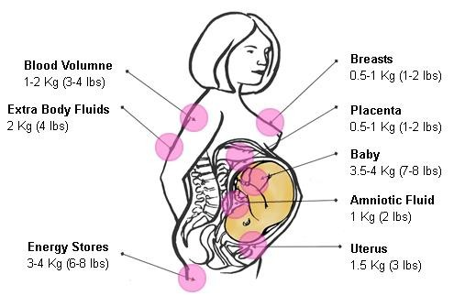
Physiologic Changes related to Pregnancy
  Weight Gain.
9

Slide 10

Physiologic Changes related to Pregnancy
Patterns of weight gain
  The amount of weight a woman gains during pregnancy is an important indicator of fetal growth.
  Obese women should gain at least 15 pounds during pregnancy.
  2-4 pound weight gain during the first trimester. Weight gain for normal-weight women is 1 pound/ week, overweight women should gain about 0.66 pounds/week and underweight women should gain more than 1 pound/week.
10

Slide 11



Maternal Weight
Weight gain during pregnancy
Recommended Weight gains
Underweight woman <18.5 BMI: 28-40 pounds
Healthy weight woman 18.5-24.9 BMI: 25-35 pounds.
Overweight woman 24.9-29.9 BMI: 15-25 pounds.
Obese woman > 30 BMI: 15-pound minimum.
A woman pregnant with twins: 35-45 pounds
Weight-Gain Patterns
3 1/2 pounds first semester
1 pound per week after
11

Slide 12




Nutrient Requirements during Pregnancy
  Calories. During the last two trimesters, normal- weight women need approximately 300 extra calories/day which is approximately 15% of a woman’s normal calorie requirement.
  The increased need for calories does not occur until the beginning of the second trimester.
  During lactation, 500 extra 1st 6 months and 400 extra 2nd 6 months. Calorie requirements are higher during lactation than during pregnancy. (second trimester + 340 calories, third trimester 450 calories).

Slide 13
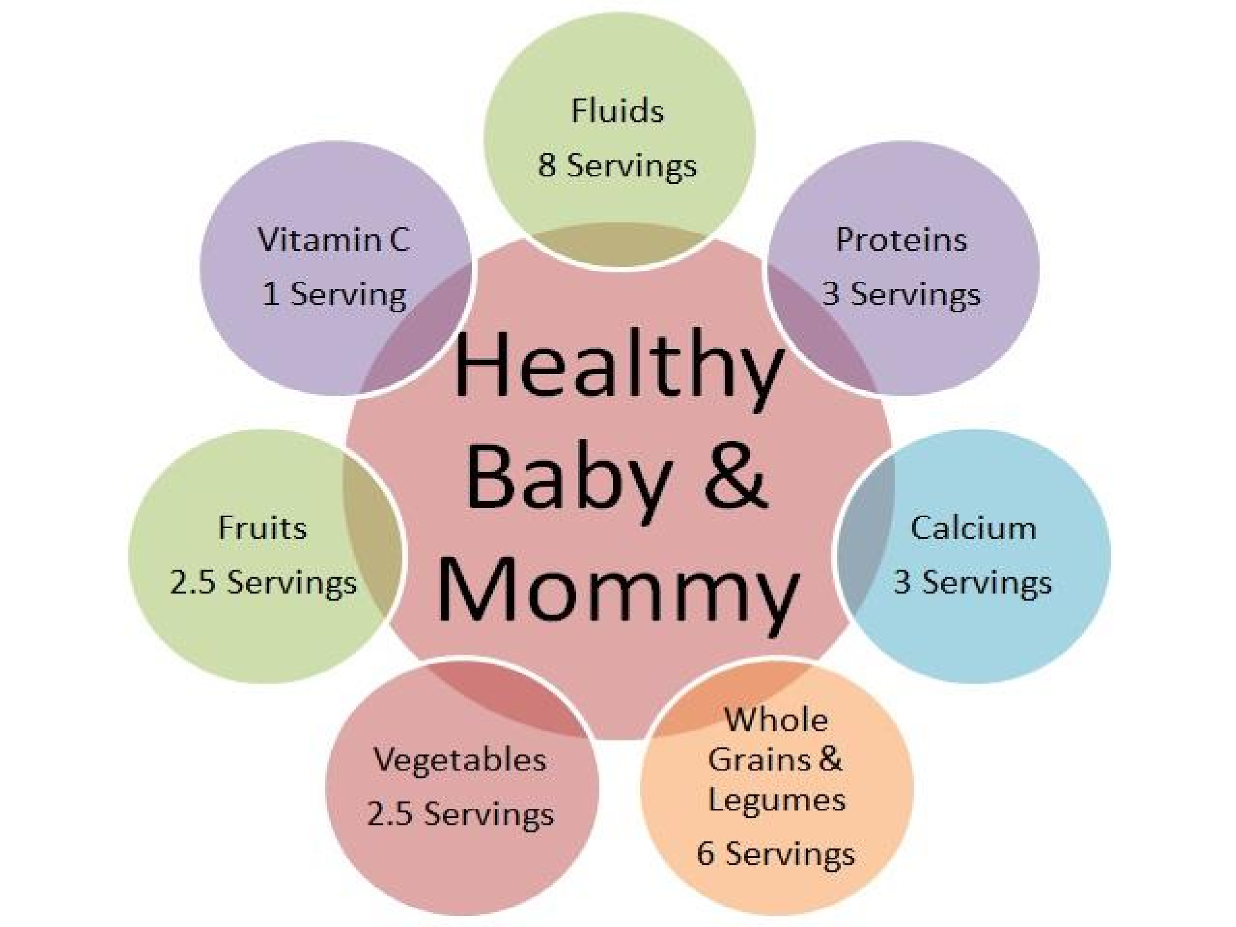

Slide 14



Nutrient Requirements during Pregnancy
  Protein. RDA during pregnancy is 1.1g/kg/day, or a daily increase of 25 g above normal. The nutritional needs for non pregnant woman (19-30 years old) is 46 g while 71 g during pregnancy. Use food, not supplements.
  B Vitamins. The requirement for folate increases 50% during pregnancy. The need for B 12 increases.

Slide 15

Nutrient Requirements during Pregnancy
Vitamin | Non pregnant woman | Pregnancy | Lactation
Vit B12 (microgram) | 1.3 | 1.9 | 2.0
Folate (microgram) | 400 | 600 | 500
Vit B6 (mg) | 1.3 | 1.9 | 2.0
Niacin (mg) | 14 | 18 | 17
Riboflavin (mg) | 1.1 | 1.4 | 1.6

Slide 16


Nutrient Requirements during Pregnancy
Vitamin | Non pregnant woman | Pregnancy | Lactation
Thiamin (mg) | 1.1 | 1.4 | 1.4
Vit C (mg) | 75 | 85 | 120
Vit A (microgram) | 700 | 770 | 1300
Vit D (microgram) | 5 | 5 | 5
Vit E (mg) | 15 | 15 | 19

Slide 17



Nutrient Requirements during Pregnancy
  Calcium. RDA during pregnancy or not and during lactation is 1000 mg (The RDA does not increase during pregnancy). 1300 mg/day for pregnant adolescents aged 14-18.
  Iron. The requirement for non-pregnant women is 18 mg, and 27 mg for pregnant women, and 9 mg during lactation.
  Fortified cereals are a significant source of folic acid.

Slide 18







Food Guidance during Pregnancy
Nutrient Density. Foods that are nutrient-dense (wholegrain breads and cereals; fresh fruits and vegetables; dried beans and peas, or fat or fat-free dairy products; lean meats; and nuts.
Meal Frequency. Avoid periods of hunger by eating three meals and two or three nutritious snacks each day.
Fluid Consumption. Pregnant women need 8 glasses of fluid daily, preferably in the form of water, fruit juice, or milk.
Salt Intake. A moderate intake of iodized salt is recommended.

Slide 19




Food Guidance during Pregnancy
Use of Caffeine. Moderate use of coffee and caffeine (<300 mg/day). Higher intakes should be avoided. Moderate to heavy use may cause spontaneous abortion.
Avoid Alcohol. Chronic alcohol consumption during pregnancy increase the risk of mental retardation, learning disabilities, and major birth defects.
Supplements. Use of vitamins and mineral supplements or herbal supplements during pregnancy
should be carefully considered.
19

Slide 20

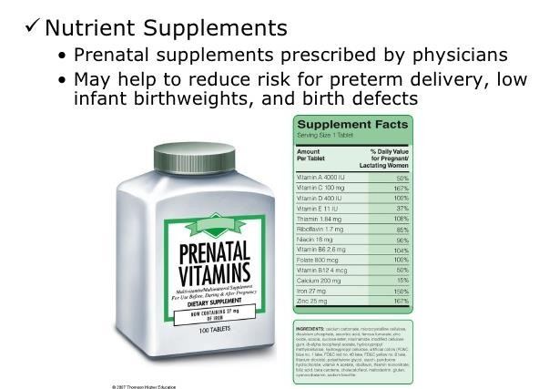
Dr. Malakeh
20

Slide 21


Food Guidance during Pregnancy
Use of artificial sweeteners. Woman should consider carefully the use of saccharin because it crosses the placenta and remains in fetal tissues owing to slow fetal clearance. Not more than 15 mg/kg body weight (the equivalent of 10 sweetener packets).
21

Slide 22

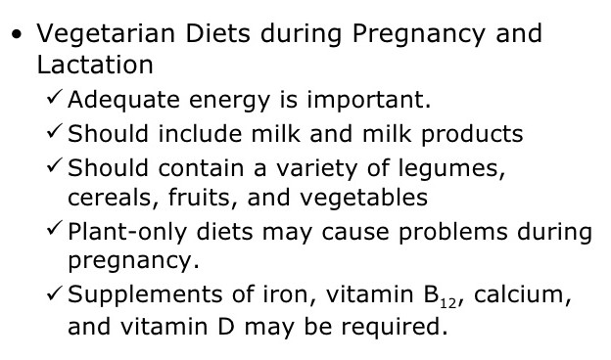
Dr. Malakeh
22

Slide 23






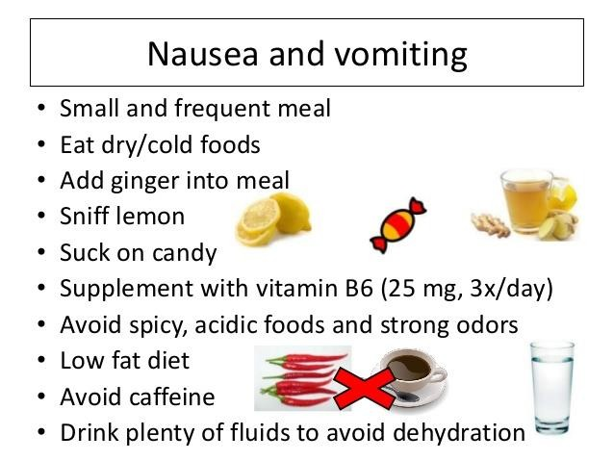
Common Nutrition-related Concerns of
Pregnancy
23

Slide 24



Constipation and Hemorrhoids
Alleviation strategies
High fiber foods
Exercise regularly
Eight glasses of fluids each day
Respond promptly to the urge to defecate
Use laxatives only when prescribed by physicians.
Dr. Malakeh
24

Slide 25



Heartburn
Alleviation strategies
Relax and eat slowly
Chew food thoroughly
Eat small, frequent meals
Drink liquids between meals
Avoid spicy or greasy foods.
Sit up while eating; elevate head while sleeping
Wait an hour after eating before lying down
Wait two hours after eating before exercising
Dr. Malakeh
25

Slide 26








Food Craving and aversions
  Common
  Don’t reflect real physiological needs.
  Hormone-induced changes in sensitivity to taste and smell.
Non- food Craving
Pica
Associated with iron deficiency
Pica is a psycho-behavioral disorder characterized by the ingestion of nonfood substances such as dirt, clay, starch, and ice.
Dr. Malakeh
26

