Slide 1











“Nutrition in Health and Illness” Second semester 2022-2023
Nutrition for Infants, Children, and Adolescents.
Dr. Malakeh. Z.Malak
Presented by:
Dr. Majdi Alhadidi
Dr. Malakeh 1

Slide 2

Introduction
An intake of adequate nutrition in children and adolescents period promotes optimal physical, social, and cognitive growth and development.
Malnutrition in children and adolescents increases the risk of impaired health, such as iron deficiency anemia and growth retardation.
2

Slide 3
Introduction
Over-nutrition in children and adolescents increases the risk of obesity which lead to chronic diseases.
An overweight child aged 2-4 years old has a fivefold higher risk of being overweight at age 12 years.
3

Slide 4



Infancy (Birth to 1 Year)
Growth in the first year of life is faster than at any other time in the life cycle.
Birth weight doubles by 4 to 6 months of age and triples by the first birthday.
Length increases by approximately 10 in. during the first year.
4

Slide 5



Infancy (Birth to 1 Year)
The iron stores present at birth start to become depleted between 3 and 4 months of age. The immune system matures between 4 and 6 months of age.
Infants use large amounts of energy and nutrients to fuel their body processes and growth.
5

Slide 6
Infancy (Birth to 1 Year)
Nutritional needs per unit of body weight are greater than at any other time in the life cycle.
Breastfeeding is recommended as the major source of nutrition for the first 6 to 12 months of life.
If the infant is not breastfed, the infant should receive
one of the commercially prepared iron-fortified infant formulas.
Cow's milk is not recommended for infants under the age of 1 year.

Slide 7


Breast Milk
Breast milk is best nutrition for the newborn
Breast milk benefits for the infant (3 months or more): lower risks of otitis media, upper respiratory tract infection, lower respiratory tract infection, asthma, atopic dermatitis, gastroenteritis, obesity, celiac disease, type 1 and type 2 diabetes, certain types of leukemia, and sudden infant death syndrome.
Breastfeeding should continue for at least the first 12 months of age.

Slide 8
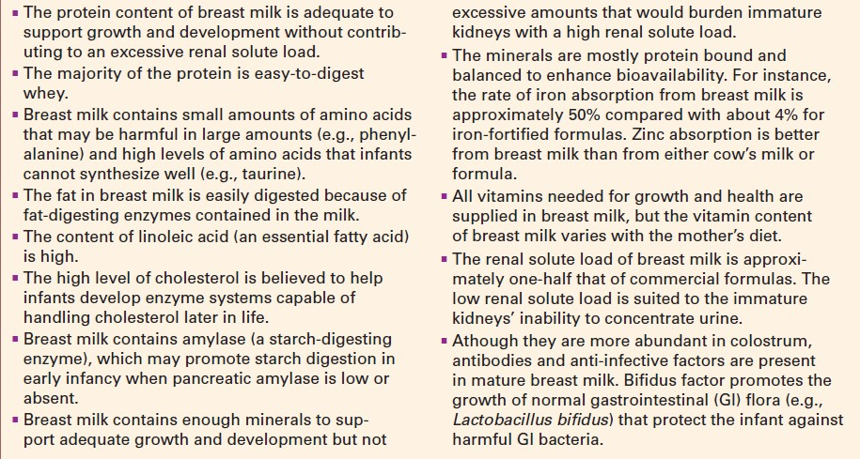

Slide 9
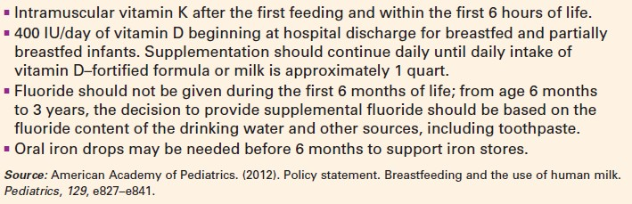

Slide 10
Supplemental vitamins may be prescribed.
Generally, solid foods are not introduced before the infant is developmentally ready, usually between 4 and 6 months of age.
Iron-fortified infant cereal is usually the first food introduced, then vegetables, fruits, meats, and then eggs.
The amount of solid food taken at a feeding may vary
from 1 to 2 tsp.
New foods should be introduced one at a time for a period of 5 to 7 days so that any allergic reaction can be easily identified.
10

Slide 11
A positive family history for food allergies, milk, eggs, wheat, and fruits should be introduced carefully. Peanuts and peanut butter should be avoided for infants with allergy family history.
By 1 year of age, the infant typically is eating table food. Iron-fortified foods are recommended.
11

Slide 12



Toddlers and Preschoolers
During this stage, the growth rate slows. Nutritionally, toddlers and preschoolers can feed themselves, verbalize food likes and dislikes, and occasionally use food to manipulate their parents.
The dramatic decrease in growth rate is reflected in a lack of interest in food (Appetite dramatically decreases and becomes erratic), a “physiologic anorexia” due to lower calorie needs per kilogram of body weight.

Slide 13



Toddlers and Preschoolers
Inappropriate use of food (i.e., to punish, reward, or convey love) may lead to inappropriate food attitudes.
Content of childhood diets should be similar to that of adult diets.

Slide 14
Toddlers and Preschoolers
At age one year, whole milk becomes a major source of nutrients. Milk intake should not exceed 2 to 3½ cups per day because at this level it may displace the intake of iron-rich foods from the diet and promote milk anemia.
Low-fat or nonfat milk not be started until after the age of 2.

Slide 15
Toddlers and Preschoolers
Until the age of 4, young children are at risk of choking. To decrease the risk of choking, foods that are difficult to chew and swallow should be avoided. meals and snacks should be supervised; foods should be prepared in forms that are easy to chew and swallow.

Slide 16




Toddlers and Preschoolers
Foods Most often Causing Choking
Hot dogs
Candy
Nuts
Grapes
Raw carrots
Hard meat
Celery
Popcorn
Peanut butter
Watermelon with seeds

Slide 17



School-aged Children
The 6- to 12-year-old child has an uneven, individualized, sometimes erratic growth pattern. Children grow 2 to 3 in. in height and gain about 5 pounds on average per year.
Commonly, a larger child eats more than a smaller one, an active child eats more than a quiet one, and a happy, content child eats more than an anxious one.
Total calorie needs gradually increase during childhood.

Slide 18

Bad Eating Habits
Snacks, especially sweetened beverages, should be limited during sedentary activities.
Important alarms during childhood include extreme intakes of calories, sodium, and fat, especially saturated fat.
Nutrients most likely to be consumed in insufficient amounts are calcium, fiber, vitamin E, magnesium, and potassium

Slide 19
School-aged Children
Nutritional implications for the school-aged child focus on health promotion. Increasing energy requirements need to be balanced with foods of high nutritional value.
The appetite improves but still may be irregular. The parents' role as the primary regulator of food intake diminishes, and advertising has more of an impact on the child's food choices.

Slide 20

Adolescents
Adolescence is a period of physical, emotional, social, and sexual maturation. Approximately 15% to 20% of adult height and 50% of adult weight are gained during adolescence. Fat distribution shifts and sexual maturation occurs.
Generally, nutrient requirements are higher during adolescence than at any other time in the life cycle, with the exception of pregnancy and lactation.

Slide 21
Adolescents
Calories suggested for moderately active females aged 12 to 18 years is 2000, males, the need ranges from 2200 to 2800 calories.
Nutrient needs, especially for calories, protein, calcium, and iron, increase to support growth.

Slide 22
Adolescents have increased needs for iron related to an expanding blood volume, the rise in hemoglobin concentration, and the growth of muscle mass.
In boys, peak iron requirement occurs at 14 to 18 years of age as muscle mass expands.
The requirement for iron in girls increases from 8 to 15 mg/day at the age of 14 to account for menstrual losses. For girls who are not menstruating at 14 the requirement for iron is 10.5 mg/day, not 15 mg/day. Girls tend to develop an iron deficiency slowly after puberty,

Slide 23
Weight consciousness becomes compulsive in 1 of 100 teenaged girls and results in eating disorders.
Anorexia nervosa, an eating disorder characterized by extreme weight loss, muscle wasting, refusal to eat, and bizarre eating habits.
23

Slide 24
Bulimia, another eating disorder characterized by gorging followed by purging with self-induced vomiting, diuretics, and laxatives, also becomes more common in this age group. Other unhealthy diet practices include fasting, the use of diet pills, and laxative abuse.
Adolescents often eat their food rapidly, leading to over consumption before satiety is experienced.
24

Slide 25

Adolescent Pregnancy
Adolescent pregnancy is associated with physiologic, socioeconomic, and behavioral factors that increase health risks for both
Infants (low birth weight, preterm birth, and are more likely to die within the first year of life
Mother (anemia, high blood pressure, and excessive postpartum weight retention)

Slide 26
Adolescent Pregnancy
May not have sufficient nutrient stores because they need large amounts of nutrients for their own growth and development. female adolescent growth is usually complete by the age of 15 years, with physical maturity at 17.
Need to gain more weight for their BMI than older women to improve birth outcomes.
Give low priority to healthy eating.

Slide 27


Breakfast Skipping
Children who regularly skip breakfast have lower intakes of vitamins and minerals than others, also more likely to frequently eat unhealthy snacks.
Breakfast skipping has been reported to be associated with a higher BMI in children
10-year-old breakfast skippers failed to meet 2/3 the reference standards for vitamins A, B6, D, riboflavin, folate, calcium, iron, magnesium, phosphorus, riboflavin, and zinc

Slide 28
Indicators of Nutrition Risk
Meal skipping three or more times per week
Frequent breakfast skipping
Eating fast food more than three times per week
Eating from only one food group
Poor appetite
Frequently eating without family supervision

