Slide 1











“Nutrition in Health and Illness” Second Semester 2022-2023
Nutrition for Older Adults
Dr. Malakeh. Z. Malak
Presented by:
Dr. Majdi Alhadidi
5/5/2023

Slide 2




Aging and Older Adults
Aging is a gradual, usual, complex process of progressive physiologic, cellular, cultural, and psychosocial changes that begin at conception and end at death.
As cells age, they undergo degenerative changes in structure and function that finally lead to impairment of organs, tissues, and body functioning.
In Jordan
15-64 years: 60%
65 years and more: 5.1% aged
5/5/2023
2

Slide 3
Changes that may occur with Aging
Body Composition / Energy Expenditure Changes
1- Decrease in lean body mass, BMR and PA 2- Increase in fat tissue.
3

Slide 4




Changes that may occur with Aging
Oral and GI Changes
Digestive disorders may occur from a decreased
secretion of HCl in the stomach and digestive enzymes; decreased GI motility; and decreased organ function.
Prevalence of atrophic gastritis increases.
Nutrient absorption may decrease because of decreased mucosal mass and decreased blood flow to and from the mucosal villi.
4

Slide 5
Changes that may occur with Aging
Metabolic Changes
Altered glucose tolerance; the underlying reason may
be a decrease in insulin secretion or a decrease in tissue sensitivity to insulin.
Synthesis of vitamin D in the skin decreases with age.

Slide 6



Changes that may occur with Aging
Other Changes
Change in income related to retirement.
Reliance on medications.
Social isolation related to death of spouse, living alone, impaired mobility.
Poor self-esteem related to change in body image, lack of productivity, feelings of aimlessness.

Slide 7
Nutritional Needs of Older Adults
Nutrient recommendations may not be appropriate for all elderly individuals at all times.
In general, calorie needs decrease, yet vitamin and mineral requirements stay the same or increase.
5/5/2023
Dr. Malakeh
7

Slide 8


Calories
Calorie needs decrease with age due to a decrease in metabolic rate and PA.
Changes in body composition, namely a decrease in muscle and bone mass and an increase in percentage of body fat.

Slide 9


Calories
Decrease in metabolic rate 2% per decade beginning around the age of 30.
Together, the decrease in PA and lower metabolic rate lead to an estimated 5% decrease in total calorie needs each decade.

Slide 10


Protein
The Recommended Dietary Allowance (RDA) for protein remains constant at 0.8 g/kg for both men and women from the age of 19 .
Older adults need more protein than younger adults and that a protein intake between 1.0 and 1.6 g/kg/day is safe and adequate to meet the needs of healthy older adults.

Slide 11


Protein
Factors that contribute to a reduction in protein intake include the cost of high protein foods, the decreased ability to chew meats, lower overall intake of food, and changes in digestion and gastric emptying.

Slide 12


Water
The adequate intake (AI)for water is 3.7 L/day for men and 2.7 L/day for women aged19 - 70 years old and more.
A number of physiologic changes and other factors increase the risk of dehydration in the elderly, including an impaired sensation of thirst, alterations in mental status and cognition, adverse effects of medications, impaired mobility.
12

Slide 13

Water
Fear of incontinence and pain from arthritis may cause voluntary restriction in fluid intake. Dehydration can contribute to constipation, cognitive impairment, functional decline, and death.
13

Slide 14


Fiber
The AI for fiber is based on median intake levels observed to protect against coronary heart disease (CHD).
The AI from the age of one year for fiber is set at 14 g/1000 cal of intake, the AI for fiber is 38 g/day for men through age 50 and 30 g/day afterward.
14

Slide 15


Fiber
For females AI is 25 g/day from 19 to 50 years and 21 g/day afterward.
Increasing fiber intake by adult may help prevent
constipation, improve glycemic control, reduce serum cholesterol levels and Alzheimer.
15

Slide 16


Vitamins and Minerals
Most recommended levels of intake for vitamins and minerals do not change with aging, except calcium and vitamin D, and iron recommendations for women
Related to vit. B12, people over 50 years are advised to consume fortified food or supplements because 10% to 30% of older adults may not be able to absorb natural vitamin B12 from food.
16

Slide 17
Functional Limitations
Social Isolation: Eating alone is a risk factor for poor nutritional status among older adults
Polypharmacy : The elderly are at risk for developing drug-induced nutrient deficiencies because they have more chronic illnesses, are often on long-term drug therapy, and polypharmacy increases with age.

Slide 18




Nutrition-related Concerns in Older Adults
Arthritis
Osteoporosis
Sarcopenia
Obesity
Alzheimer Disease

Slide 19
Preventing Malnutrition
Preventing malnutrition is a quality of life issue.
Optimize food and fluid intake at each meal and snack.
Meal time should be made as enjoyable an experience as possible.
Encourage independence in eating,

Slide 20
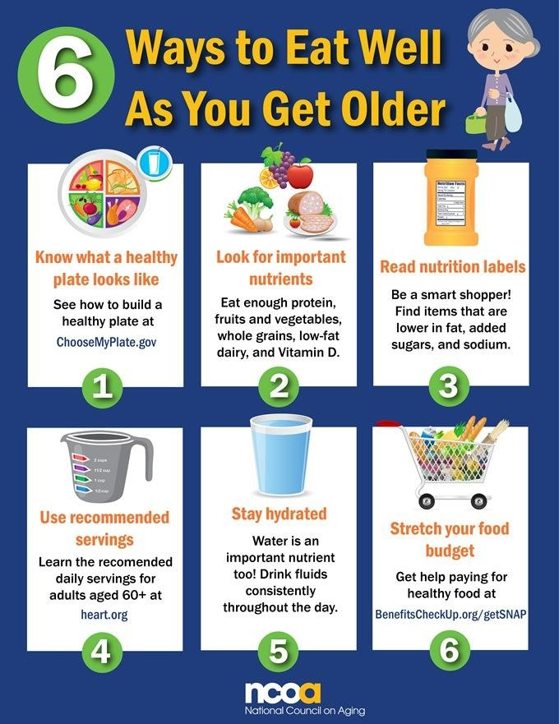
5/5/2023
Dr. Malakeh 20

