Slide 1

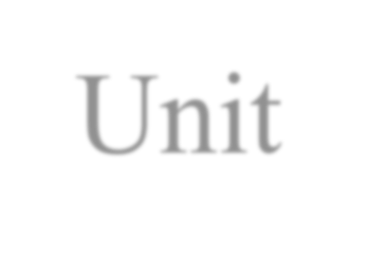
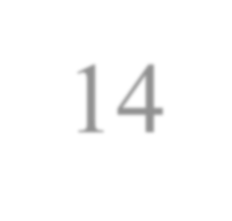


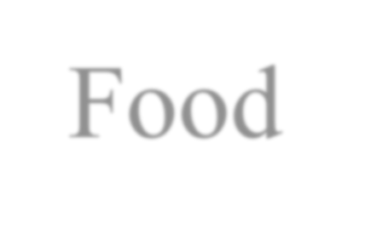
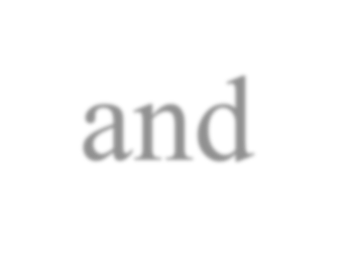

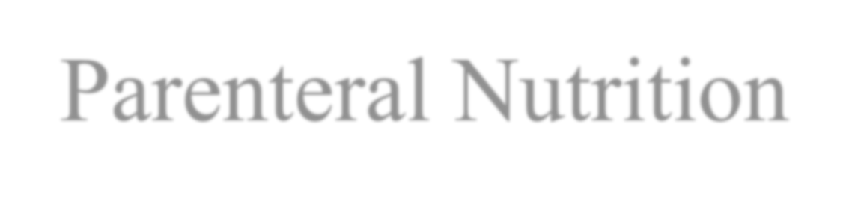
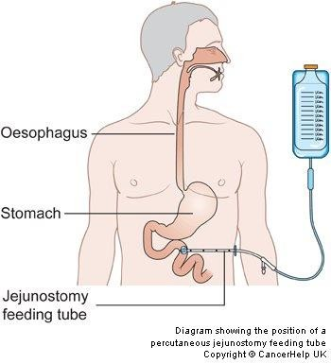
Unit 14
Feeding Patients Hospital Food and Enteral and Parenteral Nutrition
5/5/2023
1

Slide 2

15% to 60% of hospitalized patients have malnutrition, which is associated with morbidity and mortality, post operative complications, increased length of hospitalization, and higher health-care costs.
Malnourished may be start at admission because of the chronic illness, increase during hospitalization.
Factors affect the appetite during hospitalization 1- fear
pain
anxiety
52/5/2023

Slide 3


Oral Diets
Oral diets are the easiest and most preferred method of providing nutrition.
Oral diets may be categorized as “regular,” modified consistency, or therapeutic.
Often combination diets are ordered, such as
….....…
53/5/2023

Slide 4


Normal, Regular & House Diets
Regular diets are used to achieve or maintain optimal nutritional status in patients who do not have altered nutritional needs.
No foods are excluded, and portion sizes are not limited on a regular diet. The nutritional value depend on the actual foods chosen by the patient.
54/5/2023

Slide 5

Normal, Regular & House Diets
Regular diets are adjusted to meet age-specific needs throughout the life cycle. For instance, a regular diet for a child differs from one for a pregnant woman or an elderly patient. Regular diets are also altered to meet specifications for vegetarian or kosher eating.
55/5/2023

Slide 6


Modified Consistency Diets
Include clear liquid and mechanically altered diets.
Clear liquid diets may be used to
maintain hydration during gastrointestinal illness, such as nausea, vomiting, and diarrhea
Preparation for bowel surgery or procedures,
When oral intake resumes after a prolonged period. 4- post operation
56/5/2023

Slide 7


Modified Consistency Diets
Clear liquids Full liquid Soft
Regular, or
therapeutic diet as tolerated.
Mechanically altered diets contain foods that are pureed, chopped/ground, or soft for patients who have difficulty chewing or swallowing.
57/5/2023

Slide 8


Therapeutic Diets
Therapeutic diets differ from a regular diet in the amount of one or more nutrients or food components for the purpose of preventing or treating disease or illness.
The number or timing of meals may also be altered
58/5/2023

Slide 9

The gastrointestinal tract (GI) is the most effective way to feed the patient.
If the patient has at least a partially functioning gut, but is unable to meet his nutritional needs via the oral (po) route, then enteral nutrition therapy via tube feeding should be considered.
Enteral nutrition (EN) promotes the usual physiologic integrity of the GI tract, has less risk of harm (line infections, sepsis) and is more economical than parenteral nutrition.
9

Slide 10


Enteral Nutrition
The delivery of nutrients by tube, catheter, or stoma into the gastrointestinal tract beyond the oral cavity; for those unable to consume an adequate oral intake to administer a formula containing adequate nutrients. Commonly known as tube feeding.
10

Slide 11


Enteral Nutrition
Gastric feedings have the advantage of allowing the stomach to be used as a natural reservoir, regulating the amount of foods and liquids released into the small intestine. This alternate feeding method may deliver total or supplemental nutrition over a short-term period or for longer intervals.
11

Slide 12
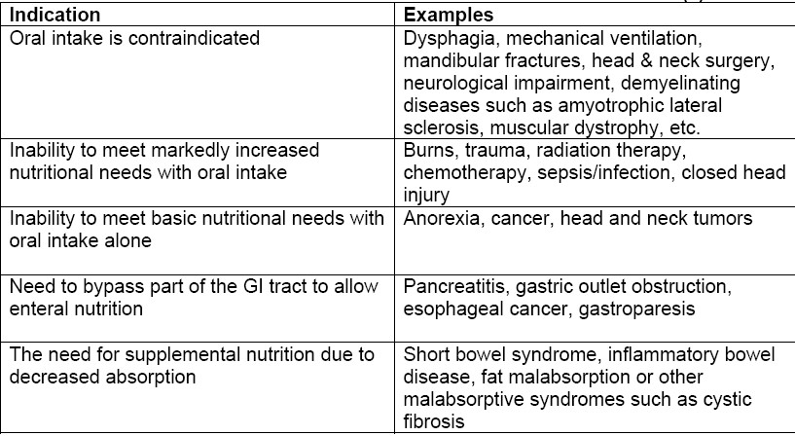
INDICATIONS FOR INITIATION OF ENTERAL NUTRITION
12

Slide 13
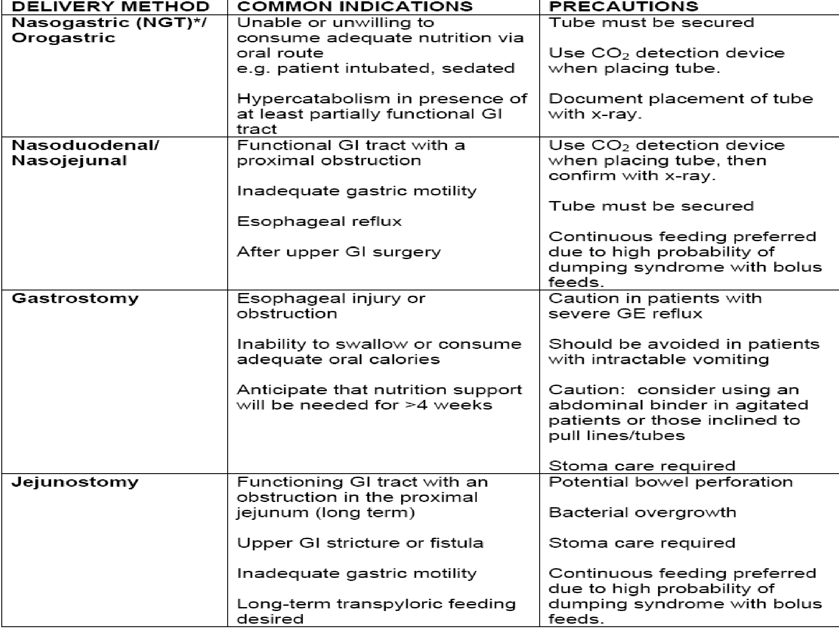
13

Slide 14




Short-Term Nutritional Support
For short-term use (less than 4 weeks), a
nasogastric or nasointestinal route is usually
tube is inserted
selected. A nasogastric (NG)
through the nose and into the stomach.
Aspiration risk
Patients stasis, patients
with a dysfunctional gag reflex, gastric
gastroesophageal reflux, nasal injuries,
unable to have the head of the bed
elevated during feedings are not candidates for nasogastric feeding.

Slide 15


Nasointestinal
A nasointestinal (NI) tube is passed through the nose and into the upper portion of the small intestine. A patient with a nasointestinal tube is at minimal risk for aspiration.

Slide 16


Intermittent Feedings
Intermittent feedings are given at specific intervals, often corresponding to mealtimes. Intermittent feedings may be given over a long (e.g., hours) or shorter (e.g., minutes) period, depending on factors such as tube placement, feeding volume, and number of feedings per day. A syringe, gravity flow, or a pump is used. When feedings are alternated with nonfeeding times, such a schedule may also be called
5/5_{c}/20_{y}23_{clic.}
16

Slide 17

CRITERIA TO MONITOR IN HOSPITALIZED PATIENTS RECEIVING ENTERAL NUTRITION
Daily weight to detect fluid shifts.
Daily intake and output.
Gastric residuals every 4 to 6 hours in critically ill patients. Return all aspiration secretions to the stomach because they contain nutrients, electrolytes, and digestive enzymes.
Character and frequency of bowel movements.

Slide 18

CRITERIA TO MONITOR IN HOSPITALIZED PATIENTS RECEIVING ENTERAL NUTRITION
Signs and symptoms of intolerance: vomiting, nausea, distention, constipation.
Daily electrolyte levels, blood urea nitrogen (BUN), and creatinine until goal rate is achieved; thereafter two to three times per week. Minerals and a weekly blood count may be ordered.
External length of the tube, to check for displacement
Tube site for infection.

Slide 19

Gastrointestinal Complication
Diarrhea.
Rapid infusion/bolus feedings.
Bacteria-contaminated feedings.
Lactase deficiency.
Food allergies.
Cold formula

Slide 20

Gastrointestinal Complication
**Treatment
Assess fluid balance and electrolyte levels; report findings.
Implement changes in tube feeding formula or rate
**Prevention
Assess rate of infusion and temperature of formula Replace formula every 4 hours; change tube feeding container and tubing daily
20

Slide 21

Mechanical Complication
Aspiration pneumonia
Tube displacement
Tube obstruction
Residue
Nasopharyngeal irritation
Metabolic Complication
Hyperglycemia
Dehydration and azotemia (excessive urea in the blood)

Slide 22



Parenteral Nutrition
Parenteral nutrition (PN) is a method of providing nutrients to the body by an IV route.
Indication of Parenteral Nutrition
The patient's intake is insufficient to maintain an anabolic state (e.g., severe burns, malnutrition, short bowel syndrome, acquired immunodeficiency syndrome [AIDS], sepsis, cancer).
The patient's ability to ingest food orally or by tube is impaired (e.g., paralytic ileus, Crohn's disease with obstruction, post-radiation enteritis, severe hyperemesis gravidarum in pregnancy).

Slide 23


Indication of Parenteral Nutrition
The patient is unwilling or unable to ingest adequate nutrients (e.g., anorexia nervosa, postoperative elderly patients).
The underlying medical condition precludes being fed orally or by tube (e.g., acute pancreatitis, high enterocutaneous fistula).
Preoperative and postoperative nutritional needs are prolonged (eg, extensive bowel surgery).

Slide 24


Administration Methods
Peripheral Method:
Peripheral parenteral nutrition (PPN) is administered through a peripheral vein; this is possible because the solution is less hypertonic than PN solution.

Slide 25


Administration Methods
PPN formulas are not nutritionally complete: there is typically less dextrose content. Dextrose concentrations of more than 10% should not be administered through peripheral veins because they irritate the intima (innermost walls) of small veins, causing chemical phlebitis. Lipids are administered simultaneously to buffer the PPN and to protect the peripheral vein from irritation. The usual length of therapy using PPN is 5 to 7 days.

Slide 26


Central Method
Because PN solutions have five or six times the solute concentration of blood (and exert an osmotic pressure of about 2000 mOsm/L), they are injurious to the intima of peripheral veins. Therefore, to prevent phlebitis and other venous complications, these solutions are administered into the vascular system through a catheter inserted into a high-flow, large blood vessel (the subclavian vein). Concentrated solutions are then very rapidly diluted to isotonic levels by the blood in this vessel.

Slide 27


Central Method
Whenever one of these catheters is inserted, catheter tip placement should be confirmed by x- ray studies before PN therapy is initiated.

Slide 28



Complications
Pneumothorax
Air embolism
Clotted catheter line
Catheter displacement and contamination.
Sepsis
Hyperglycemia
Fluid overload

