Slide 1





Nutrition for Patients with Kidney Disorders
Presented by:
Dr. Majdi Alhadidi
Dr. Malakeh
1

Slide 2



Nephrotic Syndrome
Nephrotic syndrome is a generic term that refers to a kidney disorder characterized by urinary protein losses greater than 3.0 g/day.
Signs and Symptoms:
  Proteinuria
  Hypoalbuminemia
  Hyperlipidemia
  Edema.
2

Slide 3


Causes of Nephrotic Syndrome
Diabetes. Autoimmune diseases. Infection.
Certain chemicals and medications.
3

Slide 4

Increased urinary losses of proteins such as albumin, transferrin, immunoglobulins, vitamin D- binding protein, and anti-blood clotting proteins may lead to:
  Protein-calorie malnutrition.
  anemia, increased risk of infection.
  Vitamin D deﬁciency.
* Increased clotting.
Hyperlipidemia increases the risk of cardiovascular disease and progressive renal damage..
4

Slide 5

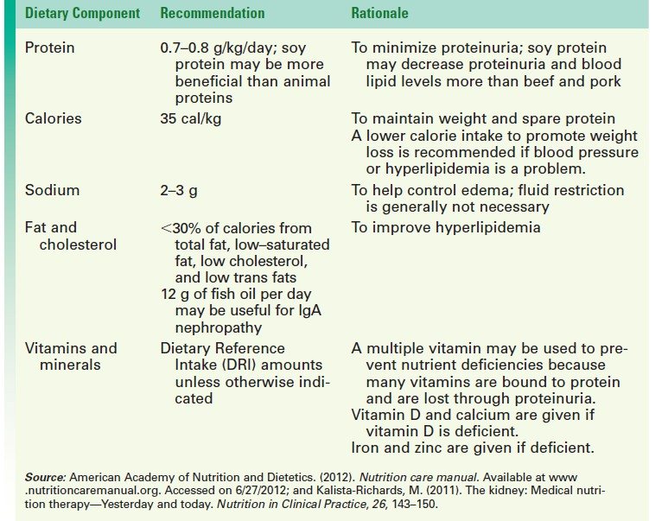
5

Slide 6


Interventions
IMPORTANT NOTE: High-protein diet is contraindicated - because it aggravates urinary protein losses, promoting further kidney damage.
A protein intake of 0.7 to 0.8 g/kg/ day is recommended
At least half of the protein from high biologic value (HBV) sources, such as meat, fish, poultry, milk, eggs, and soy.
Soy protein may be better than other HBV protein sources at decreasing proteinuria and lipid levels.
- To spare protein and maintain weight, calorie intake should be increased to approximately 35 cal/kg/day.
6

Slide 7


Kidney stones
Kidney stones form when insoluble crystals precipitate out of urine. Approximately 75% of kidney stones are made of calcium oxalate, remaining stones are composed of calcium phosphate, uric acid, or striates.
- Certain factors increase the risk of kidney stones, including dehydration or low urine volume, urinary tract obstruction, gout, chronic inﬂammation of the bowel, and intestinal bypass or ostomy surgery.
7

Slide 8


Kidney stones
- Nutritionally, inadequate ﬂuid intake and excessive - intakes of oxalate, calcium, protein, and sodium may increase the risk of calcium oxalate stones
in susceptible people.
8

Slide 9




Nutrition Recommendations For Calcium Oxalate Kidney Stones
Drink 3 to 4 quarts of ﬂuid /day, with most in the form of water.
Avoid high-oxalate foods and mega doses of vitamin C.
FOODS HIGH IN OXALATE
Nuts: peanuts, almonds, cashews, Nut butters Tea Instant coffee (more than 8 oz/day) Rhubarb Beets Beans: green, wax, baked, and dried, such as kidney beans, beans, Berries: blackberries, raspberries, straw-berries, gooseberries Chocolate grapes Dark leafy greens Oranges, Sweet potatoes
9

Slide 10

Maintain adequate calcium intake (3 servings/day) that is balanced throughout the day.
Avoid high intakes of animal protein (6 oz/day) and sodium (2 g/day).
10

Slide 11



CHRONIC KIDNEY DISEASE (CKD)
is a syndrome of progressive kidney damage and loss of function. Over time, a decrease in the number of functioning nephrons overburdens the remaining nephrons, and the kidney’s ability to ﬁlter blood deteriorates, as measured by a decrease in glomerular ﬁltration rate (GFR). CKD is associated with premature mortality and decreased quality of life.

Slide 12

Smoking cessation, an increase in physical activity, and controlling blood lipid levels are modiﬁable risk factors that have the potential to reduce CKD damage.
People with CKD that progresses to stage 5 require dialysis or kidney transplant for survival.
Diabetes is the leading cause of CKD, accounting for approximately 40% of cases.
Other risk factors include cardiovascular disease, hypertension, and obesity. Compared with whites, African-Americans, Native Americans, and Hispanics are at increased risk for CKD.

Slide 13


Goals of nutrition therapy
Reduce workload on the kidneys to delay or prevent further kidney damage
Restore or maintain optimal nutritional status
Control the accumulation of uremic toxins such as urea, phosphorus, sodium, and sometimes potassium.

Slide 14



Protein. Restricting protein helps lessen workload on the kidneys. Restricted protein intake of 0.6 g/kg/day helped delay the progression of kidney disease by 41%. High biologic value proteins are emphasized because they provide a higher percentage of essential amino acids, which may promote reuse of circulating non essential amino acids for protein synthesis and by doing so minimizes urea production.

Slide 15


Calories
Whenever protein intake is restricted, it is vital to consume adequate calories to spare protein from being used for energy, enabling it to be used for protein synthesis.
For all stages of CKD, calorie recommendations are 35 cal/kg for adults under 60 years of age and 30 to35 cal/kg for those who are older.

Slide 16


Calories
People who undergo peritoneal dialysis absorb a large amount of calories daily through the dialysate (approximately 340 to 680 cal/day), which needs to be considered.
The best protein free calorie option is to choose foods rich in monounsaturated fats such as canola oil, olive oil, and trans fat–free margarines.

Slide 17

Sodium and Fluid
Sodium restriction begins when ﬂuid retention occurs. It is recommended that sodium intake be limited to 1500 mg/day
For stages 1 to 4 and hemodialysis, 1000 to 3000 mg/day are recommended; the range is 2000 to 4000 mg for peritoneal dialysis.
Fluid is unrestricted in stages 1 to 4 with normal urine output. For people on hemodialysis, ﬂuid allowance equals the volume of any urine produced plus 1000 mL.

Slide 18

Sodium and Fluid
For people on hemodialysis, ﬂuid allowance equals the volume of any urine produced plus 1000 mL. Fluid intake is monitored by weight gain: anuric hemodialysis patients should not gain more than approximately 2 pounds/day between treatments.
Teaching clients why fluid restriction is important; teaching them how to control their intake and thirst is vital.

Slide 19

Potassium
For all CKD stages, potassium allowance is based on the individual’s serum potassium levels. Unlike sodium, potassium cannot be tasted and rarely appears on the “Nutrition Facts” label, making it difﬁcult to comply with a potassium-restricted eating plan.

Slide 20


Strategies to relieve thirst
Use ice or popsicles within the fluid allowance—very cold things are better at relieving thirst.
Chew gum.
Rinse your mouth without swallowing using refrigerated water and refrigerated mouthwash sometimes
Suck on a lemon wedge, hard candy or mints..
Control blood glucose levels, as appropriate.
Try frozen low-potassium fruit, such as grapes.
Use small glasses instead of large ones.
Apply petroleum jelly to the lips
20
Dr. Malakeh

Slide 21


Nutrition Therapy During Dialysis
Limit meat intake to less than 5 to 6 oz/day for most men and less than 4 oz/day for most women.
Spread protein allowance over the whole day instead of saving it all for one meal.
Limit dairy products.
Limit high-phosphorus foods to one serving or less per day.
Do not add salt during cooking or at the table.
Avoid processed foods, regular canned vegetables, co₂₁nvenience foods, and se_{Dr}a_{. M}s_{ala}o_{keh}nings that contain salt

Slide 22

- Eat heart-healthy by choosing lean meats, nonfat milk and dairy products, trans fat–free margarine, and canola and olive oils.
Try highly seasoned or strongly flavored foods if uremia has caused a change in the sense of taste.
consistent intake of carbohydrates with regularly timed meals to control blood glucose levels, if appropriate.
Seek physician approval before using any vitamin, mineral, or supplement.
22
Dr. Malakeh

