Slide 1
Environmental Emergencies (2)
Nonfatal drowning
Animal and human bites

Slide 2
OUTLINE
Nonfatal drowning
Animal and human bites

Slide 3
INTENDED LEARNING OUTCOMES
Define nonfatal drowning.
Recognize causes of nonfatal drowning.
Recognize signs and symptoms of nonfatal drowning.
Explain the emergency management of patients with nonfatal drowning.
Recognize signs and symptoms of animal and human bites.
Explain the emergency management of patients suffered from animal and human bites.

Slide 4
Nonfatal Drowning
Nonfatal drowning is defined as survival for at least 24 hours after submersion that caused a respiratory arrest.
The most common consequence is hypoxemia.
Children under 5 years of age and those over the age of 85 have the highest risk of drowning.
An estimated 320,000 drownings occur throughout the world annually, accounting for 7% of global mortality from unintentional injury (WHO, 2020).

Slide 5
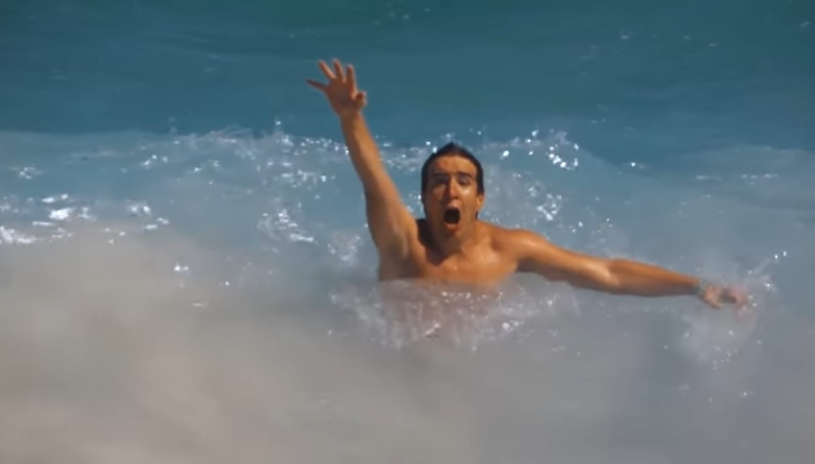
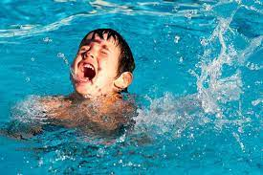
Nonfatal Drowning

Slide 6
Nonfatal Drowning
Drowning and nonfatal drowning can be prevented by avoiding rip currents offshore; approximately 85% of shore drownings involve a rip current.
Pool drownings can be prevented by surrounding the pool with fencing, a self-latching/closing gate, and providing swimming lessons.
Supervision near water is still the best prevention measure.

Slide 7
Nonfatal Drowning
When boating, a personal flotation device (PFD), even for swimmers, prevents drowning events.
Approximately 50% of nonfatal drownings require hospital admission for management (WHO, 2020).

Slide 8
Nonfatal Drowning
Factors associated with drowning and nonfatal drowning include:
Alcohol ingestion
Inability to swim
Diving injuries
Hypothermia, and exhaustion
The majority of drowning events occur in pools, lakes, and bathtubs.
Suicide by drowning rarely occurs in pools and rarely involves alcohol (WHO, 2020).

Slide 9
Nonfatal Drowning
Efforts to save the patient should not be abandoned prematurely.
Successful resuscitation with full neurologic recovery has occurred in patients who have experienced nonfatal drowning after prolonged submersion in cold water.
This is possible because of a decrease in metabolic demands and the diving reflex.
The nonfatal drowning process involves the onset of hypoxia, hypercapnia, bradycardia, and arrhythmias.

Slide 10
Nonfatal Drowning
If there is a violent struggle associated with the nonfatal drowning episode, exercise-induced acidosis and tachypnea can result in aspiration.
Hypoxia and acidosis cause eventual apnea and loss of consciousness.
When the victim loses consciousness and makes a final effort to breathe, the terminal gasp occurs.
Water then moves passively into the airways prior to death.
After resuscitation, hypoxia and acidosis are the major complications experienced by a person who has experienced nonfatal drowning; immediate intervention in the ED is essential.

Slide 11
Nonfatal Drowning
Resultant pathophysiologic changes and pulmonary injury depend on the type of fluid (fresh or salt water) and the volume aspirated.
Freshwater aspiration results in a loss of surfactant and, therefore, an inability to expand the lungs.
Salt-water aspiration leads to pulmonary edema from the osmotic effects of the salt within the lungs.
If a person survives submersion, ARDS, resulting in hypoxia, hypercarbia, and respiratory or metabolic acidosis, can occur.

Slide 12
Nonfatal Drowning/ Management
Therapeutic goals include maintaining cerebral perfusion and adequate oxygenation.
CPR is the factor with the greatest influence on survival.
The most important priority in resuscitation is to manage the hypoxia, acidosis, and hypothermia.
Prevention and management of hypoxia are accomplished by ensuring an adequate airway and respiration, thus improving ventilation and oxygenation.
ABGs are monitored to evaluate oxygen, carbon dioxide, bicarbonate levels, and pH. These parameters determine the type of ventilatory support needed.

Slide 13
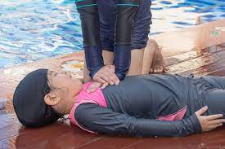

Slide 14
Nonfatal Drowning / Management
The use of endotracheal intubation with PEEP improves oxygenation, prevents aspiration, and corrects intrapulmonary shunting and ventilation–perfusion abnormalities (caused by aspiration of water).
If the patient is breathing spontaneously, supplemental oxygen may be given by mask.
An endotracheal tube is necessary if the patient does not breathe spontaneously.
Because of submersion, the patient is usually hypothermic. A rectal probe or other core measurement device is used to determine the degree of hypothermia.

Slide 15
Nonfatal Drowning / Management
Prescribed rewarming procedures (e.g., extracorporeal warming, warmed peritoneal dialysis, inhalation of warm aerosolized oxygen, torso warming) are started during resuscitation.
The choice of warming method is determined by the severity and duration of hypothermia and available resources.
Intravascular volume expansion and inotropic agents are used to treat hypotension and impaired tissue perfusion.
ECG monitoring is initiated
Notes:
Torso: trunk, body without limbs and head

Slide 16
Nonfatal Drowning / Management
An indwelling urinary catheter is inserted to measure urine output.
Nasogastric intubation is used to decompress the stomach and to prevent the patient from aspirating gastric contents.
Even if the patient appears healthy, close monitoring continues with serial vital signs, serial ABGs values, ECG monitoring, intracranial pressure assessments, serum electrolyte levels, intake and output, and serial chest x-rays.

Slide 17
Nonfatal Drowning / complications
Hypoxic or ischemic cerebral injury
ARDS
Life-threatening cardiac arrest
The patient is also at heightened risk for:
Aspiration;
Vomiting frequently occurs in patients requiring rescue breathing and in up to 86% of patients requiring CPR.

Slide 18
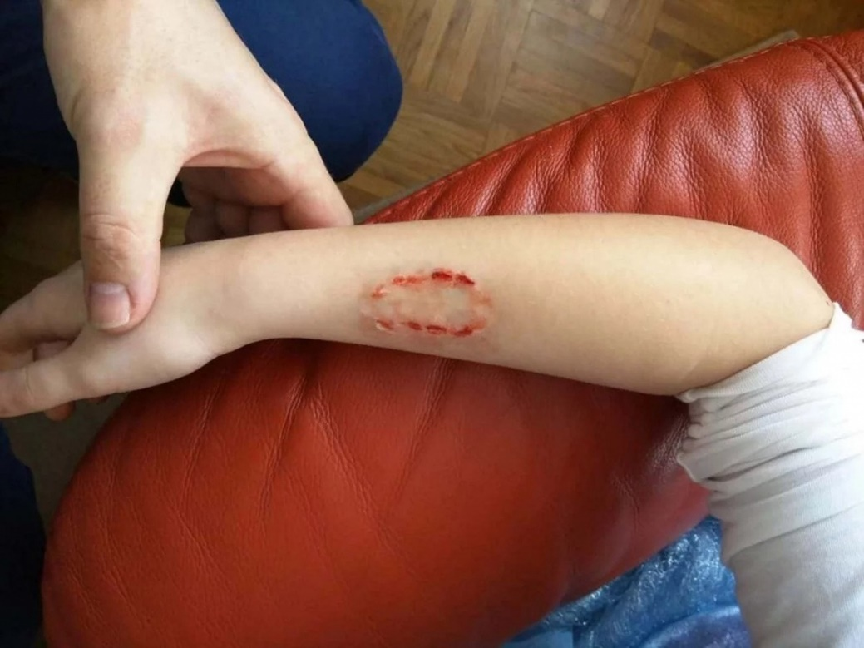
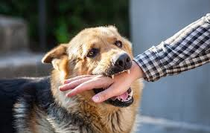
animal and human bites.

Slide 19
animal and human bites.
Bites are a common reason for visits to the ED.
Dog bites constitute 80% to 90% of these bites and are responsible for the majority of deaths from bites by a nonvenomous animal.
Cat bites have a high risk of infection because of the presence of pasteurella in their saliva.
All animal bites must be reported to public health authorities, which must provide follow-up screening of the offending animal for rabies.

Slide 20
animal and human bites.
If the animal cannot be located and rabies vaccination verified, rabies prophylaxis for the person who has been bitten must be instituted.
Human bites are frequently associated with rapes, sexual assaults, or other forms of battery.
The human mouth contains more bacteria than that of most other animals, so a high risk of bite-related infection exists.
Depending on the circumstances surrounding the event, the victim may delay seeking treatment.

Slide 21
animal and human bites.
The ED nurse should inspect any bitten tissue for pus, erythema, or necrosis.
A health care provider should take photographs, which can be used as evidence in criminal and legal proceedings.
Guidelines for collecting forensic evidence for photographing with and without a measuring device should be followed.
Cleansing with soap and water is then necessary, followed by the administration of antibiotics and tetanus toxoid as prescribed.

Slide 22
Snakebites
Across the globe, between 4.5 and 5.4 million people get bitten by snakes each year, with 81,000 to 138,000 dying from complications (WHO, 2019).
Children between 1 and 9 years of age are the most likely victims.
The greatest number of bites occurs during the daylight hours and early evening of the summer months.
The most common site is the upper extremity.
Of PIT VIPER bites, 75% to 80% result in envenomation (injection of a poisonous material by sting, spine, bite, or other means); the rest result in what are called dry bites.

Slide 23
Snakebites
Venomous snakebites are medical emergencies.
19 different species of venomous snakes are found in various regions within the united states.
Nurses should be familiar with the types of snakes common to the geographic region in which they practice.

Slide 24
Clinical Manifestations
Snake venom consists primarily of proteins and has a broad range of physiologic effects.
It may affect multiple organ systems, especially the neurologic, cardiovascular, and respiratory systems.
Classic clinical signs of envenomation are edema, ecchymosis, and hemorrhagic bullae, leading to necrosis at the site of envenomation.

Slide 25
Clinical Manifestations
Symptoms include:
Lymph node tenderness,
Nausea & vomiting
Numbness
A metallic taste in the mouth.
Without decisive treatment, these clinical manifestations may progress to include:
Fasciculations,
Hypotension,
Paresthesias,
Seizures,
Coma

Slide 26
Management
Initial first aid at the site of the snakebite includes:
Having the person lie down,
Removing constrictive items such as rings,
Providing warmth,
Cleansing the wound,
Covering the wound with a light sterile dressing,
Immobilizing the injured body part below the level of the heart.
CABs are the priorities of care.

Slide 27
Management
Ice, incision and suction, or a tourniquet is not applied.
Tetanus and analgesia should be given as necessary.
Initial evaluation in the ED is performed quickly and includes information about the following: whether the snake was venomous or nonvenomous; discourage bringing the snake for identification—even a dead snake’s venom is poisonous.
Do not handle any snake brought to the ED.
If the snake is transported to the ED, caution should be taken because the snake is frequently in a stunned, not dead, state.
Notes:
إذا تم نقل الثعبان إلى قسم الطوارئ، فيجب توخي الحذر لأن الثعبان غالبًا ما يكون في حالة ذهول وليس ميتًا.

Slide 28
Management
The bite reflex can remain intact for up to 90 minutes after the death of the snake.
Where and when the bite occurred and the circumstances of the bite, sequence of events, signs, and symptoms (fang punctures, pain, edema, and erythema of the bite and nearby tissues).
Severity of poisonous effects.
Call the local poison control to gain access to information about an exotic snakebite presentation and management, as necessary.
Notes:
(ثقوب الأنياب).: FANG PUNCTURES

Slide 29
Management
Vital signs.
Circumference of the bitten extremity or area at several points.
The circumference of the extremity that was bitten is compared with the circumference of the opposite extremity.
Laboratory data (CBC, urinalysis, and coagulation studies).

Slide 30
Management
The course and prognosis of snakebite injuries depend on the kind and amount of venom injected; where on the body the bite occurred; and the general health, age, and size of the patient.
There is no one specific protocol for treatment of snakebites.
In general, ice, tourniquets, heparin, and corticosteroids are not used during the acute stage.

Slide 31
Management
Corticosteroids are contraindicated in the first 6 to 8 hours after the bite because they may depress antibody production and hinder the action of antivenin (antitoxin manufactured from the snake venom and used to treat snakebites).
Parenteral fluids may be used to treat hypotension.
if vasopressors are used to treat hypotension, their use should be short term.

Slide 32
Management
The patient is never left unattended.
Administration of antivenin although envenomation does not always occur, it should always be suspected with snakebites.
An assessment of progressive signs and symptoms is essential before considering administration of antivenin, which is most effective if given within 4 hours and no greater than 12 hours after the snakebite.

Slide 33
Management
The decision to administer antivenin depends on worsening tissue injury and evidence of systemic and coagulopathic symptoms.
Coagulation abnormalities are not restricted to severe envenomation.
The dose depends on the type of snake and the estimated severity of the bite.

Slide 34
Management
Premedication with antihistamines may be indicated, because these may decrease the allergic response to antivenin.
Antivenin is given as an IV infusion whenever possible, although intramuscular administration can be used.
Depending on the severity of the snakebite, the antivenin is diluted in 500 to 1000 ml of normal saline solution.

Slide 35
Management
The infusion is started slowly, and the rate is increased after 10 minutes if there is no reaction.
The total dose should be infused during the first 4 to 6 hours after the bite.
The initial dose is repeated until symptoms decrease, after which time the circumference of the affected part should be measured every 30 to 60 mins for the next 48 hrs to detect symptoms of compartment syndrome (swelling, loss of pulse, increased pain, and paresthesias).

Slide 36
Management
There is no limit to the number of antivenin vials that can be given.
The decision to continue to administer vials is based upon patient symptoms.
The most common cause of allergic reaction to the antivenin is too-rapid infusion.
Reactions may consist of a feeling of fullness in the face, urticaria, pruritus, malaise, and apprehension.
These symptoms may be followed by tachycardia, SOB, hypotension, and shock.
In this situation, the infusion should be stopped immediately and IV diphenhydramine given. vasopressors are used for patients in shock, and resuscitation equipment must be on standby while antivenin is infusing.

Slide 37
Management
It is important to note that serum sickness (hypersensitivity) can occur within the first few weeks after discharge.
The patient and the patient’s family members should be educated about the clinical manifestations of serum sickness (i.e., fever; rash starting on the chest and spreading to the back; arthralgia; GI disturbances [e.g., nausea, vomiting, diarrhea, abdominal pain], and headache) and return to the ED if they occur.

Slide 38
Thank you
Any question

