Slide 1
CHEST TRAUMA (1)
Blunt trauma

Slide 2
OUTLINE
Types of chest traumas
Pathophysiology, diagnosis, and treatment of blunt trauma
Pulmonary contusion
Flail chest
Sternal and Rib Fractures

Slide 3
INTENDED LEARNING OUTCOMES
Differentiate between the two types of chest trauma
Describe signs and symptoms of the various types of blunt trauma
Explain diagnostic workup for patients complaining from blunt trauma
Explain medical and nursing management of the various types of blunt trauma

Slide 4
Introduction
Major chest trauma may occur alone or in combination with multiple other injuries.
Chest trauma is classified as either blunt or penetrating.
Blunt chest trauma results from sudden compression or positive pressure inflicted to the chest wall.
Penetrating trauma occurs when a foreign object penetrates the chest wall.

Slide 5
Blunt Trauma
Directly responsible for 20% to 25% of all trauma deaths.
Although blunt chest trauma is more common than penetrating trauma, it is often difficult to identify the extent of the damage because the symptoms may be generalized and vague.
Patients may not seek immediate medical attention, which may complicate the problem.

Slide 6
Pathophysiology
The most common causes:
Motor vehicle crashes (trauma from steering wheel, seat belt),
Falls, and
Bicycle crashes (trauma from handlebars).
Types of blunt chest trauma include:
Chest wall fractures, dislocations, and barotraumas (including diaphragmatic injuries);
Injuries of the pleura, lungs, and aerodigestive tracts;
Blunt injuries of the heart, great arteries, veins, and lymphatics

Slide 7
Pathophysiology
Pathologic states:
Hypoxemia from disruption of the airway;
Injury to the lung parenchyma, rib cage, and respiratory musculature
Massive hemorrhage
Collapsed lung
Pneumothorax

Slide 8
Pathophysiology
Hypovolemia from massive fluid loss from the great vessels, cardiac rupture, or hemothorax
Cardiac failure from cardiac tamponade, cardiac contusion, or increased intrathoracic pressure
These pathologic states frequently result in impaired V./Q. leading to acute kidney injury, hypovolemic shock, and death.

Slide 9
Assessment and Diagnostic Findings
The patient must be assessed immediately.
The patient is completely undressed to avoid missing additional injuries.
Assess of airway, breathing, and circulation status (obstruction, pneumothorax, hemothorax, cardiac tamponade).
Assess any secondary complications (esophageal perforation, and penetrating wounds…etc).
Perform comprehensive respiratory physical examination (abnormalities such as stridor, cyanosis, nasal flaring, the use of accessory muscles…etc).
Assess for signs of shock.

Slide 10
Diagnostic workup
Chest x-ray,
CT scan,
Complete blood count,
Clotting studies,
Type and cross-match,
Electrolytes,
Oxygen saturation,
ABGs analysis,
ECG.

Slide 11
Medical Management
Initiate aggressive resuscitation.
Maintain airway and oxygenation (ET intubation and ventilatory support).
Maintain fluid volume and correct hypovolemia and low cardiac output.
Reestablish negative intrapleural pressure.
Drain intrapleural fluid and blood if needed.
Drain or remove any air or fluid from the thorax to relieve pneumothorax, hemothorax, or cardiac tamponade.
Initiate blood transfusion.
Restore and maintain cardiopulmonary function.
Perform immediate surgical interventions.

Slide 12
Pulmonary Contusion
Pulmonary contusion is a common thoracic injury.
It is defined as damage to the lung tissues resulting in hemorrhage and localized edema.
It is associated with chest trauma when there is rapid compression and decompression to the chest wall.
Represents a spectrum of lung injury characterized by the development of infiltrates and various degrees of respiratory dysfunction

Slide 13
Pulmonary Contusion
May not be evident initially on examination but develops in the posttraumatic period
It may involve a small portion of one lung, a massive section of a lung, one entire lung, or both lungs.
Depending on the extent of injury, this type of trauma may be associated with a mortality rate greater than 50%.

Slide 14
Pulmonary Contusion/ Pathophysiology
The primary pathologic defect is an abnormal accumulation of fluid in the interstitial and intra-alveolar spaces.
It is thought that injury to the lung parenchyma and its capillary network results in a leakage of serum protein and plasma.
The leaking serum protein exerts an osmotic pressure that enhances loss of fluid from the capillaries.

Slide 15
Pulmonary Contusion/ Pathophysiology
Blood, edema, and cellular debris (from cellular response to injury) enter the lung and accumulate in the bronchioles and alveoli, where they interfere with gas exchange.
An increase in pulmonary vascular resistance and pulmonary artery pressure occurs.
The patient has hypoxemia and carbon dioxide retention.

Slide 16
Pulmonary Contusion/ Clinical Manifestations
Pulmonary contusion may be mild, moderate, or severe.
The clinical manifestations vary from decreased breath sounds, tachypnea, tachycardia, chest pain, hypoxemia, and blood-tinged secretions to more severe tachypnea, tachycardia, crackles, frank bleeding, severe hypoxemia (cyanosis), and respiratory acidosis.
Changes in sensorium, including increased agitation or combative irrational behavior, may be signs of hypoxemia.

Slide 17
Pulmonary Contusion/ Clinical Manifestations
Patients with moderate pulmonary contusion have a large amount of mucus, serum, and frank blood in the tracheobronchial tree; patients often have a constant cough but cannot clear the secretions.
Patients with severe pulmonary contusion have signs and symptoms that mirror ARDS, which may include central cyanosis; agitation; combativeness; and productive cough with frothy, bloody secretions.

Slide 18
Pulmonary Contusion/ Assessment and Diagnostic
ABGs
Pulse oximetry is used to measure O2 sat continuously.
The initial chest x-ray may show no changes; changes may not appear for 1 or 2 days after the injury and appear as pulmonary infiltrates on chest x-ray.

Slide 19
Pulmonary Contusion/ Medical Management
Treatment priorities:
Maintaining the airway
Providing adequate oxygenation
Controlling pain

Slide 20
Pulmonary Contusion/ Medical Management
Mild pulmonary contusion
Adequate hydration via IV fluids and oral intake (to mobilize secretions).
Volume expansion techniques, postural drainage, physiotherapy including coughing, and ET suctioning (to remove the secretions).
Pain is managed by intercostal nerve blocks or by opioids via PCA or other methods.
Antimicrobial therapy (susceptible to infection)
Oxygen is usually given by mask or cannula for 24 to 36 hours.

Slide 21
Pulmonary Contusion/ Medical Management
Moderate pulmonary contusion
Bronchoscopy may be required to remove secretions.
Intubation and mechanical ventilation with PEEP may also be necessary to maintain the pressure and keep the lungs inflated.
NG tube is inserted to relieve gastrointestinal distention.

Slide 22
Pulmonary Contusion/ Medical Management
Severe pulmonary contusion
Aggressive treatment with ET intubation and ventilatory support, diuretics, and fluid restriction may be necessary.
Antimicrobial medications may be prescribed for the treatment of pulmonary infection. This is a common complication of pulmonary contusion (especially pneumonia in the contused segment) because the fluid and blood that extravasate into the alveolar and interstitial spaces serve as an excellent culture medium.

Slide 23
Sternal and Rib Fractures
Sternal fractures are most common in motor vehicle crashes with a direct blow to the sternum via the steering wheel.
Rib fractures are the most common type of chest trauma with blunt chest injury.
Most rib fractures are benign and are treated conservatively
Ribs 4 through 10 are most frequently involved.
Fractures of the first three ribs are rare but can result in a high mortality rate because they are associated with laceration of the subclavian artery or vein.
Fractures of the lower ribs are associated with injury to the spleen and liver, which may be lacerated by fragmented sections of the rib.

Slide 24
Clinical Manifestations and Complications
Sternal fractures: anterior chest pain, overlying tenderness, ecchymosis, crepitus, swelling, and possible chest wall deformity.
Rib fractures: severe pain; point tenderness; and muscle spasm over the area of the fracture that are aggravated by coughing, deep breathing, and movement; and bruising over the area of the fracture.

Slide 25
Complications
Diminished ventilation,
Atelectasis (collapse of unaerated alveoli),
Pneumonitis,
Hypoxemia as a result of reluctance to move or breathe deeply.

Slide 26
Assessment and Diagnostic Findings
Evaluate for underlying cardiac injuries.
Detect with auscultation a crackling, grating sound in the thorax (subcutaneous crepitus).
The diagnostic workup may include a chest x-ray, rib films of a specific area, ECG, continuous pulse oximetry, and ABGs analysis.

Slide 27
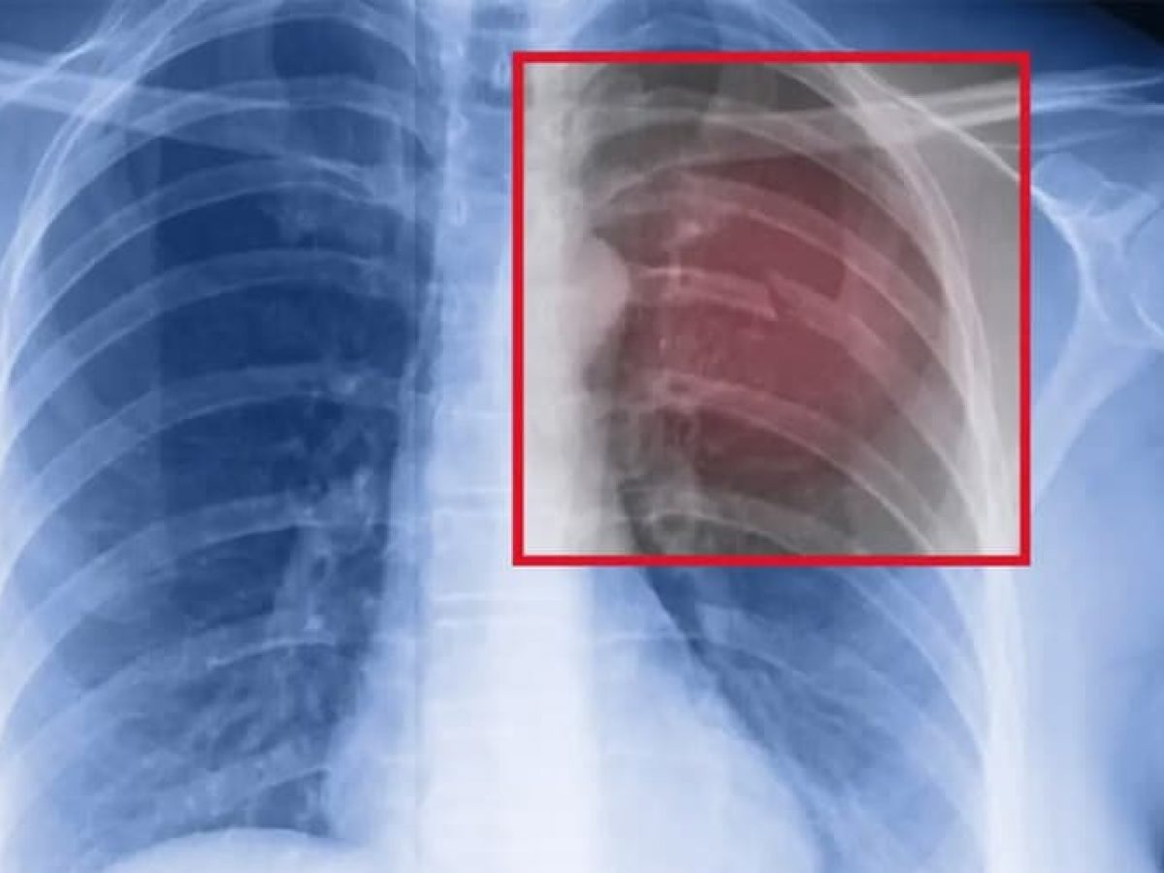
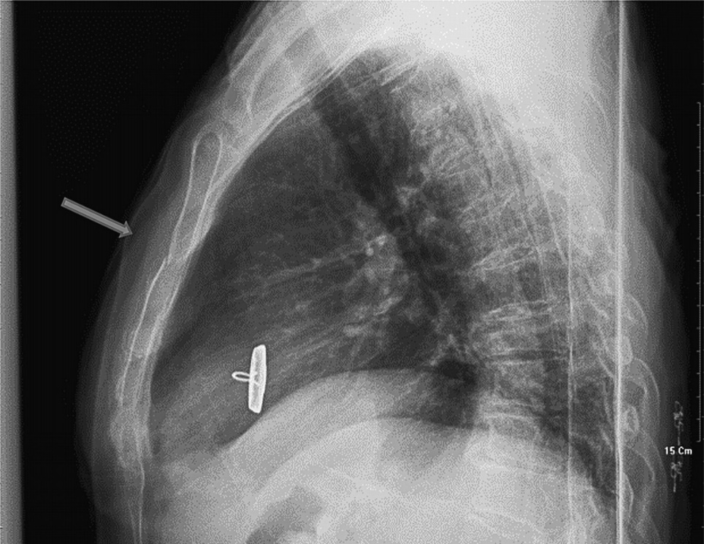
Sternal and Rib Fractures

Slide 28
Medical Management
Most rib fractures heal in 3 to 6 weeks.
Relieving pain.
Sedation is used to relieve pain and to allow deep breathing and coughing.
Intercostal nerve block and ice over the fracture site.
Epidural analgesia, PCA, or nonopioid analgesia.
Avoiding excessive activity.
Treating any associated injuries.
Notes:
An intercostal nerve block is an injection of medication under your rib that helps relieve pain in your chest area or upper abdomen.
Your intercostal nerves are located under each of your ribs. When one of these nerves or the tissue around it gets irritated or inflamed, it can cause pain. A nerve block, which contains a steroid medication and local anesthetic, can help reduce the inflammation and alleviate the pain.
Healthcare providers also use intercostal nerve blocks to help diagnose the source of pain.

Slide 29
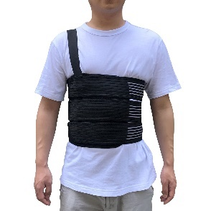
Medical Management
A chest binder may be used as supportive treatment to
provide stability to the chest wall and may decrease pain.
The patient is instructed to apply the binder comfortably enough to provide support, but not to impair respiratory excursion.
Surgical fixation is rarely necessary unless fragments are grossly displaced and pose a potential for further injury.

Slide 30
Flail Chest
Flail chest is frequently a complication of blunt chest trauma,
It may occur from a steering wheel injury, motor vehicle crash involving a pedestrian or cyclist, a significant fall onto the chest, or an assault with a blunt weapon.
The incidence of flail chest among patients with chest wall injury is 5% to 13%.

Slide 31
Flail Chest
It occurs when three or more adjacent ribs (multiple contiguous ribs) are fractured at two or more sites, resulting in free-floating rib segments.
It may also result as a combination fracture of ribs and costal cartilages or sternum.
As a result, the chest wall loses stability, causing respiratory impairment and usually severe respiratory distress.

Slide 32
Pathophysiology
During inspiration: as the chest expands, the detached part of the rib segment (flail segment) moves in a paradoxical manner (pendelluft movement) in that it is pulled inward during inspiration, reducing the amount of air that can be drawn into the lungs.
On expiration: because the intrathoracic pressure exceeds atmospheric pressure, the flail segment bulges outward, impairing the patient’s ability to exhale. The mediastinum then shifts back to the affected side.
This paradoxical action results in increased dead space, a reduction in alveolar ventilation, and decreased compliance.

Slide 33
Pathophysiology
Retained airway secretions and atelectasis frequently accompany flail chest.
The patient has hypoxemia, and if gas exchange is greatly compromised, respiratory acidosis develops as a result of carbon dioxide retention.
Hypotension, inadequate tissue perfusion, and metabolic acidosis often follow as the paradoxical motion of the mediastinum decreases cardiac output.

Slide 34
Medical Management
Treatment of flail chest is usually supportive.
Management includes providing ventilatory support, clearing secretions from the lungs, and controlling pain.
If only a small segment of the chest is involved, the objectives are to clear the airway through positioning, coughing, deep breathing, and suctioning to aid in the expansion of the lung, and to relieve pain by intercostal nerve blocks, high thoracic epidural blocks, or cautious use of IV opioids.

Slide 35
Medical Management
Mild-to-moderate flail chest injuries:
The underlying pulmonary contusion is treated by monitoring fluid intake and appropriate fluid replacement while relieving chest pain.
Pulmonary physiotherapy focusing on lung volume expansion and secretion management techniques is performed.
The patient is closely monitored for further respiratory compromise.

Slide 36
Medical Management
Severe flail chest injuries
ET intubation and mechanical ventilation are required to provide internal pneumatic stabilization of the flail chest and to correct abnormalities in gas exchange.
Rib-specific plating systems may be used for three or more rib fractures or flail chest in order to achieve chest wall stabilization (CWS).
These systems are inserted internally in the operating room, preferably within the first 72 hours of injury.
The benefits of their use include decreased bleeding, less inflammation, and reduced chest wall deformities.
Contraindications for CWS include traumatic brain injury and unstable spine fracture.

Slide 37
End of the Lecture
Thank You

