Slide 1
CHEST TRAUMA (2)
Penetrating trauma

Slide 2
OUTLINE
Pneumothorax :
Simple (spontaneous)
Traumatic
Tension pneumothorax
Cardiac tamponade

Slide 3
INTENDED LEARNING OUTCOMES
Differentiate between the various types of pneumothorax.
Identify the clinical manifestations of the various types of pneumothorax.
Describe the medical and nursing management of the various types of pneumothorax.
Define cardiac tamponade.
Identify causes of cardiac tamponade.
Recognize signs and symptoms of cardiac tamponade.
Describe the medical and nursing management of cardiac tamponade.

Slide 4
Penetrating Trauma
Penetrating trauma: a foreign object penetrates the chest wall.
Any organ or structure within the chest is potentially susceptible to traumatic penetration.
These organs include the chest wall, lung and pleura, tracheobronchial system, esophagus, diaphragm, and major thoracic blood vessels, as well as heart and other mediastinal structures.
The clinical consequences include pneumothorax and cardiac tamponade.
Notes:
mediastinal structures: heart, great vessels, trachea, and essential nerves

Slide 5
Diagnosis
Chest x-ray
Chemistry profile
Arterial blood gas
Pulse oximetry
ECG.
Blood type and cross-matched

Slide 6
Pneumothorax
Pneumothorax occurs when the parietal or visceral pleura is breached and the pleural space is exposed to positive atmospheric pressure.
Normally, the pressure in the pleural space is negative or sub-atmospheric.
This negative pressure is required to maintain lung inflation.
When air enters the pleural space, the lung or a portion of it collapses.

Slide 7
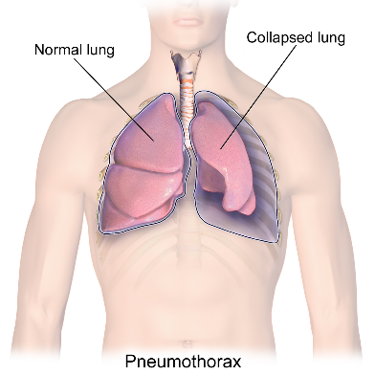
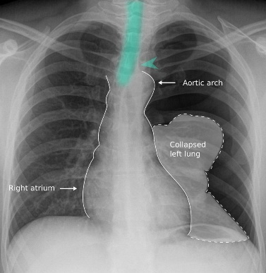

Slide 8
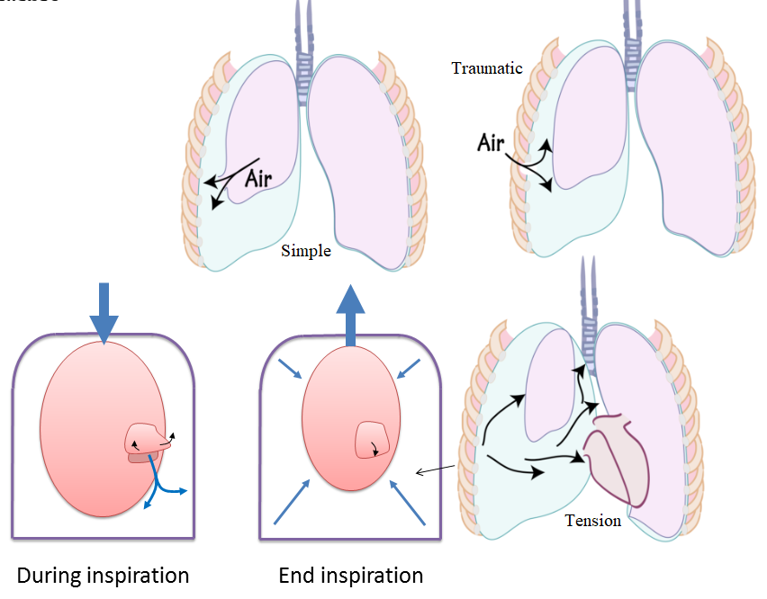
Types of Pneumothorax
Simple (spontaneous)
Traumatic
Tension pneumothorax

Slide 9
Simple Pneumothorax
A simple (or spontaneous) pneumothorax:
Most commonly, occurs as air enters the pleural space through the rupture of an air-filled bleb, blister, or bronchopleural fistula on the surface of the lung, allowing air from the airways to enter the pleural cavity.
It may be associated with diffuse interstitial lung disease and severe emphysema.

Slide 10
Pulmonary Blebs and Bullae
Pulmonary blebs and bullae are small subpleural thin-walled (less than 1 mm) air-containing spaces that are thought to occur as a result of subpleural alveolar rupture.
Blebs/Bullae themselves do not cause any symptoms and may be present for a long time before they rupture.
The difference between blebs and bullae that is bullae generally considered to be larger in their size than blebs (more than 1 cm in diameter).
Notes:
Blebs and Bullae: فقاعات هواء

Slide 11
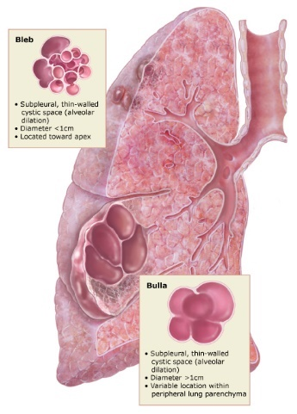
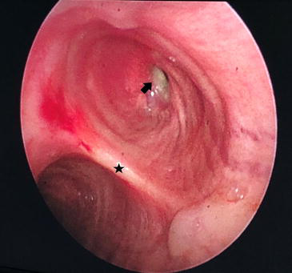
Pulmonary Blebs and Bullae

Slide 12
Clinical manifestation
• History of blunt chest trauma or blast injury
• Sudden onset of sharp, pleuritic chest pain
• Signs of respiratory distress: dyspnea and tachypnea
• Diminished breath sounds on the affected side
• Asymmetric chest wall movement
Notes:
صابة الانفجار هي نوع معقد من الصدمات الجسدية الناتجة عن التعرض المباشر أو غير المباشر للانفجار. تتراوح إصابات الانفجارات من إصابات الأعضاء الداخلية، بما في ذلك إصابات الرئة وإصابات الدماغ إلى إصابات الأطراف والحروق وإصابات السمع والبصر. Blast injury

Slide 13
Assessment
The trachea is midline,
Expansion of the chest is decreased,
Breath sounds may be diminished or absent,
Percussion of the chest may reveal normal sounds or Hyperresonance depending on the size of the pneumothorax.

Slide 14
Diagnostic Procedures/ Therapeutic Interventions
Diagnostic Procedures
Evidence of pneumothorax on chest x-ray
Therapeutic Interventions
Administer supplemental oxygen; continuous SpO2 monitoring.
If no contraindications, place patient in semi-Fowler’s position to promote chest expansion.
Prepare for chest tube insertion as indicated.
Notes:
Treatment includes thoracentesis & chest drainage tube

Slide 15
Traumatic Pneumothorax
A traumatic pneumothorax occurs when air escapes from a laceration in the lung itself and enters the pleural space or from a wound in the chest wall.
It may result from:
Blunt trauma: e.g., rib fractures (closed pneumothorax).
Penetrating chest or abdominal trauma: e.g., stab wounds or gunshot wounds.
Invasive thoracic procedures: i.e., thoracentesis, transbronchial lung biopsy, and insertion of a subclavian line (pleura is inadvertently punctured).
Notes:
Laceration: تمزق

Slide 16
Traumatic Pneumothorax
Chest surgery.
Diaphragmatic tears.
Barotrauma (pressure-related trauma) from mechanical ventilation.
A traumatic pneumothorax is often accompanied by hemothorax.
Hemothorax: collection of blood in the pleural space resulting from torn intercostal vessels, lacerations of the great vessels, or lacerations of the lungs.
Hemopneumothorax: both blood and air in the chest cavity which is also common after major trauma.

Slide 17
Traumatic Pneumothorax
Open pneumothorax: is one form of traumatic pneumothorax that occurs when a wound in the chest wall is large enough to allow air to pass freely in and out of the thoracic cavity with each respiration causing lung collapse and shifting of the mediastinum (heart and great vessels) toward the uninjured side with each inspiration and in the opposite direction with expiration. (This is termed mediastinal flutter or swing which produces serious circulatory problems).
Traumatic open pneumothorax calls for emergency interventions.
Stopping the flow of air through the opening in the chest wall is a lifesaving measure.

Slide 18
Clinical manifestations of Open pneumothorax
History of penetrating chest trauma; visible chest wound (may be as small as an ice pick hole)
Signs of respiratory distress: dyspnea, tachypnea, restlessness, and cyanosis.
“Sucking” sound heard with respiration (sucking chest wound).
Asymmetric chest expansion.
Bubbling of blood around a chest wound with exhalation.
Subcutaneous emphysema may also develop

Slide 19
Diagnostic Procedures
• Clinical assessment findings
• Chest x-ray show evidence of a pneumothorax

Slide 20
Therapeutic Interventions
Support airway and breathing; administer supplemental oxygen.
Immediately cover the wound with an occlusive dressing taped on three sides.
Observe patient closely for development of tension pneumothorax (increasing respiratory distress, jugular venous distension, hypotension).
If tension pneumothorax occurs, remove dressing immediately to relieve tension.
Prepare for immediate chest tube insertion.

Slide 21
Hemothorax
The accumulation of blood in the pleural space and may result from either blunt or penetrating trauma.
Often accompanied by a pneumothorax, bleeding is the result of laceration of the intercostal vessels or internal mammary arteries, or from direct lung parenchymal damage.
Massive hemothorax results from the rapid accumulation of more than 1500 mL of blood in the chest cavity and leads to respiratory and circulatory failure.

Slide 22
Hemothorax

Slide 23
Clinical Manifestation
Signs of respiratory distress: dyspnea and tachypnea
Pain on inspiration
Asymmetric chest wall movement
Clinical signs of hypovolemic shock: tachypnea, tachycardia, hypotension, cool clammy skin, decreased capillary refill, restlessness, and confusion
Decreased breath sounds on the affected side
Dullness to percussion on the affected side

Slide 24
Diagnostic Procedures
Draw serial CBCs: may show a decreasing hemoglobin and hematocrit
Chest x-ray: may show blunting of the costophrenic angle in the upright position
Notes:
costophrenic angle الزاوية الضلعية الحجابية

Slide 25
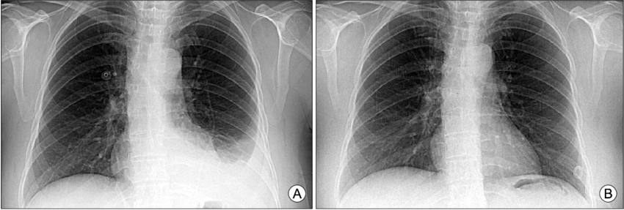
(A):Chest X-ray shows left costophrenic angle blunting which is indicated with left pleural effusion (B): it is improved with conservative treatment.

Slide 26
Therapeutic Interventions
Support airway and breathing; administer supplemental oxygen.
Restore circulating blood volume with intravenous crystalloids and blood products.
Assist with chest tube placement and provide chest tube and drainage system care.
Consider autotransfusion.
Prepare for emergent surgery if initial drainage is more than 1500 ml or initial drainage of 1000 mL is followed by 200 mL per hour for 2 to 4 hours.

Slide 27
Tension Pneumothorax
A tension pneumothorax occurs when air is drawn into the pleural space from a lacerated lung or through a small opening or wound in the chest wall.
In contrast to open pneumothorax, the air that enters the chest cavity with each inspiration is trapped; it cannot be expelled during expiration through the air passages or the opening in the chest wall (one-way valve or ball valve mechanism).

Slide 28
Tension Pneumothorax
With each breath (inhalation), tension (positive pressure) is increased within the affected pleural space.
This causes the lung to collapse and the heart, the great vessels, and the trachea to shift toward the unaffected side of the chest (mediastinal shift).

Slide 29
Tension Pneumothorax
Both respiration and circulatory function are compromised because of the increased intrathoracic pressure, which decreases venous return to the heart, causing decreased cardiac output and impairment of peripheral circulation (e.g., pulseless electrical activity (PEA)).

Slide 30
In open pneumothorax, air enters the chest during inspiration and exits during expiration.
A slight shift of the affected lung may occur because of a decrease in pressure as air moves out of the chest.

Slide 31
Tension Pneumothorax
In tension pneumothorax, air enters but cannot leave the chest.
As the pressure increases, the heart and great vessels are compressed and the mediastinal structures are shifted toward the opposite side of the chest.
The trachea is pushed from its normal midline position toward the opposite side of the chest, and the unaffected lung is compressed.

Slide 32
Assessment
Assess tracheal alignment, expansion of the chest, breath sounds, and percussion of the chest.
In a tension pneumothorax: the trachea is shifted away from the affected side, chest expansion may be decreased or fixed in a hyper-expansion state, breath sounds are diminished or absent, and percussion to the affected side is hyper-resonant.

Slide 33
Clinical Manifestations
Pain is usually sudden and may be pleuritic.
In a small, simple or uncomplicated pneumothorax: Chest discomfort and tachypnea.
In lung collapse: Acute respiratory distress occurs.
Dyspnea and air hunger.
Increased use of the accessory muscles.
May develop central cyanosis.
Notes:
Pleuritic chest pain: sharp pain, well localized in the affected area, exacerbated by Breathing (inspiration)

Slide 34
Medical Management
The goal of treatment is to evacuate the air or blood from the pleural space.
The pleural cavity can be decompressed by thoracentesis or by chest tube drainage of the blood or air.
If the pt. has pneumothorax, a small chest tube is inserted near the 2nd intercostal space. Because it is the thinnest part of the chest wall, minimizes the danger of contacting the thoracic nerve, and leaves a less visible scar.
If a patient also has a hemothorax, a large-diameter chest tube is inserted, usually in the 4th or 5th intercostal space at the midaxillary line, and suction is applied

Slide 35
Medical Management
Thoracotomy is performed if:
More than 1500 mL of blood is aspirated initially by thoracentesis (or is the initial chest tube output)
Or if chest tube output continues at greater than 200 mL/h,
Or if a cardiovascular injury secondary to chest or penetrating trauma is suspected.

Slide 36

Medical Management
Thoracotomy is a surgical procedure in which a cut is made between the ribs to see and reach the lungs or other organs in the chest or thorax.

Slide 37
Medical Management
In tension pneumothorax: a high concentration of supplemental oxygen to treat the hypoxemia.
A tension pneumothorax: can be decompressed by inserting a large-bore needle at the second intercostal space, midclavicular line on the affected side.
This relieves the pressure and vents the positive pressure to the external environment.
A chest tube is then inserted and connected to suction to remove the remaining air and fluid, reestablish the negative pressure, and re-expand the lung.

Slide 38
Cardiac Tamponade
Cardiac tamponade is the collection of blood or blood clots in the pericardial sac; the accumulating blood exerts pressure on the heart, limiting ventricular filling and decreasing cardiac output.
The decrease in cardiac function is directly related to both rate and amount of fluid accumulation.
If accumulation is rapid, as little as 100 to 150 mL of blood in the pericardial sac can adversely affect cardiac output.
The leading cause of cardiac tamponade is penetrating chest injuries (80% to 90%) such as stab wounds.

Slide 39
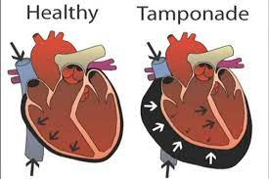
Cardiac Tamponade

Slide 40
Clinical manifestations
Chest pain
Tachycardia, tachypnea, and dyspnea
Beck’s triad (present in only about one third of patients with tamponade)
Hypotension
Muffled or distant heart sounds
Altered mental status
Pulsus paradoxus—a decrease in systolic blood pressure greater than 10 mm Hg during inspiration, caused by a decrease in venous return.
Notes:
Beck’s triad, 1- Hypotension, 2- distension of the jugular veins, and 3- muffled or diminished heart sounds on cardiac auscultation

Slide 41
Diagnostic Procedures
ECG may show: • Low-voltage QRS complexes • Pulseless electrical activity • Electrical alternans—alternating amplitude of QRS complexes.
Chest x-ray may be normal initially; possibly widened mediastinum or enlarged heart shadow
Bedside echo
Chest CT scan if patient is hemodynamically stable

Slide 42
Therapeutic Interventions
Support airway, breathing, and circulation; administer supplemental oxygen.
Rapid infusion of intravenous fluids to increase cardiac filling pressures.
In the hemodynamically unstable patient, needle pericardiocentesis may be needed to temporarily decompress the heart, “buying time” for transfer to the operating room or tertiary center.
Surgical intervention is generally needed.
Notes:
The treatment of cardiac tamponade can be performed at the bedside or in the operating room
The treatment of cardiac tamponade is the removal of pericardial fluid to help relieve the pressure surrounding the heart. This can be done by performing a needle pericardiocentesis at the bedside, performed either using traditional landmark technique in a sub-xiphoid window or using a point-of-care echo to guide needle placement in real-time. Often the removal of the first small amounts of fluid can make a large improvement in hemodynamics, but leaving a catheter within the pericardium can allow for further drainage.
Surgical options include creating a pericardial window or removing the pericardium. Emergency department resuscitative thoracotomy and the opening of the pericardial sac is a therapy that can be used in traumatic arrests with suspected or confirmed cardiac tamponade. These options are preferable to needle pericardiocentesis for traumatic pericardial effusions.

Slide 43
END OF THE LECTURE
THANK YOU

