Slide 1
Cardiac and great vessel injury

Slide 2
Intended learning outcomes
Identify the etiologies and consequences of cardiac and great vessels trauma.
Discuss clinical presentations of cardiac and great vessels trauma.
Recognize diagnostic strategies for cardiac and great vessels trauma.
Identify medical and nursing management of cardiac and great vessels trauma.

Slide 3
Introduction
Although the heart appears to be protected by bony structures, in reality it is highly vulnerable to injury.
Traumatic heart injuries can be categorized based on the mechanism and type of injury.
Traumatic injuries often result from blunt or penetrating trauma to the chest and can affect various structures within and around the heart.

Slide 4
Introduction
Blunt and penetrating cardiac and great vessels trauma are serious injuries associated with life-threatening consequences and need urgent intervention.
In penetrating injuries, up to 90% of victims die before reaching hospital and resuscitation is of limited benefit; therefore, survival depends on rapid pre-hospital intervention
Aorta and great vessels are most commonly injured in blunt manner. The majority of patients succumb to this type of injury and do not survive to present to the hospital.

Slide 5
Blunt cardiac injuries (BCI)
Blunt cardiac injuries refer to trauma to the heart that occurs without penetration or an open wound.
These injuries are typically caused by blunt force trauma, such as that sustained in motor vehicle accidents, falls, or assaults.
Blunt cardiac injury is most commonly due to motor vehicle collisions (50%).
The myocardial changes associated with BCI can range from scattered areas of petechiae and microscopic contusion to lacerations and full thickness wall damage.

Slide 6
Blunt cardiac injuries (BCI)
Blunt cardiac injuries include Cardiac Contusion, Pericardial Effusion, Myocardial Rupture, Blunt trauma to the aorta and other vessels, and Blunt trauma to the valves.
In BCI, the most common associated injuries are:
Rib fractures (18-69%),
Lung contusion (6-58%),
Flail chest (3-38%),
Sternal fracture (0-60%),
Head injury (20-73%),
abdominal solid organ injury

Slide 7
Cardiac Contusion
Cardiac contusion refers to a bruise or injury to the heart muscle (myocardium) caused by blunt force trauma to the chest.
Most common causes: motor vehicle accidents, falls, or physical assaults.
The severity of a cardiac contusion can vary, ranging from mild to severe, and it may lead to a wide range of symptoms and complications.

Slide 8
Cardiac Contusion
The symptoms of cardiac contusion can vary widely and may not be immediately apparent.
Common symptoms include chest pain which may be mild to severe, generally does not radiate to the arm or jaw, and is unrelieved by nitroglycerin
Chest wall contusions and abrasions
Tachycardia and hypotension
Dyspnea
Possibly signs of cardiac tamponade
Other symptoms may include arrhythmias, difficulty breathing, fatigue, and signs of heart failure.

Slide 9
Cardiac Contusion
Diagnostic Procedures:
High index of suspicion based on mechanism of injury
Continuous cardiac monitoring may reveal sinus tachycardia, premature ventricular or atrial contractions, atrial fibrillation
12-lead ECG may show elevated ST segments and right bundle branch block pattern
Transesophageal or transthoracic echocardiogram to identify abnormal left ventricular wall motion
Creatine kinase MB and troponin may be elevated but this finding is not an accurate predictor of BCI

Slide 10
Cardiac contusion
Therapeutic Interventions:
Management vary depending on the severity of signs and symptoms
Mild cases of cardiac contusion may require only observation and supportive care.
Severe cases necessitate hospitalization, monitoring, and interventions based on the specific complications.
Administer supplemental oxygen.
Place patient in the semi-Fowler’s position and allow bed rest.
Administer analgesia for chest pain.
Transfer patient to ICU for hemodynamic and cardiac monitoring.
If there are signs of cardiac failure, use vasopressors to maintain systolic blood pressure of 90 mm Hg and inotropes to improve contractility

Slide 11
Myocardial Rupture
Traumatic myocardial rupture may involve:
Perforation of the ventricles (most commonly) or atria
Laceration or rupture of the ventricular septum or valvular apparatus (leaflets, chordae tendineae, papillary muscle).
The most common cause of myocardial rupture is a high-speed motor vehicle crash (MVC). It is almost always immediately fatal with death resulting from exsanguination or cardiac tamponade.

Slide 12
Myocardial Rupture
Signs and Symptoms
Signs and Symptoms consistent with exsanguination (uncontrolled hemorrhage) or cardiac tamponade:
Severe hypotension unresponsive to fluid resuscitation
Distended neck veins; may be absent with hypovolemia
Distant heart sounds
Loud, harsh murmur
Cyanosis of upper torso, arms, and head
May be little evidence of thoracic trauma or massive chest injuries

Slide 13
Myocardial Rupture
Diagnostic Procedures
Chest radiograph to detect other chest injuries such as hemopneumothorax
FAST (Focused Assessment With Sonography in Trauma ) examination,
Transthoracic echocardiogram (TTE)
Transesophageal echocardiogram (TEE)

Slide 14
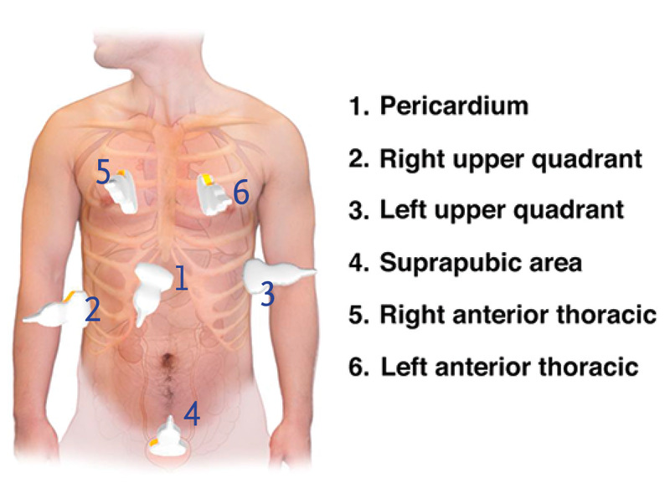
FAST Examination in thoracic injuries

Slide 15
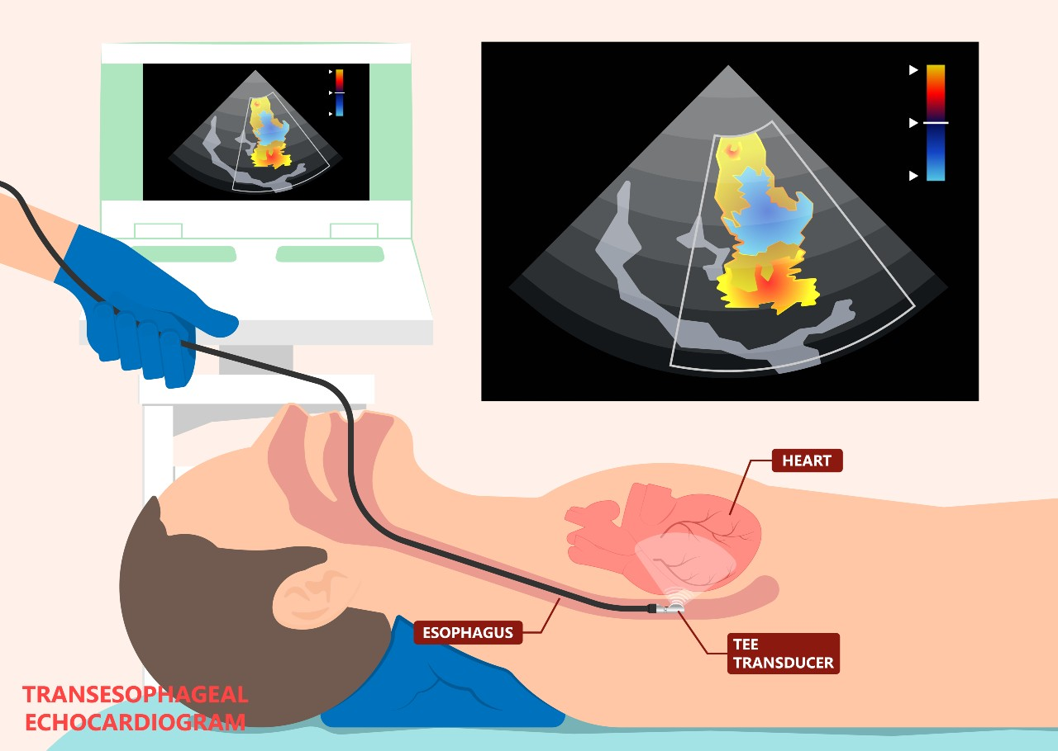
Transesophageal echocardiogram (TEE)

Slide 16
Myocardial Rupture
Therapeutic Interventions:
Minimize prehospital on-scene time (“load and go”), particularly in urban settings.
Immediate surgical intervention is the treatment of choice.
Pericardiocentesis may be performed as a temporary measure until surgery can be performed.
If patient arrives at the ED with vital signs and then experiences cardiopulmonary arrest, open thoracotomy (resuscitative thoracotomy) should be considered

Slide 17
Pericardial effusion and cardiac tamponade
Traumatic pericardial effusion refers to the accumulation of blood or fluid in the pericardial sac surrounding the heart as a result of blunt or penetrating chest trauma.
Normally, the pericardial sac contains about 20 mL of fluid, which is needed to decrease friction for the beating heart.
An increase in pericardial fluid raises the pressure within the pericardial sac and compresses the heart.

Slide 18
Pericardial effusion and cardiac tamponade
This has the following effects:
Elevated pressure in all cardiac chambers
Decreased venous return due to atrial compression
Inability of the ventricles to distend and fill adequately
Pericardial fluid may build up slowly without causing noticeable symptoms until a large amount (1 to 2 L) accumulates.

Slide 19
Pericardial effusion and cardiac tamponade
A rapidly developing effusion (e.g., hemorrhage into the pericardial sac from chest trauma) can quickly stretch the pericardium to its maximum size and cause an acute problem and can result in cardiac tamponade.

Slide 20
Clinical Manifestations
chest pain
tachypnea
dyspnea
JVD results from poor right atrial filling and increased venous pressure.
Hypotension occurs from low CO,
heart sounds are often muted.

Slide 21
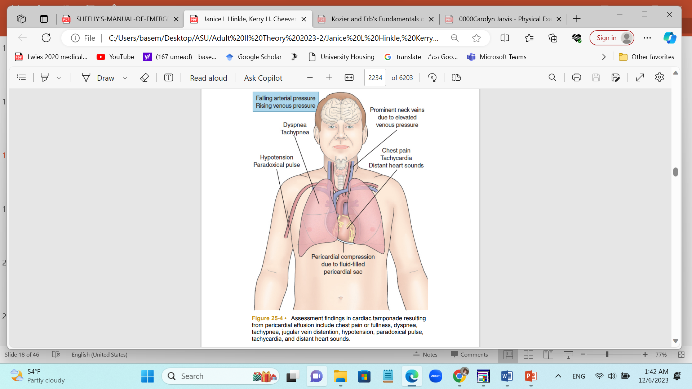

Slide 22
Pericardial effusion and cardiac tamponade
Assessment and Diagnostic Findings
An echocardiogram is performed to confirm the diagnosis and quantify the amount of pericardial fluid.
A chest x-ray may show an enlarged cardiac shadow due to pericardial effusion.
The ECG shows tachycardia and may also show low voltage

Slide 23
Pericardial effusion and cardiac tamponade
Medical Management:
Pericardiocentesis: If cardiac function becomes seriously impaired, pericardiocentesis (puncture of the pericardial sac to aspirate pericardial fluid) is performed.
Catheter pericardiocentesis is performed using echocardiography to guide placement of the drainage catheter
During this procedure, the patient is monitored by continuous ECG and frequent vital signs.

Slide 24
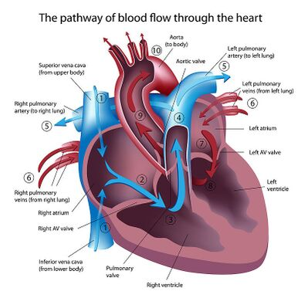
Great vessels injuries
Great vessels are major blood vessels that originate from the heart and play a crucial role in the circulation of blood throughout the body.
These vessels are susceptible to injury in cases of severe chest trauma, whether the trauma is blunt or penetrating.

Slide 25
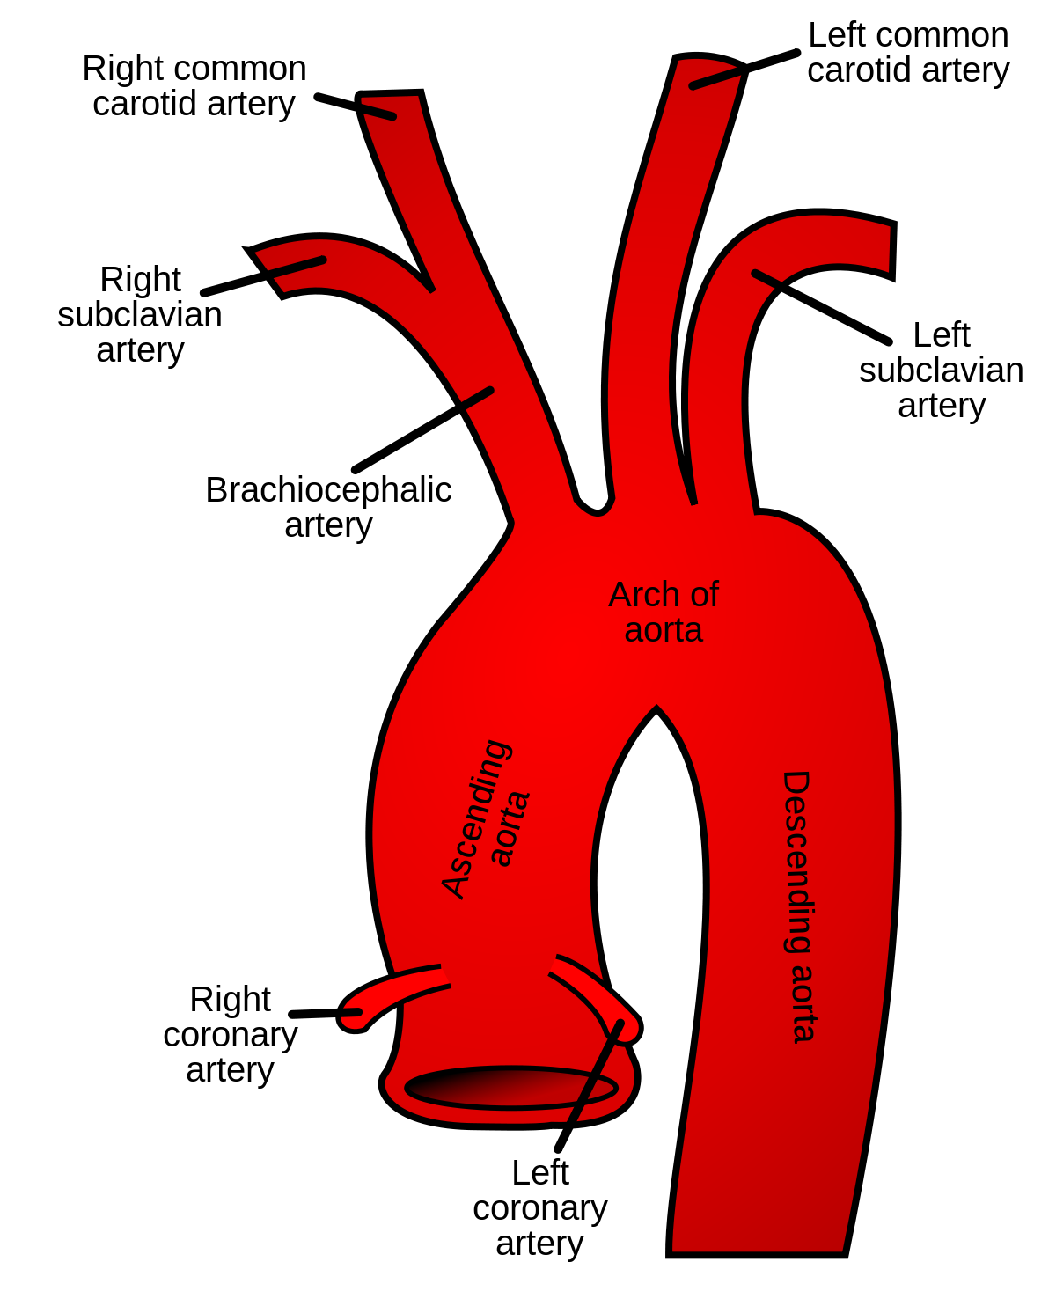
Great vessels injuries
The great vessels most commonly at risk for injury in chest trauma include:
1- Aorta: the largest artery in the body and arises from the left ventricle of the heart. It descends through the chest and abdomen.
Blunt chest trauma can lead to various injuries, including aortic dissection or rupture.

Slide 26
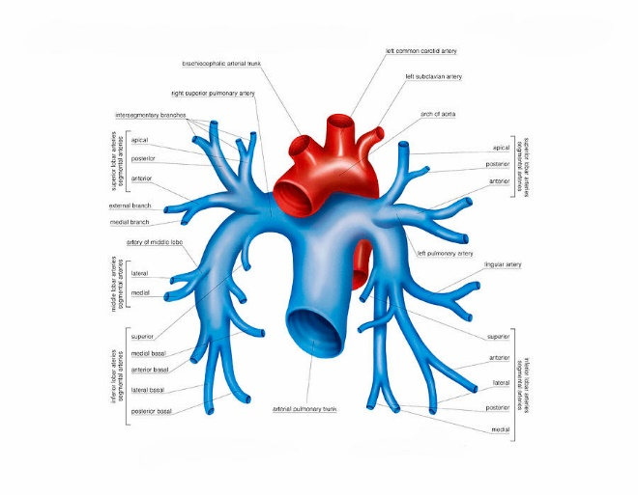
Great vessels injuries
2- Pulmonary Artery: The pulmonary artery carries deoxygenated blood from the right ventricle of the heart to the lungs for oxygenation.
Trauma can leads to conditions such as pulmonary artery dissection or rupture.

Slide 27
Great vessels injuries
3- Superior Vena Cava (SVC): a large vein that carries deoxygenated blood from the upper body to the right atrium of the heart.
Trauma, especially in the upper chest, can compress or injure the SVC, causing conditions like SVC syndrome.
4- Brachiocephalic Artery: a major branch of the aorta, supplying blood to the right arm, right side of the head, and neck.
5- Subclavian Arteries and Veins: The subclavian arteries supply blood to the arms, while the subclavian veins return deoxygenated blood from the arms to the heart.

Slide 28
Great vessels injuries
6- Pulmonary Veins: carry oxygenated blood from the lungs to the left atrium of the heart.
7- Coronary Arteries: Coronary arteries supply blood to the heart muscle itself.
Trauma can cause coronary artery dissection or rupture.
8- Coronary Veins: collect deoxygenated blood from the heart muscle and return it to the right atrium.

Slide 29
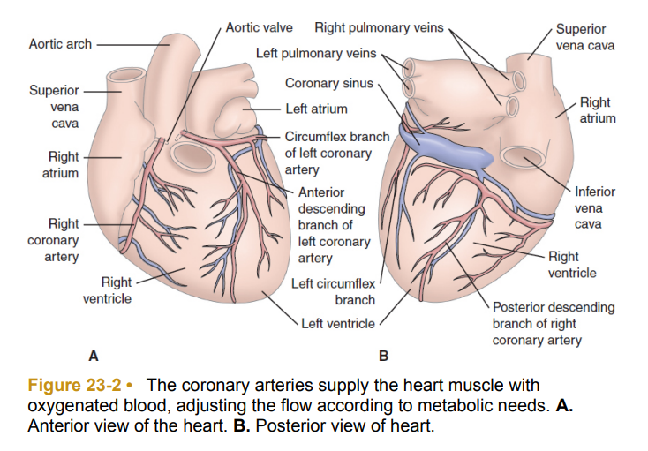
Coronary Arteries and veins

Slide 30
Great vessels injuries
Aortic Dissection:
Description: Tear in the inner lining of the aorta.
Mechanism: Often associated with sudden, severe chest or back trauma.
Clinical Features: Severe chest or back pain, depending on the location of the tear.
Aortic Rupture:
Description: Catastrophic tear or rupture of the aorta.
Mechanism: Typically associated with high-energy trauma, such as a severe car crash.
Clinical Features: Sudden and severe chest or back pain, signs of shock.
Coronary Artery Injury:
Description: Trauma causing damage to the coronary arteries.
Mechanism: Direct blow to the chest.
Clinical Features: Can lead to myocardial infarction (heart attack), presenting with chest pain and other symptoms.

Slide 31
Great vessels injuries
Primary cause of death in patients with cardiac and great vessels injuries is exsanguination, which occurs in up to 20% of patients who arrived to the hospital alive; therefore, time to diagnosis is of paramount importance.
The absence of clear, sign and symptoms, make the diagnosis of cardiac and great vessels injury difficult.
The signs and symptoms most frequently reported are chest pain, hypotension, elevated central venous pressure, tachycardia, upper body cyanosis, unresponsiveness, and increased heart shadow on chest X-ray

Slide 32
Great vessels injuries
A careful history and dynamic physical examination and injury evaluation is crucial to get early diagnosis.
Cardiac and/or great vessels injuries should be highly suspected when there is involvement of the cardiac diamond, region bounded by the sternal notch superiorly, the nipples laterally and the umbilicus inferiorly.
The injury-severity score (ISS) system is used in clinical practice to classify the type and severity of cardiac and great vessels injuries with the aim to grade them and to guide management.

Slide 33
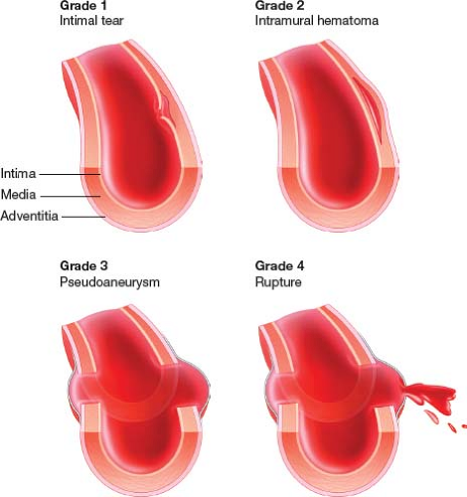
Classification system for traumatic aortic injuries

Slide 34
Great vessels injuries
Diagnostic Imaging:
Computed Tomography (CT) Scan: is often used to assess the extent and location of great vessel injuries.
Angiography: In some cases, angiography may be used to visualize the blood vessels and identify the site of injury.

Slide 35
Management of great vessel injuries
Management of great vessel injuries depends on the grade of injury and severity of signs and symptom. It may involves prompt assessment, supportive treatment, and surgical intervention.
Primary Assessment and Stabilization:
Emergency Medical Services (EMS): Activate EMS for immediate transportation to the hospital.
Airway, Breathing, Circulation (ABCs): Ensure an open airway, assess breathing, and address any circulatory compromise.
Hemodynamic Support: Initiate measures to maintain blood pressure and tissue perfusion. Administer fluids and blood products as needed. Medications may be used to maintain a target blood pressure.

Slide 36
Management of great vessel injuries
Surgical Intervention:
Thoracotomy: An emergency thoracotomy may be performed to gain direct access to the chest and repair the injured vessels. This is particularly relevant for penetrating injuries or in cases of suspected aortic injury.
Endovascular Repair: In certain situations, endovascular procedures such as stent placement or embolization may be considered to repair or stabilize the injured vessels.

Slide 37
Management of great vessel injuries
Pain Management and Comfort Measures:
Pain Control: Adequate pain management is important for patient comfort and recovery.
Psychosocial Support: Given the severity of these injuries, patients and their families may benefit from psychosocial support.
Anticoagulation and Antiplatelet Therapy:
Anticoagulation: Depending on the nature of the injury and the overall clinical situation, anticoagulation may be initiated to prevent clot formation.
Antiplatelet Agents: In some cases, antiplatelet medications may be considered.
Long-Term Follow-Up:
Imaging Studies: Periodic imaging studies, such as CT scans or angiography, may be performed to assess the healing of vessels and detect any potential complications.

Slide 38
Penetrating cardiac injuries
Penetrating Cardiac Wounds:
Mechanism: Stab wounds or gunshot wounds are common causes.
Clinical Features: Symptoms can vary but may include chest pain, shortness of breath, rapid heart rate, and signs of shock.
Diagnosis: ECG, echocardiography, and imaging studies help assess the extent of injury.

Slide 39
Penetrating cardiac injuries
Pericardial Tamponade:
Description: Accumulation of blood in the pericardial sac, compressing the heart.
Clinical Features: Beck's triad (hypotension, muffled heart sounds, jugular venous distension).
Diagnosis: Echocardiography is essential for confirming the diagnosis.

Slide 40
Penetrating cardiac injuries
Myocardial Injury:
Description: Injury to the heart muscle, potentially leading to myocardial infarction.
Clinical Features: Chest pain, arrhythmias, and signs of heart failure.
Diagnosis: ECG changes, cardiac enzymes, and imaging studies.

Slide 41
Management of penetrating cardiac and great vessel injuries
Management requires a multidisciplinary approach involving trauma surgeons, cardiovascular surgeons, anesthesiologists, and critical care specialists.
Timely intervention and a systematic approach to resuscitation and surgery are critical for optimizing outcomes

Slide 42
Management of penetrating cardiac and great vessel injuries
Emergency Resuscitation:
Immediate attention to ABCs (Airway, Breathing, Circulation).
Stabilization with intravenous fluids and blood products. Inotropic support may be required.
Diagnostic Imaging:
CT scans, echocardiography, angiography for assessing the extent of injury.
Surgical Intervention:
Emergency thoracotomy may be performed to directly access the chest and repair injuries.
Cardiac or vascular surgery for definitive repair.
Anticoagulation and Antiplatelet Therapy:
Depending on the situation, anticoagulation may be initiated to prevent thrombosis.

Slide 43
Traumatic valvular injuries
Traumatic valvular injuries refer to damage to the heart valves that occurs as a result of blunt or penetrating chest trauma.
The heart valves play a crucial role in maintaining the unidirectional flow of blood through the heart chambers.
When these valves are injured, it can lead to valvular insufficiency (leakage) or stenosis (narrowing), disrupting the normal function of the heart.
Traumatic valvular injuries are relatively uncommon but can have serious consequences. Here are some aspects of traumatic valvular injuries:

Slide 44
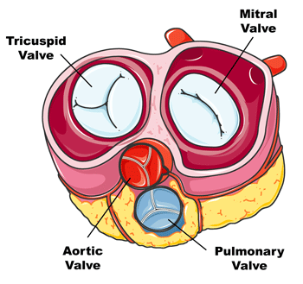
Heart valves

Slide 45
Types of Valves Most Affected
Mitral Valve:
Susceptibility: The mitral valve, located between the left atrium and left ventricle, is often susceptible to traumatic injuries due to its anatomical position.
Consequences: Traumatic mitral valve injuries can result in regurgitation (leakage) or stenosis.
Aortic Valve:
Susceptibility: The aortic valve, situated between the left ventricle and the aorta, can be affected by trauma.
Consequences: Traumatic injuries to the aortic valve may lead to regurgitation or stenosis.

Slide 46
Types of Traumatic Valvular Injuries
Valvular Rupture or Tear:
Mechanism: Direct trauma to the chest can cause tears or ruptures in the valve leaflets.
Clinical Features: Symptoms may include chest pain, palpitations, and signs of heart failure.
Valvular Avulsion:
Mechanism: Severe trauma may lead to the complete avulsion (tearing away) of a heart valve.
Clinical Features: Rapid onset of symptoms, including severe chest pain and hemodynamic instability.

Slide 47
Diagnosis
Clinical Evaluation:
Symptoms: Chest pain, shortness of breath, palpitations, and signs of heart failure.
Physical Examination: Murmurs, abnormal heart sounds, and signs of cardiovascular compromise.
Echocardiography:
Transthoracic Echocardiogram (TTE): Initial imaging to assess valve structure and function.
Transesophageal Echocardiogram (TEE): Provides a more detailed view of the valves and surrounding structures.
Cardiac Catheterization:
Angiography: Invasive procedure to visualize blood flow and assess valvular function.

Slide 48
Management of valvula injuries
Stabilization:
ABCs (Airway, Breathing, Circulation): Immediate attention to resuscitation.
Hemodynamic Support: Intravenous fluids and blood products as needed.
Medical Management:
Hemodynamic Support: Inotropic agents may be used to support cardiac function.
Antiarrhythmic Medications: If arrhythmias are present.
Surgical Intervention:
Valvular Repair (valvuloplasty) or Replacement: Depending on the extent of the injury, surgical repair or replacement of the damaged valve may be necessary.

Slide 49
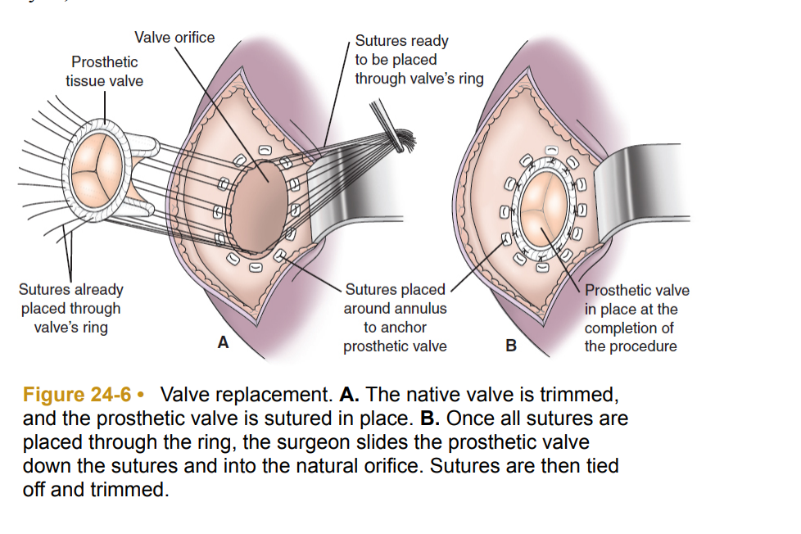

Slide 50
END OF THE LECTURE
THANK YOU

