Slide 1
Head Trauma (2)

Slide 2
Outline
Specific head injury conditions:
Diffuse Brain Injuries (Concussions and DAI)
Focal Brain Injuries (contusions and several types of hematomas)
Special considerations to head injury
Increased Intracranial Pressure
Herniation
Seizures After Head Trauma

Slide 3
Intended Learning Outcomes
Describe the mechanisms of injury, clinical signs and symptoms, diagnostic testing, and treatment options for patients with Diffuse Brain Injuries
Describe the mechanisms of injury, clinical signs and symptoms, diagnostic testing, and treatment options for patients with Focal Brain Injuries
Use the nursing process as a framework for care of the patient with traumatic brain injury.
Discuss special considerations to head injuries including increased intracranial pressure, herniation, and seizures after head trauma

Slide 4
Diffuse Brain Injuries (it involve the entire brain)/ A. Concussion
A-Concussion Concussion results from acceleration, deceleration, or blast injuries that cause brain movement within the bony skull.
A brief interruption of the reticular activating system occurs, causing a short period of diminished consciousness.
Duration of loss of consciousness is usually less than 5 minutes but by definition may be as long as 6 hours?
A concussion is a transient, limited process that usually requires no therapeutic intervention, although patients occasionally require months to recover fully.
Concussion often accompanies other, more significant brain injuries.

Slide 5
Diffuse Brain Injuries / A. Concussion
Signs and symptoms Common • Loss or dimming of consciousness • Flaccid paralysis (while unconscious) • Dizziness, vertigo • Headache • Retrograde (posttraumatic) amnesia • Nausea, vomiting • Visual disturbances Occasional • Behavior disorders • Hypertension or hypotension • Apnea • Seizures

Slide 6
Diffuse Brain Injuries/ A. Concussion
Diagnosis • History of a sudden loss of consciousness • Serial neurologic examinations • Computed tomography (CT) scan will be normal if concussion is the only injury • MRI may show subtle changes, but is rarely clinically indicated.

Slide 7
Diffuse Brain Injuries/ A. Concussion
Therapeutic interventions • Immobilize and evaluate the cervical spine . • Perform serial observations of level of consciousness. • Administer nonnarcotic analgesics for headache. • Admit to the hospital for observation if the following are present:
Level of consciousness does not quickly return to normal.
Vomiting is severe.
The skull is fractured.
Discharge home if a family member or friend can reliably follow careful verbal and written aftercare instructions
• Encourage the patient to obtain follow-up neuropsychiatric consultation for any post-concussive syndrome symptoms.

Slide 8
Diffuse Brain Injuries/ B-Postconcussive syndrome
Late sequelae of concussion may include the following: • Headache • Syncopal episodes • Nausea • Loss of coordination • Memory loss
Numbness
Decreased concentration • Tinnitus (ringing in the ears) • Decreased organizational skills • Diplopia (double vision) • Difficulty handling multiple tasks

Slide 9
Diffuse Brain Injuries/ C. Diffuse axonal injury
A diffuse axonal injury (DAI) is the most severe form of diffuse brain injury and differs from concussion in degree, rather than in type of brain injury.
Tension, shearing, and compression strains—created by rotational acceleration forces—cause widespread, microscopic axonal disruption throughout the brain.
Severity and outcome depend on the extent and degree of structural damage. This injury is almost always associated with high-speed motor vehicle crashes.

Slide 10
Diffuse Brain Injuries/ C. Diffuse axonal injury
Signs and symptoms
• Immediate and prolonged coma lasting greater than 6 hours
• Abnormal posturing
• Confusion, amnesia, and behavioral problems following coma emergence
• Possible persistent vegetative state

Slide 11
Diffuse Brain Injuries/C. Diffuse axonal injury
Diagnosis
• History of sudden loss of consciousness following head injury
• Serial neurologic examinations
• Initial CT scan: Small hemorrhagic lesions may be visible, or the CT scan may be negative if DAI is the only injury. Subsequent CT scans (days to weeks following injury) will show diffuse cerebral edema, neuronal loss, and brain shrinkage.
• MRI will show lesions more effectively than CT, particularly in the early acute phase, but this study rarely is indicated emergently.
Therapeutic interventions
The same as Management of Patients With Severe Traumatic Brain Injuries.

Slide 12
Focal Brain Injuries (it has identifiable area of involvement)/ A. Contusion
A contusion is a bruising of the surface of the brain. Findings and prognosis vary extensively based on contusion size and location.
Signs and symptoms • Altered level of consciousness for more than 6 hours • Nausea, vomiting
Visual disturbances • Neurologic dysfunction • Weakness • Ataxia (lack of coordination of muscle movements, leading to unsteady and clumsy motion) • Hemiparesis (one-sided muscle weakness) • Confusion • Speech problems • Posttraumatic seizures

Slide 13
Focal Brain injuries/ A. Contusion
Diagnosis
CT scan
MRI
Therapeutic interventions • Immobilize and evaluate the cervical spine. • Admit to the hospital for observation. • Administer antiemetics as needed. • See Management of Patients With Severe Traumatic Brain Injuries. • Surgical intervention may be performed as indicated

Slide 14
Focal Brain Injuries/ B. Intracranial bleeding
The three meningeal layers of the brain (from outer to proximal) are the dura mater, the arachnoid mater, and the pia mater.
Bleeding sites in the head are named according to their location with respect to these meningeal layers.
Hematomas are collections of blood in the brain that may be epidural (above the dura), subdural (below the dura), or intracerebral (within the brain)

Slide 15
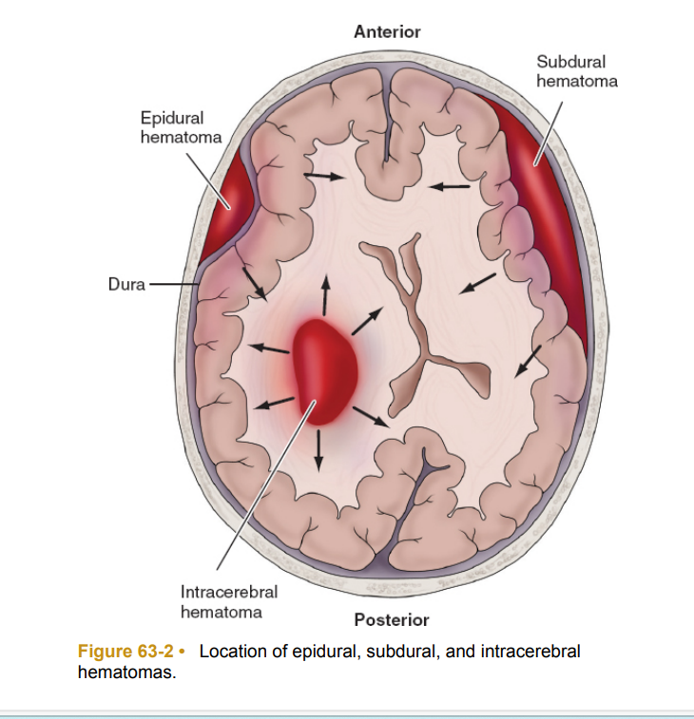

Slide 16
Focal Brain Injuries/ B. Intracranial bleeding
1. Epidural (extradural) hematomas An epidural hematoma is a collection of blood between the skull and the dura mater.
Epidural hematomas occur in only 1% to 2% of all traumatic brain injuries. This bleeding is usually arterial.
The most common cause is a rupture or tear of the middle meningeal artery that runs directly beneath the fractured temporal bone.
Venous bleeding is rare and may be manageable medically.
Deterioration is generally rapid because accumulating arterial blood causes increasing pressure on the brain tissue, resulting in uncal herniation.
- Mortality is about 8%, the lowest of all intracranial hematomas.

Slide 17
Focal Brain Injuries/ B. Intracranial bleeding
Signs and symptoms
Agitation and complaint of severe headache or • Sudden loss of consciousness or • Progressive loss of consciousness or • Short period of unconsciousness (concussion) followed by a lucid interval (as the concussion resolves) and then a subsequent deterioration of consciousness caused by accumulating pressure from the bleed • Contralateral (opposite side) weakness or hemiparesis • Ipsilateral (same side) dilated pupil • Bradycardia • Increased blood pressure • Abnormal respiratory patterns

Slide 18
Focal Brain Injuries/ B. Intracranial bleeding
Diagnosis • Emergent CT scan • Burr holes (rarely done since the advent of ready access to CT scans and neurosurgery) • Increased ICP
Therapeutic interventions • See Management of Patients With Severe Traumatic Brain Injuries. • Emergent surgical evacuation may be required.

Slide 19
Focal Brain Injuries/ B. Intracranial bleeding
2. Subdural hematoma
A subdural hematoma results from hemorrhage between the dura and the arachnoid mater in the subdural space.
The cause of acute bleeding is generally severe blunt trauma, such as an acceleration/deceleration incident, in which cortical tissue is lacerated, bridging veins between the cortex and venous sinuses are torn, or a dural tear into a venous sinus occurs.
Subdural hematomas are much more common than epidural hematomas. They are reported to occur in 10% to 20% of traumatic brain injuries and have the highest mortality rate (50% to 60%).

Slide 20
Focal Brain Injuries/ B. Intracranial bleeding
Bleeding is bilateral in 15% to 20% of cases. Subdural hematomas may develop rapidly (acute) or over a period of days or weeks (subacute or chronic).
In alcoholics and the elderly, chronic subdural bleeds may develop a traumatically or following minor injury.
The most common cause of subdural hematoma in persons less than 1 year of age is child maltreatment (shaken baby syndrome).
If bleeding is not surgically controlled in a timely manner, pressure from an acute expanding subdural hematoma can cause transtentorial herniation and death

Slide 21
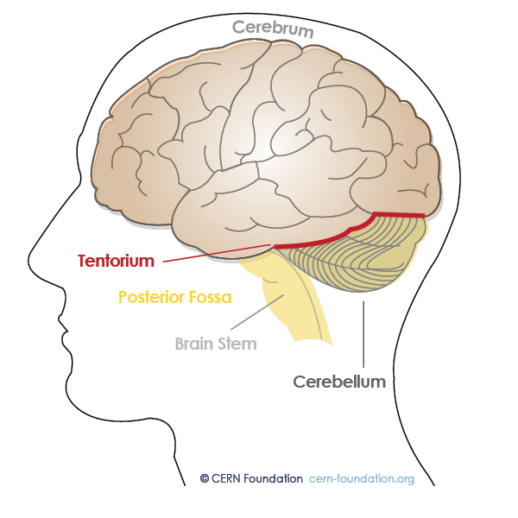
The tentorium cerebelli
The tentorium cerebelli is a crescent-shaped fold of the dura mater that separates the cerebrum (the large upper part of the brain) from the cerebellum (located at the back and bottom of the brain).

Slide 22
Focal Brain Injuries/ B. Intracranial bleeding
Signs and symptoms
Acute subdural hematoma
• Headache
• Sudden or progressive loss of consciousness
• Positive Babinski reflex
• Fixed and dilated pupil(s) (first ipsilateral and then bilateral)
• Contralateral hemiparesis
• Progression from hyperreflexia to abnormal flexion to abnormal extension to flaccidity

Slide 23
Focal Brain Injuries/ B. Intracranial bleeding
Signs and symptoms (cont.)
Abnormal respiratory patterns (type depends on the level of involvement)
• Elevated temperature
• Increased ICP
• Nausea and/or vomiting
--Subacute (24 hours to 2 weeks after injury) and chronic (2 weeks to months after injury) subdural hematoma
-Headache -Ataxia -Incontinence -Increasing confusion/dementia
-Decreasing level of consciousness Worsening nausea and/or vomiting

Slide 24
Focal Brain Injuries/ B. Intracranial bleeding
Diagnosis • Clinical findings
• Emergent CT scan. The old (isodense) blood of chronic subdural hematomas may be difficult to visualize on CT.
Therapeutic interventions
(Acute subdural hematoma )
• See Management of Patients with Severe Traumatic Brain Injuries. Subacute and chronic subdural hematoma • Surgical evacuation of the clot or burr holes with gradual drainage of the hematoma to prevent recurrence

Slide 25
Focal Brain Injuries/B. Intracranial bleeding
Traumatic subarachnoid hemorrhage A subarachnoid hemorrhage occurs between the arachnoid membrane and the pia mater. This can result from head injury, severe hypertension, or aneurysm or arteriovenous malformation rupture.
The most common cause of subarachnoid hemorrhage is trauma. However, the most devastating bleeds are generally aneurysmal.

Slide 26
Focal Brain Injuries/ B. Intracranial bleeding
Signs and symptoms
Nuchal rigidity
Headache
Vomiting
Photophobia

Slide 27
Focal Brain Injuries/ B. Intracranial bleeding
Diagnosis • Clinical signs and symptoms • CT scan • Blood in the CSF
Therapeutic interventions • Because traumatic subarachnoid hemorrhage is rarely the primary brain injury, treatment focuses on associated conditions. • Bloody CSF, which can lead to the development of obstructive hydrocephalus, may be drained through a ventriculostomy or shunt.

Slide 28
Focal Brain Injuries/ B. Intracranial bleeding
Intracerebral (brain) hemorrhage -Traumatic intracerebral hemorrhage involves bleeding into brain tissue or the ventricles.
Signs and symptoms • Presenting signs and symptoms vary dramatically based on the size, location, and number of hemorrhagic sites and on the presence of concomitant injuries.
• Loss of consciousness • Abnormal size of pupil(s) • Abnormal respiratory patterns • Abnormal motor function

Slide 29
Focal Brain Injuries/ B. Intracranial bleeding
Diagnosis • Clinical observation • CT scan • Magnetic resonance imaging
Therapeutic interventions See Management of Patients with Severe Traumatic Brain Injuries.

Slide 30
Penetrating injuries
Penetrating trauma to the head includes gunshot wounds, stab wounds, missile wounds, and impalement injuries.
Because of the high velocity of bullets, bullet wounds have a devastating effect on extensive areas of fragile brain tissue.
Objects impaled in the cranial vault commonly travel at much lower velocities. Consequently, they may or may not produce severe injury.
The extent of trauma depends on the location of the wound and on the size and velocity of the penetrating object.

Slide 31
Penetrating injuries
Diagnosis • Direct observation • Skull radiography • CT scan
Therapeutic interventions • See Management of Patients with Severe Traumatic Brain Injuries. • Impaled objects: • Do not attempt to remove impaled objects. • Stabilize impaled objects to prevent movement or dislodgment. • Control associated bleeding. • Apply a sterile dressing around the impaled object. • Ensure tetanus prophylaxis.

Slide 32
SPECIAL CONSIDERATIONS
A-Increased Intracranial Pressure
The brain, along with its CSF and blood, are contained within a rigid skull that allows little space for expansion.
When one of these components increases, the others attempt to compensate by reducing their volume, thereby maintaining a constant ICP.

Slide 33
SPECIAL CONSIDERATIONS
Such compensation is effective only for slight or gradual increases in volume. If volume increase is extensive or rapid, ICP will rise.
When ICP exceeds mean arterial pressure (MAP), all blood flow to the brain ceases. Therefore management of brain-injured patients focuses heavily on avoiding or moderating increases in ICP and subsequent secondary brain trauma.

Slide 34
SPECIAL CONSIDERATIONS
B- Herniation Herniation occurs whenever portions of the brain extend beyond their normal location and impinge on other areas of brain tissue.
Herniation can result from an expanding hematoma, cerebral edema, or a mass (e.g., tumor or impaled object) that propels brain tissue toward the path of least resistance. 1-Uncal (or lateral, transtentorial) herniation -It occurs when a lesion in the temporal lobe region causes the uncus (inner portion of the temporal lobe) to be pushed toward the midline and then over the edge of the tentorium.

Slide 35
SPECIAL CONSIDERATIONS
Early signs of transtentorial herniation
Decreasing level of consciousness
Ipsilateral pupil dilation Cheyne-Stokes respirations
Contralateral hemiparesis Positive Babinski reflex
Elevated ICP

Slide 36
SPECIAL CONSIDERATIONS
Late signs of transtentorial herniation 1• Unconsciousness 2• Bilateral fixed and dilated pupils 3• Central neurogenic breathing or other abnormal respiratory patterns 4• Flexion or extension posturing 5• Elevated ICP unresponsive to therapy 6• Bradycardia

Slide 37
SPECIAL CONSIDERATIONS
2-Central herniation When ICP increases and is fairly uniformly distributed throughout the supratentorial region of the brain (e.g., cerebral edema), brain tissue begins to shift. This compresses the ventricles and forces both hemispheres of the cerebrum downward through the tentorial notch. Early signs of central herniation • Restlessness progressing to lethargy • Pupils: Constricted, but equal and reactive • Cheyne-Stokes breathing with yawns and sighs • Elevated ICP

Slide 38
SPECIAL CONSIDERATIONS
Late signs of central herniation • Loss of consciousness (coma) from reticular activating system impairment • Pupils: Midpoint or dilated, and fixed • Decreased or abnormal motor response: posturing or flaccidity • Cheyne-Stokes, central neurogenic, or ataxic respirations • Elevated ICP unresponsive to therapy • Bradycardia • CT scan • Elevated ICP
Therapeutic interventions See Management of Patients with Severe Traumatic Brain Injuries.

Slide 39
SPECIAL CONSIDERATIONS
C-Seizures After Head Trauma These seizures can manifest within minutes, hours, days, or months of the incident.
Early posttraumatic seizures result from direct injury to the brain or increased ICP.
Late posttraumatic seizures are associated with areas of tissue scarring.
Seizure activity greatly increases metabolic demands and reduces respiratory effectiveness, causing PCO2 to rise and P02 to fall. This can significantly aggravate preexisting cerebral hypoxia and edema in patients who are still in the acute phase of injury.

Slide 40
SPECIAL CONSIDERATIONS
Signs and symptoms
Loss of consciousness
• Seizure activity
• Generalized Autonomic findings
• Bowel/bladder incontinence
• Focal
Diagnosis • Clinical observation • History of traumatic brain injury • Electroencephalography (intermittent or continuous) is required to diagnose seizures in the heavily sedated or chemically paralyzed patient.

Slide 41
SPECIAL CONSIDERATIONS
Therapeutic interventions: • Airway management with spinal immobilization (if there is a history of falling). • Provide supplemental oxygen. • Give benzodiazepines to control seizure activity; titrate to effect. • For ongoing seizure control, administer phenytoin IV • Consider phenobarbital or deep sedation if seizures remain uncontrolled.

Slide 42
End of the lecture
Thank you

