Slide 1
Neurologic Trauma
Spinal Cord Injury (SCI)

Slide 2
Outline
Definition of spinal cord injury
Causes of spinal cord injury
Mechanisms of injury
Types of injury affecting spinal cord
Signs and symptoms
Diagnostic procedures
Therapeutic interventions

Slide 3
Intended learning outcomes
Define spinal cord injury
Identify the population at risk for spinal cord injury
Describe the mechanisms of injury, clinical signs and symptoms, and diagnostic testing
Describe treatment for patients with spinal cord injury.

Slide 4
The Spinal Cord
The spinal cord is continuous with the medulla, extending from the cerebral hemispheres and serving as the connection between the brain and the periphery.
Approximately 45 cm long and about the thickness of a finger.
It extends from the foramen magnum at the base of the skull to the lower border of the first lumbar vertebra, where it tapers to a fibrous band called the conus medullaris.

Slide 5
The Spinal Cord
Continuing below the second lumbar space are the nerve roots that extend beyond the conus, which are called the cauda equine because they resemble a horse’s tail.
Meninges surround the spinal cord.

Slide 6
Vertebral Column
The bones of the vertebral column surround and protect the spinal cord and normally consist of 7 cervical, 12 thoracic, and 5 lumbar vertebrae, as well as the sacrum (a fused mass of 5 vertebrae) and terminate in the coccyx.
Nerve roots exit from the vertebral column through the intervertebral foramina.
The vertebrae are separated by discs, except for the first and second cervical, the sacral, and the coccygeal vertebrae.

Slide 7
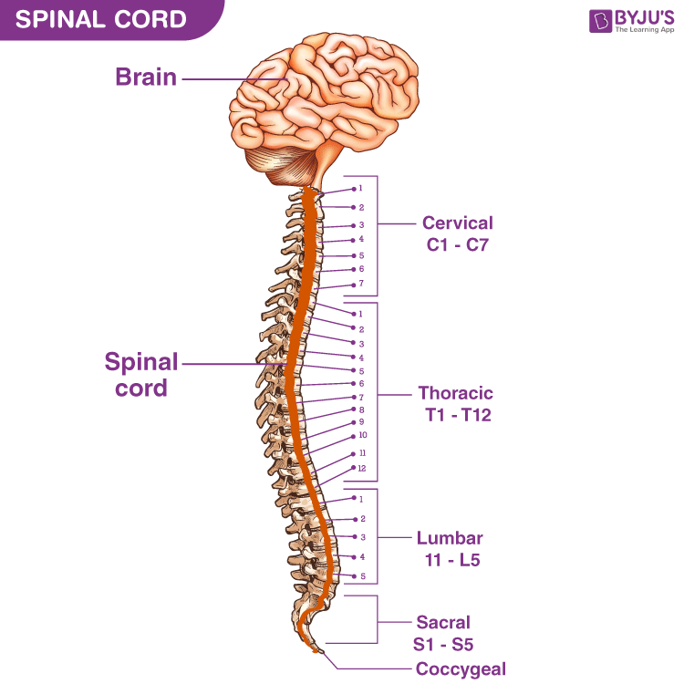
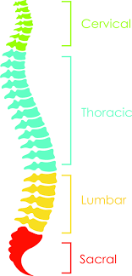

Slide 8
Definition
Spinal cord injury (SCI), is an injury to the spinal cord, vertebral column, supporting soft tissue, or intervertebral discs caused by trauma.
Common causes are motor vehicle crashes, falls, violence (predominantly gunshot wounds), and sports related injuries.
Males account for 78% of patients with SCI.
The predominant risk factors for SCI include younger age, male gender, and alcohol and illicit drug abuse.

Slide 9
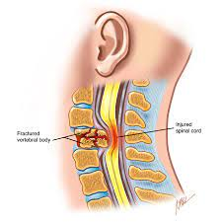
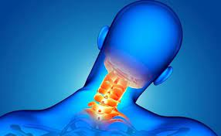

Slide 10
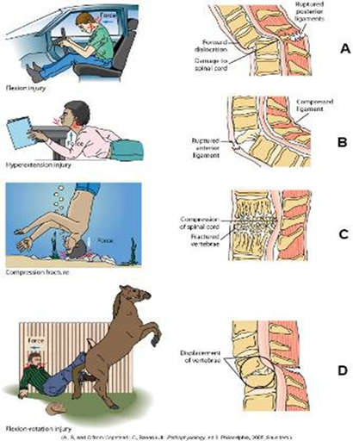
Mechanisms of injury
Flexion
Hyperextension
Compression
Flexion-Rotation

Slide 11
Mechanisms of injury
SCI can be separated into two categories: primary injuries and secondary injuries.
Primary injuries are the result of the initial insult or trauma and are usually permanent.
Secondary injuries resulting from SCI include edema and hemorrhage.

Slide 12
Mechanisms of injury
Damage in SCI ranges from transient concussion (from which the patient fully recovers) to contusion, laceration, and compression of the spinal cord tissue (either alone or in combination), to complete transection (severing) of the spinal cord (which renders the patient paralyzed below the level of the injury).

Slide 13
Mechanisms of injury
The vertebrae most frequently involved are the fifth, sixth, and seventh cervical vertebrae (C5–C7), the 12th thoracic vertebra (T12), and the first lumbar vertebra (L1).
These vertebrae are most susceptible because there is a greater range of mobility in the vertebral column in these areas.

Slide 14
Clinical Manifestations
Manifestations of SCI depend on the type and level of injury.
A complete spinal cord lesion signifies loss of both sensory and voluntary motor communication from the brain to the periphery, resulting in paraplegia or tetraplegia.

Slide 15
Clinical Manifestations
Incomplete spinal cord lesion denotes that the ability of the spinal cord to relay messages to and from the brain is not completely absent. Sensory and/or motor fibers are preserved below the lesion.
Paralysis of all four extremities occurs (tetraplegia) if cervical cord is involved
When damage is low in cervical cord, arms are rarely completely paralyzed
Paraplegia results if thoracic or lumbar cord is damaged

Slide 16
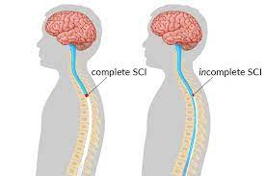

Slide 17
Clinical Manifestations
If conscious, the patient usually complains of acute pain in the back or neck, which may radiate along the involved nerve.
Respiratory dysfunction is related to the level of injury. The muscles contributing to respiration are the diaphragm (C4), inter-costals (T1–T6), and abdominals (T6–T12).
Injuries at C4 or above (causing paralysis of the diaphragm) often will require ventilator support
Injuries of T12 and above will have impact on respiratory function.

Slide 18
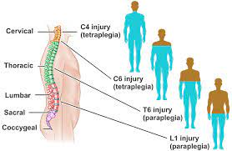

Slide 19
Assessment and Diagnostic Findings
A detailed neurologic examination.
X-rays
CT scan used to assess stability of injury, location, and degree of bone injury
An MRI scan may be ordered if there is unexplained neurologic deficit
Continuous ECG monitoring may be indicated because bradycardia and asystole are common in patients with acute SCI.

Slide 20
Emergency Management
The immediate management at the scene of the injury is critical because improper handling of the patient can cause further damage and loss of neurologic function.
Any patient who has head and neck must be considered to have SCI until such an injury is ruled out.

Slide 21
Emergency Management
Initial care must include:
A rapid assessment
Immobilization
Extrication (helping people getting out of the damaged vehicle)
Stabilization or control of life-threatening injuries
Transportation to the most appropriate medical facility

Slide 22
Emergency Management
At the scene of the injury, the patient must be immobilized on a spinal (back) board, with the head and neck maintained in a neutral position, to prevent an incomplete injury from becoming complete.
One member of the team must assume control of the patient’s head to prevent flexion, rotation, or extension; this is done by placing the hands on both sides of the patient’s head at about ear level to limit movement and maintain alignment while a spinal board and cervical device is applied

Slide 23
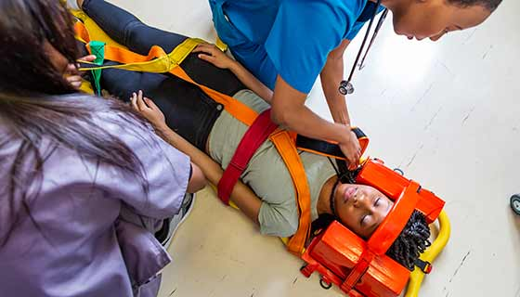
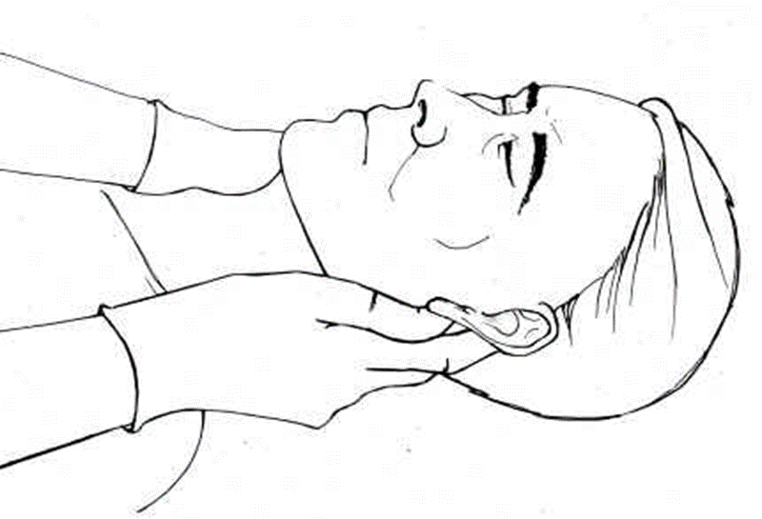
Emergency Management

Slide 24
Emergency Management
Head blocks should also be considered, as they will further limit any neck movement.
Any twisting movement may irreversibly damage the spinal cord by causing bony fragment or disc movement or exacerbating ligamentous injury, causing further instability.

Slide 25
Emergency Management
During treatment in the emergency and x-ray departments, the patient is kept on the transfer board.
The patient must always be maintained in an extended position.
No part of the body should be twisted or turned, and the patient is not allowed to sit up.

Slide 26
Acute Medical Management
The goals of management are to:
prevent secondary injury
observe for symptoms of progressive neurologic deficits
prevent complications
The patient is resuscitated as necessary, and oxygenation an cardiovascular stability are maintained.

Slide 27
Acute Medical Management
Cervical fractures can be reduced, and the cervical spine aligned with some form of skeletal traction, such as with skeletal tongs or with the use of the halo device.
Thoracic and lumbar injuries are usually treated with surgical intervention, followed by immobilization with a fitted brace. Traction is often not indicated either before or after surgery, due to the relative stability of the spine in these regions.

Slide 28
Skeletal traction
Realignment or reduction of injury
Provided by rope from center of tongs over a pulley that has weights attached at end
Traction must be maintained at all times
If dislodged, stabilize head and then call for help
Sites of tong insertion can become infected. Clean twice daily

Slide 29
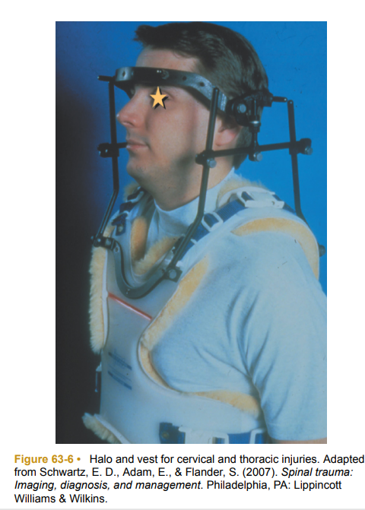

Slide 30
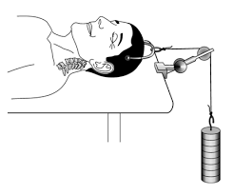
Skeletal Traction Device By Weights

Slide 31


Slide 32
Surgical Management
Surgery is indicated in any of the following situations:
Compression of the cord is evident.
The injury results in a fragmented or unstable vertebral body.
The injury involves a wound that penetrates the cord.
Bony fragments are in the spinal canal.
The patient’s neurologic status is deteriorating.

Slide 33
Management of Acute Complications of Spinal Cord Injury
Spinal and Neurogenic Shock
Venous Thromboembolism (VTE)

Slide 34
Spinal and Neurogenic Shock
Neurogenic shock develops as a result of the loss of autonomic nervous system function below the level of the lesion.
The vital organs are affected, causing decreases in blood pressure, heart rate, and cardiac output, as well as venous pooling in the extremities and peripheral vasodilation.
Hypotension and shock can further damage the spinal cord; therefore, the mean arterial pressure (MAP) should be maintained at 85 mm Hg or higher.

Slide 35
Venous Thromboembolism
Patients who develop VTE are at high risk for both deep vein thrombosis (DVT) and PE due to immobility, flaccidity, and decreased vasomotor tone (Wang et al., 2017).
Manifestations of PE include pleuritic chest pain, anxiety, shortness of breath, and abnormal blood gas values (increased PaCO2 and decreased PaO2 ).
Low-dose anticoagulation therapy usually is initiated to prevent DVT and PE, along with the use of anti-embolism stockings or sequential pneumatic compression devices (SCDs)

Slide 36
End of the lecture
Thank you

