Slide 1
Poisoning Emergencies

Slide 2
Introduction
A poison is any substance–liquid, solid, or gas– that impairs health or causes death by its chemical action→ purposeful or accidental scenarios.
Poisons may enter the body in four ways
  Ingesting
  Inhaling
  Penetration/injection
  Absorption
© 2012 Pearson Education, Inc.

Slide 3
Ingested Poisons
Children are the most common victims of ingested poisons
Most common items causing poisoning when swallowed
  Aspirin, acetaminophen, alcohol, cleaners, petroleum distillates
Poisonous plants
© 2012 Pearson Education, Inc.

Slide 4

Ingested Poisons
Ingested poisons stay in stomach short time
Majority of absorption occurs in small intestine
The goal of first aid care → to get the victim to the hospital as quickly as possible in order to get rid of poison before it enters the intestinal tract.
© 2012 Pearson Education, Inc.

Slide 5
Ingested Poisons
Poison Control Centers (PCC)
  Specialized health care centers that provide information and advice to people who have been poisoned
  Numbers are staffed by professionals 24/7.
  Call PCC as early as possible.
  If the poisoning victim is conscious→ call the poison control center before you do anything else.
  If the victim is unconscious→ activate the EMS before calling poison control.
© 2012 Pearson Education, Inc.

Slide 6
Ingested Poisons
Taking a history of a poisoned patient
  What was swallowed? type
  When was it swallowed? time
  How much was swallowed? amount
  Are there any underlying medical illnesses, allergies, drug use, or addictions? Past medical history
  Is this a suicide attempt? Any psych history? Intake senario
  Has anyone tried to induce vomiting?
  Has anything been given as an antidote?
© 2012 Pearson Education, Inc.

Slide 7
Ingested Poisons
Symptoms of ingested poisons
  Nausea, vomiting, diarrhea
  Excessive salivation
  Varying levels of consciousness
  Abdominal pain, tenderness, bloating, cramps
  Burns or staining around mouth and oral cavity
  Unusual breath or body odors
© 2012 Pearson Education, Inc.

Slide 8
Ingested Poisons
First aid care for ingested poisons
  Activate EMS and call PCC.
  Establish and maintain an airway.
  Provide ventilations, if necessary.
  Remove any poison from mouth, if present.
  Follow directions provided by PCC regarding dilution.
  DO NOT give anything by mouth for dilution.
  the poison was a corrosive (acid) or caustic (alkali) → you may consider immediately giving the victim one or two 8-ounce glasses of cold water or milk to dilute the poison.
© 2012 Pearson Education, Inc.

Slide 9
Ingested Poisons
  Water or milk may cause a dry poison (such as a tablet) to dissolve and fills up the stomach, forcing stomach contents more quickly into the small intestine
  Position patient on left side → can delay movement of the poison into the small intestine as long as two hours.
  Never induce vomiting.
  All poisoning victims must be seen by a physician.
© 2012 Pearson Education, Inc.

Slide 10
Food poisoning
Ingestion of food that contains bacteria or the toxins that bacteria produce or that has been contaminated by chemicals
Food is saved at room temperature for too long period of time
Many types of food poisoning
  Botulism
  Salmonella
  Staph food poisoning
First aid care
  Give nothing by mouth.
  Call PCC and initiate EMS.
© 2012 Pearson Education, Inc.

Slide 11
Botulism
The most fatal type of food poisoning
Serious illness caused by a nerve toxin that is produced by the bacterium Clostridium botulinum.
All symptoms are related to the muscle paralysis caused by the bacterial toxin.

Slide 12
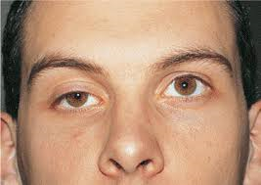

Slide 14
Activated Charcoal
What is activated charcoal?
  When consumed (as a liquid), acts like a sponge to keep poison from being absorbed
  Only works when poison is still in stomach
  Activated charcoal does not bind to alcohol, acids, alkalies, potassium, ferrous sulfate, kerosene, gasoline, or metals,
  Follow directions given by PCC.
© 2012 Pearson Education, Inc.

Slide 15

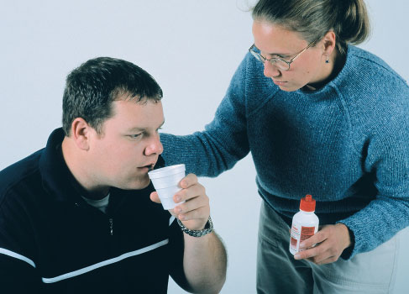
Activated Charcoal

Slide 16
Activated Charcoal
When to use activated charcoal
  Within a few hours after poison is ingested
  Use should first be approved by PCC
When not to use activated charcoal
  When PCC advises not to do so
  When the patient is not fully conscious
  If the poison was an acid or alkali
  When or if the patient cannot swallow
© 2012 Pearson Education, Inc.

Slide 17
Activated Charcoal
Dose
  1 gram per kilogram of body weight
  Typical dose is between 25–50 grams for adults
  Typical infant/children dose is 12.5–25 grams
  repeated doses every two to six hours are more effective than a single dose.
© 2012 Pearson Education, Inc.

Slide 18
Activated Charcoal
How to administer activated charcoal
  Shake container thoroughly.
  Have victim drink
  Record the time administered and the dose amount given.
  Repeat dose once if patient vomits.
  Give nothing per mouth after administeration

Slide 19
Inhaled Poisons
Defined as taking toxins into the body through the lungs
Common to fires, industrial sites, cleaning solvents, and sometimes drug abuse
Fast first aid treatment is critical
  Toxins are rapidly absorbed and circulated in body
  Longer exposure = more damage
© 2012 Pearson Education, Inc.

Slide 20
Inhaled Poisons
Inhaled poisoning general symptoms
  Trouble breathing
  Chest pain or tightness
  Nausea and vomiting
  Changes in mental status
  Visual changes, ringing in ears
  Possible seizures
© 2012 Pearson Education, Inc.

Slide 21
Inhaled Poisons
General first aid care
  Move victim to fresh air immediately.
  Monitor ABCs.
  If victim is not breathing, artificially ventilate.
  Activate EMS immediately.

Slide 22
Inhaled Poisons
Carbon monoxide poisoning
  Colorless and odorless gas
  Formed from incomplete combustion
  Binds sites in blood that carry oxygen → affinity of hemoglobin for CO is 200 times greater than that for O2
  Cellular death due to lack of oxygen
  It takes only a few minutes to die from CO poisoning.
  Frequently occurs in the home (furnaces, gas stoves, etc.)
© 2012 Pearson Education, Inc.

Slide 23
Inhaled Poisons
Carbon monoxide poisoning symptoms
  Presents initially with flu-like symptoms
  Low-level exposure causes headache, ear-ringing, muscle weakness, shortness of breath
  Moderate exposure causes severe headache and nausea, visual disturbances, muddy thinking
  High exposure causes stupor, fainting, heart arrhythmias, vision loss, convulsions, coma
  A tell-tale sign is that household pets will also have symptoms.
© 2012 Pearson Education, Inc.

Slide 24
Injected Poisons
What is an injected poison?
  Poison that enters the body through a break in the skin
  Originates with substances such as drugs, bites from certain animals, stings from certain insects
  Generally causes immediate reaction at injection site
  Greatest danger from injected poisons is anaphylactic shock.
© 2012 Pearson Education, Inc.

Slide 25
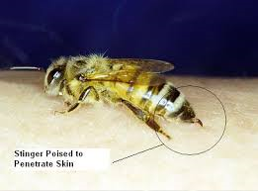

Injected Poisons

Slide 26
Injected Poisons
General symptoms
  Irritation/distress at injection site
  Weakness, dizziness
  Chills, fever
  Nausea and/or vomiting
© 2012 Pearson Education, Inc.

Slide 27
Injected Poisons
Management for injected poisonings
  Activate EMS.
  Protect yourself.
  Maintain airway, breathing, circulation.
  Attempt to identify insect, reptile, or animal.

Slide 28
Absorbed Poisons
Absorption of Poisons
  Can originate from wet or dry chemicals
  Sources include plants and industrial chemicals
  Poisonous element in most plants is urushiol (oily organic allergen)
  causes burns, lesions, and inflammation.
© 2012 Pearson Education, Inc.

Slide 29
Absorbed Poisons
General response from exposure
  Mild irritation often limited to exposed site
  Itching, redness, blisters, stinging
  Some people may have a severe and/or systemic reaction to absorbed poisons

Slide 30
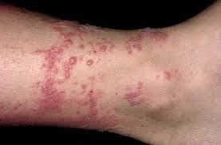
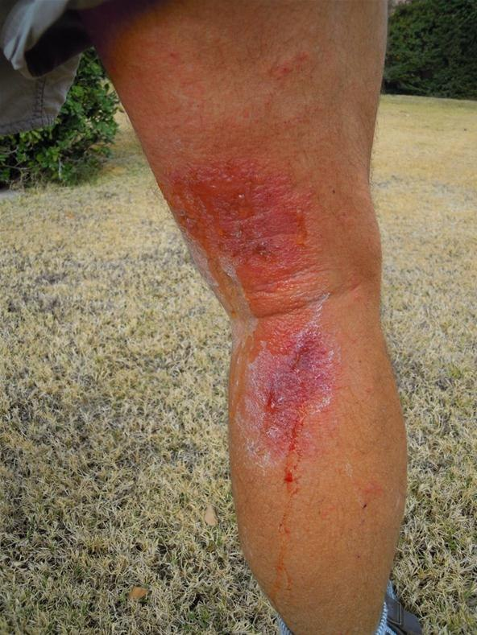
Absorbed Poisons

Slide 31
Absorbed Poisons
Signs and symptoms of poisonous plant contact and absorbed poison
  Traces of substance on skin
  Fluid filled, oozing blisters
  Itching, burning, pain
  Swelling with a rash lasting 1 to 3 weeks
  Skin infections from irritation and scratching
© 2012 Pearson Education, Inc.

Slide 32
Absorbed Poisons
Management for absorbed poisoning
  Protect yourself from exposure.
  Brush any dry chemicals or solid poisons from skin.
  Irrigate affected area with large amounts of water for at least 20 mins.
  Apply cold compress for pain, and apply colloidal oatmeal paste, baking soda or OTC cortisone, calamine, or antihistamine preparations.
  Severe reactions require prompt medical attention.
© 2012 Pearson Education, Inc.

