Slide 1
Musculoskeletal Injuries

Slide 2
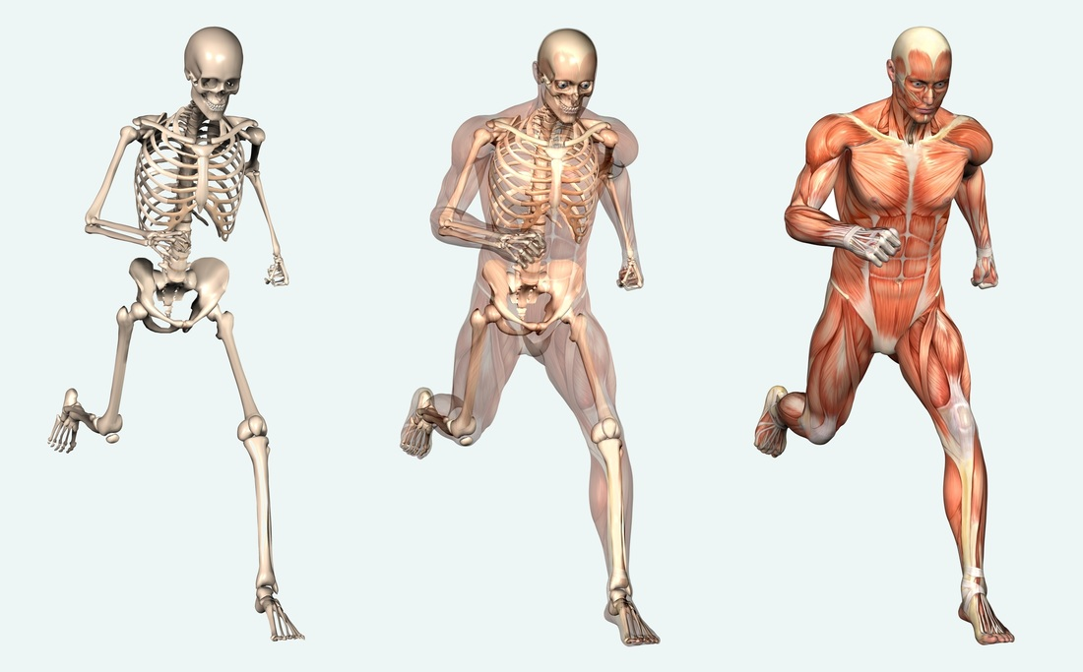
The Musculoskeletal System
Components of the musculoskeletal system
Bones
Joints
Muscles
Tendons
Ligaments
© 2012 Pearson Education, Inc.

Slide 3
The Musculoskeletal System
Functions of the skeletal system
Gives shape to the body
Supports the body
Provides the foundation for locomotion or movement
Protects major body organs

Slide 4
Common Injuries
Sprains,
Dislocations,
Strains,
Cramps
Fractures
© 2012 Pearson Education, Inc.

Slide 5
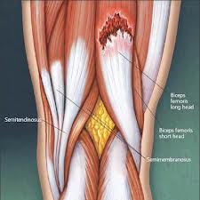
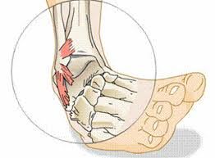
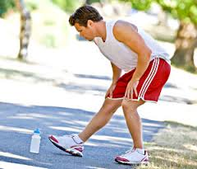
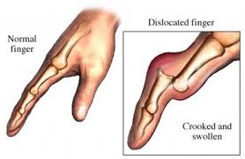

Slide 6
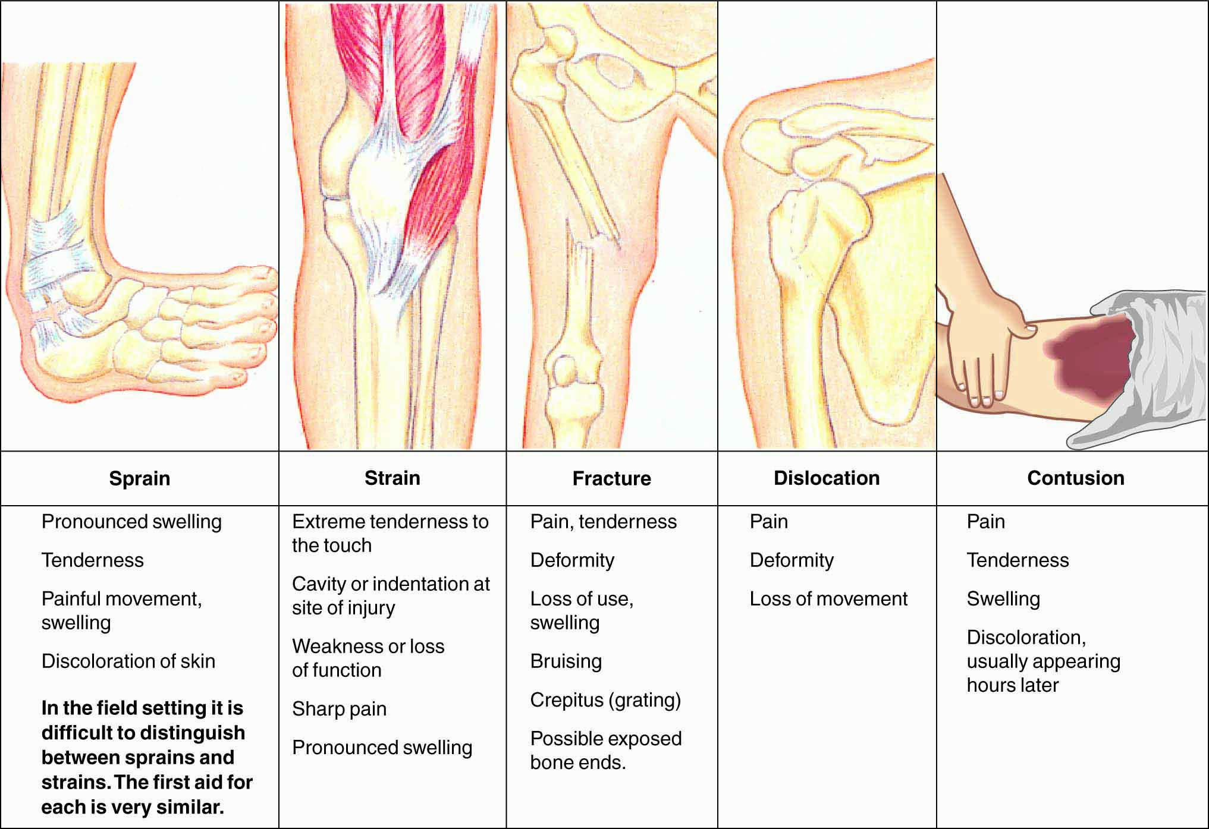
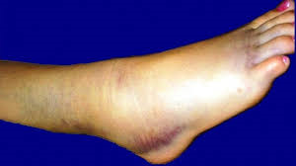
Common Injuries
Sprains
Injury to the ligaments (connect bone to bone)→ sudden twisting of the joint beyond its normal range of motion
stretched and partially or completely torn
Sprain symptoms
Pain and swelling
Deformity
Skin discoloration
Loss of function
© 2012 Pearson Education, Inc.

Slide 7
Common Injuries
Sprain management
provide care based on the acronym RICE → Rest, Ice, Compression, Elevation (RICE)
Do not allow the victim to use the sprained joint
Apple ice → 10-20 minutes every 1-2 hr for first 24-48 hrs.
Compression should wear the bandage continuously for 18-24 hrs
Active EMS or transport victim to medical facility.
© 2012 Pearson Education, Inc.

Slide 8
Common Injuries
Sprain management
Leave the fingers and toes exposed so that you can make sure the bandage is not too tight.
Reassess distal perfusion and motor/sensory during application to identify whether the bandage is too tight
Pale skin, pain, tingling, and numbness
© 2012 Pearson Education, Inc.

Slide 9
Common Injuries
Dislocations
The separation of a bone end from a joint, leaving the bone end out of alignment with the joint.
© 2012 Pearson Education, Inc.

Slide 10
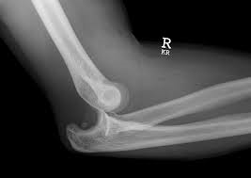

Slide 11
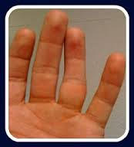
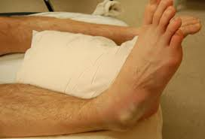
Dislocations
Symptoms
Pain, tenderness, deformity
Difficulty or inability to move joint or Possible loss of motion
Loss of pulses below injury, tingling and numbness
© 2012 Pearson Education, Inc.

Slide 12
Dislocation
Dislocation management
Assess quality of the victim’s pulse and sensory condition.
Provide RICE interventions.
Do NOT try to straighten ("reduce") the dislocation.
Immobilize in the position found → Splint above and below the dislocated joint
Check the distal pulse and capillary refill
Treat for shock and activate EMS.
© 2012 Pearson Education, Inc.

Slide 13
Common Injuries
Strains
Injury to the muscles
the muscle is stretched beyond its normal range of motion→ the muscle to tear
Signs and symptoms are:
Extreme pain
Severe tenderness
Pain or stiffness if the muscle is moved
A bump or indentation that can be seen or felt
Loss of function of the injured muscle
© 2012 Pearson Education, Inc.

Slide 14
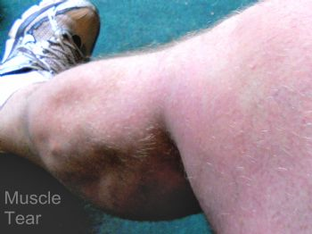

Slide 15
Common Injuries
Contusions
Bruising of muscle tissues
The signs and symptoms:
Pain
Tenderness
Swelling
Discoloration at the injury site
use the RICE procedure.
© 2012 Pearson Education, Inc.

Slide 16
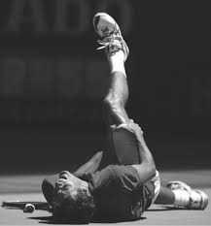
Common Injuries
Cramp
An uncontrolled spasm of a muscle.
→ severe pain and loss (or restriction) of movement.
© 2012 Pearson Education, Inc.

Slide 17
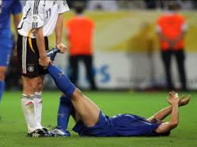
Cramp management
Cramp
don’t massage a cramp muscle → increase the pain
Gently stretch the cramping muscle→ gradual lengthening of the muscle
Apply an ice pack over the cramped muscle.
Encourage victim to drink a commercial electrolyte drink
© 2012 Pearson Education, Inc.

Slide 18
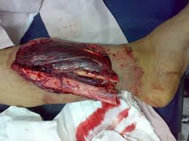
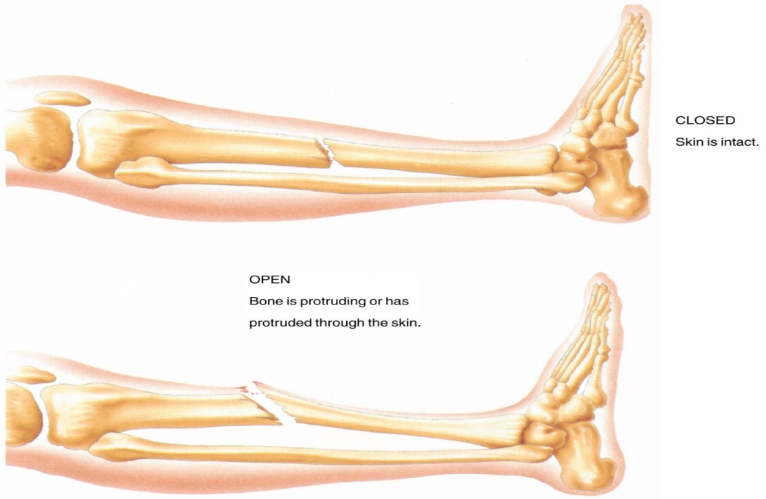
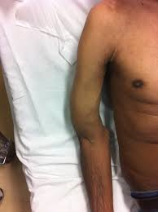
Injuries to Bones
What is a bone fracture?
Crack or break in the bone
© 2012 Pearson Education, Inc.

Slide 19
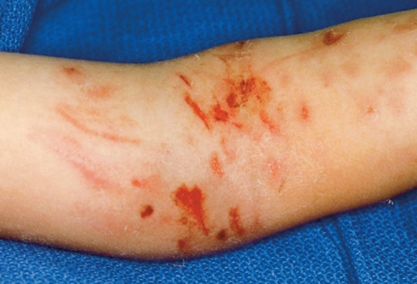
Types of Fractures
Closed fracture of the humerus. (the overlying skin is intact)

Slide 20
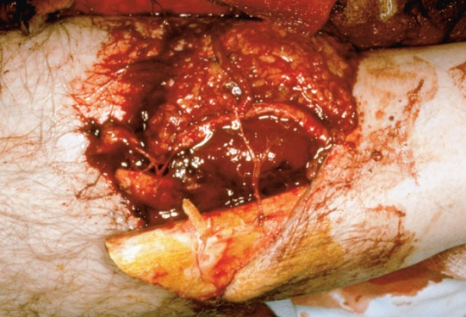
Types of Fractures
Open fracture of the fibula. (skin has been damaged or broken, either by the ends of the bone or by the blow that broke the bon
The bone might or might not protrude through the wound
you might or might not be able to see the bone through the wound
soft tissue and organs injuries
© 2012 Pearson Education, Inc.

Slide 21
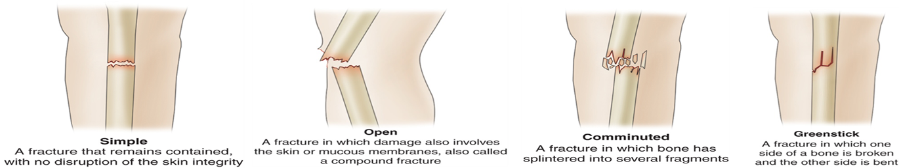
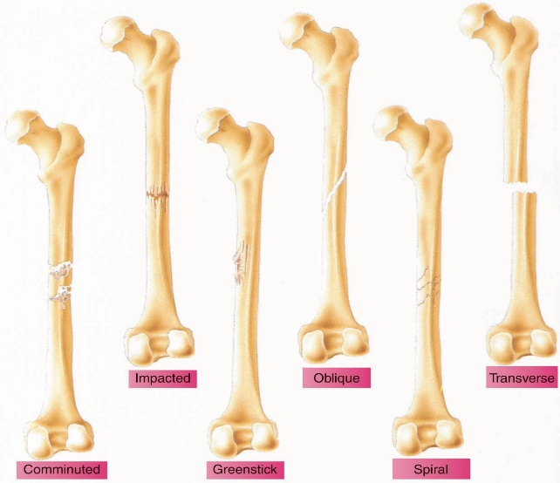
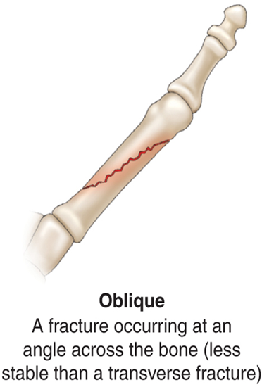
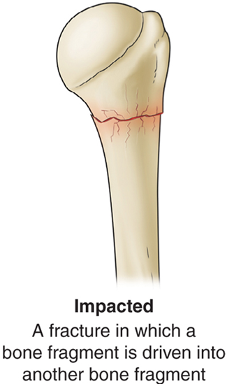
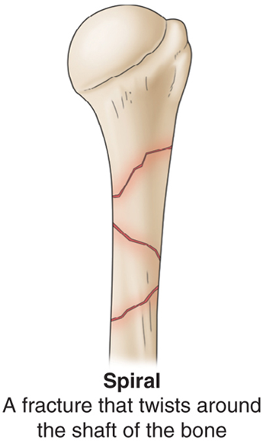
Types of Fractures
© 2012 Pearson Education, Inc.

Slide 22
Mechanisms of Injury
How much damage may have occurred
Direct force→ occurs at the point of impact.
Indirect force→ away from the point of impact.
Twisting force→ one part of the bone remains stationary while the rest of the bone twists.
© 2012 Pearson Education, Inc.

Slide 23
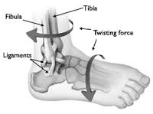
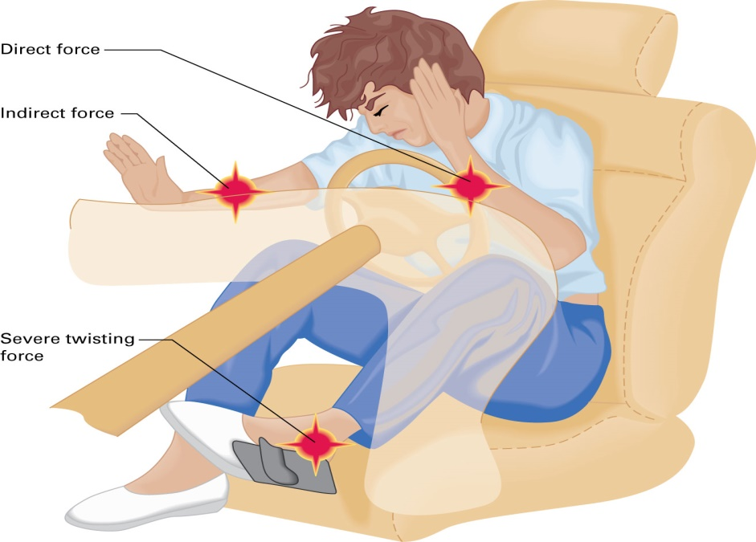
Mechanisms of Injury

Slide 24
Bone injury symptoms
Deformity, loss of function
Pain and tenderness
Visible signs of injury
Swelling, discoloration, crepitus (grating)
Rapid and immediate swelling
Discoloration or redness
Open wound, with or without exposed bone ends
Guarding
Possible loss of function
© 2012 Pearson Education, Inc.

Slide 25
Bone injury management
Fractures should be treated in priority order, as follows:
Spinal fractures
Fractures of the head and rib cage
Pelvic fractures
Fractures of the lower limbs
Fractures of the upper limbs
© 2012 Pearson Education, Inc.

Slide 26
Bone injury management
Your priority in caring is immobilization of any suspected fracture or extensive soft-tissue injury.
You should immobilize before you apply ice or elevate the injured part.
Remember–if there was enough force to damage the pelvis or to cause severe head or facial injuries, assume there are also injuries to the spine.

Slide 27
Bone injury management
Uncover and manually stabilize and immobilize injured limb
Minimizes damage to soft tissue, muscle, or bone
Prevents a closed fracture from becoming an open one
Prevents more damage to surrounding nerves, blood vessels, and other tissues from the broken bone ends
Minimizes bleeding and swelling
Diminishes pain, which helps control shock
Prevents restriction of blood flow by bone ends compressing blood vessels
© 2012 Pearson Education, Inc.

Slide 28
Bone injury management
Assess motor, sensory, blood-flow capacities.
Treat with RICE procedures.
immobilizing joints above and below the fracture.
Stabilize with equipment, if possible.
© 2012 Pearson Education, Inc.

