Slide 1
Administration and Leadership in Nursing
Management Functions 2- Organizing
B- Organizational Structure and Chart

Slide 2
Organizational Structure
Organizational Structure refers to the way in which a group is formed, its lines of authority, span of control and channels of communication.

Slide 3
Purposes of Organizational Structure
It reveals information about size of the nursing service department.
It shows the different functions in the nursing department
It shows the span of control of each manager in the nursing department.
It shows levels and layers of supervisions, and channels of communication
It can be used for orientation of newly hired employees.

Slide 4
Types of Organizational Structure
Traditionally, nursing departments have used one of the following structural patterns:
Line organization,
line- and-staff organization,
Functional organization,
ad hoc organization,
Matrix organization.

Slide 5

Types of Organizational Structure
Line Organization = Bureaucracy
This type characterized by each position has general authority over lower positions in the hierarchy. It relay
mostly on orders.
Advantages
Easy to orient new personnel
Responsibility and accountability are clearly defined.
Disadvantages:
Rigid and create engender passivity and dependence in staff members.
Weak integration of different divisions.
Concentration of authority at the top make employee to refer problems to superiors, and managers view them as incompetent, who perform under threa5t
3/19/2021

Slide 6
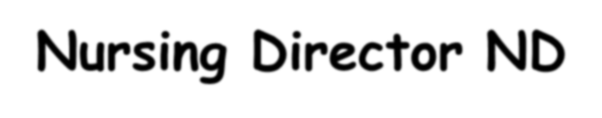

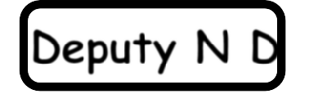



Line Organizational structure
Nursing Director ND
Deputy N D Deputy N D Nursing Supervisor
Head Nurse
Staff Nurse

Slide 7
Line and Staff Organization
This pattern is originated to support the chief executive, by specialists to improve management functions. It is purely advisory (consultant , or specialist) to the liner structure and has no authority.
Advantages
Employees are less stressed
Authority and responsibility are clearly defined
Efficiency and simplicity of relationship.
Disadvantages
This type may produce monotony, which alienate workers,
Adherence to chain of command , restrict upward communication

Slide 8





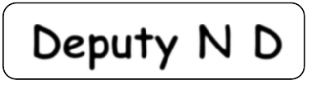




Line-Staff Organizational structure
Nursing Director ND
Deputy N D
Deputy N D
Nursing Supervisor Coordinators
Head Nurse Staff Nurse

Slide 9
Functional Organization:
In this structure, staff officer are no purely advisory but have some command authority over line employees for certain functions. This is frequently done with advisory positions in areas such as nursing education, infection control, or hospital risk management.

Slide 10
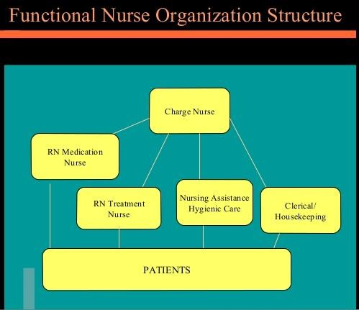
10

Slide 11


Organizational Chart
3/19/202
1
11

Slide 12
Organizational Chat: Is a diagram shows the different
positions and departments, and the relationships among them.
It is used to show:
The formal organizational structure
Areas of responsibility
Persons to whom one is accountable
Channels of communication

Slide 13
Types of Organizational Charts
Vertical Chart
Horizontal Chart
Circular

Slide 14
Types of Organizational Charts
Vertical Charts
Shows high level management at the top with formal lines of authority down the hierarchy

Slide 15
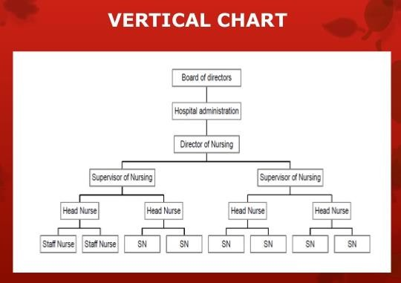
3/19/2021
15

Slide 16
Types of Organizational Charts
Horizontal Chart
It shows the high-level management at the left with
lower positions to the right.
3/19/2021
16

Slide 17
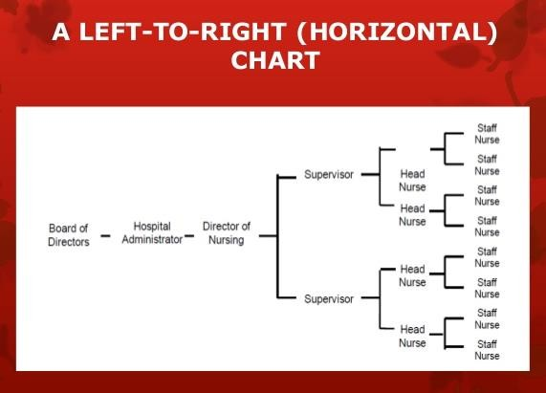
3/19/2021
17

Slide 18
Types of Organizational Charts
Circular Chart
It shows high-level management in the center with
successive positions in circles. It shows the outward flow of formal authority from the high level management.
3/19/2021
18

Slide 19
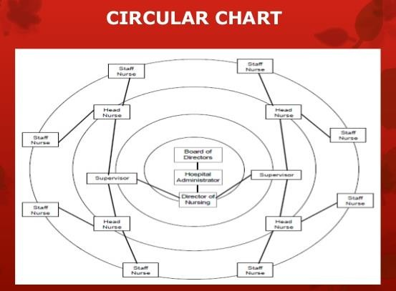
3/19/2021
19

Slide 20
Characteristics of an effective organizational chart
Be accurate, simple and updated.
Shows the chain of command, lines of authority, responsibility and relationships.
All members of the department should be notified when any change occurs.
20

Slide 21
Principles for drawing an accurate organizational chart
The chart should have a clear title
It should be dated
The higher management should be shown at the top, while most junior positions at the end of the chart.
Positions of equal seniority should be shown at the same level
For clarity, details should be well spaced

Slide 22
Principles for drawing an accurate organizational chart
Solid lines must be used to indicate flow authority, staff relationships can be shown by dotted line.
Colors may be used to distinguish between departments

Slide 23
Advantages of an Organizational Chart
It promotes a quick visual illustration of the organizational structure.
It provides help in organizational planning.
It shows lines of formal authority, responsibility and accountability.
It clarifies who supervises whom and to whom one is responsible.
It emphasizes the important aspect of each position.

Slide 24
Advantages of an Organizational Chart
It facilitates management development and training.
It is used to evaluate strength and weakness of current structure.
It provides starting points for planning organizational changes.
It describes channels of communication.

