Slide 1
Administration and Leadership in Nursing
Management Functions 1- Planning
D- Decision Making /Problem Solving

Slide 2
What is a problem
Problem is any difference between an actual situation and a desired solution
Exists whenever objectives are not being met.
What is happening vs. what is wanted to happen

Slide 3
Problem Solving
The process of identifying a discrepancy between an actual and desired state of affairs and then take action to resolve the deficiency or take advantage of the opportunity

Slide 4





Problem situation
Problem situation may be one of the following:
Performance deficiency, which exists when actual performance is less than desired. Ex. Turnover or absenteeism suddenly increase
A performance opportunity, which emerges when an actual situation turns out either better than anticipated, or offers the potential to be so

Slide 5
Types of Managerial Problems
The problems which managers face are usually classified into 3 main types:
Structures problems
Unstructured problems
Crisis problems

Slide 6
1. Structured Problems
These are familiar, straightforward, and clear with respect to the information needed to resolve them. They can be expected and managers can plan ahead and develop specific ways to deal with them, or even can take action to prevent their occurrence

Slide 7
2. Unstructured Problems
Involve ambiguities and information deficiencies, and often occur as new or unexpected situations. They usually require novel solution

Slide 8
3. Crisis Problems
Is an unexpected problem that can lead to a disaster if not resolved quickly and appropriately.
There is clear relationship between the types of managerial problems and the decisions applicable to each type.

Slide 9
Elements in Managerial Decisions
Decision: A conscious choice among alternative courses of action.
Therefore, the 3 elements are:
  A conscious choice among alternatives
  A specific purpose
  A course of action

Slide 10
Kinds of Decisions a Manager Makes
Routine data based decisions
Serious decisions having important consequences
Emergency decisions requiring distinctiveness problem- Solving
* It is essential to recognize which decisions need to be made now and are most important

Slide 11



Decision-making
Decision making: is the process of choosing a course of action for dealing with a problem or opportunity

Slide 12
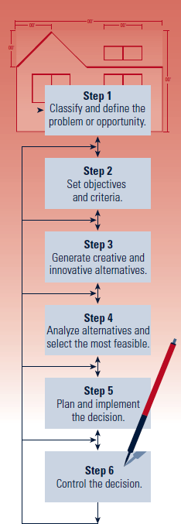
The Decision-Making Model
A six-step process that when properly utilized increases chances of success in decision making and problem solving.
Exhibit 4–1

Slide 13
Define the Problem
Distinguish Symptoms from the Cause of the Problem
  List the observable and describable occurrences (symptoms) that indicate a problem exists.
  Determine the cause of the problem.
  Removing the cause should cause the symptoms to disappear or cease.
    Symptom: Patient’s dissatisfaction
    Cause: Poorly trained nurses
    Solution: Implement patient relations training program for nurses

Slide 14
Decision-Making Conditions
Certainty
  Each alternative’s outcome is known in advance.
Risk
  Probabilities can be assigned to each outcome.
Uncertainty
  Lack of information or knowledge makes the outcome of each alternative unpredictable such that no probabilities can be determined.

Slide 15



Decision-Making Styles
Reflexive Style
Makes quick decisions without taking the time to get all the information that may be needed and without considering all the alternatives.
Reflective Style
Takes plenty of time to make decisions, gathering considerable information and analyzing several alternatives.
Consistent Style
Tends to make decisions without either rushing or wasting time.

Slide 16
Decision Structure
Programmed Decisions
Recurring or routine situations in which the decision maker should use decision rules or organizational policies and procedures to make the decision.
Non programmed Decisions
Significant and nonrecurring and non routine situations in which the decision maker should use the decision-making model.
3/19/2021

Slide 17
When Is Participation Appropriate for Decision Making?
Degrees of Decision Participation
  Autocratic
  Consultative
  Group

Slide 18
Participative Problem Solving
Group Decision Making :
  You get more info. And expertise relevant to the decision
  You get more good ideas and can generate more and better alternatives
  People thinking together can arrive at better decisions because of the stimulation and interplay of different points of view
  Participants are more committed to carrying out
  Coordination and communication are simpler and better because everyone understands

Slide 19

Potential Advantages and Disadvantages of Using Group Decision Making
Potential Advantages
Better-quality decisions
More information, alternatives, creativity, and innovation
Better understanding of the decision
  Greater commitment to the decision
  Improved morale and motivation
  _{3/19}G_{/2021}ood training
Potential Disadvantages
Wasted time
Domination and goal displacement
Conformity and groupthink
Exhibit 4–4

Slide 20
Group Decision Making Works Best When:
Members are accustom to working together as a team and having differing expertise and point of view but common goals
The leader is skillful at keeping the meeting on target
The group is rewarded for making good decisions

Slide 21
Guidelines for Building Decision Making Skills
Be sure of your authority for making decisions
Accept responsibility fully
Distinguish what's important
Make the decision at the time it is needed
Be alert to signs of problems needing solutions
Keep an open mind

Slide 22
Guidelines for Building Decision Making Skills
Don’t solicit advise but do consult your supervisor when a problem is beyond your ability to solve
Learn from your mistakes
Evaluate your decisions when carried out

Slide 23
Approaches to Decision Making
Rational (Logical Approach)
Intuitive Approach
Unable to decide (Indecisive Approach)
Impulsive Approach

