Slide 1
Nursing informatics
Preface
Iyad Salameh

Slide 2


Content
What is Informatics ?
IT Systems in Healthcare
Benefits in Healthcare
What is Nursing Informatics ?
Nursing Informatics as a Nursing Speciality
Roles of Informatics Nurses
Significance of Nursing Informatics
Essential Nursing Informatics Competencies

Slide 3
What is Informatics

Slide 4
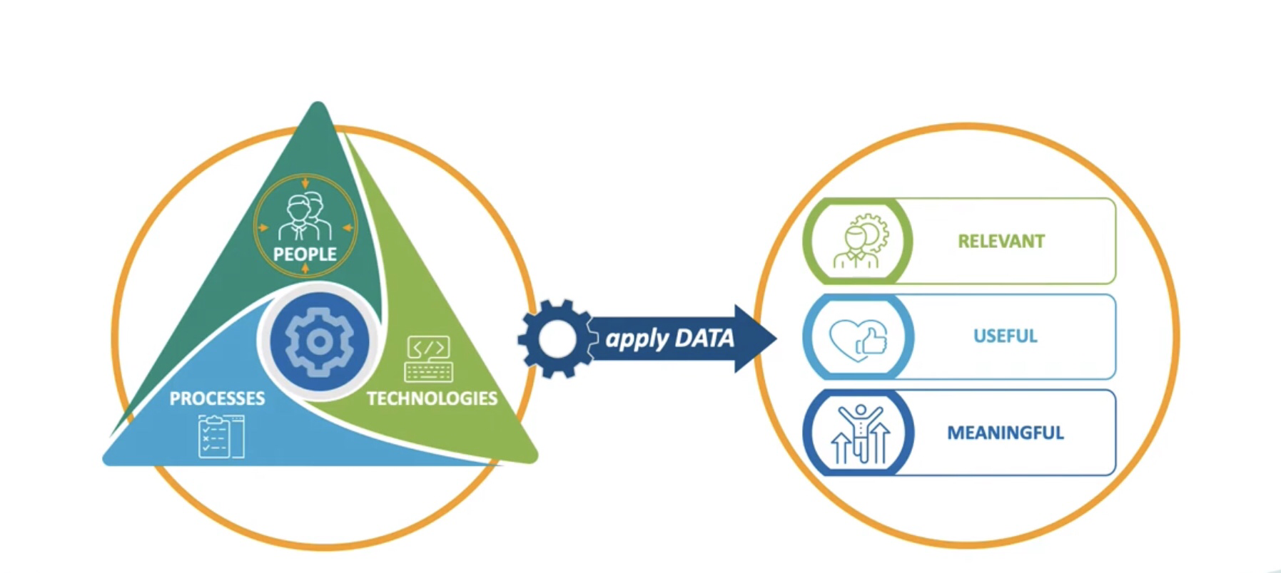
Refers to an interrelated activity involving people, technologies and processes.
This interconnected triad allows trusted data to be applied in a manner that is Relevant, Useful and Meaningful
Centered around people and end-users of technologies

Slide 5
It systems utilised in healthcare
Clinical IT SYSTEMS
Clinical documentation systems
EMR/HER
RIMS/ PACS
Wireless Systems
PoC CDS (point of care clinical decision support)
Data Repositories.
ICU TECH
Mobile systems
RFID
BARCODE Systems
Physician Order Portals
Care planing systems Electronic Medication Administration Records
Staffing/Scheduling
Various Apps and device support

Slide 6
benefits
In healthcare
Reduce errors
Increase safety
Increase productivity
  Time
  Efforts
  Resources
Better organisation
Better communication / earlier detection / improve capacity to respond
Support evidence-based practice at the point of care
Improve quality of care
Decrease mortality and morbidity
Reduce Costs

Slide 7

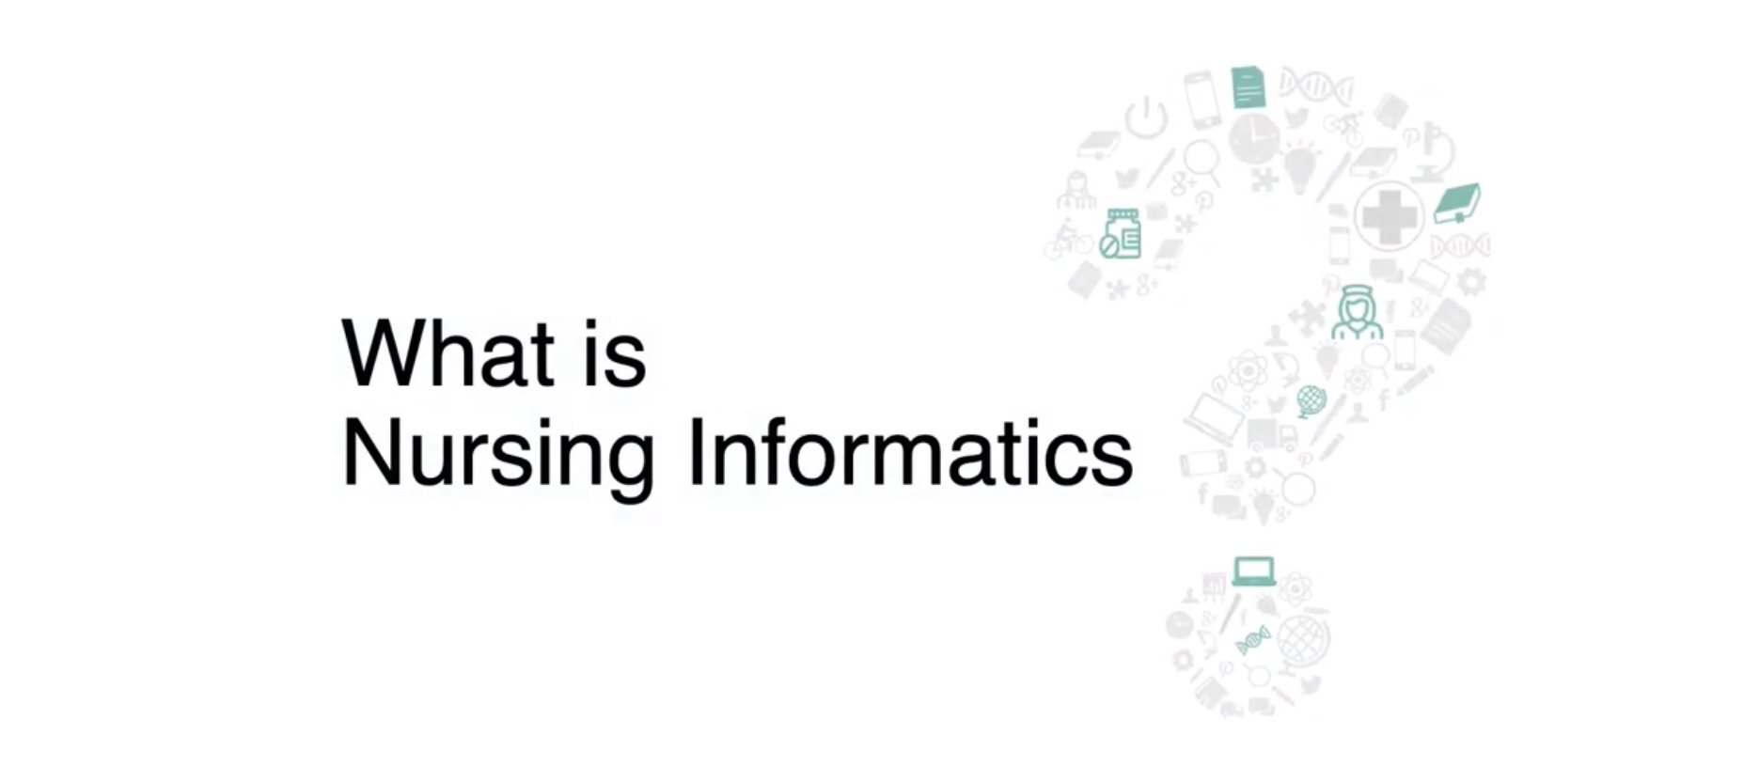

Slide 8

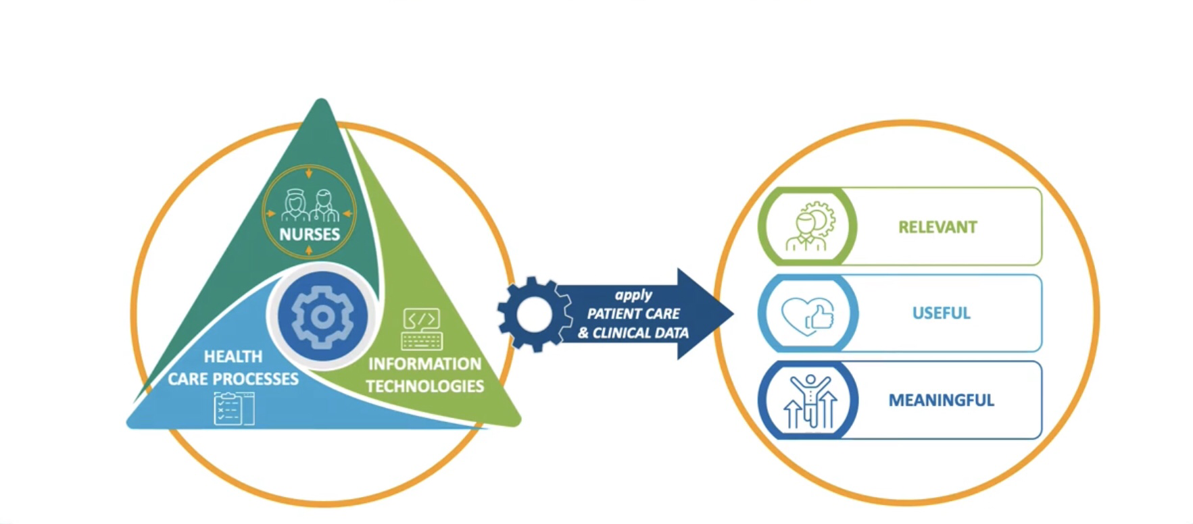
Informatics in nursing

Slide 9
Nursing informatics
The speciality that integrates nursing science with multiple information and analytical sciences to identify, define, manage and communicate data, information, knowledge and wisdom in nursing practice to support the health of people worldwide.
HIMSS, 2021
CNIA, 2022
ANA, 2014

Slide 10
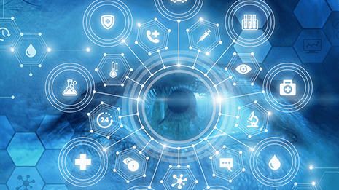
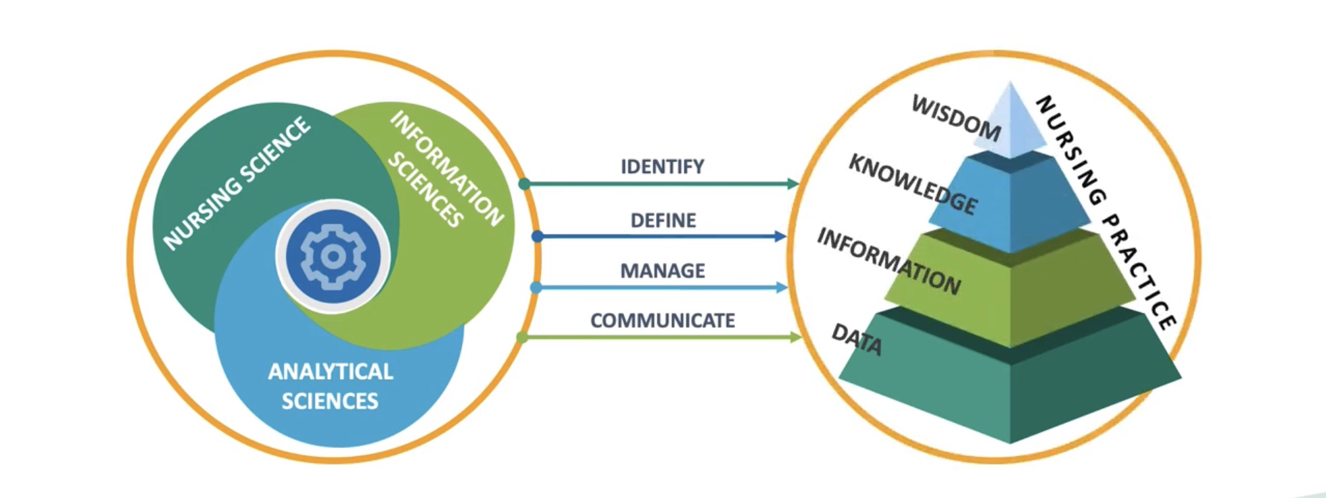
Nursing Informatics

Slide 11
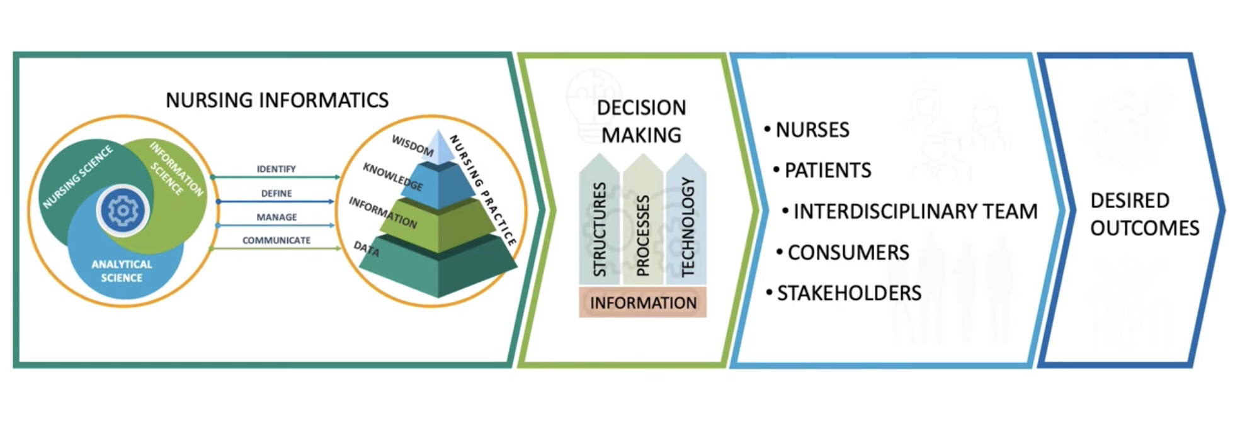
Nursing Informatics

Slide 12
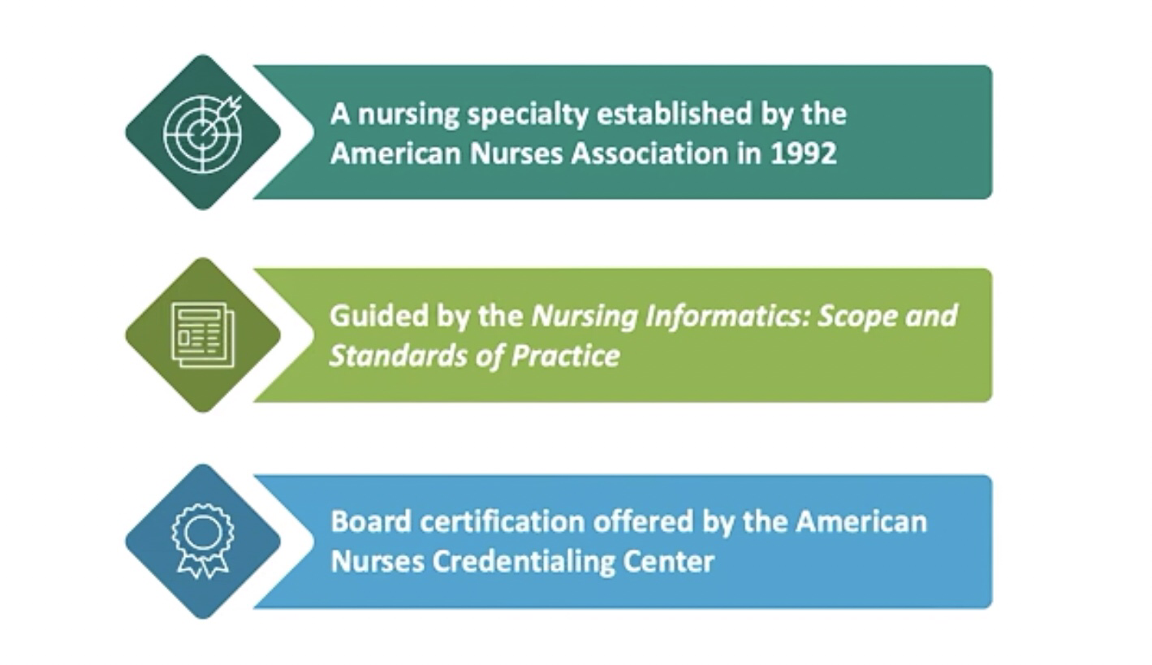
Nursing informatics as a nursing speciality

Slide 13
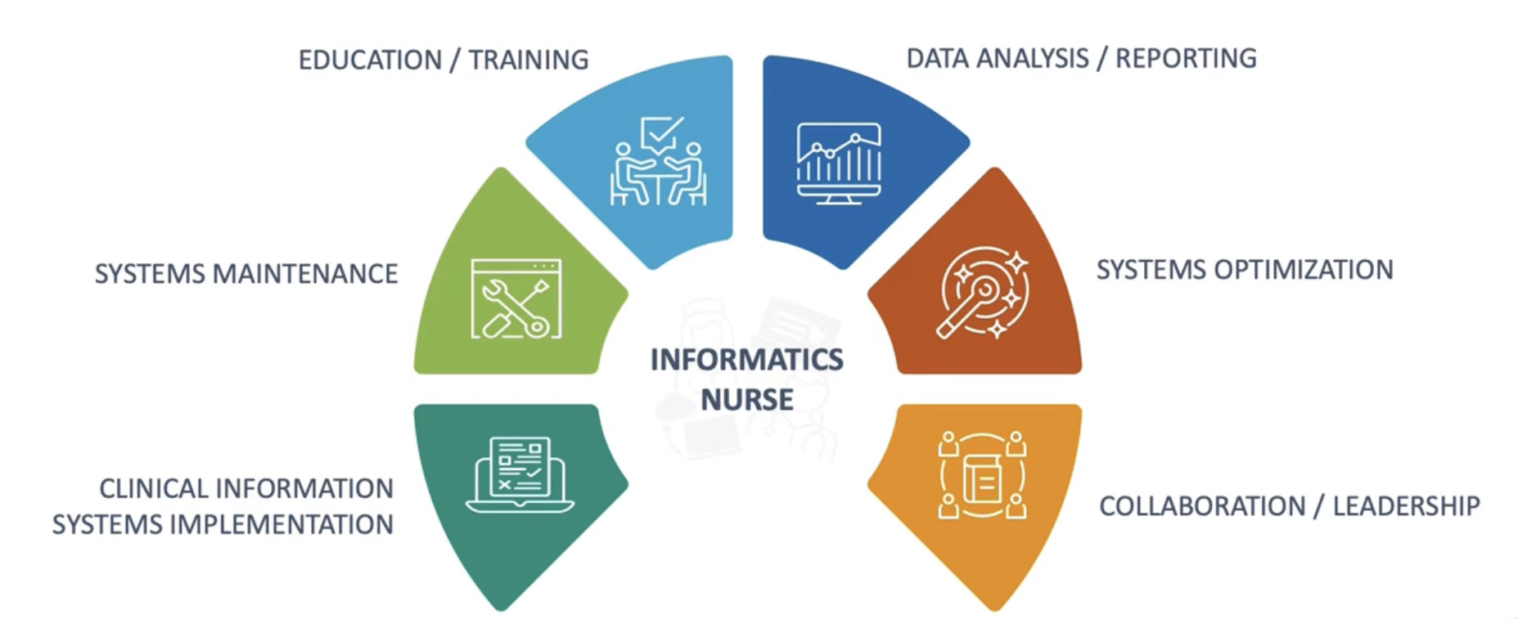
ROLES OF NURSING INFORMATICS SPECIALISTS OR INFORMATICS NURSES

Slide 14
Roles of informatics nurse
Clinical information systems implementation
  NI can lead / coordinate a project to implement or upgrade HIS e.g HER
Systems Maintenance
  Ensuring HIS runs smoothly and efficiently by troubleshooting systems and processes issues
Education and Training
    end-users around the practical use of HIS and other technologies in patient care v
    Promote and reinforce guidelines and polices around pt safety, data privacy and confidentiality and HIS mandates.
Data Analysis / Reporting
  Day to day operations
  Research / predictive analysis
  Attestation of compliance with authorities /governance / bodies.
Systems Optimization
  Continuous improvements of HIS and other healthcare technologies
  With knowledge and skills in systems and workflow analysis, an informatics nurse can influence or lead the efforts to improve the usability of info systems in practice settings.
Collaboration/ Leadership
  As nursing is part of MDT an IN works closely with other members of HC team to ensure proper functioning of HIS and other pt HC TECHS.
  NI act as liaison between clinicians and tech experts

Slide 15
Why nursing informatics competencies are vital for all practicing nurses
Advancement of technologies in health care
  More than 96% of hospitals and 87% of clinician offices some form of HER or other pt/healthcare technologies
Significant impact on nursing practice
  Nurses represent the largest group of professionals in the forefront in healthcare
    Consequently, nurses are greatly impacted by these technological advances
HER-driven regulatory requirements
  Promoting interoperability (formerly Meaningful Use) program and electronic clinical quality measures
  Nurses are significant contributors to meeting these requirements

Slide 16
Fundamental nursing informatics competencies
Basic Computer Competencies
  Computer hardware and software application, electronic communication, internet and online resources
Information Literacy
  Information search, access and evaluation, information use to support care, EHR-related standards and guidelines
  With easy and rapid access to a wealth of info, nurses must be able to assess the reliability, credibility, relevance, and value of info.
Information Management
  Use of EHR & other healthcare technologies, nursing documentation, communication, care coordination, use of decision support and other clinical processes are vital in healthcare
  Data Protection & Security , maintain the integrity of pt Privacy & Confidentiality

Slide 17
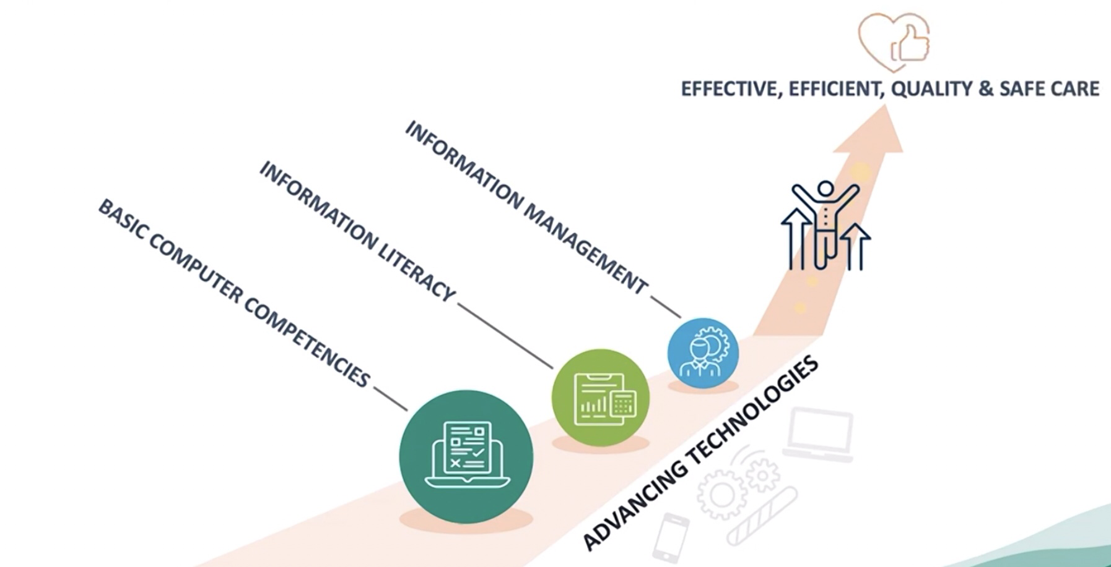
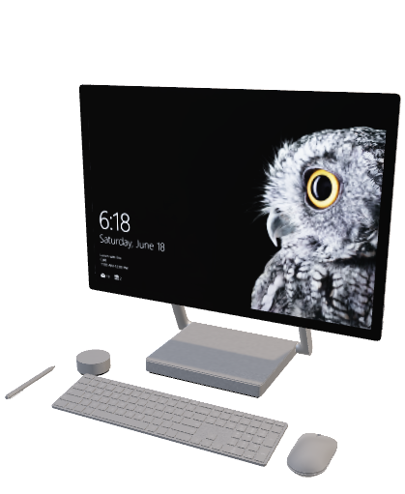

Slide 18
References
American Medical Informatics Association. (2020). Nursing Informatics working Group. Accessed on October 1, 2022, accessed at https://www.amia.org/programs/working-groups/nursing-informatics
American Nursing Association, (2015). Nursing Informatics: Scope and Standards of Nursing informatics practice (2nd Ed.).
Canadian Nursing Informatics Association. (2022). Nursing Standards. Accessed on October 1, 2022, accessed at https://cnia.ca/nursing-data-standards
Health Information and Management Systems Society. (2019). What is nursing informatics ? Accessed on October 1, 2022, accessed at https://www.hiss’s.org/resources/what-nursing-informatics
HIMSS
ANA
CNIA,

Slide 19
Thank you any questions

Slide 20
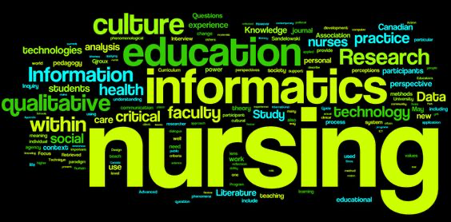
Nursing informatics
Overview
Iyad Salameh

