Slide 1


Administration and Leadership in Nursing
Management Functions
3- Directing
Documenting and Reporting

Slide 2
Report: Is oral, written, or computer- based communication intended to convey information to others.
Record: Is written or computer based, the process of making an entry on a client’s record is called recording, charting, or documenting.

Slide 3
A clinical record: also called a chart or client record is a formal, legal document that provides evidence of a client’s care.

Slide 4
Ethical and legal considerations
“The nurse has a duty to maintain confidentiality of all patient information” (ANA code of ethics 2001).
The records are used in client conferences, clinics, rounds, client studies, and written papers. It is the responsibility of the student or health professional to protect the client’s privacy by not using a name or any statements in the notations that would identify the client.

Slide 5
Purposes of Client Records
Communication… The record serves as the vehicle by which different health professionals who interact with a client communicate with each other.
Planning Client Care……Each health professional uses data from the client’s record to plan care for
that client.
Auditing Health agencies……An audit is a review of client records for quality assurance purpose.

Slide 6
4- Research…….. The information contained in a record can be a valuable source of data for research. The treatment plans for a number of clients with the same health problems can yield information helpful in treating other clients.

Slide 7
5- Education……. a record can frequently provide a comprehensive view of the client, illness, effective treatment strategies, and factors that affect the outcome of the illness.

Slide 8
Reimbursement……. for a facility to obtain payment through Medicare, the client’s clinical record must contain the correct diagnosis.
Legal Documentation…….The client’s record is a legal
document and is usually admissible in a court as evidence.
Health Care Analysis ……. it assists health care planners to identify agency needs.

Slide 9
Documentation Systems
A number of documentation systems are in current use:-
1- Source – oriented Record
It is a traditional client record, each person or department makes notations in a separate section or sections of the client’s chart, For example, the admissions department has an admission sheet, the physician’s has order sheet, a physician’s history sheet, and progress notes, nurse’s notes.

Slide 10
Documentation Systems
Narrative charting is a traditional part of the
source – oriented record. It consists of written notes that include routine care, normal findings, and client problems.

Slide 11
Advantage
- Source– oriented records are convenient because care providers from each discipline can easily locate the forms on which to record data and it is easy to trace the information specific to one’s discipline.

Slide 12
Disadvantage
- Information about a particular client problem is scattered throughout the chart, so it is difficult to find chronological information on a client’s problems and progress. This can lead to decreased communication among the health team, an incomplete picture of the client’s care, and a lack of coordination of care.

Slide 13
2- Problem- Oriented Medical Record (POMR)
The data are arranged according to the problems the
client has rather than the source of information. Members of the health care team contribute to the problem list , plan of care, and progress notes.

Slide 14
2- Problem- Oriented Medical Record (POMR)
Advantage of POMR:
Encourages collaboration
The problem list in the front of the chart alerts caregivers to the client’s needs and makes it easier to
track the status of each problem.

Slide 15
2- Problem- Oriented Medical Record (POMR)
Disadvantage
Caregivers differ in their ability to use the required charting format.
It takes constant vigilance to maintain an up – to – date problem list.

Slide 16
The POMR has four basic components:
Database
Problem list
Plan of care
Progress notes

Slide 17
Data base
Consists of all information known about the client when the client first enters the health care agency. It includes nursing assessment, the physician’s history, social and family data, baseline diagnostic tests.
Problem list
Problems are listed in the order in which they are identified, and the list is continually updated as new problems are identified and others resolved.

Slide 18
Plan of care
Care plans are generated by the person who lists the problems. Physicians write medical care plans; nurses write nursing care plans.

Slide 19
Progress Notes
Is a chart entry made by all health professionals involved in a client’s care, they all use the same type of sheet for notes. For example, the SOAP format is frequently used.
S – Subjective data consist of information obtained from what the client says. It describes the client’s perceptions of and experience with the problem.
O – Objective data consist of information that is measured or observed by use of the senses (e.g., V/S , Lab test, X-ray results).

Slide 20
A – Assessment is the interpretation or conclusions drawn about the subjective and objective data. ’’A’’ should describe the client’s condition and level of progress rather than merely restating the diagnosis or problem.
P- Plan is the plan of care designed to resolve the stated problem.

Slide 21
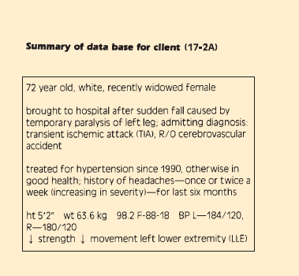

Slide 22
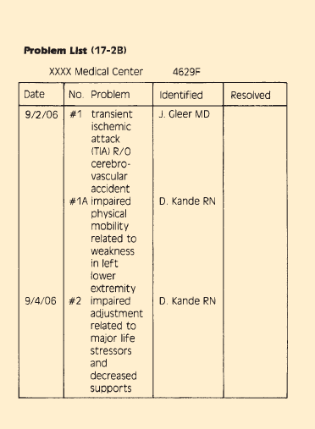

Slide 23
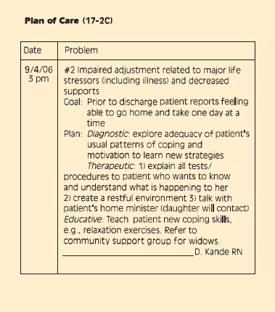

Slide 24
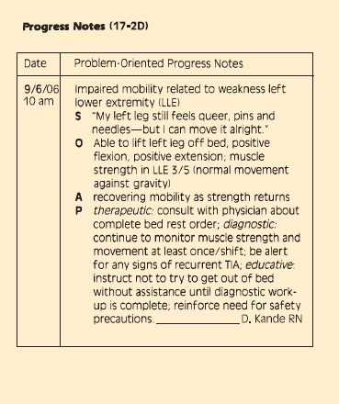

Slide 25
The SOAP format has been modified to SOAPIER
I- Interventions refer to the specific interventions that have been performed by the caregiver.
E- Evaluation includes client responses to nursing interventions and medical treatments.
R- Revision reflects care plan modifications suggested by the evaluation.

Slide 26
3- PIE Charting (Problem, intervention, evaluation)
Each client problem is labeled and numbered for easy reference. When interventions are implemented to manage the client’s problem, the problem number is identified.

Slide 27
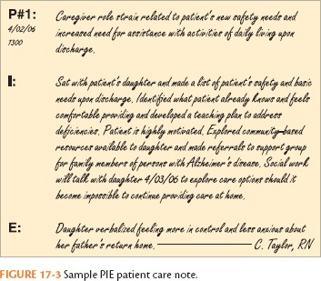

Slide 28
4- Focus Charting
Is intended to make the client and client concerns and strengths the focus of care. The progress notes are organized into:
(D) data which reflects the assessment phase of the nursing process.
(A) action which reflects planning and implementation and includes immediate and future nursing action.
(R) response which reflects the evaluation phase of the nursing process and describes the client’s response to any nursing and medical care.

Slide 29
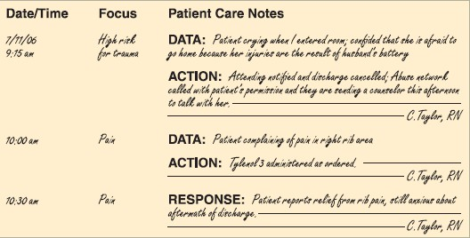

Slide 30
5- Charting by exception (CBE)
Is a documentation system in which only abnormal or significant findings or exceptions to norms are recorded.
6- Computerized documentation
Nurses use computers to store the client’s database,
add new data, create and revise care plans, and document client progress.

Slide 31
General Guidelines for Recording
Because the client’s record is a legal document and may be used to provide evidence in court, many factors are considered in recording:
1- Date and Time, document the date and time of each recording. This is essential not only for legal reasons but also for client safety. Accurate according to the 24-hours clock (military clock) or in the conventional manner (am, pm).

Slide 32
2- Timing, follows the agency’s policy about the frequency of documenting, and adjusts the frequency as a client’s condition indicates. No recording should be done before providing nursing care.

Slide 33
3- Legibility, all entries must be legible and easy to read to prevent interpretation errors.
4- Permanence, all entries made in dark ink so that the record is permanent and changes can be identified.

Slide 34
Correct Spelling, is essential for accuracy in recording.
Incorrect spelling gives a negative impression to the reader and, thereby, decreases the nurse’s credibility.
Signature, each recording on the nursing notes is signed by the nurse making it. The signature includes the name and title. For example, Ahmed Kamel, RN.

Slide 35
7- Accuracy, the client’s name and identifying information should be stamped or written on each page of the clinical records. Before making any entry, check that it is the correct chart. Do not identify charts by room number only, check the client’s name. Notations on records must be accurate and correct. Accurate notations consist of facts or observations rather than opinions or interpretation. It is more accurate, for example, to write that the client”
refused medication” (fact) than to write that the client “was uncooperative” (opinion).

Slide 36
When describing something, avoid general words, such as large ,good, or normal, for example, chart specific data such as “2cm* 3cm bruise” rather than ”large bruise”. When a recording mistake is made, draw a line through it and write the words mistaken entry above or next to the original entry, with your initials or name. Do not erase, or use correction fluid. Write on every line but never between lines.

Slide 37
Sequence, document events in the order in which they occur, such as record assessments, then the nursing interventions, and then the client’s responses. Update or delete problems as needed.
Appropriateness, records only information that pertains to the client’s health problems and care. Recording irrelevant information may be considered an invasion of the client’s privacy.

Slide 38
10- Completeness, not all data that a nurse obtains about a client can be recorded; however, the information that is recorded needs to be complete and helpful to the client and health care professionals. Nurse’s record need to reflect the nursing process, record assessment, dependent and independent nursing interventions, client problems, client comments and responses to interventions and tests, progress toward goals.

Slide 39
Conciseness, recording need to be brief as well as complete to save time in communication.
Accepted Terminology, Use only commonly accepted abbreviations, symbols, and terms are specified by the agency. Many abbreviations are standard and used universally.

Slide 40
13- Legal Prudence, accurate, complete documentation should give legal protection to the nurse, the client’s other caregivers, the health care facility, and the client. “Complete charting for example by using the steps of the nursing process as a framework, is the best defense against malpractice.”

Slide 41
Reporting: is a process of communicating information meanings and ideas to others. Both the oral and written type of communication is used in nursing.
Purpose
The purpose of reporting is to communicate specific information to a person or group of people.

Slide 42
Types of Reports:
There are two types: intradepartmental and interdepartmental
I. The intradepartmental reports:
Intradepartmental reports are those exchanged between members of the different categories within the nursing service department, for example, the head nurse and the nursing service director. Intradepartmental reports includes the three types: shift report; daily conditional report, and incident report.

Slide 43
Types of Reports:
There are two types: intradepartmental and interdepartmental
II. The interdepartmental reports:
Interdepartmental reports are those exchanged between nursing department and other departments such as the admission office.

Slide 44
Characteristics of a good report
Accurate, clear, comprehensive and concise.
Appropriate and understandable language.
Use acceptable abbreviations only.
In the proper place, with only concerned person.
Dated and timely.
Oral reports should be on an unhurried, clear and audible voice.
Written reports should be clearly written in ink and signed, with full name beside signature.

Slide 45
Telephone Reports, health professionals frequently report about a client by telephone. Nurses inform primary care providers about a change in a client’s condition.
The nurse receiving a telephone report should document the date and the time, the name of the person giving the information, and the subject of the information received.
The person receiving the information should repeat it back to the sender to ensure accuracy.

Slide 46
When giving a telephone report to a primary care provider, begin with name and relationship to the client.
For example “This is Maher Battat, RN, I’m calling about your client, Shamsa Mendes. I’m her nurse on the 7pm to 7am shift’’.
Telephone reports usually include the client’s name and medical diagnosis,…ect. The nurse should have the client’s chart ready to give any further information.

Slide 47
Telephone Orders, physicians often order a therapy for a client by telephone. While the primary care provider gives the order, write the complete order down and read it back to ensure accuracy. Question about any order that is ambiguous, unusual, or contraindicated by the client’s condition.

Slide 48
Shift report (Change-of–shift Reports)
It is an oral and written report given by the head nurse of one shift to the head nurse and all members of the oncoming shift. It is exchanged at the beginning of the oncoming shift.
Purpose:
Its purpose is to provide continuity of care for clients by providing the new caregivers a quick summary of
client needs and details of care to be given.

Slide 49
Contents of the shift report:
It contains information about general condition and the specific nursing care needed by every patient in the unit.
Begins with the census
Admission, discharge and transfers.
Critically ill and operative patients.
Patients with deviations in vital signs from normal.

Slide 50
Contents of the shift report:
A small report on every patient including:
The unit and bed number.
The patient full name and diagnosis.
Nursing care needed i.e. laboratory tests, and special observations.

Slide 51
Shift Report (cont.)
For critically ill or post operative patient you should report:
Patient complaint
Your observations.
Special equipment used by the patient.
Parental fluids.
Any diagnostic tests to be done.
Condition of wound presence of drain level of consciousness, urination, passage of
flatus… ect.

Slide 52
Daily condition report:
A report from the unit/ward to the nursing office. It is written by the head nurse of each shift. It includes all the:
Pre-and postoperative patients.
Admissions, transfers and deaths.
Acutely ill patients.
Patients with elevated temperatures.
Patients having painful or special treatment.
Emergencies such as: insulin shock, hemorrhage and convulsion.
Depressed or suicidal patients.

Slide 53
Accident report (occurrence report):
A written summary of all accidents that occurs in the unit to be sent to the nursing office.
Are used to document any unusual occurrence or accident in the delivery of client care, such as falls or medication errors.
These reports are used for quality improvement and should not be used for disciplinary action against staff members.
Incident reports improve the management and treatment of patients by identifying high-risk patterns and initiating in-service programs to prevent future problems.

Slide 54
II. The interdepartmental reports:
Interdepartmental reports are those exchanged between nursing department and other departments such as the admission office. These include:
The daily census report:
An accurate number of patients on the unit. This is usually taken at midnight. It is sent to the admission office.

