Slide 1







Slide 2
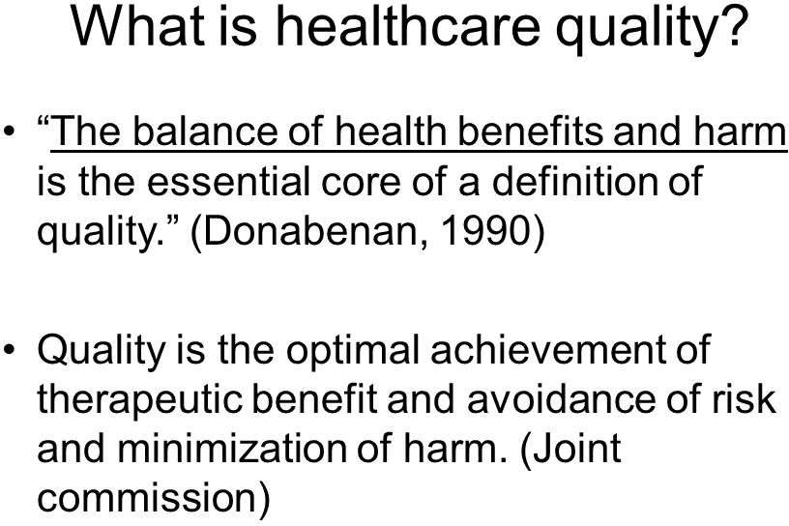



Slide 3
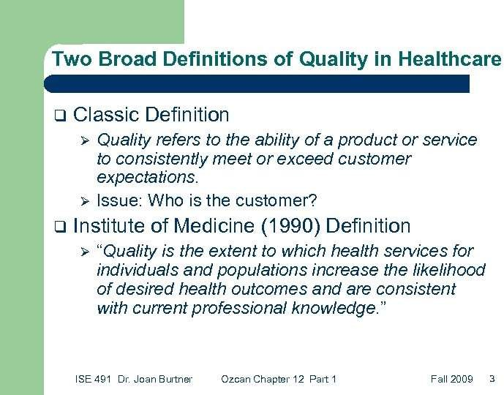




Slide 4
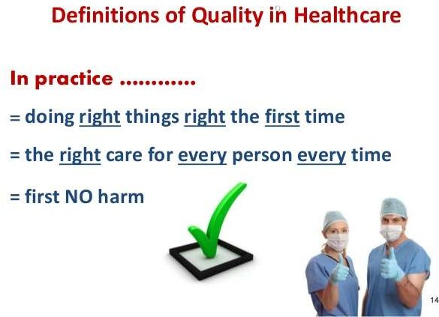





Slide 5

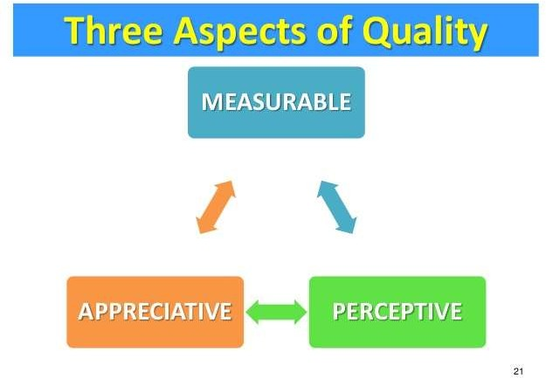

Slide 6
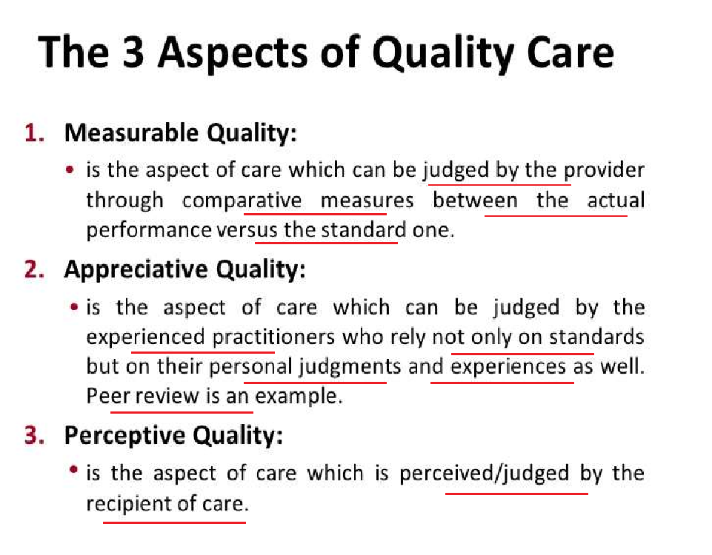


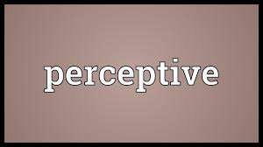

Slide 7




ASPECTS OF QUALITY (MAP)
Compliance with/ adherence to standards.
According to the judgment of peer review bodies.
As perceived by the recipient of care.

Slide 8
The ideal organizationwide strategy is effective in tracking while understanding the value
healthcare
measurable
quality
quality
and necessity of
appreciative quality and actively fostering perceptive quality.
But the ideal healthcare quality strategy is also well- supported by the governing body, by physicians and other independent clinical practitioners, by the chief executive officer, by senior and middle management, and by all employees.

Slide 9


A customer is anyone who receives our service Or dependent on me as a supplier.

Slide 10
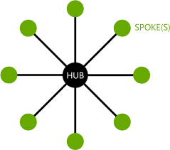
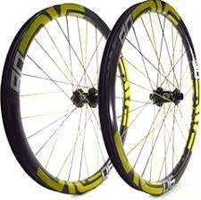


Identifying customers:
- "Wheel and spoke" or "sundial“.
- Customer lists by type: Internal and external.
Identifying customer needs:
Surveys and interviews.
Research.
Brainstorming.

Slide 11




within the organization /
outside the organization

Slide 12
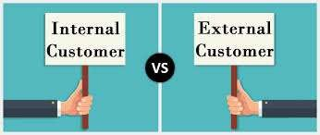
Admitting/reception/front office
staff
Administrative staff
Administrative services staff
Ancillary staff/technicians
Care coordination/social
services staff
Communications staff
Human resource staff
Facilities staff
Finance staff
Medical/clinical record staff
Nurses, aides, medical
assistants
Performance improvement, QM
Pharmacists
Physicians, med. directors
Patients/families
Physicians
Purchasers
Insurance companies and health plans
Employers
Government agencies
Regulators and accrediting agencies
Vendors/suppliers )goods and services)
Other providers
Educational institutions

Slide 13





Slide 14
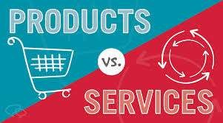
Product | Service
Tangible | Intangible
Measure Output “objects” | Measure Outcome "performances"
Homogenous | Heterogeneous
Can be stored or resold | Perishable cannot be stored or resold
Can be patented | Very difficult to patent

Slide 15

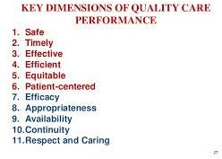
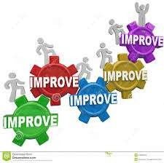


Slide 16




Appropriateness
The degree to which the care and services provided are:
1. Relevant to an individual's clinical needs.
Correct: Doing the right things in accordance with the purpose (Medical necessity).
Suitable resource utilization as judged by peers.

Slide 17

Timeliness
The degree to which care is provided to the individual at the most beneficial or necessary time.

Slide 18
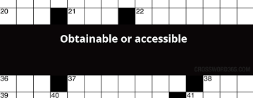

Availability
The degree to which appropriate care and services are accessible and obtainable to meet an individual's needs.

Slide 19

Competency
The degree to which the practitioner adheres to professional and/or organizational standards of care and practice.

Slide 20








Continuity
The coordination of needed healthcare services for a patient among all practitioners and across all involved organizations over time.
The delivery of needed healthcare as a coherent unbroken succession of services.

Slide 21

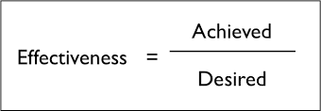

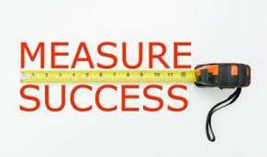

Effectiveness
The degree to which care is provided in the correct manner, given the current state of knowledge, to achieve the desired or projected outcome(s) for the individual"

Slide 22



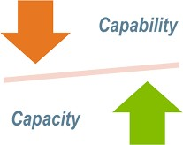


Efficacy
The potential capacity, or capability of the care to produce the desired effect or outcome, as already shown, e.g., through scientific research (evidence- based) findings.
The power of a procedure or treatment to improve health status.

Slide 23
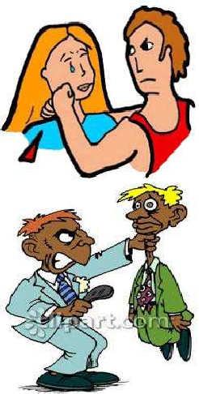
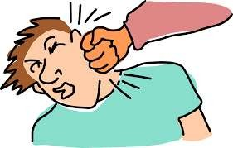

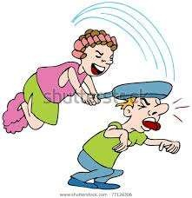


Slide 24
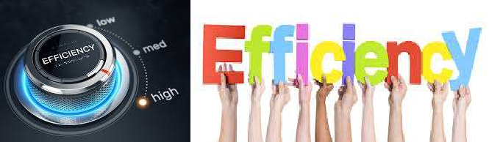



Efficiency
The relationship between the outcomes (results of care) and the resources used to deliver care.
"The relationship of outputs (services produced) to inputs (resources used to produce the services)"

Slide 25


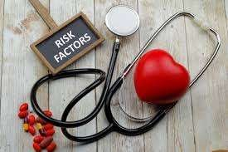
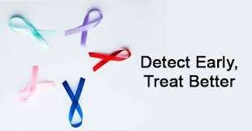
Prevention/Early Detection
The degree to which interventions, including the identification of risk factors, promote health and prevent disease.

Slide 26
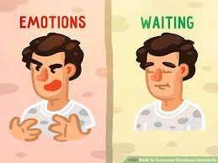




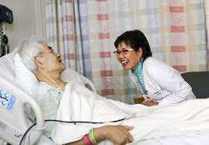
Respect and Caring
The degree to which those providing services do so with sensitivity for the individual's needs, expectations, and individual differences.
The degree to which the individual or a designee is involved in his or her own care and service decisions

Slide 27

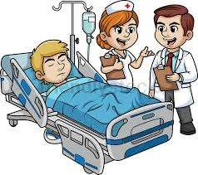
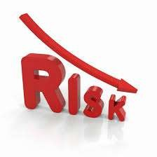
Safety
The degree to which the healthcare intervention minimizes risks of adverse outcome for both patient and provider.

Slide 28
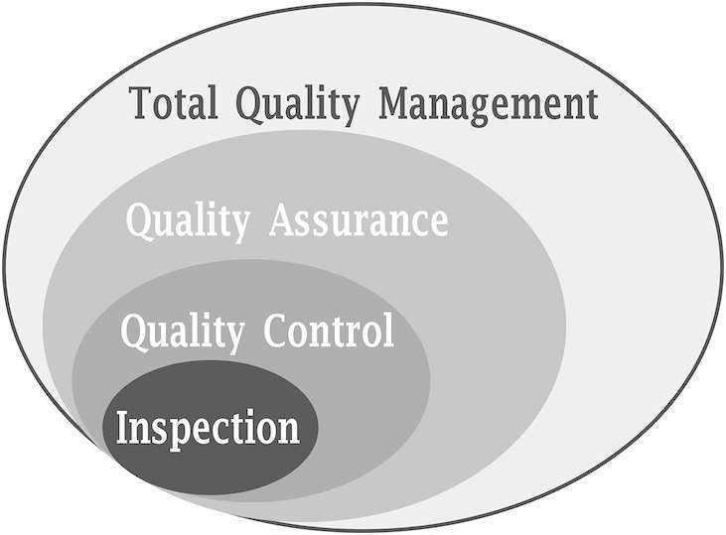

Slide 29
Comparison Between Traditional Monitoring and Evaluation utilizing the three aspects of quality (Quality Assurance) and
Continuous Quality Improvement (CQI)
 | QA | TQM / CQI
Objective | Outcome. | Process and outcome.
Focus | Statistical tail. Problem-focused methods (Actions are initiated when a problem is identified). | Entire group. (Continuous improvement process) trying to improve the process itself.
Focus on | Clinical aspects of care only. | Clinical and non clinical aspects.

Slide 30
Comparison Between Traditional Monitoring and Evaluation utilizing the three aspects of quality (Quality Assurance) and
Continuous Quality Improvement (CQI)
 | QA | TQM / CQI
Objective | Outcome. | Process and outcome.
Focus | Statistical tail. Problem-focused methods (Actions are initiated when a problem is identified). | Entire group. (Continuous improvement process) trying to improve the process itself.
Focus on | Clinical aspects of care only. | Clinical and non clinical aspects.

Slide 31
Comparison Between Traditional Monitoring and Evaluation utilizing the three aspects of quality (Quality Assurance) and Continuous Quality Improvement
QA | TQM / CQI
Departmental. | Cross-departmental acc. to patient flow.
Frequently separating the dimensions of quality care— review of appropriateness separate from effectiveness and/or efficiency. | Integrating all efforts to improve both patient outcomes and efficiency of care delivery (improving value).
Errors are due to individual performance. | Errors are due to system failure (85%).

Slide 32
Comparison Between Traditional Monitoring and Evaluation utilizing the three aspects of quality (Quality Assurance) and Continuous Quality Improvement
 | QA | TQM / CQI
 | WHAT of care Patient care | Also, focuses to the previous ones: HOW of care Patient care processes. Systems and their key processes, Policies, procedures, and regulatory compliance, Relationships and communications; Clinical pathways, practice guidelines, and protocols. RESULT of care Patient care outcome.
 | given.
 | The right service to the right
 | patient at the right time and
Focus | place.
on | WHO of care Patient care
 | giver.
 | Competent and qualified staff
 | who is doing the rights things
 | right.

Slide 33
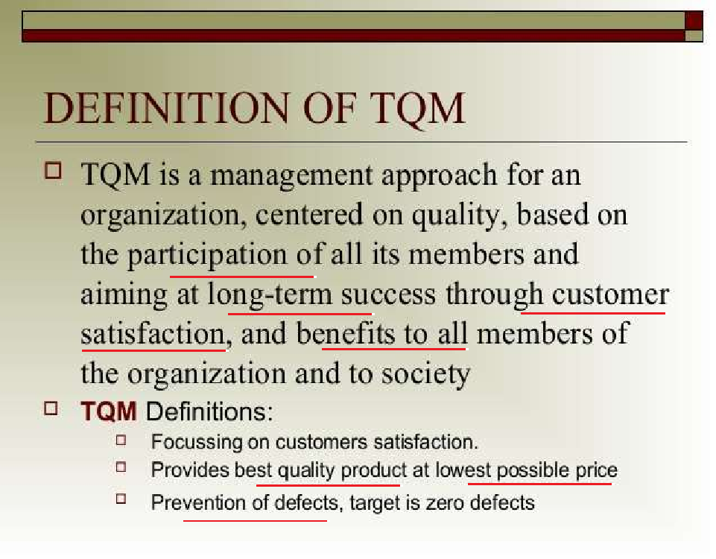
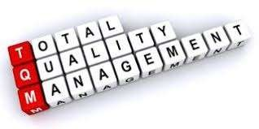


Slide 34
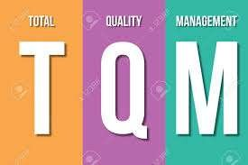
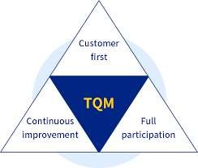
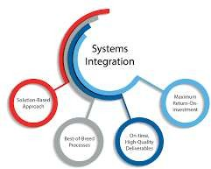


It is the involvement of the entire organization in a process of quality improvement to provide value.
All functions and all employees have to participate.

Slide 35


Focusing on meeting customer needs and organizational objectives.
Continuous improvement in all work, from high level strategic planning and decision-making, to detailed execution of work elements on the shop floor.

Slide 36
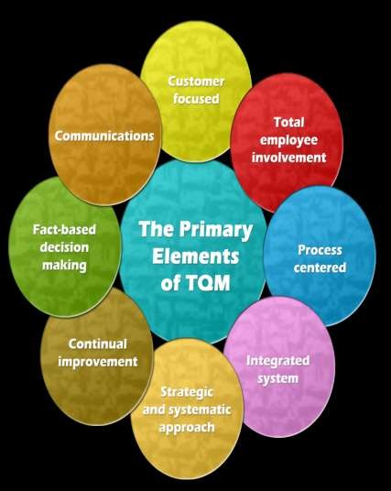
The key principles are:
Management Commitment.
Employee Empowerment.
Fact Based Decision Making.
Continuous Improvement.
Customer Focus.
- Organizational Culture.
- Continuous learning.

Slide 37
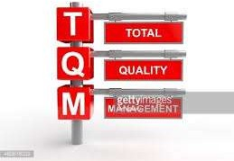
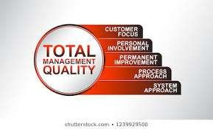

key concepts of TQM
Top management leadership.
Creating corporate framework for quality
Transformation of corporate culture.
Customer focus.
Process focus.
Collaborative approach to process improvement.
Employee education and training.
Learning by practice and teaching.
Benchmarking.
Quality measurement and statistics.
Recognition and reward.
Management integration.
.

Slide 38

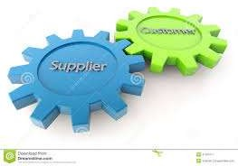
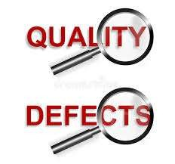
QUALITY MANAGEMENT PRINCIPLES
"Productive work is accomplished
through processes." Each person in the organization is a part of one or more processes.
"Sound customer-supplier relationships are absolutely necessary for sound quality management.“
"The main source of quality defects is problems in the process."

Slide 39

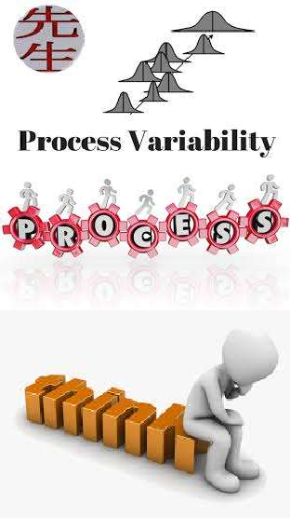
QUALITY MANAGEMENT PRINCIPLES
Poor quality is costly.
Understanding the variability of processes is a key to improving quality.
Quality control should focus on the most vital processes.
The modern approach to quality is thoroughly grounded in scientific and statistical thinking.

Slide 40

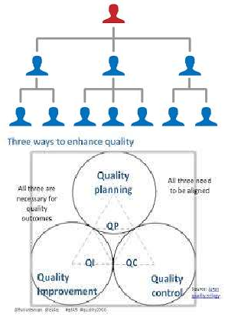
QUALITY MANAGEMENT PRINCIPLES
Total employee involvement is critical.
New organizational structures can help
achieve quality improvement.
10. Quality management employs basic, closely interrelated activities:
three
Quality planning, quality control [quality
measurement], and quality improvement.

Slide 41




1. The organizational
The Joint Commission Principles of Organization and Management Effectiveness
mission statement clearly expresses a commitment.
The organizational culture.
Opportunities for
organizational change.
The role of governing board, managerial, and clinical leaders.

Slide 42

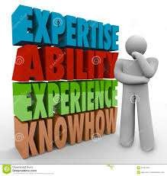
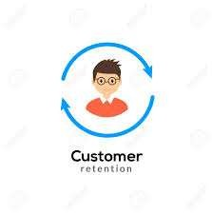
The Joint Commission Principles of Organization and Management Effectiveness
5. The governing board, managerial, and clinical leadership qualifications.
6. The qualifications, and development of
evaluation, independent
practitioners.
7. Human resources recruitment and retention policies and practices.

Slide 43



The Joint Commission Principles of Organization and Management Effectiveness
Sufficient support resources.
The monitoring, evaluation, and continuous improvement of patient care.
Organizational integration and coordination.
Continuity and comprehensiveness of care.

Slide 44
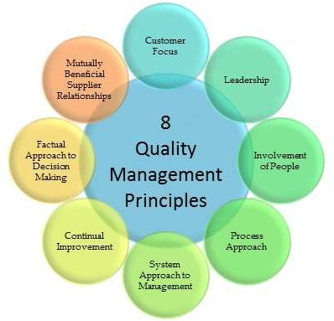
The ISO 9000:2005 Quality Management Principles

Slide 45

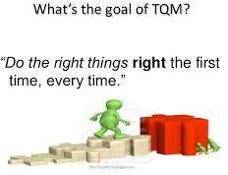
A central principle of TQM is that mistakes may be made by people, but most of them are caused, or at least permitted, by faulty systems and processes.

Slide 46



- Mistakes can be avoided and defects can be prevented.
- Improving capabilities to produce better results in the future.

