Slide 1
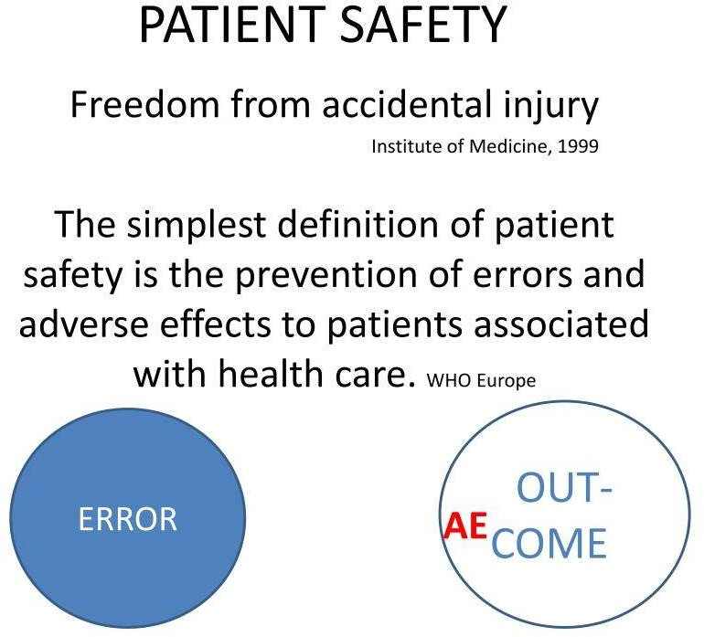
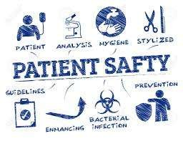

Slide 2
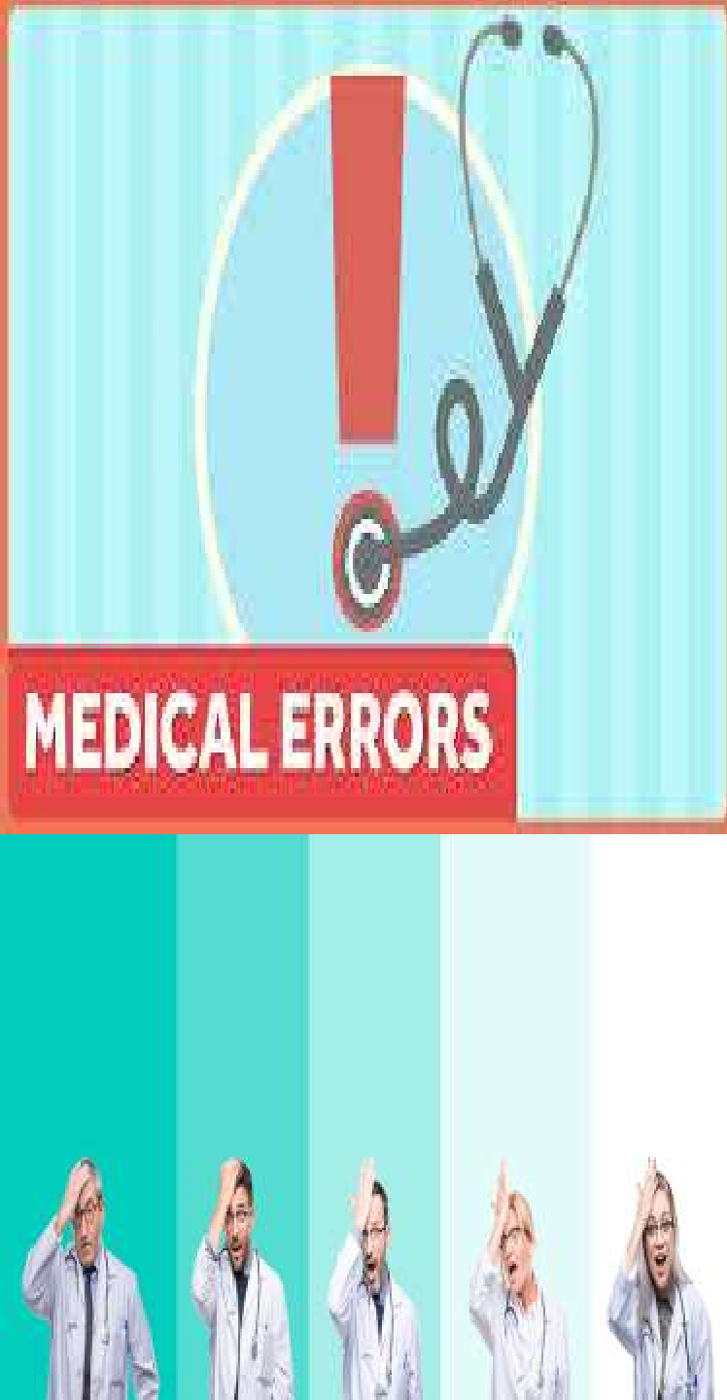
Medical Errors
Medical error: is an unintentional preventable mistake in the provision of care that has an actual or potential adverse impact on the patient.

Slide 3
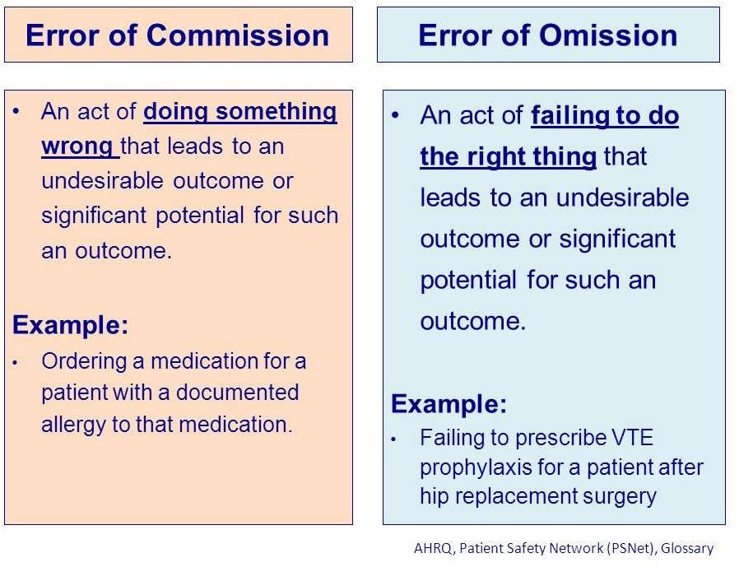
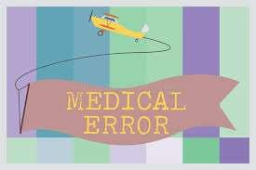
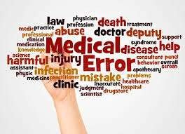


Slide 4
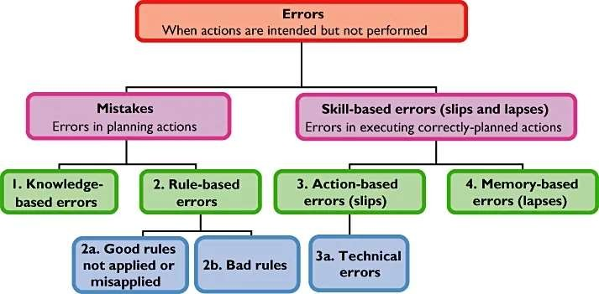



Slide 5


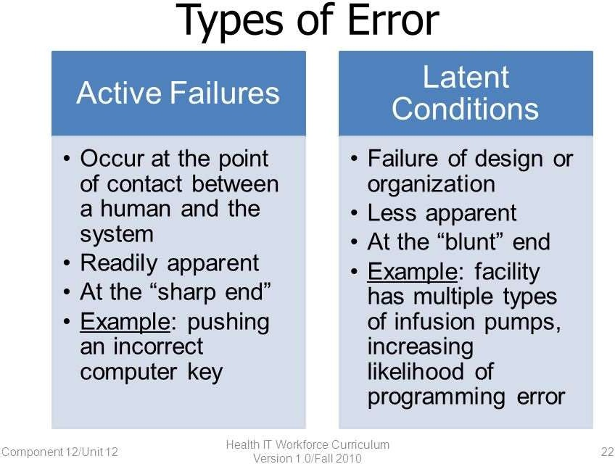



Slide 6
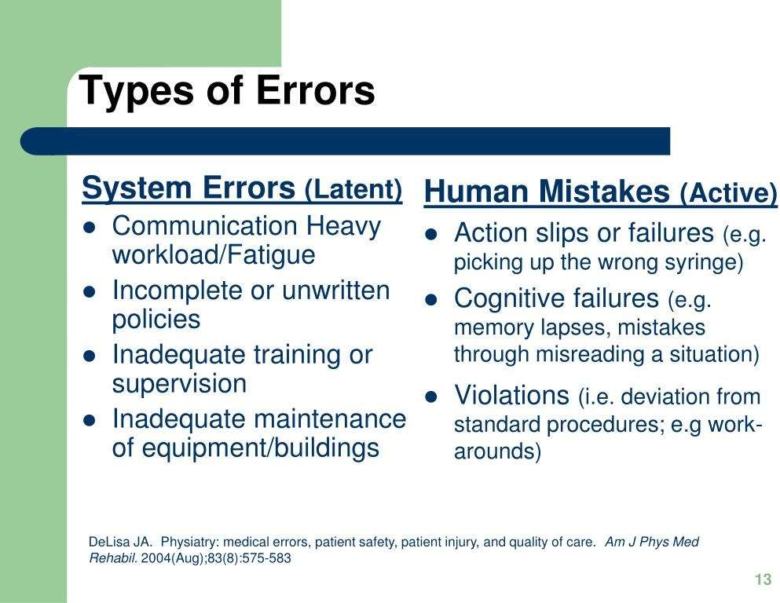




Slide 7



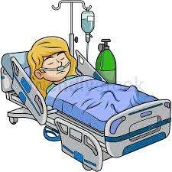

Adverse event is an unintended
injury caused by medical management rather than the underlying condition of the patient that results in measureable disability, prolonged hospitalization, or both" .

Slide 8

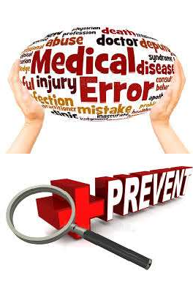
Since not all adverse events are a result of error, An adverse event attributable to error is a “preventable adverse event.”
Adverse events have been classified as either
Preventable: due to error.
Not preventable.

Slide 9

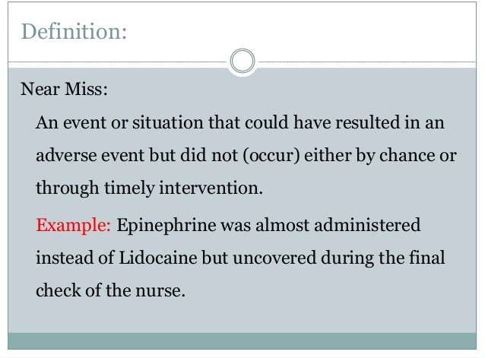

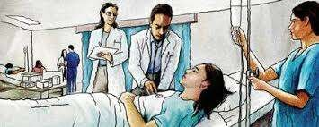

Slide 10

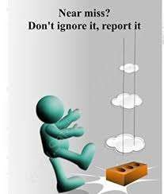



For a near miss, it is best to complete a Failure Mode Effectiveness Analysis (FMEA) or a Root Cause Analysis (RCA)

Slide 11



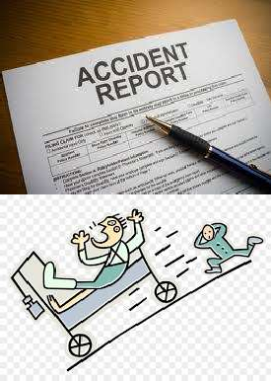
Sentinel events signal the need for immediate investigation and response; an intensive in-depth analysis.
Another name for a sentinel event is a never event. A never event is an event that should never happen.
The National Quality Forum (NQF) changed the 'never event' term to 'Serious Reportable Events (SRE)'.

Slide 12
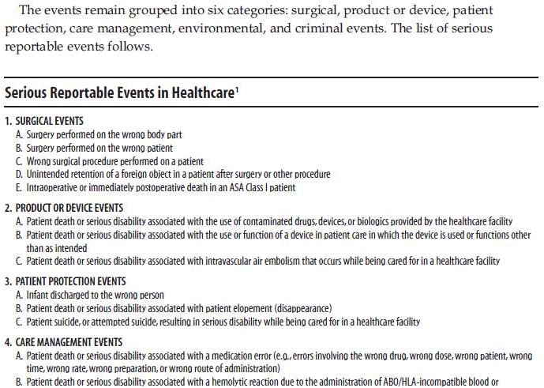

Slide 13
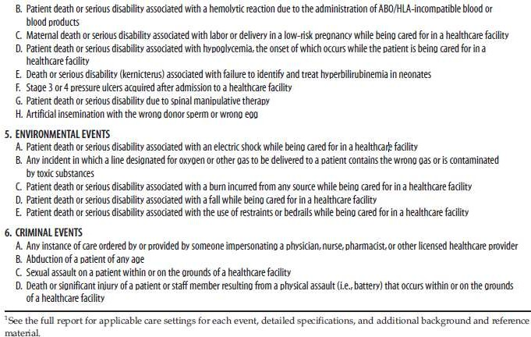


Slide 14
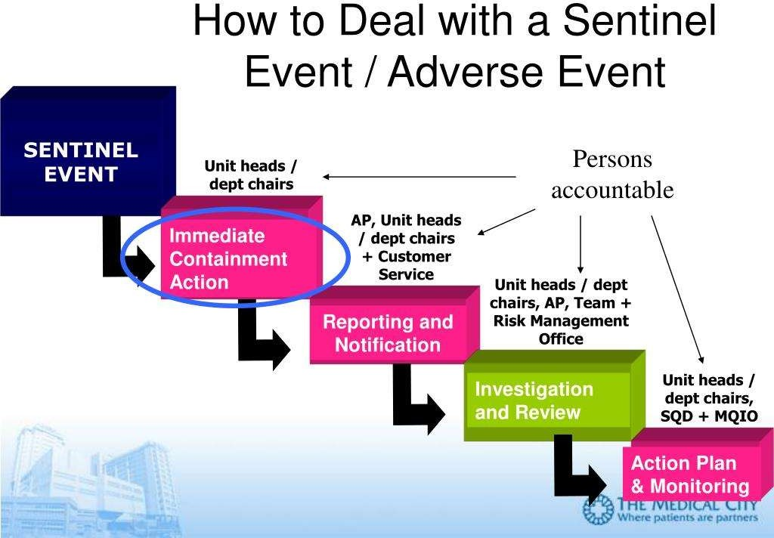

Slide 15
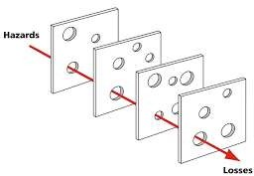
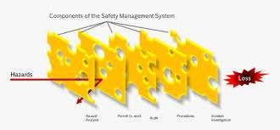
James Reason's Swiss Cheese Model
Each slice of Swiss cheese has
holes in it, but the hole location will not be consistent to allow a
straight line to be drawn from the front to the back. There is a barrier preventing further passage through the cheese.

Slide 16
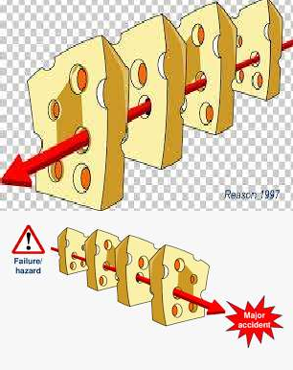
James Reason's Swiss Cheese Model
Catastrophic errors do not occur in isolation. It is only when the systems align in a certain way, and the fail-safe mechanisms all fail, that the catastrophic event occurs.
A number of smaller errors leading up to a catastrophic error.

Slide 17



1. The communication
Four categories of errors were identified in the IOM report
errors include an error or
delay | in | the | diagnosis,
failure | to | order | indicated
tests.

Slide 18

Four categories of errors were identified in the IOM report
2. The treatment errors include an
error in the performance of a procedure or test, an error in the administration of the treatment, an error in the dose or method of using a drug, and/or inappropriate care.

Slide 19
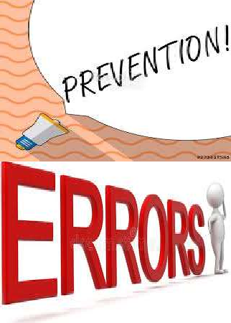
Four categories of errors were identified in the
IOM report
3. Preventative errors
include failure to provide prophylactic treatment and/or inadequate monitoring or follow-up of treatment.

Slide 20

4. And lastly, other
Four categories of errors were identified in the IOM report
errors include
equipment failure, and other system failures.

Slide 21



The IOM (2000) laid out a four-tiered approach to developing a strategy to improve patient safety
1. Establish a national focus
to create leadership tools, research, and protocols to
increase the knowledge base about patient safety.

Slide 22


The IOM (2000) laid out a four-tiered approach to developing a strategy to improve patient safety
2. Identify and learn from errors
by developing a nation-wide public mandatory reporting system as well as encouraging healthcare staff, practitioners, and the organization to participate in voluntary reporting systems.

Slide 23



The IOM (2000) laid out a four-tiered approach to developing a strategy to improve patient safety
3. Raising performance expectations and standards for improvements in patient safety
through the professional
organizations, group purchasers, and so forth within healthcare.

Slide 24
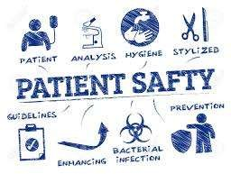
The IOM (2000) laid out a four-tiered approach to developing a strategy to improve patient safety
4. Implementing patient
safety systems in healthcare organizations and systems to ensure safe practices at the delivery area.

Slide 25

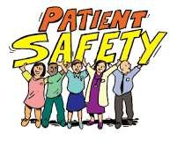

Patient Safety Practices
Patient Safety Practices were recommended for Implementation by AHRQ (AHRQ, 2013).

Slide 26

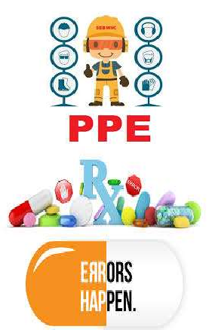
Strongly encourage implementation
Hand hygiene.
Barrier precautions to prevent healthcare- associated infections.
Do Not Use" list of hazardous abbreviations.

Slide 27


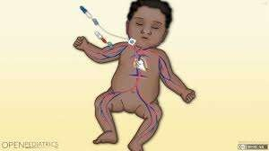

Strongly encourage implementation
Preoperative checklists and
anesthesia checklists.
Use of real-time ultrasound for central line placement.
Bundles that include checklists for central line insertion and care.

Slide 28

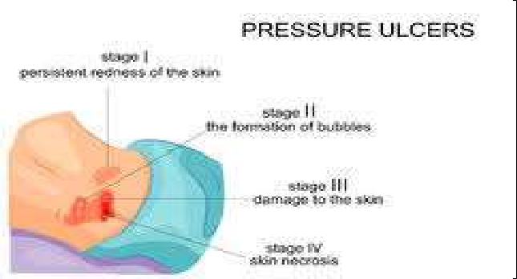

Strongly encourage implementation
Interventions to reduce urinary catheter use, including catheter reminders, stop orders, or nurse- initiated removal protocols.
Multicomponent interventions to reduce pressure ulcers.
Interventions to improve prophylaxis for VTE.

Slide 29



Encourage Implementation
Multicomponent
interventions to reduce falls.
Use of clinical pharmacists to reduce adverse drug events.
Computerized provider order entry (CPOE).

Slide 30
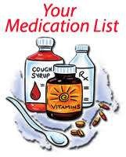

Encourage Implementation
Medication reconciliation.
Obtaining informed consent to improve patients' understanding of the potential risks of procedures.
Use of surgical outcome measurements.

Slide 31
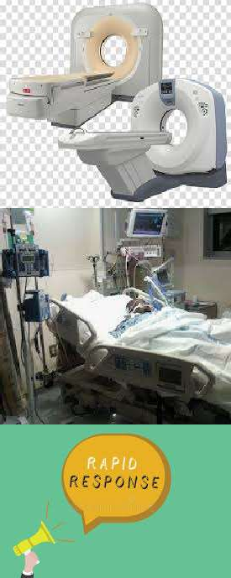
Encourage Implementation
Practices to reduce radiation
exposure from fluoroscopy and computed tomography scans.
Documentation of patient preferences for life-sustaining treatment.
Rapid response systems.

Slide 32


Basic principles of patient safety
1. Patient safety emerges from systems design.
The more complex a system is,
the more chance there is for error, especially when there are different systems working together. Safety systems have many components.

Slide 33



Basic principles of patient safety
2. Patient safety is designed for the nature of illness.
Patients can be treated with standardized protocols and/or guidelines to help minimize error.
The standardization decreases the opportunities for errors.

Slide 34




Basic principles of patient safety
3. Patient safety is dependent on open learning.
When errors occur, the team should learn from those errors.

Slide 35



Basic principles of patient safety
4. Trustworthiness is essential to the concept of patient safety.
The members of the healthcare team must trust each other to speak up when an error or a potential error is identified.

Slide 36
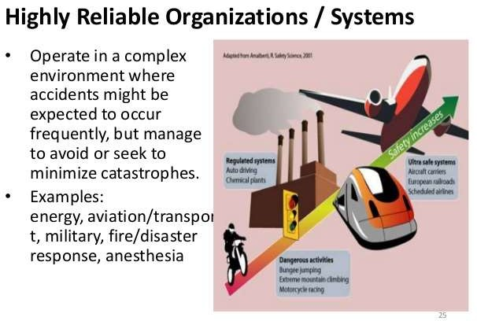

Slide 37
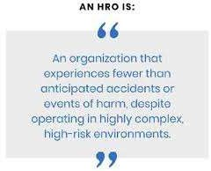
High Reliability Organizations
Are those that zero defects in
achieve quality
outcomes.
Patient safety seeks high reliability of a system that is filled with risk.

Slide 38



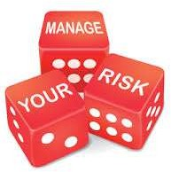
The five High Reliability Factors
1. Preoccupation لاغشنلاا with failure:
- All people within an organization must seek, report, and correct all potential or small risks before the risk has the opportunity to turn into a negative outcome.

Slide 39


The five High Reliability Factors
Organizations then frequently use Lean-Six Sigma tools to address those areas of risk that have potential for problems.
Communicate.

Slide 40


The five High Reliability Factors
2. Reluctance simplifications: These
ةبغر مدع to
organizations ask "why" more often to better understand the reasons for problems and leverage new thinking to get the right answer.

Slide 41



The five High Reliability Factors
3. Sensitivity to operations ليغشت: Pay attention to the front line and help them to develop situational awareness and speak up about safety issues. Leaders must cultivate this.

Slide 42


The five High Reliability Factors
4. Commitment to resilience.
A key human factors concept is “resilience,” which investigates how individuals, teams and organizations monitor, adapt to and act on failures in high-risk situations.
it moves from simplistic reactions to error making toward valuing a proactive focus on error recovery.

Slide 43



The five High Reliability Factors
5. Deference مارتحا to expertise. Recognize that those closest to the frontline are the experts and understand the reasons behind
issues that members determine
arise. can how
Frontline more
to make
staff easily
the
environment safer.

Slide 44
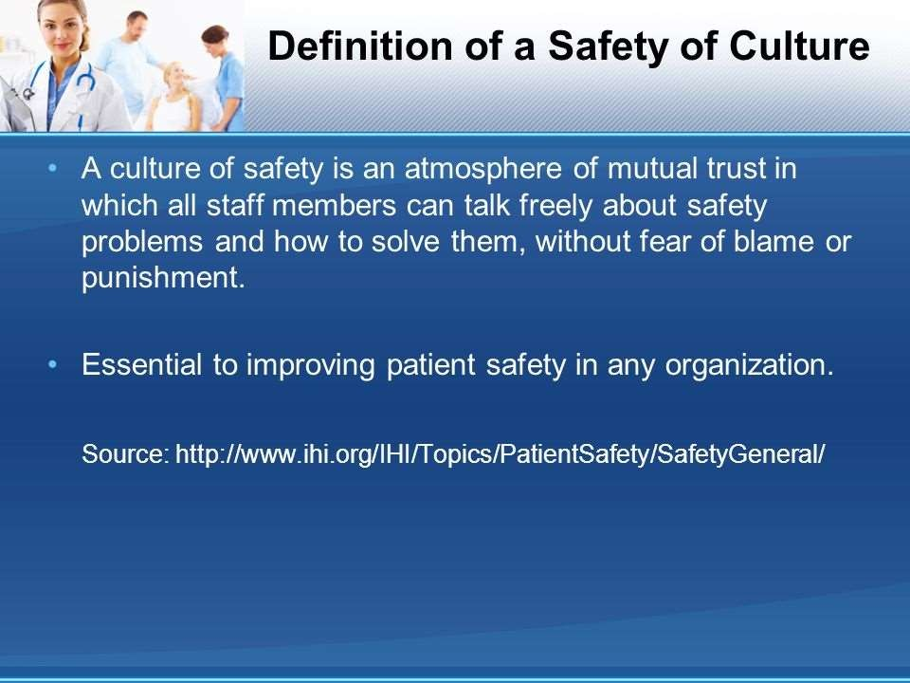


Slide 45
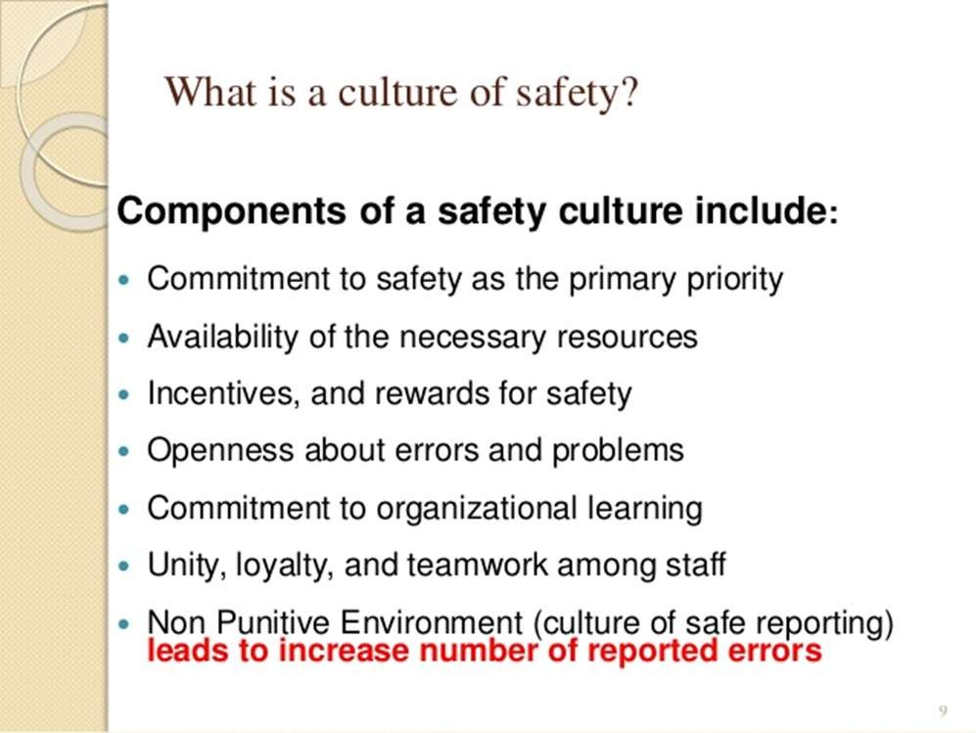
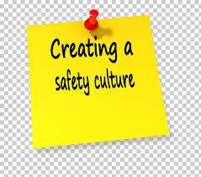
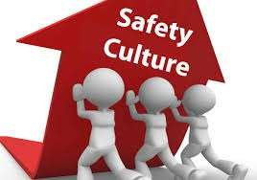

Slide 46

Just Culture
The IHI estimated that 80% of medical errors are system- driven.
A just culture recognizes that professionals should not be held accountable for system failings over which they have no control.

Slide 47


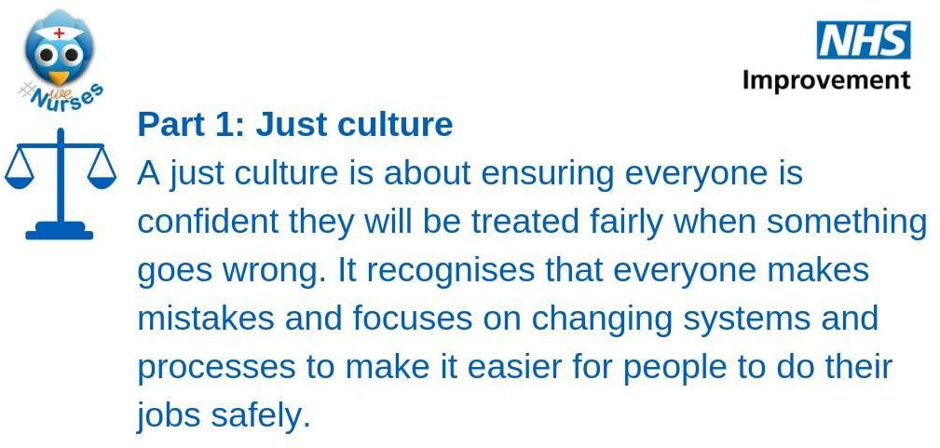

Slide 48
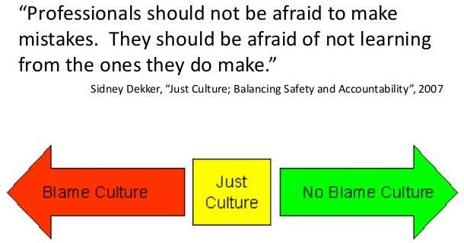


Slide 49


Just Culture
Just culture defines three possible behavior
choices individual
that an makes and
needs to manage

Slide 50
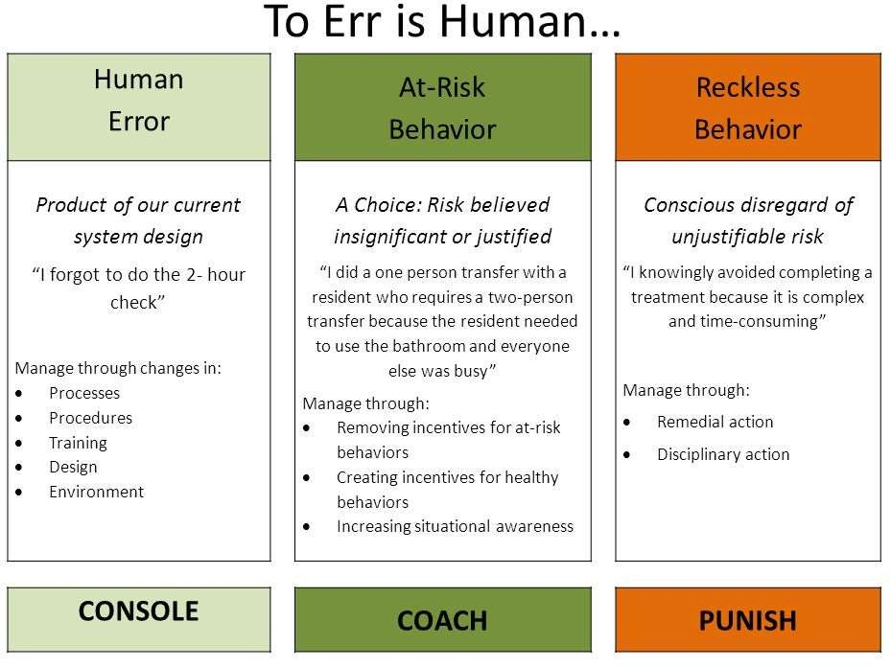




Slide 51





Measurement tool:
AHRQ free “Hospital patient safety culture”
survey on
The safety culture assessment helps identify and measure conditions in healthcare organizations that lead to adverse events and patient harm.
Surveys occurring every two years.

Slide 52

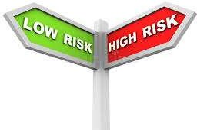

In a hospital, high-risk areas include the ICU, the ER, Labor and Delivery, Surgery, and so on.
One year the survey could be focused on one or more of these high-risk areas.

Slide 53

Six areas you have to review (assess):
1. Leadership and culture:
analyze changes, reporting
processes, implement non-punitive, error
2. People (staff): attitude, education, training

Slide 54


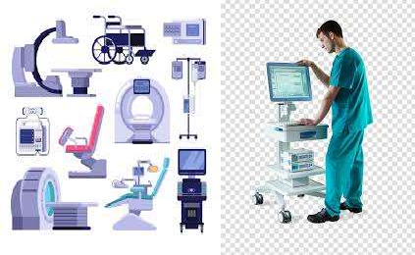
3. Processes: need
improvement? redesign?
4. Equipment/technology.

Slide 55


5. Environment: light,
temperature,
noise,
surfaces, storage.
6. Structure: supplies,
policies.

Slide 56
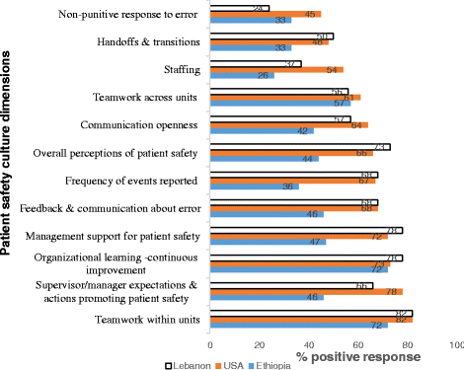


Slide 57



Benefit from assessing a patient safety culture of the organization:
Raise staff awareness about patient safety.
Diagnose and assess the
current status of patient safety Culture.

Slide 58



3. Examine trends in patient safety culture change over time.
4. Identify areas for
strengths and patient safety
culture improvement.

Slide 59





Slide 60







Slide 61



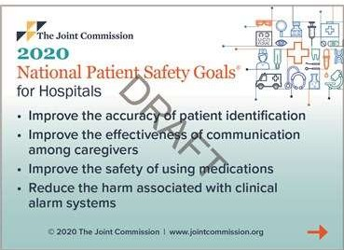

Slide 62
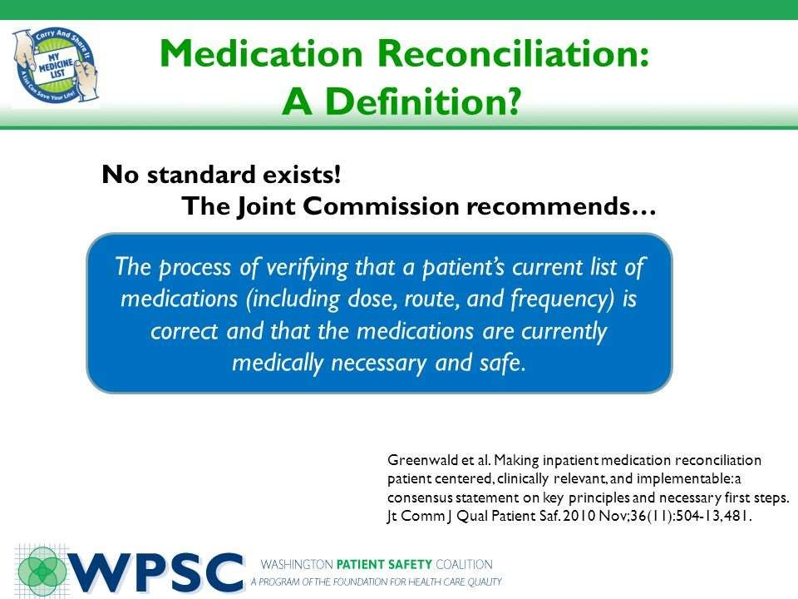
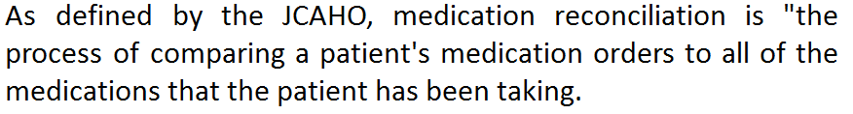
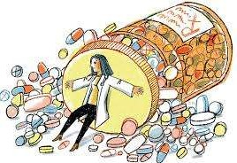
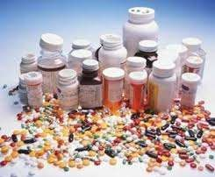
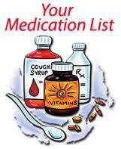
Goal 3
Improve the safety of using medications
Medication Reconciliation
As defined by the JCAHO, reconciliation is "the process of patient's medication orders to
medication comparing a all of the
medications that the patient has been taking.
This reconciliation is done to avoid medication errors such as omissions, duplications, dosing errors, or drug interactions.
It should be done at every transition of care in which new medications are ordered or existing orders are rewritten.
Transitions in care include changes in setting,
service, practitioner or level of care.

Slide 63
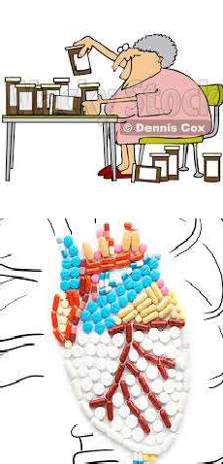
Medication Reconciliation
This reconciliation is done
to avoid medication errors such as omissions, duplications, dosing errors, or drug interactions.

Slide 64
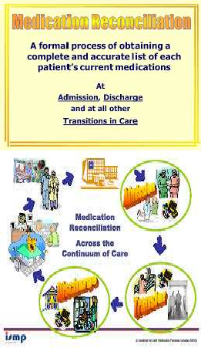
Medication Reconciliation
It should be done at every
transition of care in which new medications are ordered or existing orders are rewritten.
Transitions in care include changes in setting, service, practitioner or level of care.

