Slide 1
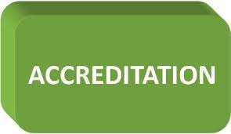


Slide 2



Healthcare Licensure.
Accreditation Survey Readiness.
Survey Process.
- U.S. Healthcare Accrediting Agencies.
International Accreditation.
Medicare and Medicaid.
Deemed Status.
External Quality Awards.

Slide 3

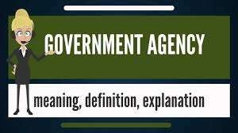


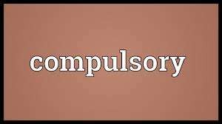
granting and receiving a license.
mandatory (compulsory, imperative, involuntary ).
A governmental regulatory entity, usually the state Department of Health Services.

Slide 4
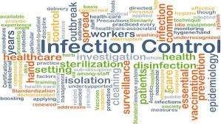


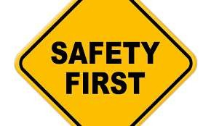

Based on
an onsite survey, sometimes
requiring several visits, and compliance with all applicable state and federal laws and regulations.

Slide 5
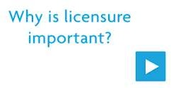




Slide 6




Most Managed Care Organizations (MCOs) are licensed or certified by their state Department of
Corporations, Department of
Department of Managed Care
Insurance, or rather than the
Department of Health Services.

Slide 7





ACCREDITATION CONCEPTS
a voluntary survey process.
non-governmental, independent, external agencies.
focusing on organizational, not individual practitioner, performance.

Slide 8


ACCREDITATION CONCEPTS
assess the extent of a healthcare organization's compliance with applicable pre- established performance standards.

Slide 9


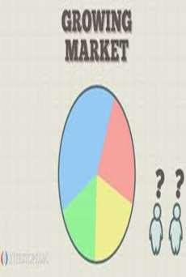

True commitment to improve the quality of care.
Enhance confidence to the public.

Slide 10




Willingness to be compared to like organizations.
to undergo a Conditions of
a
Participation survey as requirement
for contracting with
health plans reimbursements.
and
receive

Slide 11





TYPES OF SURVEYS
Corporate surveys: conducted by internal corporate consultants.
Regulatory surveys: conduct licensing surveys or investigates complaints.
Accreditation surveys: conducted by external accreditation agencies.

Slide 12
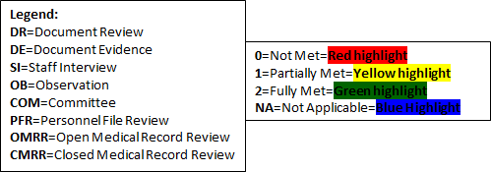




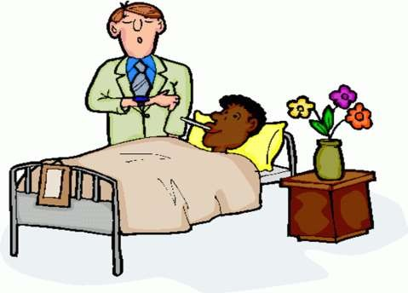



Slide 13


ACCREDITATION SURVEY READINESS
Accreditation/Regulatory Readiness Team
To ensure compliance with the standards, coordinate and oversee continuous readiness, create a survey preparedness plan:
Establish ongoing interdisciplinary teams.
Periodic walk-around inspections.
Mock surveys.
Education of Staff, Leaders, and Practitioners.
Meetings with department leaders.

Slide 14


Accreditation/Regulatory Readiness Team
consists of key leaders and managers.
The team members must have decision-making authority in the organization.
must be very familiar with the regulatory requirements.

Slide 15
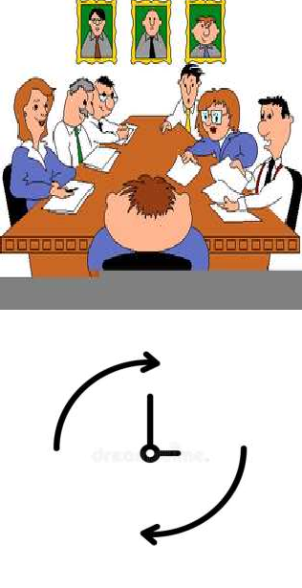
Accreditation/Regulatory Readiness Team
The Quality administrative
Council, the council, or a
senior leadership survey team may assume the role.
This is an ongoing effort and not a pre-survey effort to make improvements.

Slide 16
ACCREDITATION SURVEY READINESS
Accreditation/Regulatory Readiness Team
To ensure compliance with the standards, coordinate and oversee continuous readiness, create a survey preparedness plan:
Establish ongoing interdisciplinary teams.
Periodic walk-around inspections.
Mock surveys.
Education of Staff, Leaders, and Practitioners.
Meetings with department leaders.

Slide 17

Accreditation/Regulatory Readiness Team
Readiness Team Activities:
Establish ongoing interdisciplinary teams consist of three to five members.
These teams will be assigned portions of the standards for which they are responsible.
listing of the requirements and then performing a gap analysis (self-assessment).

Slide 18


Accreditation/Regulatory Readiness Team
Readiness Team Activities:
Periodic walk-around inspections
of all settings, departments, and services, focusing on selected standards each time.
If non-compliance issues arise, decisions can be made on the spot.
A good alternative or addition to the walk-around is to establish interview/focus groups.

Slide 19



Accreditation/Regulatory Readiness Team
Readiness Team Activities:
Mock surveys
help everyone to become more familiar with the survey process and be more relaxed and ready when the real survey occurs.
organizations do not need to hire a consultant.

Slide 20



Accreditation/Regulatory Readiness Team
Readiness Team Activities:
Mock surveys
Different organization departments.
the could survey other
departments in
If the organization is part of a larger healthcare system, then like facilities in the system could be utilized to survey another facility.

Slide 21


Accreditation/Regulatory Readiness Team
Readiness Team Activities:
Education of Staff, Leaders, and Practitioners
The surveyors increasingly want to talk to the staff more so than to managers, but both must be prepared to answer questions.

Slide 22

Accreditation/Regulatory Readiness Team
Readiness Team Activities:
Regulatory Compliance Leaders Meetings
Conducting ongoing monthly or bi- monthly meetings with department leaders.
During the meetings, section leaders provide a short presentation for the group on a particularly challenging or troublesome regulation.

Slide 23


SURVEY PROCESS
The number of surveyors is determined by the accrediting organization, with consideration of facility's size, types of patients, and services provided.
Most surveys are conducted at least once every three years.

Slide 24

SURVEY PROCESS
Document Preparation
listing the specific documents.
providing the updated documents in an organized and timely manner is a first step in demonstrating to the survey team that your organization has a working continual readiness program.
have a private area for computer set up and document review.

Slide 25

SURVEY PROCESS
Tracer: A framework used to assess the movement of a patient through the healthcare system.
A record used to assess the movement of a patient through the health system.
From entry to discharge, the record is reviewed for
completeness, assessments,
individualized communication
care planning, with the care
pain team,
discharge planning, etc.

Slide 26

SURVEY PROCESS
Staff Interviews with the Surveyor
The surveyor will ask caregivers specific questions to assess their care provided, practices, communication, and adherence to policies.
Staff members may ask a surveyor to re-state a question if they do not understand what the surveyor is asking.

Slide 27

SURVEY PROCESS
Patient Interviews with the Surveyor
The surveyor will ask permission patient.
to speak to the
Topics that are bound to come up during the interview include pain control, communication, medication reconciliation, and individualized education.
Patients and visitors can file their own complaints directly with various oversight agencies.

Slide 28


SURVEY PROCESS
End of the Survey Day
The survey team holds a debriefing meeting at the end of each day or at the beginning of the next day to discuss how the survey is going.
In some organizations, a senior leader will send a summary email communication to selected members of the leadership team at the end of each survey day.

Slide 29
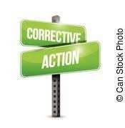

SURVEY PROCESS
End of the Survey Day
It assists with correcting any issues as soon as possible prior to the survey team's departure.
The immediate correction may, in some cases, prevent additional action plans once the surveyors have left and completed their reporting.

Slide 30


SURVEY PROCESS
At the End of the Survey
The survey team will hold an exit conference with the organization's leadership team to review preliminary findings.
The official findings and citations will be provided in a written report from the surveying agency in approximately 10 days.

Slide 31

SURVEY PROCESS
After the Surveyors Leave
The organization then corrective action plan.
completes a detailed
Begin drafting corrective action plans for suspected citations as soon as possible.

Slide 32

If CMS finds actual or potential patient harm, this puts the organization at risk of losing Medicare funding, which could be financially catastrophic, and could open the door to large legal liabilities.

Slide 33

Role Of The Quality Professional In Accreditation
Coordinate survey preparation with the assistance of all leaders, managers, and staff.
Serve as internal consultants for the organization. 3- Distribute standards and guidelines to leaders.
Flag changes in standards.
Review the surveyors’ reports for the last two full surveys. 6- Monitoring readiness of interdisciplinary teams.
7- Document the type of administrative and team structure used for survey readiness, including team activities and responsibilities.

Slide 34


U.S. HEALTHCARE ACCREDITING AGENCIES
There are numerous healthcare accreditation agencies.
NCQA.
Det Norske Veritas Healthcare (DNV Healthcare).
The Healthcare Facilities Accreditation Program (HFAP).
Joint commission.

Slide 35
Disease Specific Certification
Several agencies offer certifications in areas such as stroke, acute myocardial infarction, heart failure, hip/knee replacements, vascular disease, dialysis, and many more.
Becoming certified as a disease specific provider is very popular and can do much to enhance a healthcare organizations' reputation in the community.

Slide 36

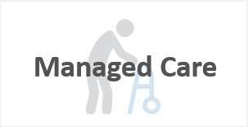


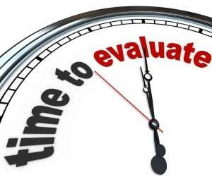
THE NATIONAL COMMITTEE FOR QUALITY ASSURANCE (NCQA)
It offers a three-year accreditation to health plans and managed care organizations (MCOs).
Accreditation status is reevaluated annually based on HEDIS performance measure results.

Slide 37
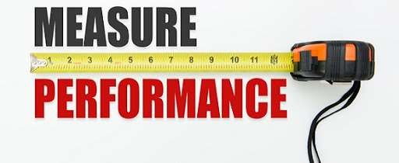
THE NATIONAL COMMITTEE FOR QUALITY ASSURANCE (NCQA)
HEDIS: Healthcare Effectiveness Data And Information Set. A set of performance measures used to evaluate the structure and functions of medical and quality management systems in MCOs.

Slide 38


Accreditation Required Measures
HEDIS data is required for NCQA accreditation, and is also utilized for consumers in reviewing health plans.
The HEDIS data is displayed in NCQA Quality Compass, the largest database of comparative health plan performance information.

Slide 39



THE JOINT COMMISSION(TJC)
Non-profit organization.
A majority of state governments recognize Joint Commission accreditation as a condition of licensure and the receipt of Medicaid reimbursement.
Has national (JCAHO) and international (JCI) standards.

Slide 40



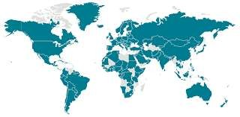

Slide 41
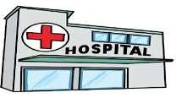






TJC has accreditation programs like:
Hospitals
Medical transport organizations
Clinical laboratories
Long term care
Ambulatory care
Primary care settings
Academic medical centers
Home care

Slide 42

ORGANIZATIONAL FUNCTIONS
If you focus on function, rather than individual departments, it
integrates services and patient care the priority,
makes rather
than the departmental processes themselves.
Identify functions by analyzing patient tracers, performance measures, and reviews.

Slide 43
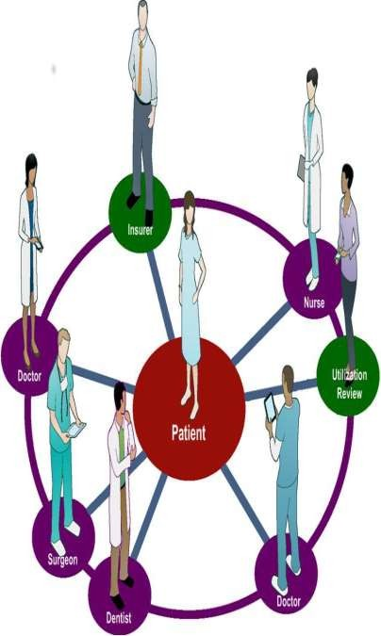
ORGANIZATIONAL FUNCTIONS
The organizational functions as identified by the JCI
Section I: Patient- Focused functions
Access to Care and Continuity of Care
Patient and Family Rights
Assessment of Patients
Care of Patients
Anesthesia and Surgical Care
Medication Management and Use
Patient and Family Education

Slide 44
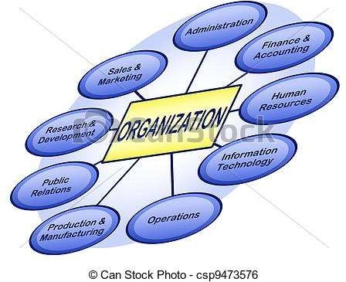
ORGANIZATIONAL FUNCTIONS
Section II: Organizational functions
Quality Improvement and Patient Safety
Prevention Infections
Governance, Direction
and Control of
Leadership, and
Facility Management and Safety
Staff Qualifications and Education
Management of Communication
and Information

Slide 45
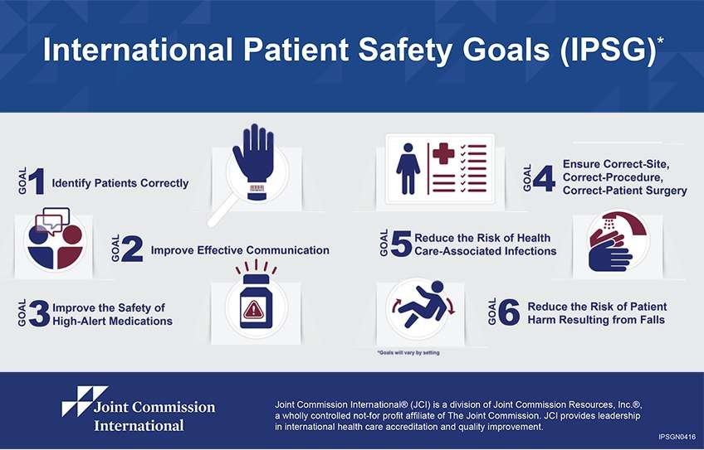

Slide 46

Patient Safety Tools & Resources
The Joint Commission - Sentinel Event Alerts, and Quick Safety Issues.
Anyone can subscribe to receive the Sentinel Event Alerts via email when a new alert is issued. They are free to all whether or not the organization is accredited by TJC.

Slide 47


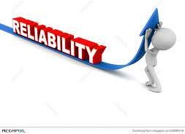
Patient Safety Tools & Resources
The Joint Commission Center for Transforming
Healthcare
works with leading hospitals and health systems using a systematic approach, to analyze care breakdowns, discover underlying causes, and develop targeted solutions to complex problems. The results of its initiatives are available to Joint Commission accredited organizations. The
ultimate goal is to consistently quality healthcare in high
provide reliable
organizations.

Slide 48

The Joint Commission's Quality Check
is a search engine and comprehensive directory of healthcare organizations that are accredited or certified by The Joint Commission.
Providing comparative Quality Reports to the public.
The Quality Report includes accreditation or certification information, compliance with the National Patient Safety Goals, including HCAHPS Survey (patient satisfaction) results, etc.

Slide 49
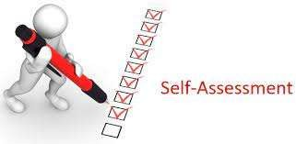
shifted the focus from survey preparation to
continuous improvement.
1• Periodic Performance Review (PPR), Intra-Cycle Monitoring (ICM): An annual self-assessment, evaluate compliance and develop a Plan of Action (POA) with Measures of Success (MOS).

Slide 50

shifted the focus from survey preparation to continuous
improvement.
2• Priority Focus Process (PFP): Pre-survey review of organization-specific data, Including:
Periodic Performance Review information.
.
Previous recommendations.
Complaints; Sentinel events.

Slide 51
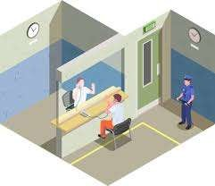

shifted the focus from survey preparation to continuous improvement.
3• Unannounced visits.
4• On-site standards evaluation related to the care
experience
Methodology
of actual patients, using Tracer
to identify types of patients and
processes more at risk.

Slide 52
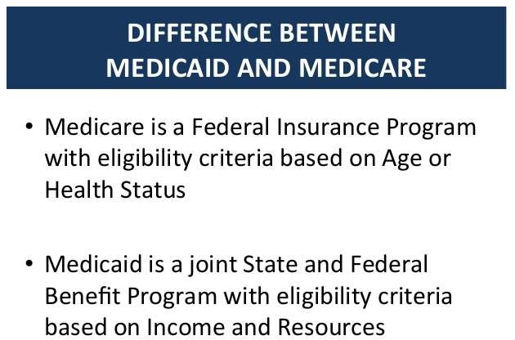

Slide 53

Deemed Status
Conditions of Participations (CoPs)
CMS develops standards, called Conditions of Participation (CoPs) that health care organizations must meet in order to begin and continue participating in and receive payment from the Medicare and Medicaid programs.
This certification is usually based on an onsite survey conducted by a state agency on behalf of CMS or the CMS regional office.

Slide 54

Deemed Status
- CMS also ensures that the standards of accrediting organizations recognized by CMS meet or exceed the Medicare standards set forth in the CoPs. e.g.
The Joint Commission (TJC).
Det Norske Veritas Healthcare (DNV Healthcare).
American Osteopathic Association/Healthcare Facilities Accreditation Program (AOA/HFAP).
Center for Improvement in Healthcare Quality (CIHQ).

Slide 55

Deemed Status
"Deemed status" refers to those circumstances under
which an accredited organization is "deemed" or considered to have met the "Conditions of Participation in the Medicare and Medicaid Programs" of the Centers for Medicare and Medicaid Services (CMS) and can therefore provide services to Medicare and Medicaid recipients.

Slide 56






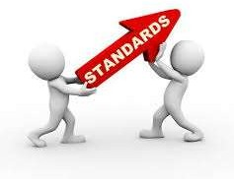





Slide 57
EXTERNAL QUALITY AWARDS
Malcolm Baldrige National Quality Award:
The goal was to enhance the competitiveness of U.S. businesses.
Magnet Recognition Program:
Magnet is the leading source of successful nursing practices and strategies worldwide.

Slide 58

External Quality Awards
Quality Professional Role
Determine goals to be achieved with obtaining the award.
Determine current state of compliance with the criteria.
Discuss current state and action needed with the leadership.
Determine action plan to meet criteria and timeline.
Develop and submit the application.

Slide 59
