Slide 1
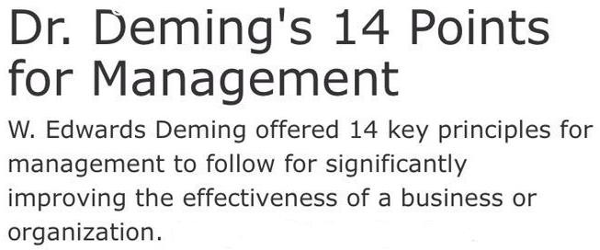
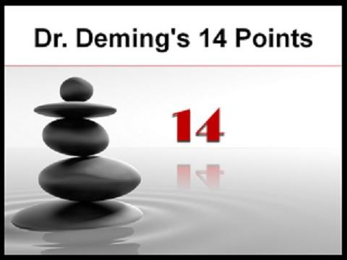

Slide 2
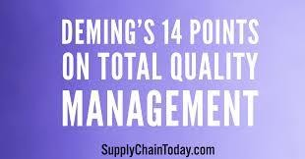





The principles were first developed
with products in mind, not services.
There is need for further adaptation in healthcare because a patient is a person, not a product.
9 out of 14 are related to behavior, psychology and ethics.

Slide 3
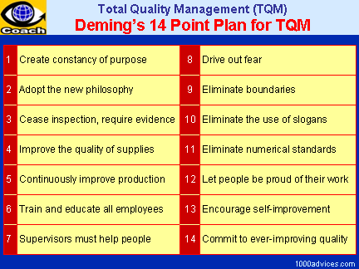



Slide 4

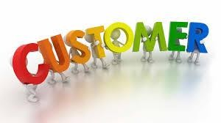



TQM fosters a belief in the value of:
Customers.
Employees/Staff.
Management.
Teamwork.

Slide 5

AN INTEGRATED PERSPECTIVE
- Activities associated with improving organization performance involve much more than the clinical aspects of care.
-

Slide 6
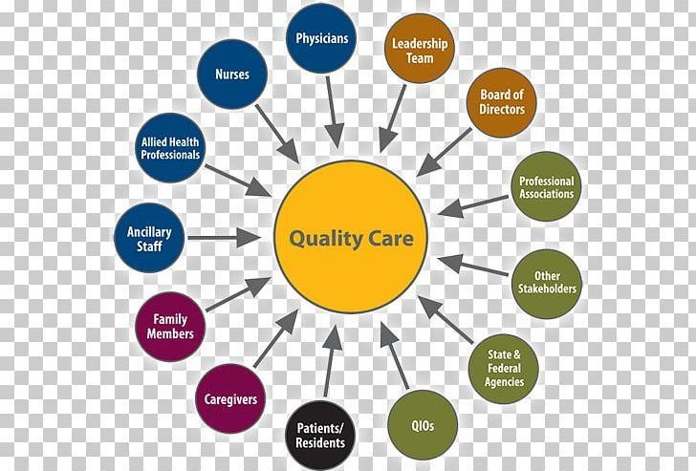
AN INTEGRATED PERSPECTIVE
- All the interrelated processes and services impact the quality of care and affect patient outcomes: governance, managerial, and support activities, as well as clinical activities.

Slide 7

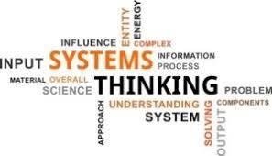
SYSTEMS THINKING IN HEALTHCARE
Systems are multiple,
interconnected (interrelated) components: people, machines, processes, and data which operate toward a common purpose.

Slide 8


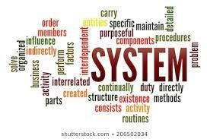
SYSTEMS THINKING IN HEALTHCARE
"The goal of a system is
to maximize the output of the whole components (system), not the output of each of its components.“

Slide 9



SYSTEMS THINKING IN HEALTHCARE
Health systems are
considered "macrosystems." Each clinical unit and support unit is a "microsystem."

Slide 10
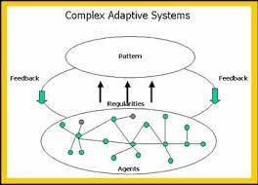


Complex System Theory: A "complex adaptive system (CAS)
A healthcare organization, is:
complex because it is diverse and comprised of many interconnected elements and
adaptive because it can learn from experience and change.

Slide 11
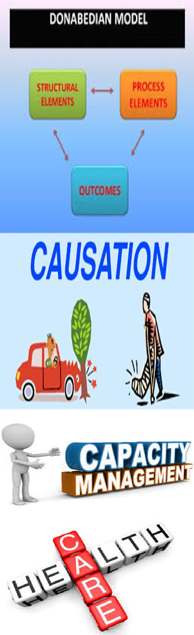
Donabedian Paradigm (Systems approach)
causal relationship “probabilities, not certainties; presence of
individual factors”.
Structure
Is the evidence of the organization’s capacity to provide care.

Slide 12

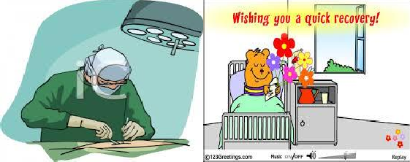
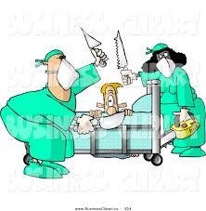
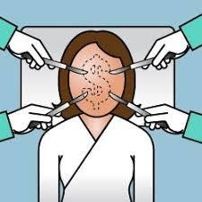
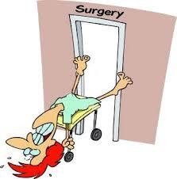

Slide 13










Structure Examples
Staff no.
Adequate nurse : patient ratio. Trained nursing staff.
Staff qualifications.
Physicians, pharmacists Certificates.
have
Organizational chart.
Resources (equipment, beds.....).
budget,
Computer systems available.
Updated treatment guidelines.
Hospital good geographical location.

Slide 14
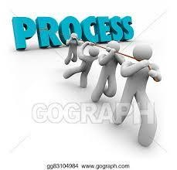

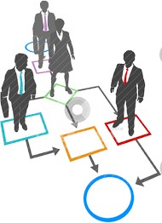

Process
Are the procedures/ sequence of steps
done to provide care
intending to
produce a
desired
outcomes.

Slide 15


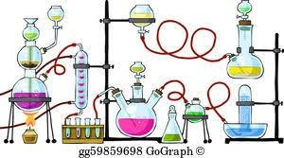




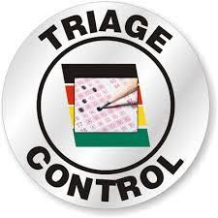
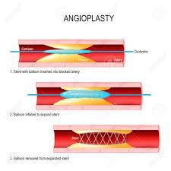

Process Examples
Services
(registration, lab, pharmacy...)
Clinical processes
(ttt ,
assessment,
medication...)
Administration and management

Slide 16

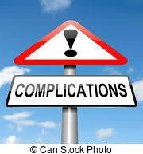
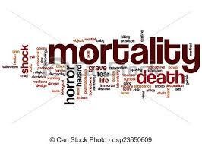




Outcome
Are the results of care
Examples:
Clinical (complication rate, mortality rate..).
Functional (long term health status..).
Perceived satisfaction, acceptability).
(patient
peer

Slide 17
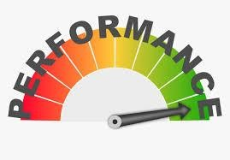

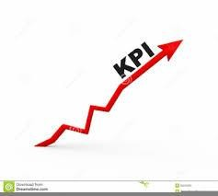
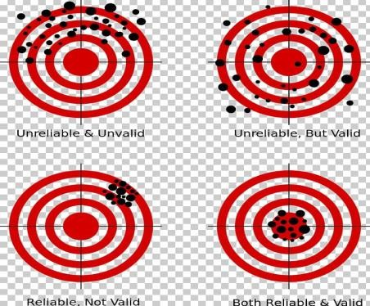

Performance measures/ indicators (most common) is a tools used for measuring performance.
Types of performance indicators: Outcome.
Process.
Who puts the indicator? Who approves it? Steps for developing an indicator:
Characteristics of a performance measure: Valid, Reliable, Specific, Sensitive

Slide 18

- Four factors influence the degree to which
healthcare services achieve desired health outcomes:
Disease process and severity;
Processes of care;
Patient compliance; and
Random and unidentified variables.
- In healthcare, we have the greatest control over the second factor: process(es) of care.

Slide 19



The Basic Elements of a Process
They Include:
Inputs by Suppliers.
A sequence of steps by Processors.
Outputs to Customers.
Suppliers Processors
Inputs => Sequence of Steps
Customers
=> Outputs

Slide 20
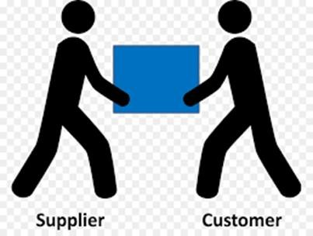


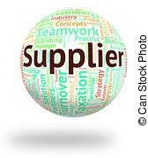
Customer- Supplier relationship (Triple role)
Each person in the organization is a part of one or more processes.
The support staff is a:
Customer of all those supplying inputs.
Processor, performing managerial, technical, or administrative tasks using the inputs.
Supplier to customers by delivering products or services (outputs).

Slide 21


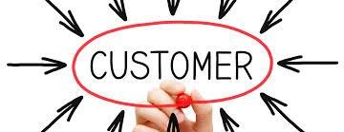
Healthcare practitioners are also
Suppliers, providing degrees of experience, commitment, empowerment, satisfaction, time.
Processors of care certainly.
Customers , dependent on others in each process.

Slide 22
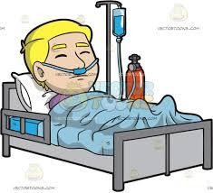
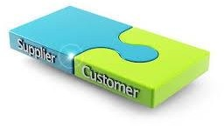

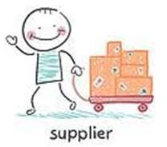
The patient has a triple role as:
Customer: ask for and receive services, with needs and expectations.
Processor : perform tasks such as taking medications, learning diet and exercises, self-care skills, diabetic management, etc.
Supplier: of characteristics such as
age, sex, care, in
socioeconomic status, and perceptions of
addition to clinical history and symptoms, etc.

Slide 23
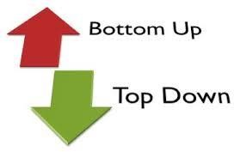
TQM Philosophy Promotes:
An increased top-down and bottom-up emphasis on quality, with top managers demonstrating leadership for the constant improvement of quality care, being responsive rather than directive.

Slide 24
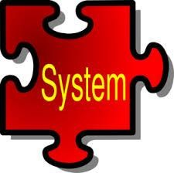


TQM Philosophy Promotes:
A decreased emphasis on inspection, surveillance, and discipline and a focus on systems rather than individuals.
A substantially increased investment of managerial time, capital, and technical expertise.

Slide 25


TQM Philosophy Promotes:
An increased investment in education, study, and training at all levels.
A steadfast, long-term vision.

Slide 26



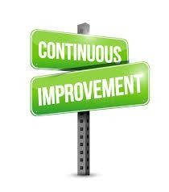
TQM Philosophy Promotes:
Cautious use of "minimal" standards of care. The healthcare organization that seeks merely to meet minimal standards may not ever reach any higher, and certainly will not achieve excellence.
Continuous, ongoing quality improvement.

Slide 27


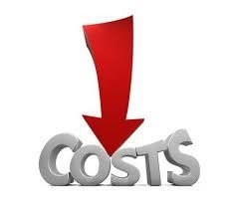
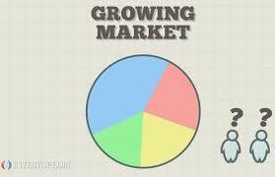
TQM is a management philosophy results in:
Increased customer satisfaction.
Increased productivity.
Increased profits.
Increased market share.
Decreased costs.

Slide 28
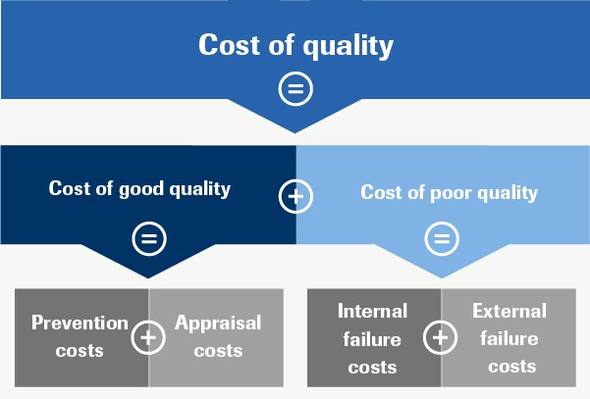
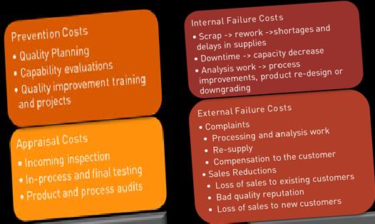

Slide 29




Value = Quality + Outcome of care / Cost of care
The goal from a value-based healthcare system Is transparency enabling consumers to compare the quality and price of healthcare services and make informed choices.

Slide 30


Four cornerstones for value based healthcare improvement
Develop interoperable information technology (HIT):
health Sharing
electronic health record information requires setting national HIT standards and a certification process.
Measure and publish quality information.

Slide 31


Four cornerstones for value based healthcare improvement
Measure and publish price information.
Promote quality and efficiency of care: offering pay-for-performance incentives to all providers.

Slide 32

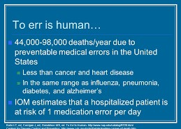
IOM Reports
1999: To Err is Human
At least 44,000 and perhaps as many as 98,000 Americans die in hospitals each year as a result of medical errors

Slide 33


One death in every 343 to 764 admissions.
In comparison, aviation averages one death for every 8 million flights.

Slide 34

2001: Crossing the Quality Chasm
The report described America's health system as "a tangled, highly fragmented web that often wastes resources by duplicating efforts.“
Should create new methods to
monitor and | track | quality in six | key
areas (IOM | aims | or attributes | of
care).

Slide 35
Six key areas (IOM aims or attributes of care)
STEEEP
Safe care.
Timely care.
Effective care.
Efficient care.
Equitable care.
Patient-centered care.

Slide 36
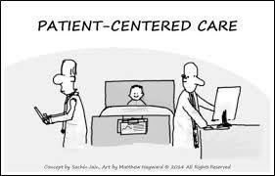



Patient-centered—"providing care that is respectful of and responsive to individual patient preferences, needs, and values.
Patient Satisfaction Surveys examines
communication physicians,
with nurses and staff responsiveness,
cleanliness and noise levels, pain control, and quality of discharge instructions and medication information.

Slide 37
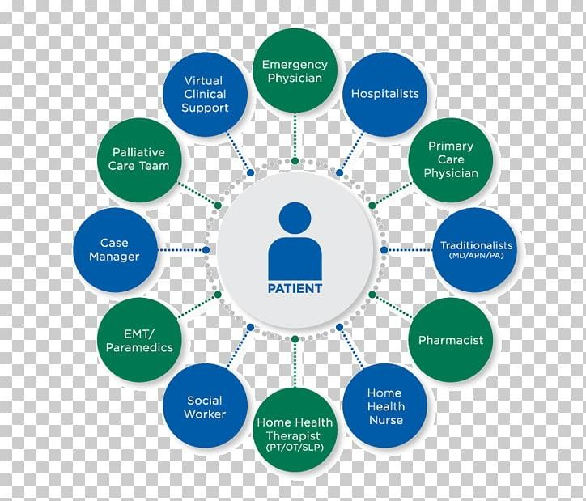
three
Berwick
maxims:
describes
1) The needs patient come first.
of the
Nothing about me without me.
Every patient is the only patient.

Slide 38


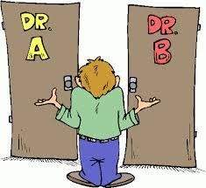
To build a Patient-Centered Culture
Emphasize centered care as dimension.
Change the
patient- a quality
locus of
control: patients and families control over all decisions about care.

Slide 39

To build a Patient-Centered Culture
Expand transparency.
Design for individualization and customization: creating flexible systems that can adapt to the needs and circumstances of individual patients.

Slide 40
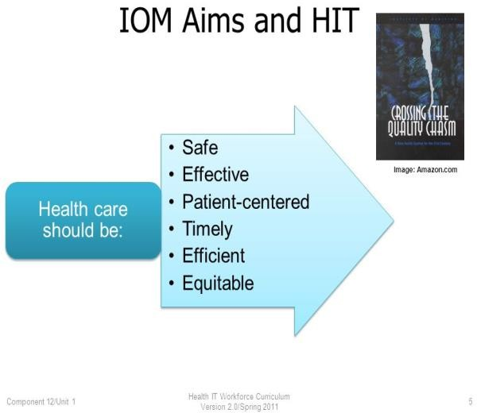
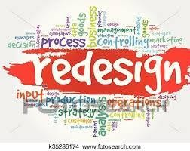

The private
report
and
challenges
public healthcare clinicians,
purchasers, organizations,
and patients together to healthcare
to work redesign processes
according to these rules:

Slide 41
The private
report
and
challenges
public healthcare clinicians,
purchasers, organizations,
and patients together to healthcare
to work redesign processes
according to these rules:

Slide 42
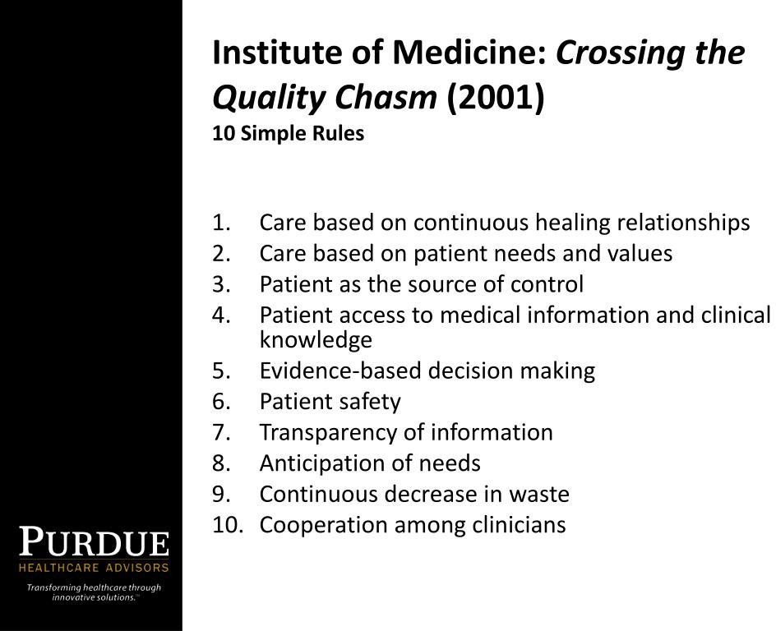
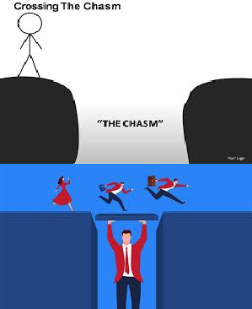
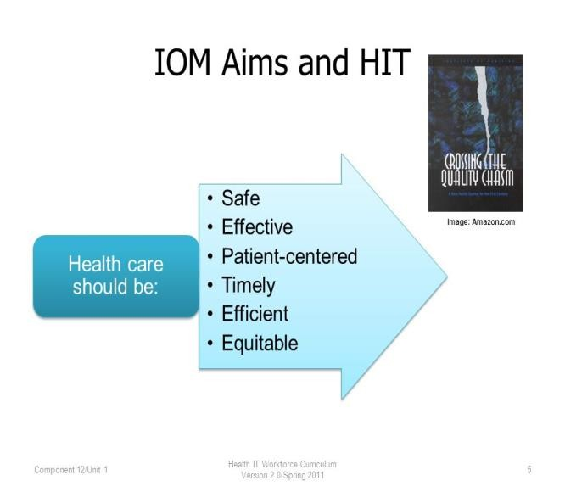

Slide 43
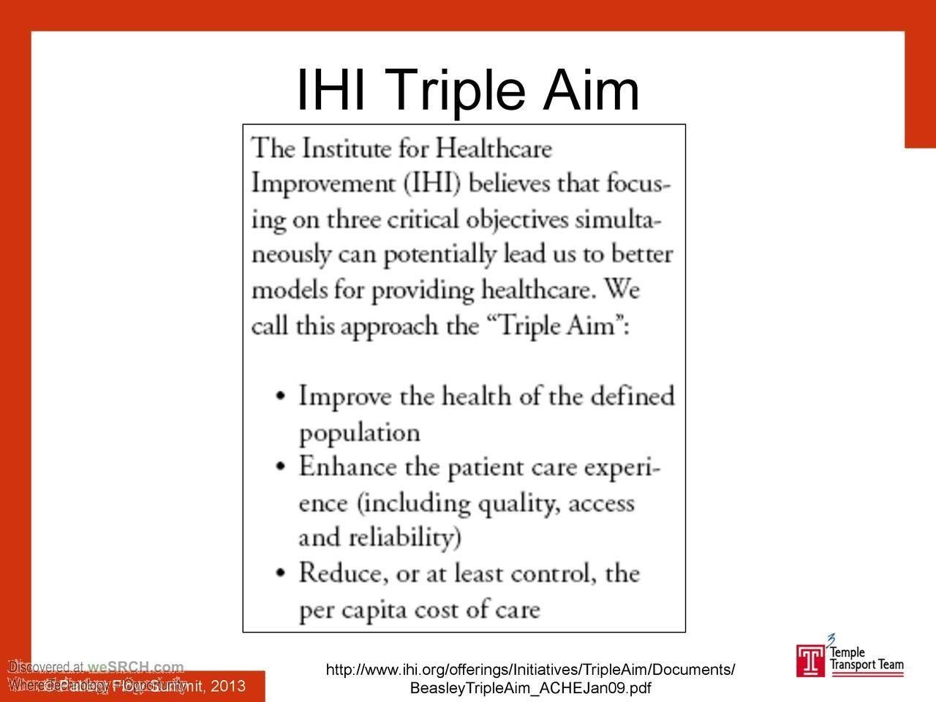



Slide 44
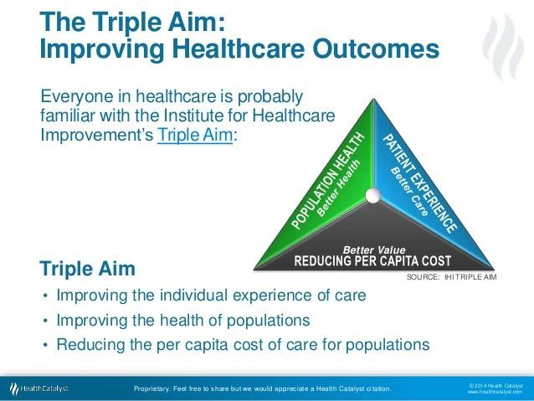

Slide 45
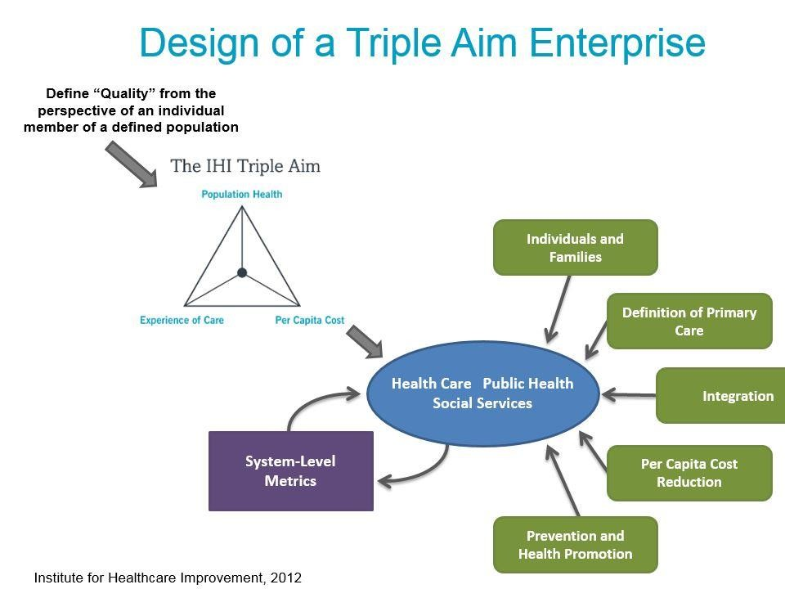
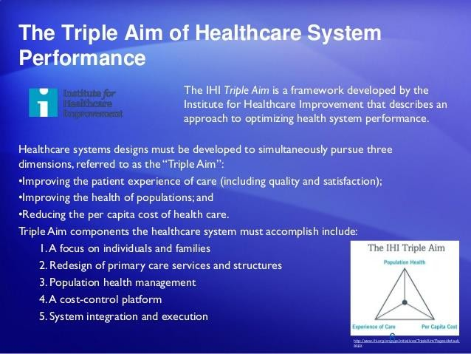

Slide 46



Slide 47


Slide 48




Slide 49




Slide 50


Slide 51




Slide 52



Slide 53


Slide 54



Slide 55





Slide 56



Slide 57





Slide 58




Slide 59



Slide 60



Slide 61







