Slide 1

INFORMATION MANAGEMENT
TOOLS, MEASURES,
AND THEIR APPLICATIONS
STATISTICAL TOOLS FOR QUALITY
IMPROVEMENT

Slide 2

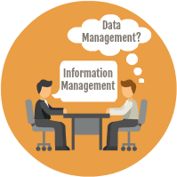
Data: raw, unanalyzed,
unrelated,
unorganized, uninterpreted facts.
observations or
Data left alone informative and meaningless.
is not very it is relatively

Slide 3

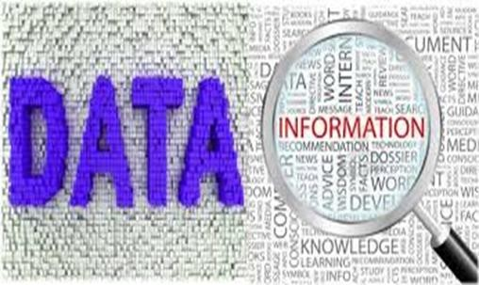
Information is the set of data that has already been processed, analyzed, and structured in a meaningful way to become useful.

Slide 4




Combination of information, experience
leads which
to knowledge can assist in
and
decision making taking actions.

Slide 5

Goal of IM
To support decision making to improve:
Patient outcomes.
Health documentation.
Patient safety.
Performance in patient care, treatment and services.

Slide 6

Potential Sources of Data
Internal
Inpatient records.
QM summaries.
Staff / Patient surveys/interviews
Indexes, register.
Reports (RM, UM, IC, researches, Financial , Claims).
Meeting minutes. External
Reference databases.
CDC reports.
Accreditation / licensure reports.
Validated clinical pathways.
Evidence based practice guidlines.

Slide 7
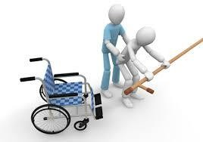


Data collection Timeframes
1. Prospective data collection:
Occurs prior to care being rendered.
Ex. Before a patient is accepted in a Rehabilitation facility, someone from the receiving facility goes to the patient to assess if the patient meets the requirements for admission.
2. Concurrent data collection:
Occurs while care is being rendered.
Medical record review is best conducted while the patient is still receiving care.

Slide 8


Data collection Timeframes
3. Retrospective data collection :
Occurs after the care is rendered.
For example, mortality data can only be collected retrospectively.
4. Focused data collection :
- Occurs when only certain topics are the focus of the data collection.

Slide 9

Index
Are permanent topical collections of medical record data to locate cases for record maintenance, statistics and research.
Examples: Master patient index. Physician index Disease index Surgery index

Slide 10





Register
Are permanent chronological listings for maintaining certain statistics.
Examples: Birth register. Death register. Deliveries register. Immunization register. Surgical log. Emergency register.

Slide 11

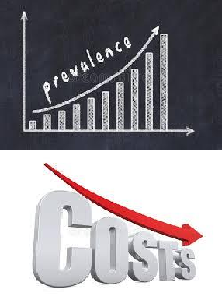
These registers are useful in the studying of diseases and disease prevalence.
Registries have been shown to lead to improved health outcomes and reduced costs of health care.

Slide 12


Medical Record
The primary legal document, as well as the primary data source for recording and ascertaining the quality of healthcare delivery to patients.
Purpose of the medical record:
I- Clinical:
Continuity of care.
Communication among practitioners.
Patient identification.

Slide 13



Medical Record
legal protection for the patient, practitioner, and the organization.
II- Non-clinical:
Finance.
Peer review.
Clinical research.
Reimbursement.
Accreditation.
RM/UM /QM.

Slide 14

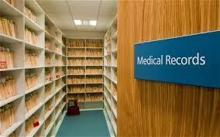

Medical Record
Medical records are stored in the Health Information Management department (Medical Records Department), unless the records are electronic.
There is a Information Management
the Health the Quality
close relationship between
Management department,
department, and the
Information
Technology department.

Slide 15
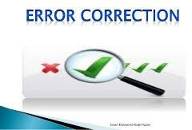

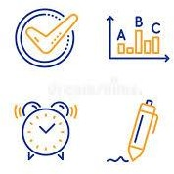
Medical records policies and procedures
Medical records officers should develop
appropriate policies for:
Documentation issues:
Time frames; Correcting errors; Late entries.
Documentation must be legible.
For every entry; time, date and signature should be identified.

Slide 16
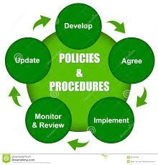

Medical records policies and procedures
Medical records officers should
develop appropriate policies for:
Use of abbreviations.
Retention of medical records.
Destruction of medical records.

Slide 17

Electronic health records (EHRs)
is more robust.
going data
beyond collected
standard clinical in the provider’s
office.
Gives clinicians access to a wider range of patient data.
They are built to share information with other health care providers.

Slide 18


Electronic health records
(EHRs)
Goes wherever the patient goes, is owned by the patient and has patient input.

Slide 19


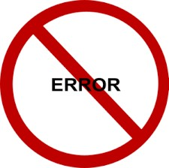

Health Information Exchange (HIE)
Health Information Exchange allows both health care
professionals and patients to appropriately access and securely share vital medical information electronically.
Sharing allows for:
Better decision making.
Avoiding readmissions.
Avoiding medication errors.

Slide 20



Health Information Exchange (HIE)
Decreasing duplicate testing.
Improving quality and safety of patient care.
Stimulating patient involvements in their own health care.

Slide 21


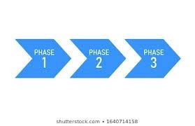

EHR Meaningful Use (EHR-MU)
Meaningful electronic technology
use is using certified health record (EHR)
The Medicaid EHR program provides
incentive incentive
payments to eligible professionals and hospitals for efforts to adopt,
implement, | upgrade | or
meaningfully | use certified | EHR
technology.

Slide 22


Computerization & Software Selection and
Implementation
Requires a team effort to assure
that all parties who could be affected by the choice are represented.
Ideally, senior leadership should mandate that all players be present at system acquisition discussions.

Slide 23


Computerization & Software Selection and
Implementation
System Features to Consider in Selecting
Software
Ease of use.
Ability to use current hardware.
Ability to interface with current software.
Ability to permit easy/timely access to information by specified users.

Slide 24
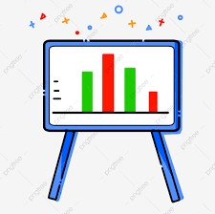

Computerization & Software Selection and
Implementation
System Features to Consider in Selecting Software
Statistical data analysis.
Graphic and tabular data display.
Produce reports as required.
Data storage and data exchange capabilities.

Slide 25


is now widely applied to cover the description and causation of:
DEFINITIONS OF EPIDEMIOLOGY
epidemic disease.
disease in general.
- many related
non-disease, conditions,
health-
such
obesity, alcohol or smoking.

Slide 26
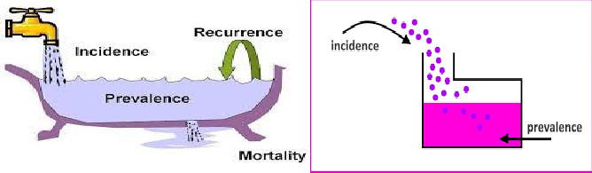
Incidence
Incidence measures the rate of occurrence of new cases of a disease or condition during a specified time period.

Slide 27

Incidence
Incidence proportion (IP):
- It is calculated dividing the number of new cases during a given period by the number of subjects at risk in the population initially at risk at the beginning of the study.

Slide 28
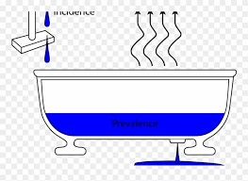
Prevalence
Refers to the total number of individuals in a
population who have a disease or health condition at a specific period of time, usually expressed as a percentage of the population.

Slide 29
Prevalence
Prevalence answers "How many people have this disease right now?" or "How many people have had this disease during this time period?".
Incidence answers "How many people acquired the disease during [a specified time period]?“
Thus, incidence conveys information about the risk of contracting the disease, whereas prevalence indicates how widespread the disease is.

Slide 30
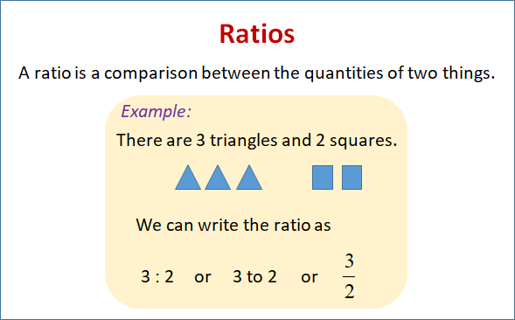

Slide 31
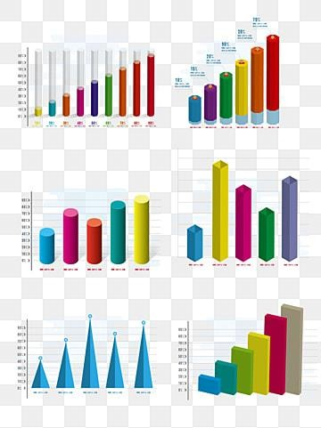
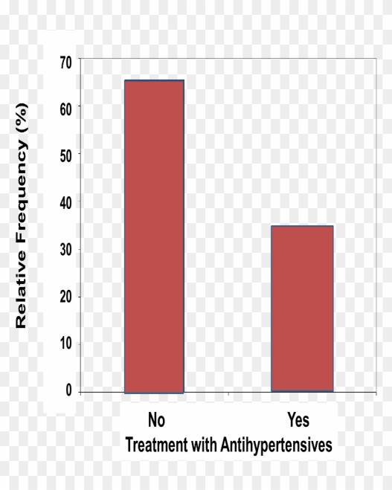
Frequency distribution
Frequency is how often something occurs.
To make meaning of the raw data, we must organize it.
It is an organized tabulation /
graphical number category
representation of the of individuals in each
of
on the scale
measurement.

Slide 32
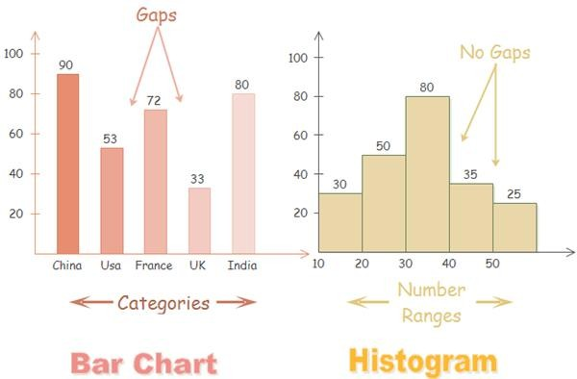
Both histograms and bar charts provide a visual display using columns (rectangular bars), with the y- axis representing the frequency count, and the x-axis representing the variable to be measured.

Slide 33
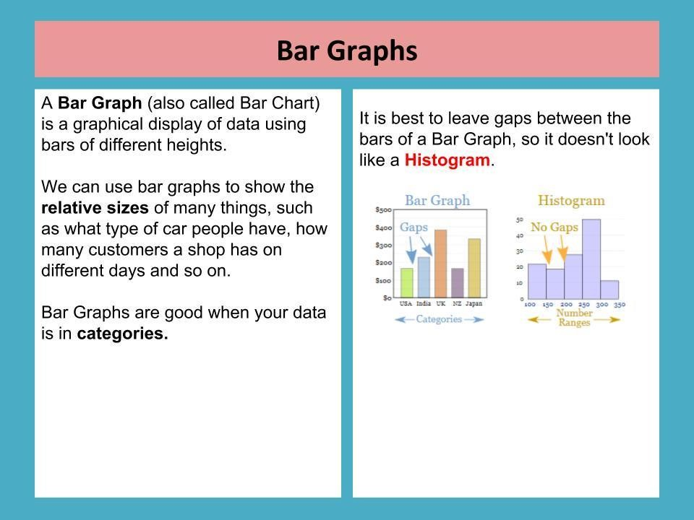

Slide 34
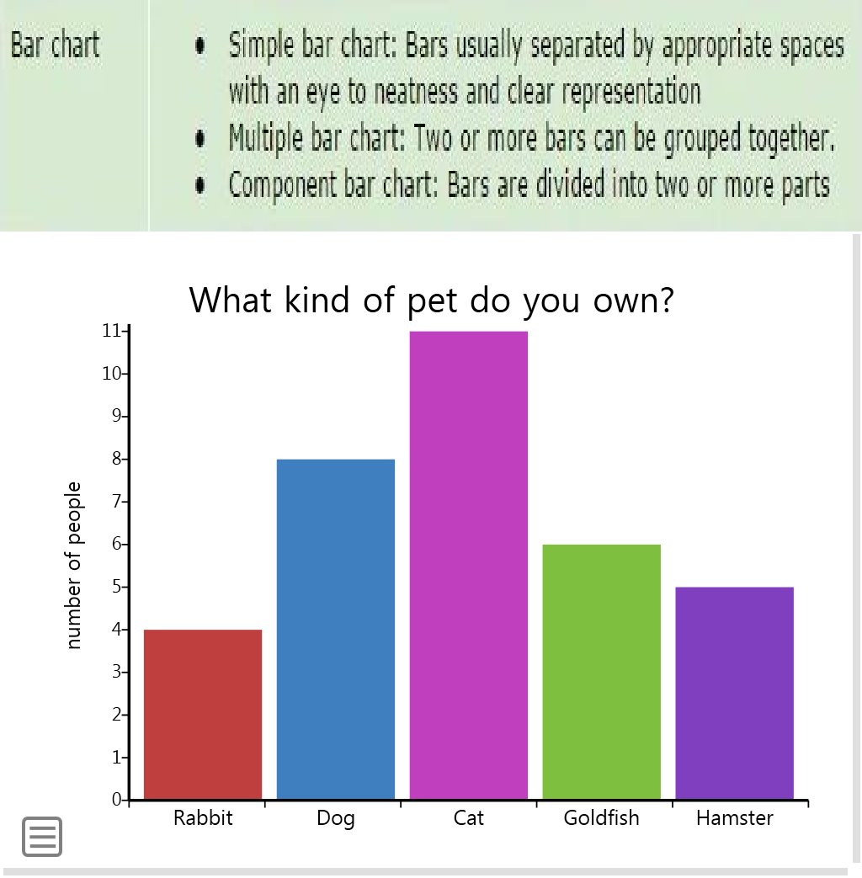


Slide 35
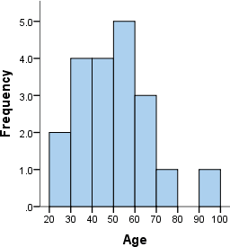
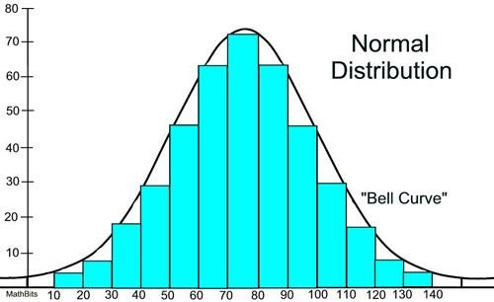
Histogram
A histogram is a bar graph of the frequency of one other variable. Because frequency is actually a continuous variable, the bars are connected ,so the bars are no longer discrete.

Slide 36
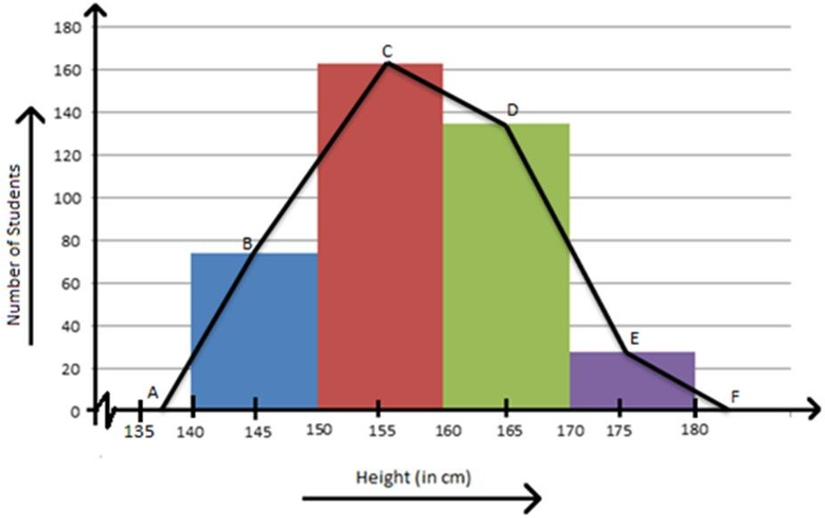

Slide 37
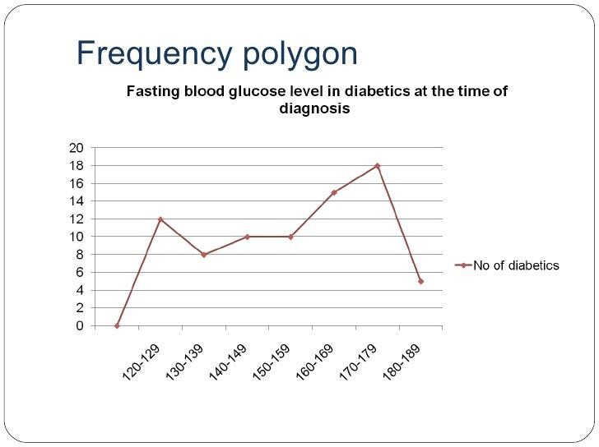

Slide 38
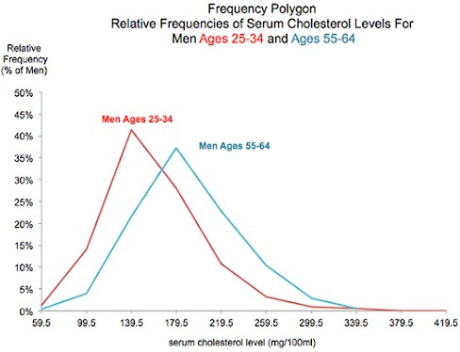

Slide 39
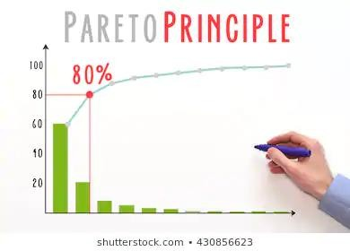

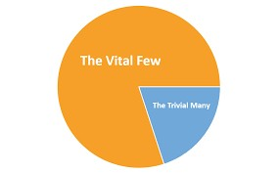


Bars in descending order. (with line)
It answers this question:
Which variables out of many are occurring most?
Which variables of causes should we focus on?

Slide 40
When to use pareto analysis
Prioritizing problems: Nominating and selecting improvement project.
Determining the vital few of the symptoms.
Identifying the root causes.
Prove effectiveness of improvements: not widespread.

Slide 41


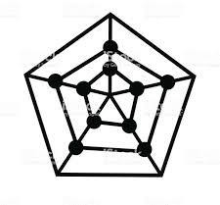
RADAR CHART
A radar chart is a graphical method of displaying multivariate data of three or more quantitative variables represented on axes starting from the same point.
The radar chart is also known as web chart, spider chart, star chart, star plot, cobweb chart, irregular polygon, polar chart, or kiviat diagram.

Slide 42
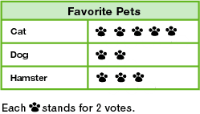
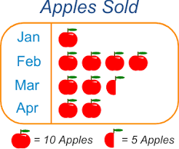
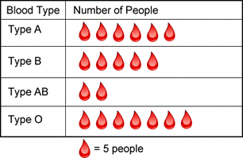
PICTOGRAPH
Pictograph representing
is a way of
statistical data
using symbolic figures to match the frequencies of different kinds of data.

Slide 43
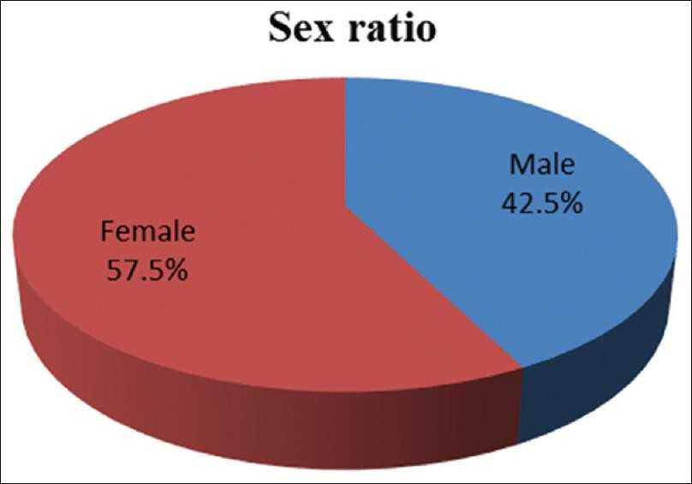
PIE CHART
A pie chart (or a circle graph) is a circular chart divided into sectors, illustrating proportion.

Slide 44
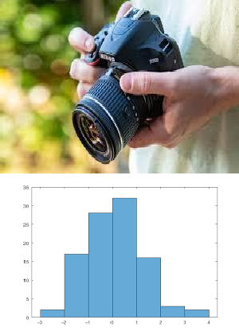
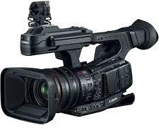
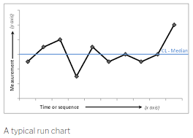
STATIC AND DYNAMIC DISPLAY
Static display
Like a snapshot with camera.
Data are shown in aggregated fashions
e.g. Tables, bar charts or histogram
Dynamic display
Video camera
Data are displayed over time (see how the data vary over time) e.g. Run and control charts

Slide 45

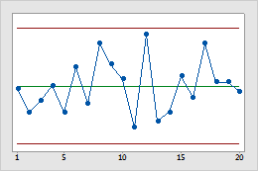
What is meant by process variation?
Variation is "change or deviation in condition from a former or usual state, or from an assumed standard."
Process variation can be best illustrated using line graphs (run and control charts).

Slide 46
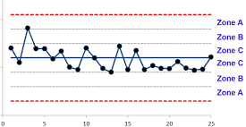

Slide 47
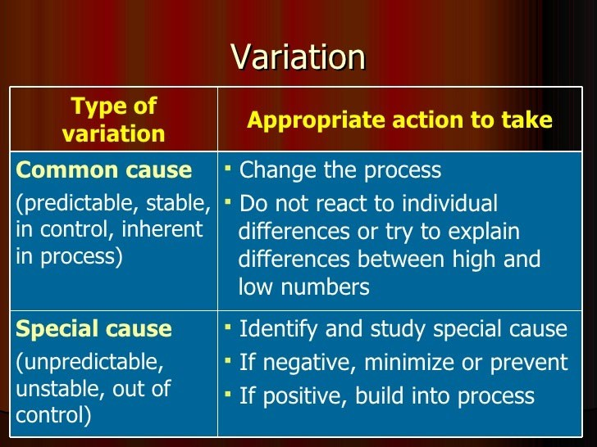



Appropriate action to take
Common cause (predictable, stable, in control, inherent in process)
Do not react to individual differences.
Try to explain differences between high and low numbers.
Special cause (unpredictable, unstable, out of control)
Verify the data collection.
Identify and study special cause:
♣If negative, minimize or prevent
♣If positive, build into process

Slide 48
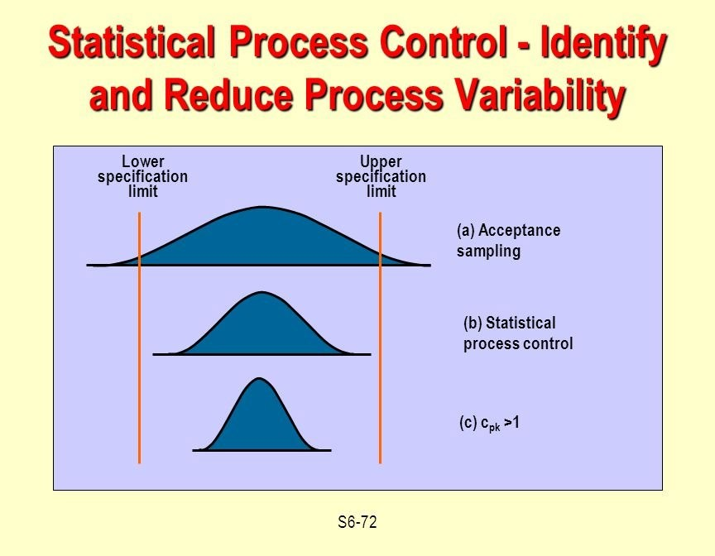


Slide 49
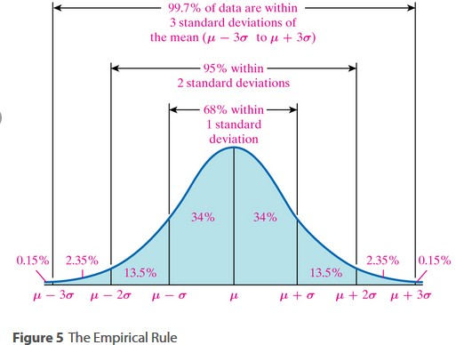


Slide 50
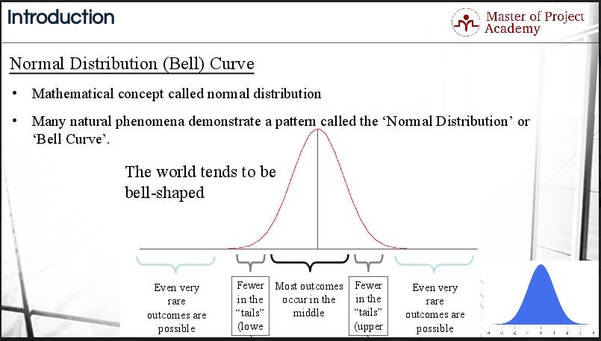



Slide 51
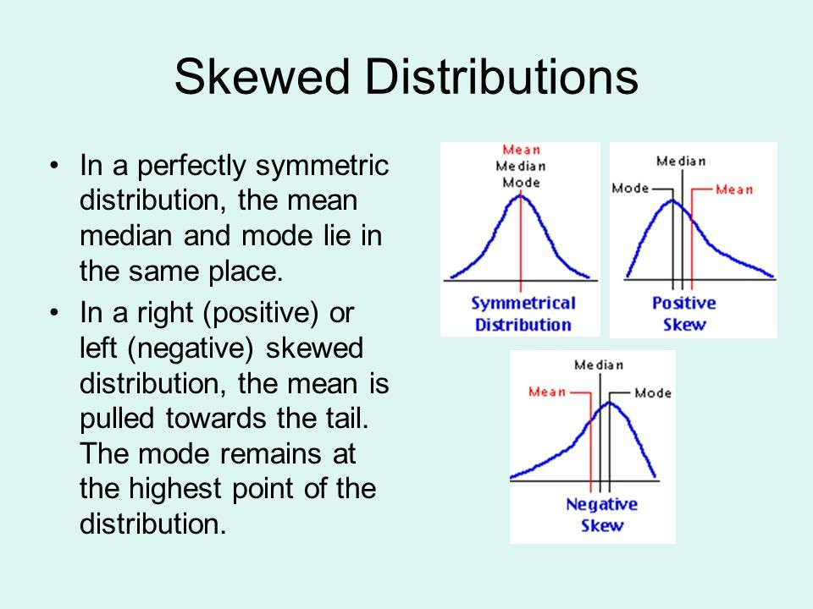

Slide 52
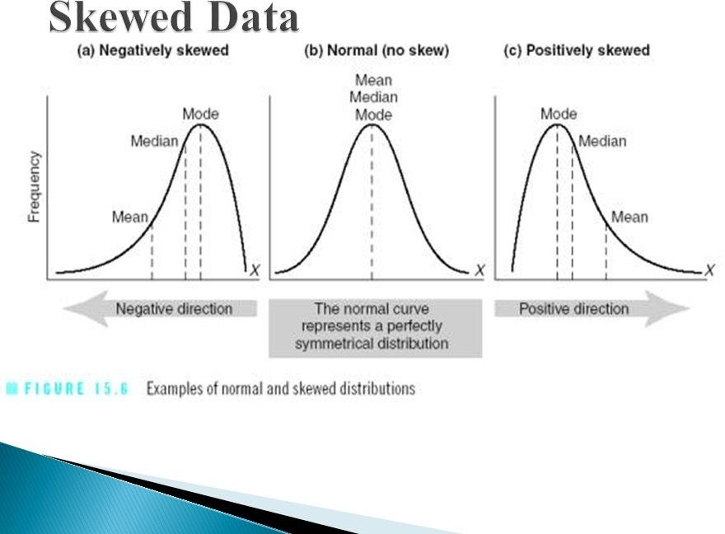

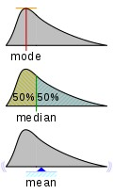

Slide 53
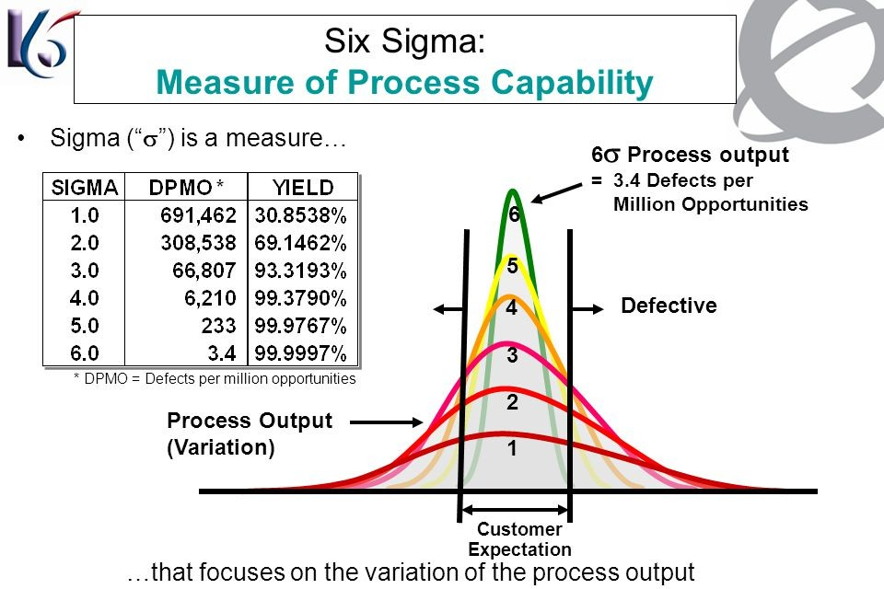
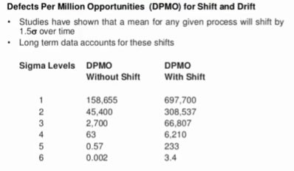



Slide 54
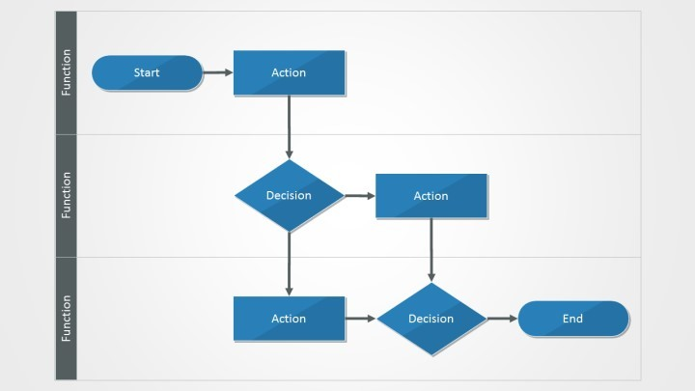
Flowchart – Flow Diagram:
It is a graphic representation of the sequence of steps in a given process.
It helps confirm that the project team has participation from the appropriate departments to solve the problem at hand.
It often uncovers potential problems, unnecessary steps.

Slide 55
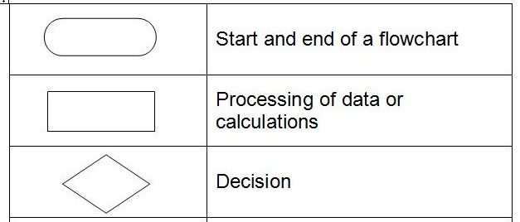

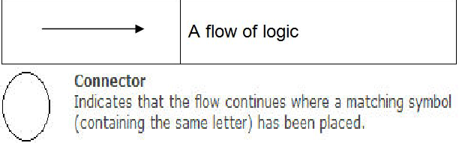



Slide 56
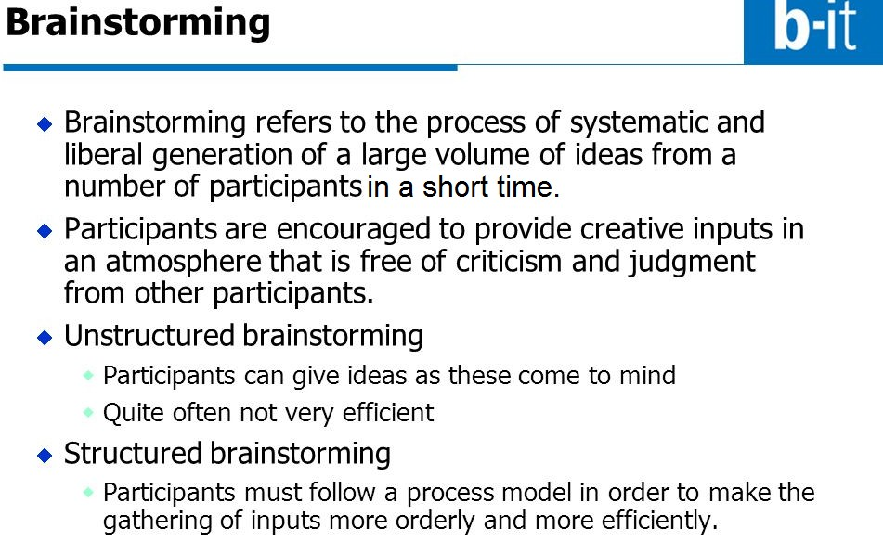


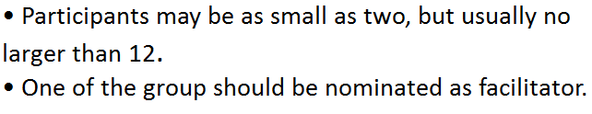


Slide 57




Slide 58



Rapid brainstorming:
Small groups have two minutes to generate ideas using flip charts and scribes who rotate, and then sharing each group's ideas with the other groups.
This process is repeated two or three times.

Slide 59



Slide 60



Ask Why!
- A fishbone
diagram,
Ishikawa or “cause and effect”
diagram is a graphic tool used
to explore and display the
possible causes (theories) of a certain effect (using brainstorming).
- It does not identify the root causes but other tools such as Pareto analysis, scatter diagrams, will be used to analyze data to establish the cause.

Slide 61




Prioritization Matrix
A tool used to select one option from a group of alternatives, or to put the options into priority order if all need to de done.
Determine the desired score, what number of criteria must be met, etc. for the option to remain under consideration.

Slide 62

This tool maps out the full range of paths and tasks that are involved in the process and which must be accomplished in order to achieve a goal.
A tree diagram resembles an organizational chart.

Slide 63



Gantt Chart
Used to keep teams on track!

Slide 64







