Slide 1
CHAPTER 3
PERFORMANCE MANAGEMENT AND PROCESS IMPROVEMENT
SUMMARY 1

Slide 2
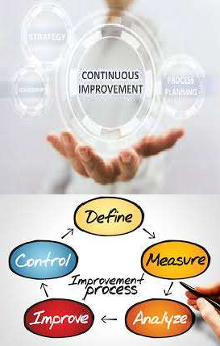

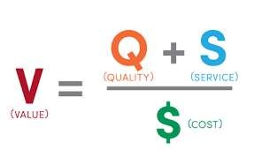
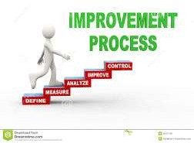

What is meant by performance improvement?
It is the continuous study of organization’s functions and processes to increase the value.
Must meet the customer needs.

Slide 3
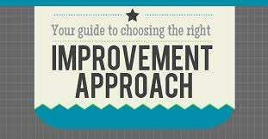

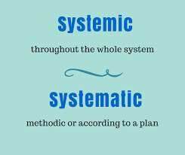

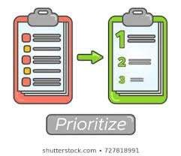
Characteristics of all PI approaches
Planned; organized- documented.
Systematic.
Organizationwide.
Collaborative : Use teams; cross-functional.
Focus on prioritized areas.

Slide 4
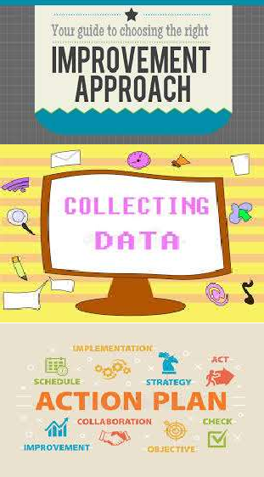

Characteristics of all PI approaches
6. Collect data/ MEASURING performance.
7. Take improvement/ improvement.
action for assessing the
8. Use statistical/ analytical tool.

Slide 5



Slide 6
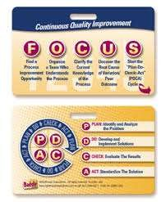
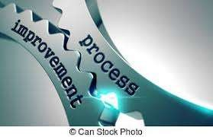
It is important to remember that FOCUS- PDCA assumes that there is a process already in place to improve (Quality Improvement).

Slide 7
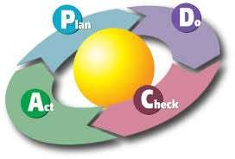
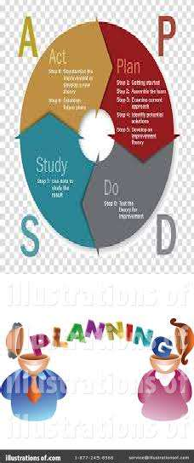
FOCUS-PDCA approach is not as
useful if there is no process, although the PDSA (Deming) (Plan, Do, Study, Act) or PDCA (Schewhart) (Plan, Do, Check, Act) components work equally well with new design or redesign projects (Quality Planning).

Slide 8
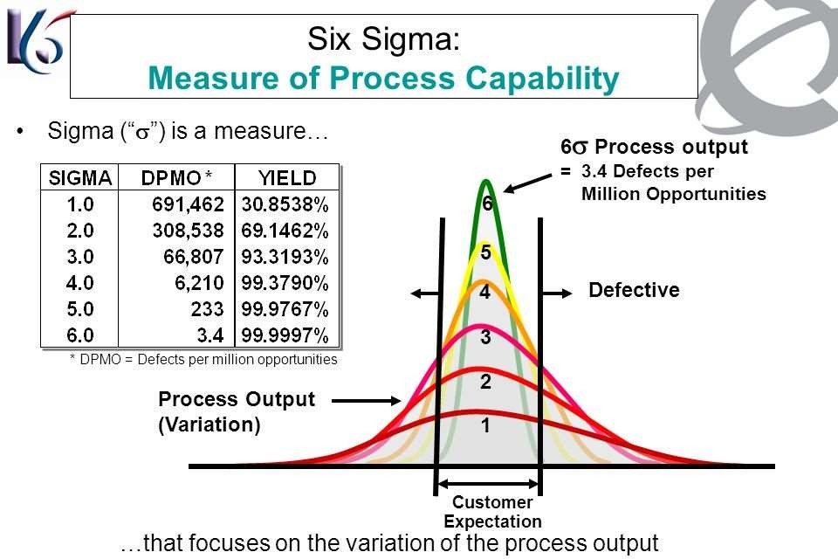
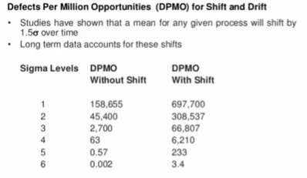



Slide 9

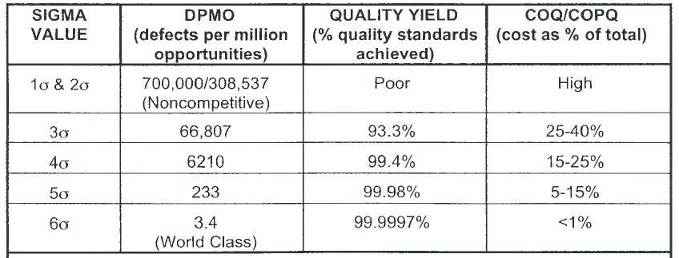
As the Sigma value increases, variation and DPMO decrease; the "quality yield,“ (the percentage of quality standards achieved) increases; and the "costs of quality“ (COQ), e.g. inspections or measure data, and the "costs of poor quality" (COPQ), e.g. rework, redundancies, malpractice, risk management, etc., both decrease.

Slide 10
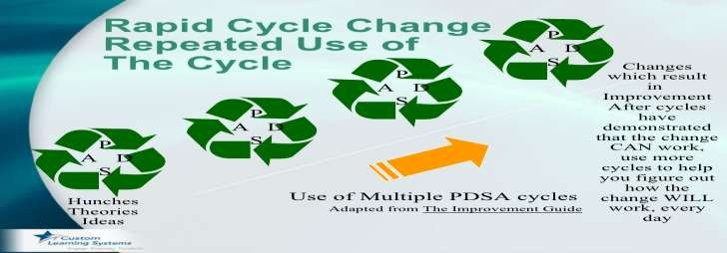

Accelerated/ Rapid Cycle Change Approach
Changes are made and tested over periods of three or 4 months or less, rather than the standard eight to twelve months.
Pre-work before the first team meeting is the key. (Problem statement, Flowchart of process, Team selection, administrative commitment of staff time and financial resources)
The team here is called RAT. (Rapid action/acceleration/achievement team).

Slide 11


Accelerated/ Rapid Cycle Change Approach
change systems, functions, and processes radically, not incrementally.
Focus team efforts on fast-track generation and testing of solutions, rather than over-analysis of and proof of root causes. Are resource-intensive.

Slide 12
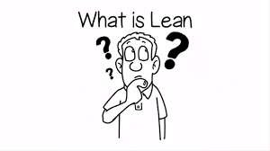
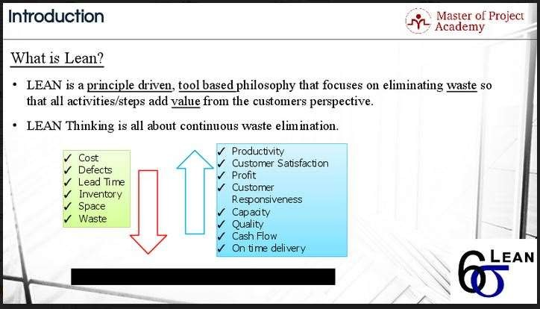
Lean Thinking Approach
Lean principles (using less to do more).

Slide 13
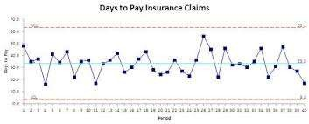

Lean Thinking Approach
Used for processes of common cause variation.
All steps that do not add value are eliminated. Only the time, people, and activities that are left will comprise the redesigned process.
The tools for implementation include: value stream mapping, Kanban pull systems, poka-yoke (mistake proofing) and Kaizen events .

Slide 14

7 types of wastes in work place
Over production
Creating more material or information or tests or treatment than needed
Over processing
Processing beyond the standard
Inventory
More material or information than needed
Rework
Repetition or correction of a process
Waiting
People or items that wait for a work cycle to be completed
Transportation
Unnecessary movement between processes
Motion
Unnecessary movement with a process

Slide 15






The 7 wastes
Overproduction
Over processing
Inventory
Rework
Waiting
Transportation
Motion
Mr. Taiichi Ohno, Former President of Toyota Motors

Slide 16
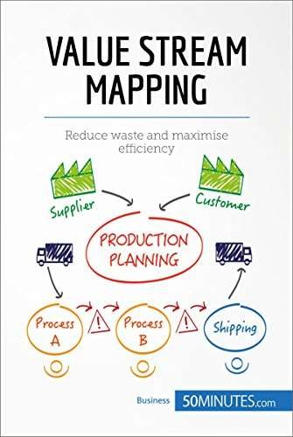
I. Value Stream Mapping
Identify the “value stream ’’ or "pathway "
that origin
for each product/service providing
value to the customer from its
(design) to customer receipt, use, and
ultimate disposal [process flowchart].
Designing a future state for the series of events
At Toyota, it is known as "material and
information flow mapping".
It can be applied to nearly any value
chain.

Slide 17


These actions are divided into 3 categories:
Value creating work: Activities adding directly to the value of the care, treatment, or service as determined by the patient or family.
Incidental work: Activities currently necessary to create or sustain the care, treatment, or service, but have no value to the patient, e.g. PI activities. (i.e. value enabling).
Waste: Activities that create no value and can be completely eliminated. (non value adding)

Slide 18
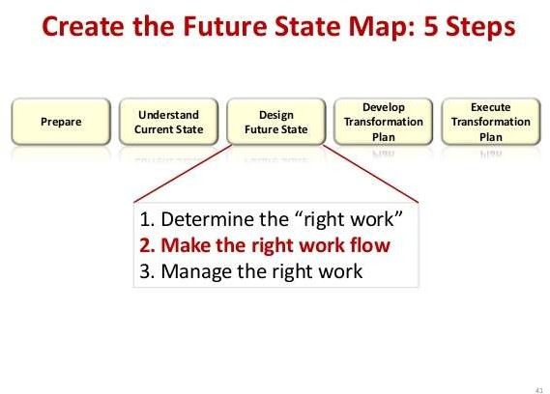
Flow: Once the incidental and waste steps are identified, make the product/service flow continuously through the remaining value-creating steps.

Slide 19
5S tool
The Sort phase: evaluates what is needed and what non-value added items/steps can be deleted.
Store: consists of examining the effectiveness of the order of steps in the process,
and reorganized to increase efficiency and productivity.
Shine consists of streamlining the process to eliminate additional processing time.
Standardize work phase is when the process steps are standardized.
The Sustain phase, the process can be monitored and refined in order to maintain the new processing time. The key to the sustainment of this and other processes is the hardwiring of a performance monitoring and feedback loop to the staff. This is where the visualization board can really help.

Slide 20
5S: Sort-Set-Shine-Standardize-Sustain
S1:
Sort
S2:
Set
S3:
Shine
S4:
Standardize
S5:
Sustain

Slide 21
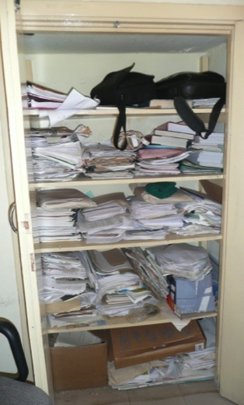

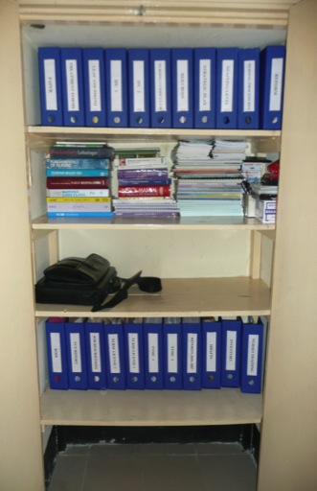

BASELINE PHOTOGRAPHS
AUGUST
2008
ADMINISTRATION
SEPTEMBER
2008
PROCESS
Before 5S
MID. YEAR
After
5S

Slide 22
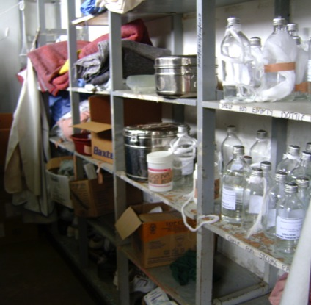
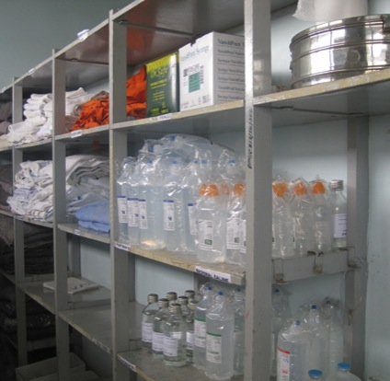
Example of 5S activities
Before 5S (2009)
Disorganized items in the store. Took long time to searching items needed
After 5S (2010)
Use labeling and organize items lead to minimize time for searching items, easy to control stocks

Slide 23
Target of 5S
Targets of Five-S include:
Zero changeovers leading to product/ service diversification
Zero defects leading to higher quality
Zero waste leading to lower cost
Zero delays leading to on time delivery
Zero injuries promoting safety
Zero breakdowns bringing better maintenance
Notes:
This is the actual purpose of implementation of 5S activities. 5S is not a cleaning campaign, and possible to solve the issues mentioned here.

Slide 24
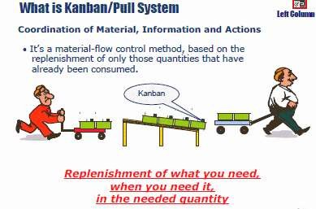



Slide 25
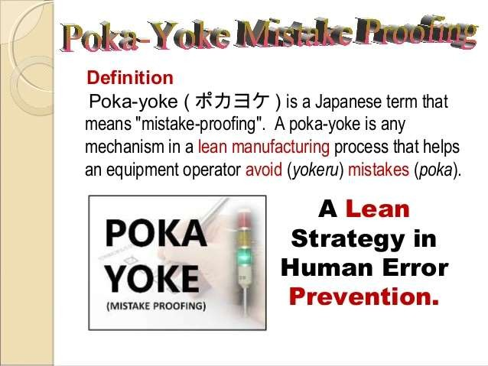

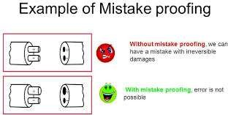
It is the concept of adding simple design features that make it almost impossible for errors to occur.

Slide 26

Kaizen Events: Kaizen means continuous, incremental improvement to create more value with less wasteful activity. it sought to improve standardized activities and processes and eliminate waste on a daily basis.
A kaizen team spends 4-5 days analyzing and changing a process (es), mapping current and then future desired process, using P-D-S-A for small tests of change, and measuring performance.
Japanese companies, such as Toyota and Canon, a total of 60 to 70 suggestions per employee per year are written down, shared and implemented.

Slide 27
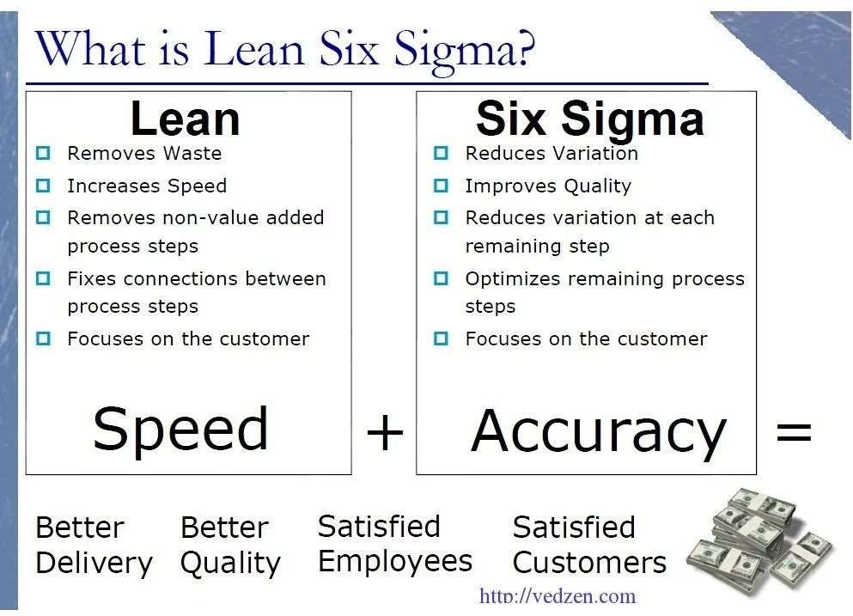

Slide 28
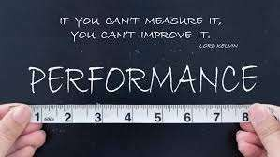
Concept of Performance Measurement
Measuring performance is the basis of all quality
management/improvement activities.
The interpreted data is valuable information for decision-making.

Slide 29
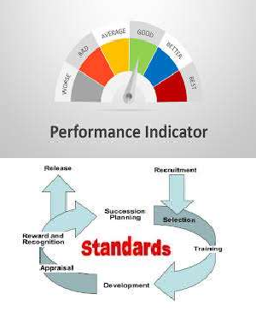


Tools used for measuring performance
Performance measures/ indicators (most common).
Standards (e.g. JCI St.).
Guidelines (e.g. diabetic exam. Guidelines).
Performance database.

Slide 30
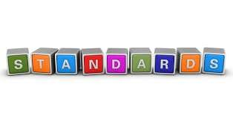
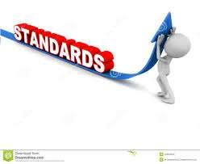

Tools used for measuring performance
A standard is a statement
of what must be done.
For example, Practitioners in healthcare must all be licenced, certified, or registered.

Slide 31
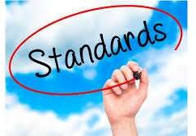


Tools used for measuring performance
Integrate the standards into
policies and procedures.
Standards can be obtained from national, accreditation/regulatory organizations, as well as the community standards and standard developed by the organization itself.

Slide 32


Tools used for measuring performance
Guidelines:
A method of standardization to decrease the variation in the care provided.
Do not necessarily mean best practice.
Measurement occurs to indicate if the guidelines were followed.

Slide 33

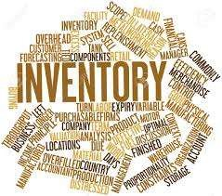

Tools used for measuring performance
A Performance Database, with standardized data definitions, consistent data sources, data analysis methods.
Items such as the core measures, infection control/prevention measures, CMS required indicators, AHRQ Patient Safety Indicators.

Slide 34


Tools used for measuring performance
Performance Measures/Indicators:
Are predictors organization's ability strategic goals.
of the to achieve
They are not considered to be direct measures of quality.
Data should not be only from the clinical areas processes, but also from non-clinical areas.

Slide 35
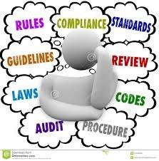

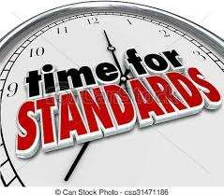
Indicator Selection/Development
Indicators can derive from
Accreditation guidelines, governing boards leaders.
standards, regulations, and other
Indicator data may assist in the development or refinement of standards and guidelines.

Slide 36
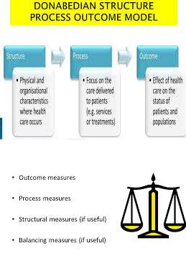
Types of performance indicators
Structure Measures.
Process Measures.
2. Outcome Measures.

Slide 37

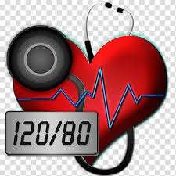
Types of performance indicators
An outcome indicator may be the only indicator needed to screen for effectiveness for a function e.g., blood pressure status of patients in a hypertension disease management program.

Slide 38
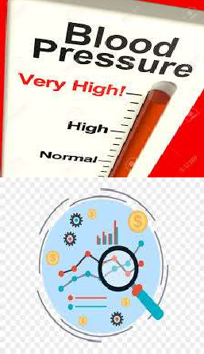
Types of performance indicators
If the outcome does not meet expectations or benchmarks, processes must be analyzed.
Process indicators and further analysis should be used to determine specific causation (root causes).
If resulting process improvements are not effective, structure analysis should occur.

Slide 39
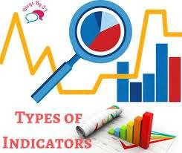
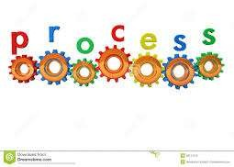
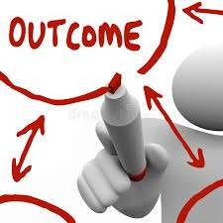
Types of performance indicators
According to Donabedian, the best strategy in quality measurement and analysis is to adopt a mixture of indicators of outcome and process, with consideration of structure as indicated.

Slide 40










Structure Examples
Staff no.
Adequate nurse : patient ratio. Trained nursing staff.
Staff qualifications.
Physicians, pharmacists
Certificates.
have
Organizational chart.
Resources (equipment,
beds.....).
budget,
Computer systems available.
Updated treatment guidelines.
Hospital good geographical location.

Slide 41
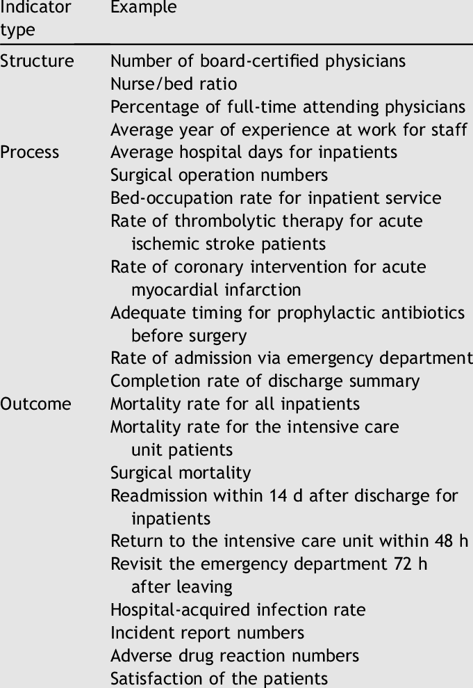

Slide 42



Types of performance indicators
The rate-based indicator consists of a numerator and a denominator (e.g. surgical site infection) .
Sentinel event indicators (100%analysis, 0%acceptability) do not have both a numerator and a denominator, but when it happens, an investigation must begin immediately.

Slide 43
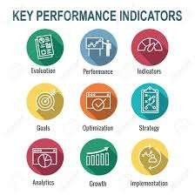
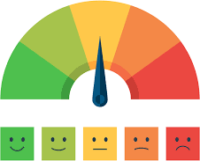
Types of performance indicators
Strategic level measures,
usually developed by senior leaders of the organization, are considered "primary" measures.
Service line and department measures are "secondary" measures.

Slide 44
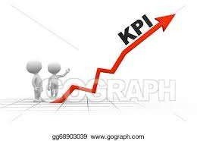


Indicator Development
The indicators can be developed by:
Senior leadership
Teams.
Process owners. Who approves it?
Quality council in collaboration with the process owner.
.

Slide 45



Purpose and Intended use
Improve quality.
For accountability, accreditation entities, and other external quality oversight groups, as well as the organization itself.
For research.

Slide 46


How to write a 'good' indicator
The organization's performance database, data inventory: what the data means, how and where it was collected, what definitions were utilized, how the data was analyzed, who owns the data, who has access to the data, who manages the data, and how the data can be used and shared.

Slide 47
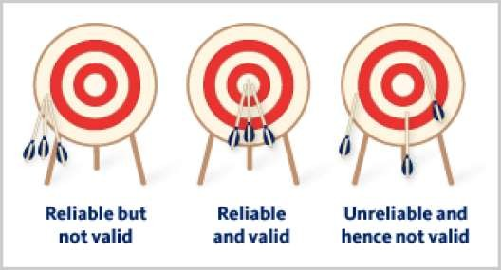
Characteristics of a performance measure
•
Valid
The accuracy with which a measurement tool measures what it is supposed to measure .
Reliable
Yields the same reproducible way)
results on repeated measures. (a
A reliable measure will give you the same information each time you measure, but it may not be valid for the intended use.

Slide 49


Characteristics of a performance measure
Sensitive
Be able to detect the positive values (all positive cases) . Called the true positive rate, or probability of detection (so false negatives are few).
Specific
Be able to detect the negative values. called the true negative rate (so false positives are few).
However, if the indicator is too specific, it
may not be sensitive enough.

Slide 50

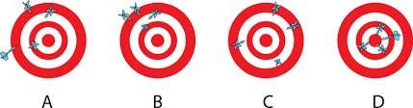
Types of Data Analysis
Initial analysis.
Intensive analysis.
A) Initial analysis
Review validity, data.
for accuracy, and reliability of

Slide 51


Initial Analysis
1. The data adequate
should intervals
be analyzed at regular, specified by the
department/service/team/setting.

Slide 52
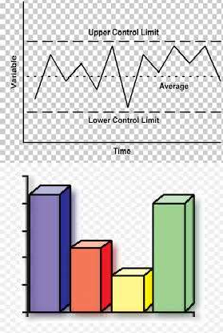
Initial Analysis
COMPARE the actual performance for each indicator:
Self-comparison overtime.
Compare with others (reference- based). Comparison with best practices and benchmarks can be either internal or external to the organization.
Compare with standards, guidelines, triggers/signals or regulations.

Slide 53

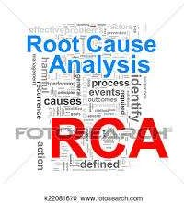
Initial Analysis
Action:
1. Immediate action (resolve an identified problem),
2. Continued (gather more information), or
measurement
specific
3. Intensive analysis is necessary.

Slide 54


Intensive analysis
Patient feedback, Staff feedback, External feedback.
Authoritative supported by expert
sources clinical
and quality management.

Slide 55



Intensive analysis
Documentation
Maintained for a period of time,
Worksheets, statistical summaries, minutes/summary reports, and other relevant reports, assessment, analysis, conclusions, recommendations and/or actions, and the rationale utilized.

Slide 56


Benchmarking
Benchmarking is a
management tool that compare your own organizational performance against
best practices.

Slide 57




Benchmarking
1. Internal benchmarking:
To compare best practices within the organization.
To compare organizational practices over time.
2. External benchmarking: involves utilizing comparative data from other organizations.

Slide 58



Benchmarking
Useful in:
Determining performance.
Re-evaluating resource.
Motivating an organization to engage in improvement; stimulate health competition.

Slide 59


Benchmarking
Using process measures measures.
Process measures:
- straightforward interpretation.
rather than outcome
- remedial action is clearer.
Outcome measures:
a broader picture.
reasons for the outcomes may not easily be explained.

Slide 60



Benchmarking
Be sure you are comparing the same
processes/outcome in both organizations. For example, if you are addressing falls in the ICU, be sure to utilize the other organization's ICUs' processes.
The same caution would apply when fall data are being compared internally.

Slide 61




Evidence-based Medicine / Practice
Introduction:
17 years for clinical research to become part of
everyday practice.
More quickly incorporate best evidence into everyday practice.

Slide 62


Evidence-based Medicine / Practice
Evidence-based practice "is the integration of best research evidence with clinical expertise and patient values“ .

