Slide 1

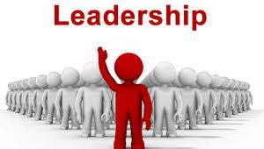
CH2: STRATEGIC LEADERSHIP

Slide 2
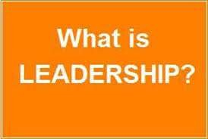
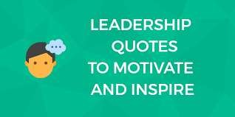

What is leadership?
The ability to take others where they otherwise would not go.
Influencing people to make the changes necessary to achieve results.

Slide 3



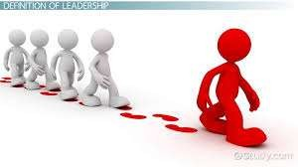
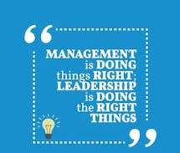
Leadership is
the correct direction
determining
or
path, whereas Management is doing the correct things to stay on that path.
In other words, Leadership is about doing the right things whereas Management is about doing thing right.

Slide 4
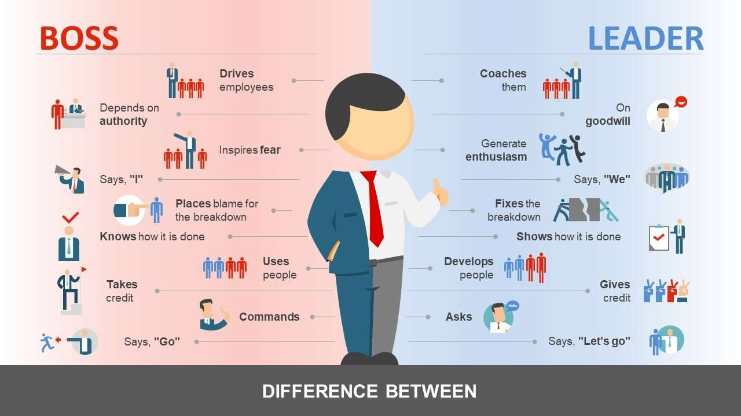
Leadership VS Management
•
ةدايقلا• Leadership •
is determining the correct • direction or path leaders are responsible for coping with
change by developing a vision for change and aligning the subsystems of
the organization.
•
ةرادلاا• Management •
is doing the correct things •
to stay on that path.

Slide 5



CHARACTERISTICS OF A GOOD LEADER
Open to contrary opinion.
Able to see the broad picture.
Motivate others to produce.

Slide 6


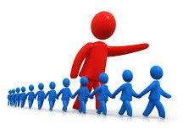
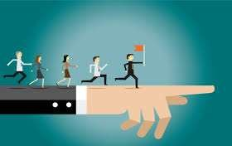

CHARACTERISTICS OF A GOOD LEADER
Clear communication.
Reward and recognition.
Power WITH not over others.
Role by modeling.

Slide 7
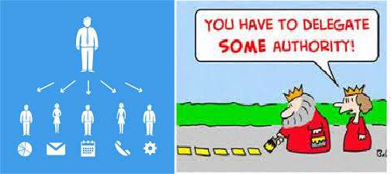
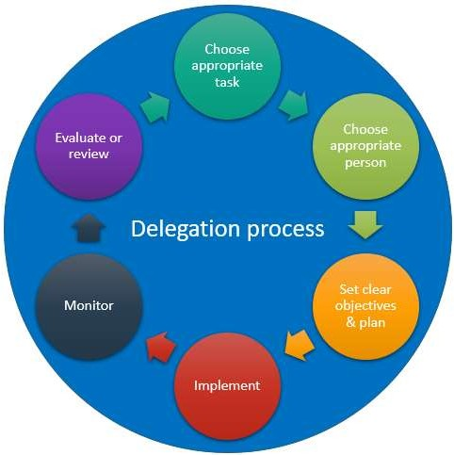
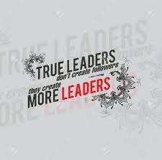
CHARACTERISTICS OF A GOOD LEADER
Delegate authorities.

Slide 8
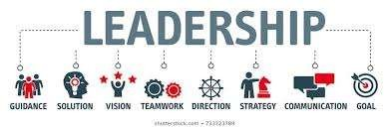
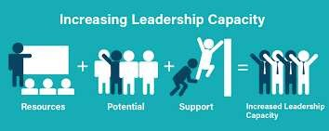
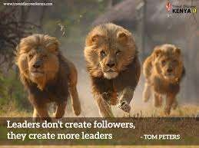
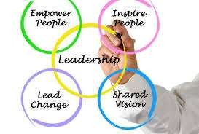
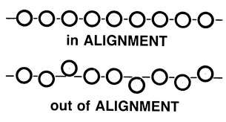

Slide 9
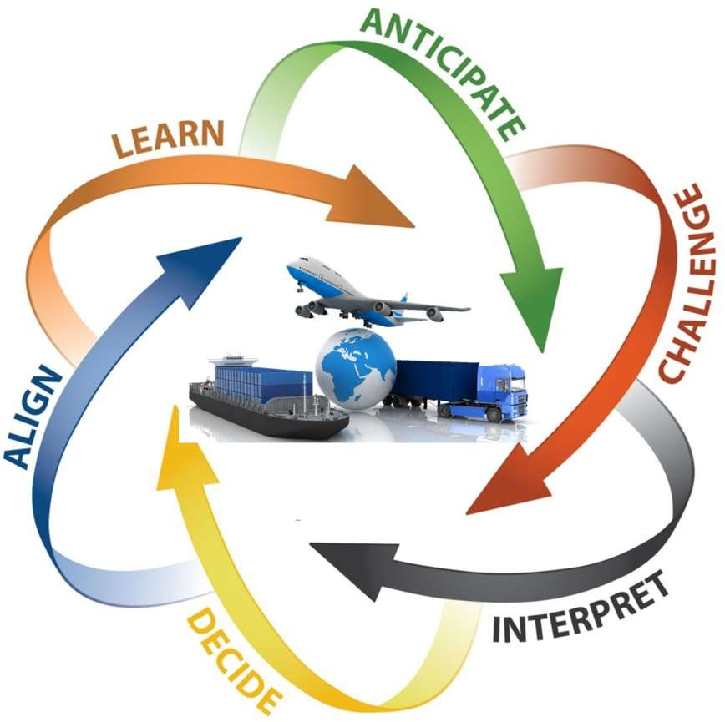

Slide 10



LEADERS’ SKILLS
1. Anticipate:
see what's ahead.
know what is not working well within the organization.
read the appropriate journals and reports.
network with others in the field.

Slide 11


LEADERS’ SKILLS
2. Challenge:
challenge the assumptions of others. Those individuals should be encouraged.
challenge the reports you present.

Slide 12
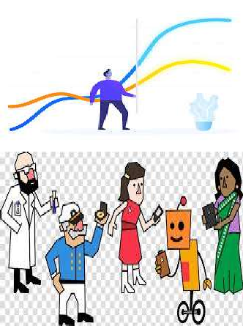
LEADERS’ SKILLS
3. Interpret:
takes time to understand the information; the data trends.
invite those with diverging perspectives to participate in the analysis of the information.

Slide 13

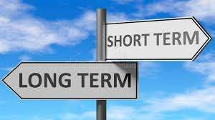
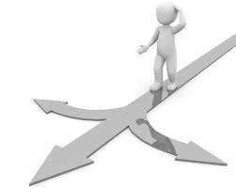

LEADERS’ SKILLS
4. Decide:
prepare a number of optional decisions before they decide and consider the plusses and minuses of each one.
They determine whether this is a long term or a short-term decision and then support the decision once it is made.

Slide 14


LEADERS’ SKILLS
5. Align:
those around that leader and those impacted by that decision understand why the decision has been made, even if they do not agree with it.
identify and communicate with the key individuals.

Slide 15
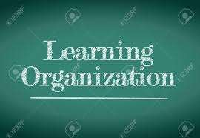
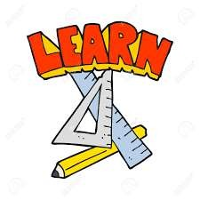
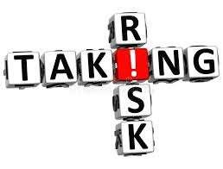
LEADERS’ SKILLS
6. Learn:
foster and support a learning organization; an organizational culture that is open.
learn from decisions they have made as well as decisions others have made.
Take risk in improvements.

Slide 16
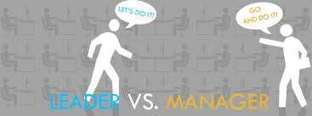
Both strong leadership and
management are
high
necessary for performance.
Some individuals are great leaders but poor managers and vice versa.
In some
cases, an
may be
individual
successful in both roles.

Slide 17
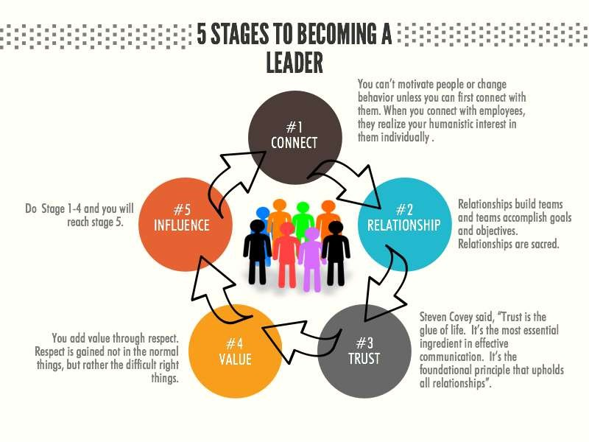


Slide 18
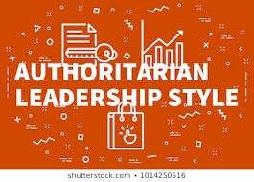

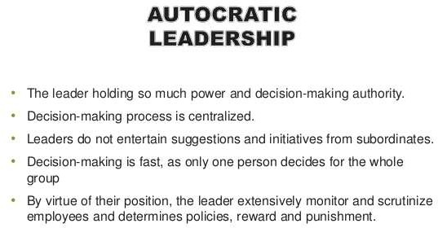

Slide 19
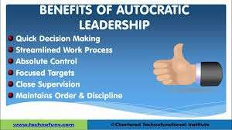
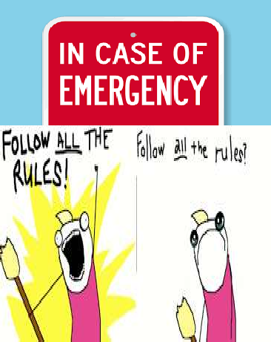
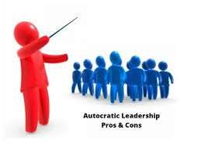
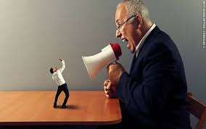

Slide 20
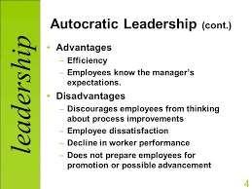
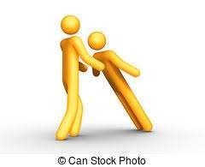

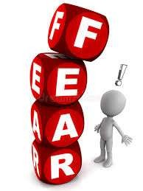
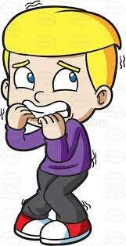




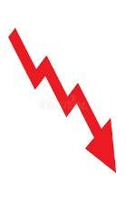

Slide 21


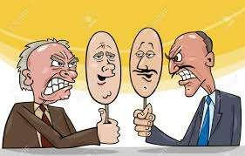

Diplomatic or Consultative
The leader/manager "sells" the decision and/or presents the decision and invites questions.
Decisions stand unless overwhelming reasons dictate a change.
Effective when gaining the support of staff is critical to the success of proposed changes.

Slide 22
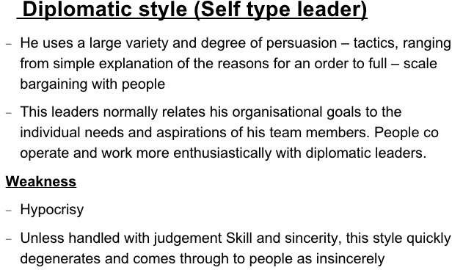

Slide 23
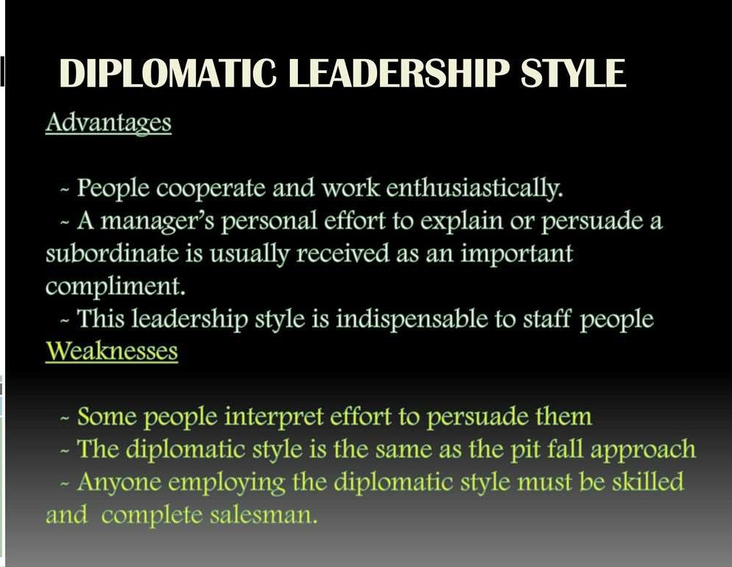

Slide 24
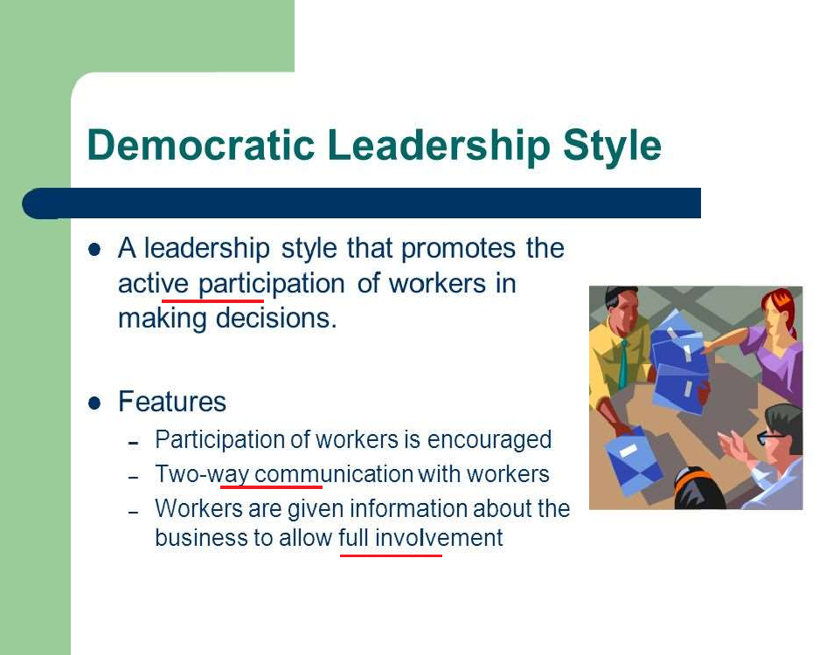

Slide 25
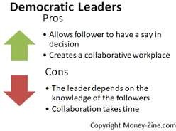




Slide 26
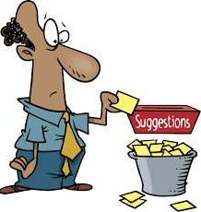


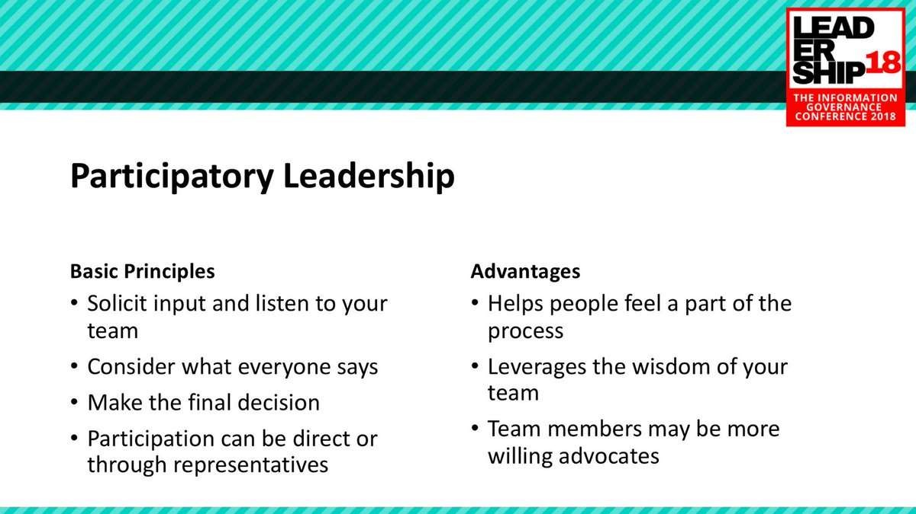


PARTICIPATORY
(THE TQM LEADERSHIP/MANAGEMENT STYLE)

Slide 27
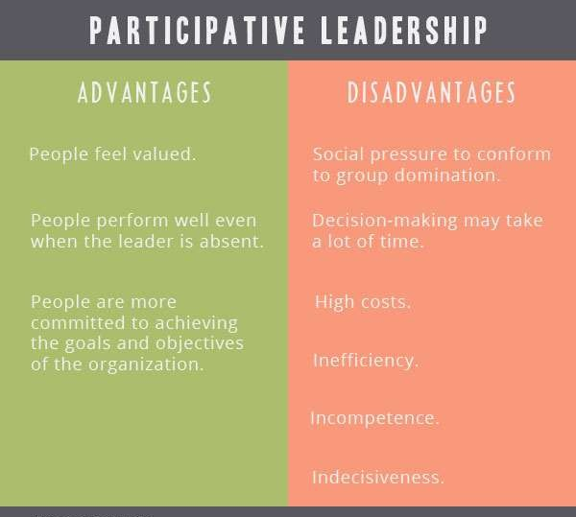

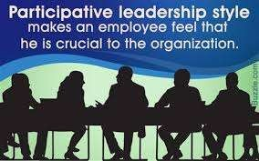



Slide 28
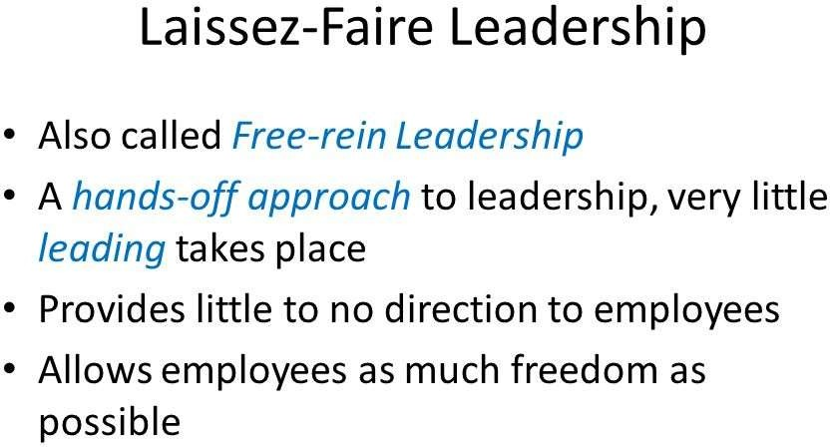
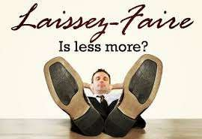

Slide 29
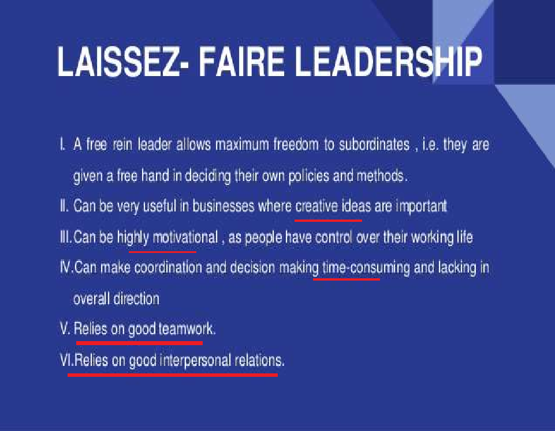

Slide 30
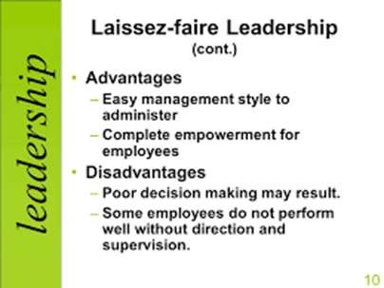


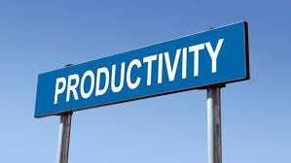


Slide 31



Slide 32








Slide 33



Transactional leadership
Transactional leadership
works established
within set goals and
organizational boundaries.
Transactional leadership is task- and outcome- oriented

Slide 34






Slide 35







Slide 36



Slide 37


SITUATIONAL LEADERSHIP
Immediate crisis: Autocratic.
Lengthy/extended crisis: Participatory.

Slide 38





ORGANIZATION CHART

Slide 39




CHIEF MEDICAL OFFICER (MEDICAL DIRECTOR, CMO, CHIEF OF STAFF)
Roles and responsibilities:
Member in the GB and quality council.
2. Chair of committee. meetings.
the medical Heads all
staff staff

Slide 40





CHIEF MEDICAL OFFICER (MEDICAL DIRECTOR, CMO, CHIEF OF STAFF)
Roles and responsibilities:
3. Enforces medical staff bylaws, rules and regulations.

Slide 41


CHIEF MEDICAL OFFICER (MEDICAL DIRECTOR, CMO, CHIEF OF STAFF)
Roles and responsibilities:
Represents the medical staff to administration and GB.
Participates in the organizationwide decision making
e.g. Q. strategy.

