Slide 1







Health Education
1
Behavioral objectives
Second Semester 2023-2024

Slide 2
Bloom’s Taxonomy of Learning
A taxonomy is a mechanism used to categorize things according to their relationships to one another.
Bloom developed a very useful taxonomy which focuses on how students learn.
This taxonomy was accepted as a standard aid for planning as well as evaluating the education of patients and families.

Slide 3
Bloom’s Taxonomy
is divided into three broad domains of learning:
Affective (attitude) – growth in feelings and emotion.
Psychomotor (skills) – manual or physical abilities.
Cognitive (knowledge) – mental skills

Slide 4
The three domains of learning are interdependent and can be experienced simultaneously (all together).
Bloom Taxonomy (cont.)
Affective Domain
Psychomotor Domain
Cognitive Domain
Bloom Taxonomy of each domain are ordered in a taxonomic form of hierarchy, with simple behaviors listed first and the more complex behaviors listed last.
4

Slide 5
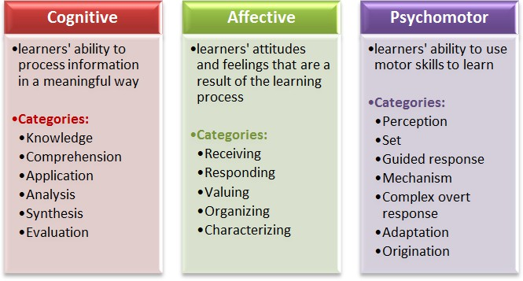
5

Slide 6
The Cognitive Domain
It encompasses mental skills.
It includes six hierarchical levels of learning.
Clients progress through the various levels as they become more confident and informed regarding their health and well-being.
They are arranged in increasing order, from Lower Order Thinking Skills to Higher Order Thinking Skills
6

Slide 7
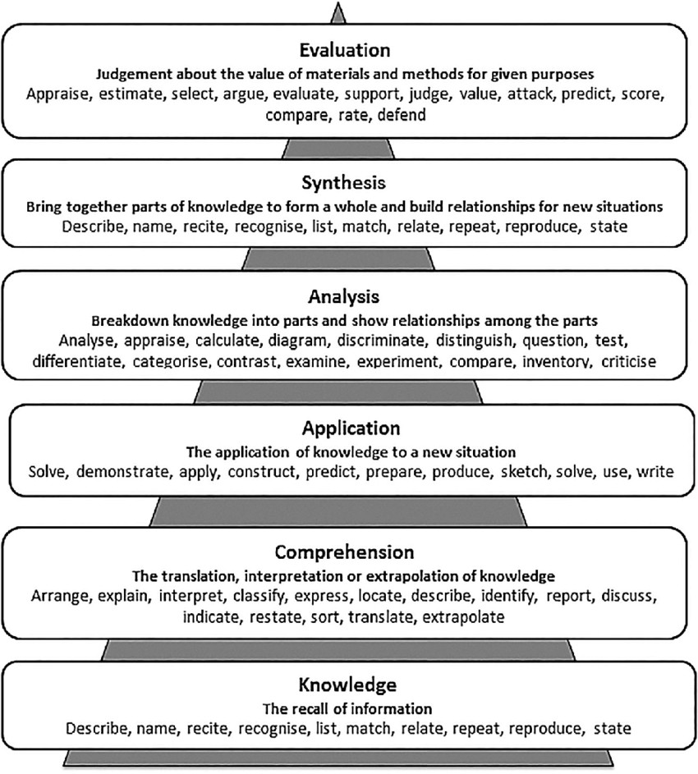
7

Slide 8
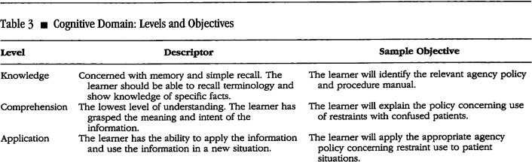

Slide 9
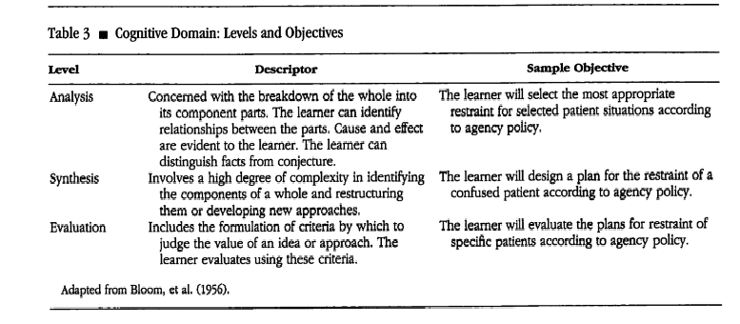

Slide 10
The Affective Domain
This domain includes the manner in which we deal with things emotionally, such as feelings, values, appreciation, enthusiasms, motivations, and attitudes.
The affective domain could be of more importance to consider for healthcare providers who are planning patient education.

Slide 11
The Affective Domain

Slide 12
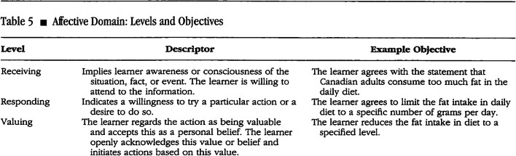

Slide 13

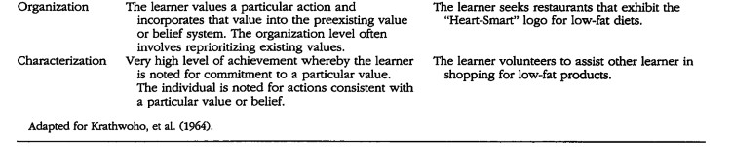

Slide 14
The Psychomotor Domain
The psychomotor domain includes physical movement, coordination, and use of the motor- skill areas.
Thus, psychomotor skills rage from manual tasks, such as washing a car, to more complex tasks, such as dancing

Slide 15
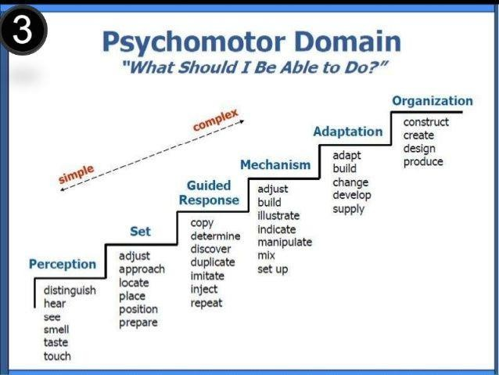

Slide 16
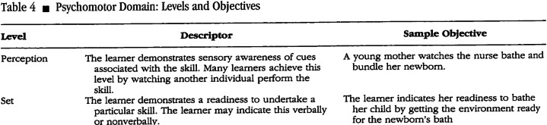

Slide 17


Slide 18
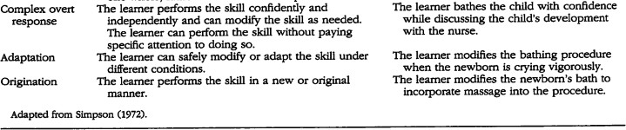
18

