Slide 1
VFCAL Judges Clinic
2026

Slide 2
Agenda
9:00 am- Routine Judging Basics (inside)
11:30 am-12:15 pm- Break for lunch
  11:30-11:45 Referee and Coaches Meeting
12:15 pm- Poolside Routine Demo
12:30 pm- Figure Judging Basics and Demo
2pm- Exam
Dismissed

Slide 3
Routine Judging Basics
The judge must evaluate the competitor as they perform at this moment in time. Make no pre-judgement.
Do not let personal preferences impact the scoring (i.e. music, costumes, etc.)
Judges will see routines from different angles and positions at the pool. Your evaluation should reflect your viewing position. Judge what you see.

Slide 4
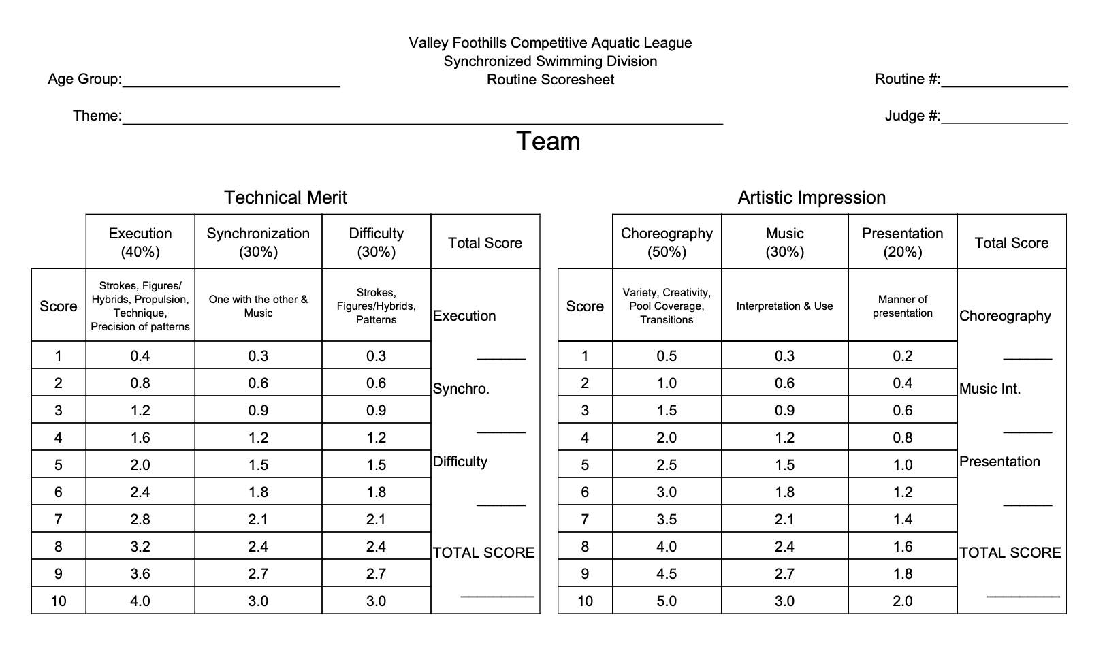
Team Routine Scorecard

Slide 5
Routine Scoring Breakdown
Technical Merit | Artistic Impression
Execution -Precision of patterns, strokes, transitions, figures/hybrids, etc. Synchronization -With each other and with the music Difficulty -Complexity, height, patterns, number of swimmers, speed of action, etc. | Choreography -Creativity, variety, fluidity and pool coverage, transitions, patterns Musical Interpretation -Feel, mood, character of the music Manner of Presentation -Spark that makes the routine stand out

Slide 6
Technical Merit- EXECUTION
Execution of Strokes:
Swimming should be smooth and effortless
Power without struggle, no unintentional splashing
Execution of Propulsive Methods
Kicks: Should propel swimmer effortlessly through the water
Eggbeater: Maintain good positions of head, arms, and shoulders above the surface of the water
Sculling
Correct body position is essential to sculling efficiency
Do not look at the sculling itself. Sculling is not judged. But the effectiveness of the sculling is.

Slide 7
Technical Merit- EXECUTION
Execution of Figures, Hybrids, and parts thereof
If a standard figure is used, it should be recognizable
Should appear effortless, smooth, controlled
Execution of Transitions
A movement between figure parts, strokes, and propulsive techniques. Transitions connect an entire routine into a cohesive performance
Execution & Precision of Patterns
The exactness of the pattern must be clearly evident. There should be no doubt as to what the pattern is

Slide 8
Technical Merit- SYNCHRONIZATION
Synchronization with Each Other
Either synchronized or not.
All body positions, arm and leg angles, and head angles should be exact
Synchronization with the Music
Swimmers might be interpreting beats of the music. Intentions should be clearly evident

Slide 9
Technical Merit- DIFFICULTY
A more difficult routine, with more difficult elements should receive higher marks. However, a difficult routine that is not well executed and synchronized should not receive higher marks than a more simple routine that was well executed and synchronized.
Some examples of difficulty include: Complexity of the movement, very quick or constant movements, sustained high energy, longer breaths held under water, challenging elements near the end of a routine, etc.

Slide 10
Technical Merit- DIFFICULTY
Difficulty in Figures/Hybrids
Sustained height out of the water
Several fast position changes in a row
Long underwater sequences
Difficulty in Synchronization
More difficult to be exact with more swimmers
Difficulty in slow music as well as fast music
Music tempos that change are more difficult that even beats

Slide 11
Technical Merit- DIFFICULTY
Difficulty in Patterns
Moving Patterns vs stationary patterns
Straight lines more difficult than spaced patterns
Circles more challenging than squares
Blind patterns
Surface pattern changes harder than underwater changes

Slide 12
Technical Merit- DIFFICULTY
Risk factor is the ultimate in difficulty. It involves risk of failure in execution or synchronization.
Lifts, throws
Rockets/Split rockets
Pair boosts
Blind pair/group actions
Also keep in mind the placement of the difficult element. It is more difficult to add a risk factor at the end of a routine, than the beginning.

Slide 13
Artistic Impression- CHOREOGRAPHY
Variety- figures used, water level, patterns, fast vs slow, synchronization
Creativity- element of surprise is your best indication of creativity
Fluidity and Pool Coverage- a routine without breaks, using as much of the pool as possible
Transitions- make the routine flow
Patterns- one pattern should not be held for too long
*Deck work before entering the pool is not judged

Slide 14
Artistic Impression- MUSICAL INTERPRETATION
A judge must disregard any personal preferences for music
A well choreographed routine will synchronize movement changes with music changes

Slide 15
Artistic Impression- MANNER OF PRESENTATION
Manner of Presentation is the spark that makes a routine stand out:
- Poise, charisma, showmanship
Expressiveness with the entire body

Slide 16
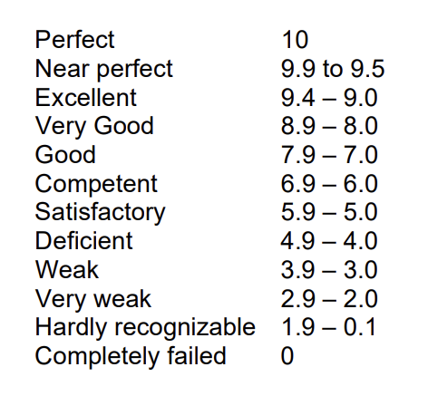
FINA Judging Scale

Slide 17
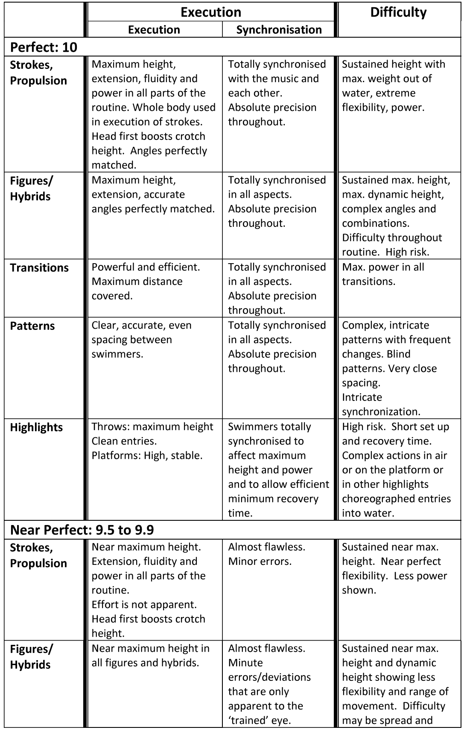
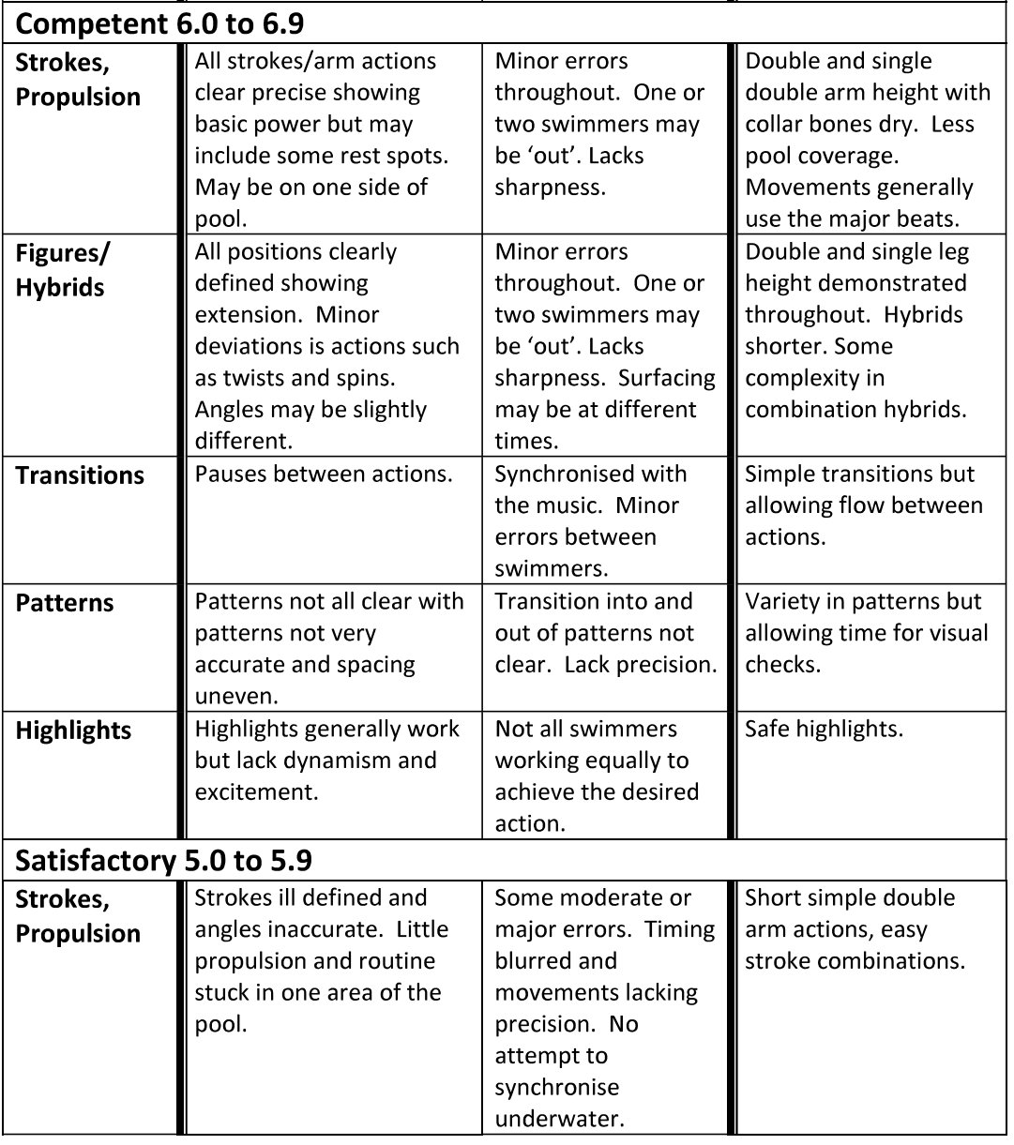
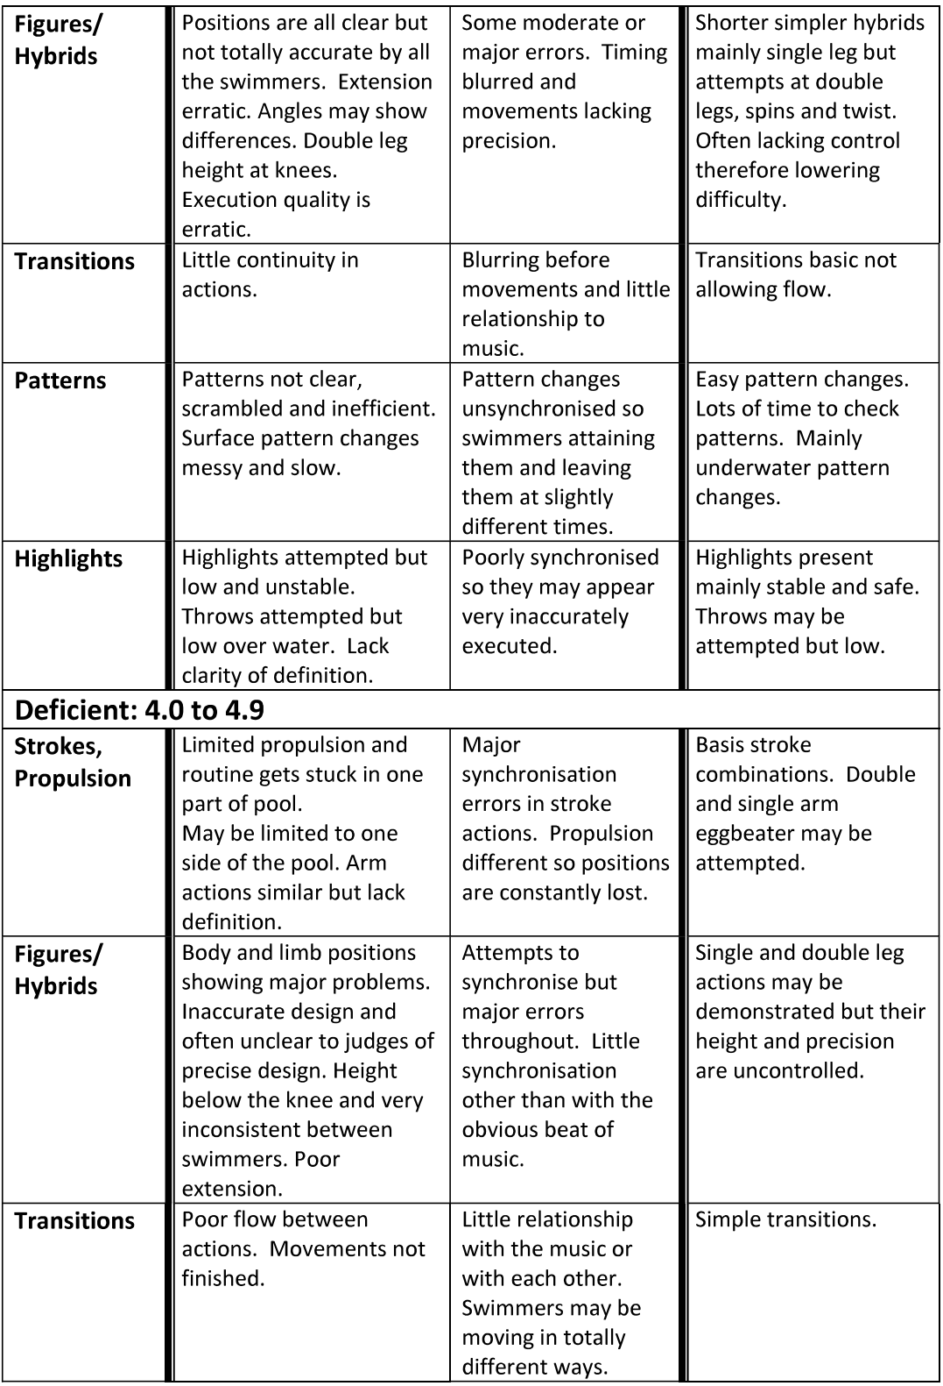
FINA Judging Scale

Slide 18
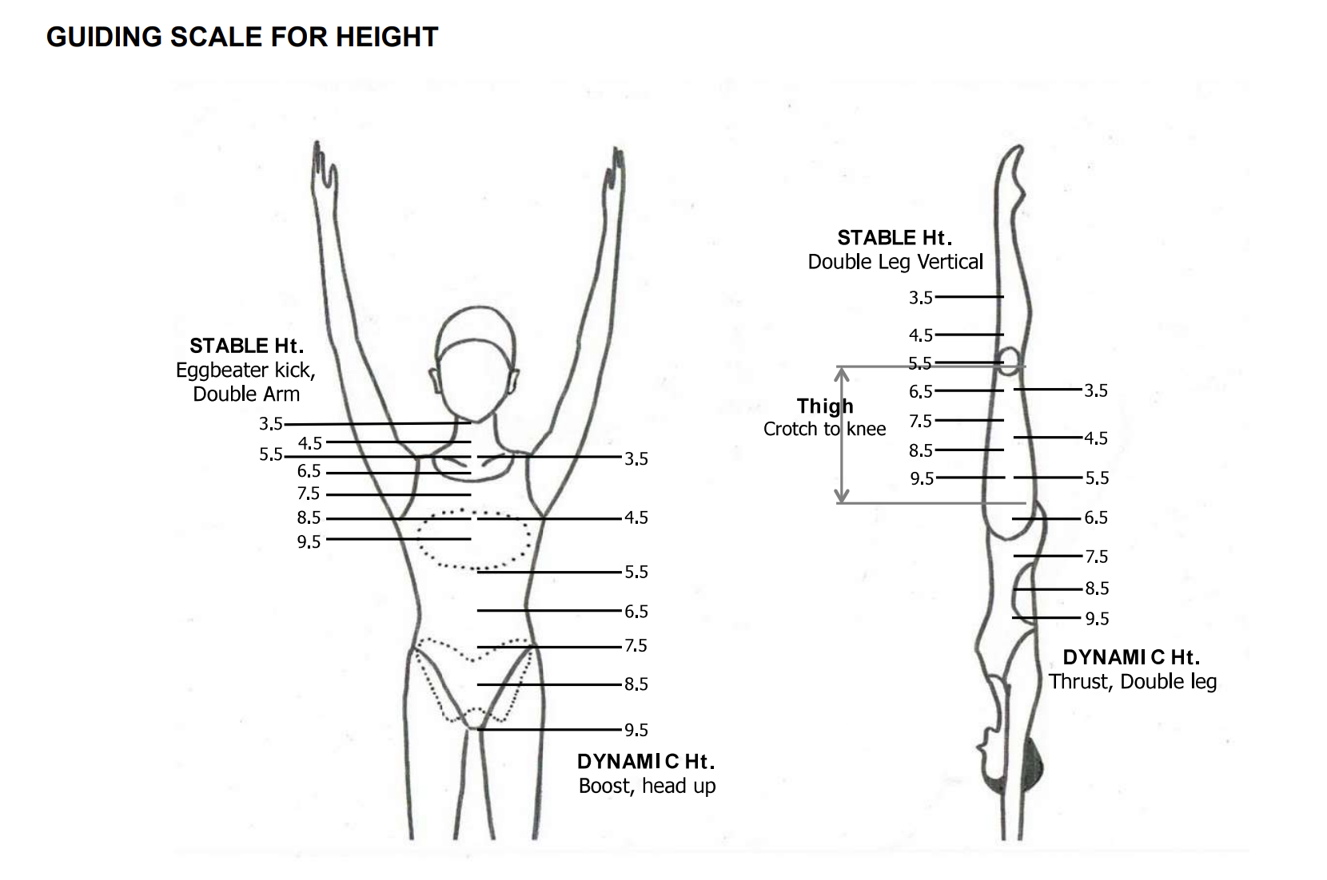
FINA Judging Scale

Slide 19
Team Routine Scorecard

Slide 20
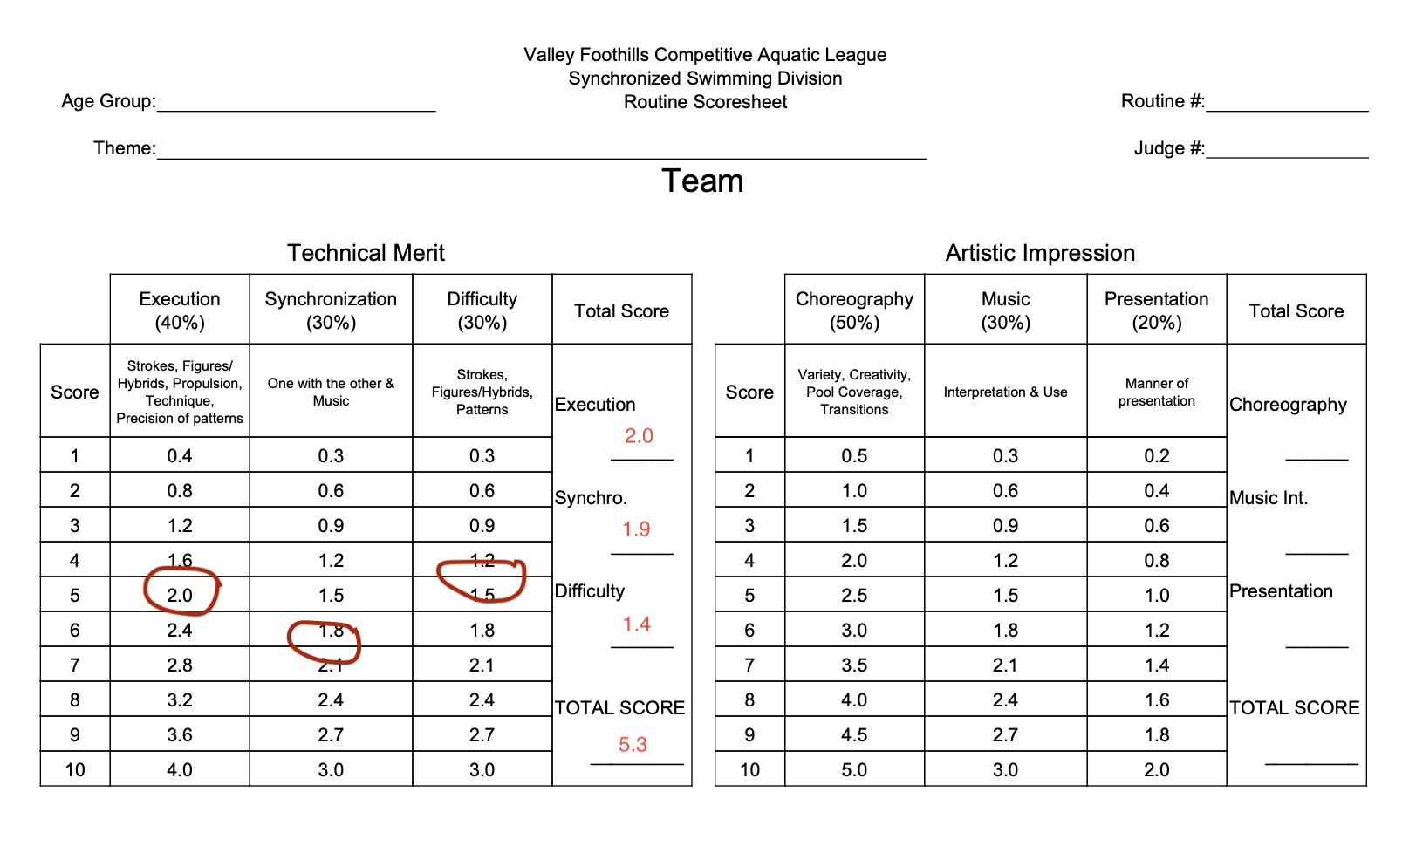
Team Routine Scorecard

Slide 21
Routine example videos
https://www.youtube.com/watch?v=kcz1eJbghXI
https://www.youtube.com/watch?v=_2AgUwKYHds
https://www.youtube.com/watch?v=lLV62R8mkU8
Combo
https://www.youtube.com/watch?v=PyjQeuIp4EY
Solo
Trio
Team

Slide 22

Referee and Judges Resources
Sunrise Swans League Info Page

