Slide 1
Chamber of Commerce Small Business Series: Minneapolis Social Media Support
July 2018

Slide 2
Social Media Support
MetLife supported the Chamber of Commerce Small Business Series in Minneapolis on July 24, 2018 with organic posts during the event. Impressions have declined due to targeting parameters of LinkedIn, however, the engagement rate has continued to increased – with the Twin Cities being the highest to date at 1.18%.
Results:
Total Impressions: 21,502
Total Engagements: 253
Twitter: 4 tweets
Total Impressions: 19,404
Total Engagements: 107
Facebook: 1 post (Facebook Live share)
1.6K impressions
1.1K video views
133 engagements
LinkedIn*: 2 posts (targeted to small business followers)
Impressions: 611
Engagements: 13
Results as of August 3, 2018
*LinkedIn’s posts are geo-targeted to small business owners and HR so metrics are greatly reduced compared to other posts
Engagements: Likes, replies, retweets, clicks (clicks are not measured on Facebook)
Impressions: Number of times the post was seen. Does not include impressions for shared content.
Notes:
Twitter: 5 tweets
Total Impressions: 3908 + 2128 + 5225 + 5083 + 4043 = 20,387
Total Engagements: 36 + 16 + 32 + 34 + 28 = 146
Facebook: 2 posts
Total Impressions: 13090 + 2138 = 15,228
Total Engagements: 44 + 31 = 75

Slide 3
Twitter

Slide 4
Tweets

Slide 5
Tweets, cont’d

Slide 6
Facebook

Slide 7
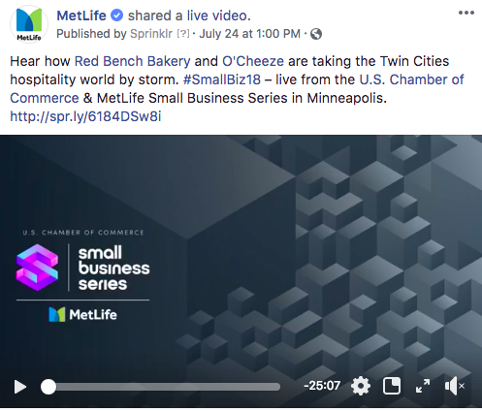
Facebook Live Share

Slide 8
LinkedIn

Slide 9
Posts targeted to small business followers

