Slide 1
Small business solutions: “ANYTHING BUT SMALL” campaign CREATIVE REVIEW

Slide 2
Driving purchase intent: Integrated Small business campaign
2016 Integrated SM Marketing Strategy
SM Advertising
Public Relations
Social Media Influencer Program
Lead Generation/Sales Desk
MetLife.com
Internal Communi-cations
Content Marketing
Objective
Drive preference and purchase intent for MetLife’s small business solutions through an integrated marketing campaign that demonstrates: The value of working with MetLife (activates the value prop) Our understanding of, and commitment to, the small business market
Measures of Success
Increased SM preference and purchase intent (pre-post research) Engagement Qualified leads

Slide 3
Small Business Integrated Campaign at-a-glance
April
May
June
July
Aug
Sep
Oct
Nov
Dec
B-to-B
Advertising
Print/Digital - Flight 1
Print/Digital – Flight 2
PGA TV Commercial & Microsite
Activation TBD
Web
MetLife.com Refresh
SB Week Social Takeover
Social Media
Small Business Influencer Program
PR
Media Relations
Content Marketing
Original Content – White Papers, Infographics, Video
See next page for tactic descriptions.

Slide 4
ANYTHING BUT SMALL: TVC ROUGH CUT
Please access link in email to download video to review

Slide 5
ANYTHING BUT SMALL: Digital Concepts - SBO
Please access link in email to download video to review

Slide 6
ANYTHING BUT SMALL: Digital Concepts - BROKER

Slide 7
ANYTHING BUT SMALL: Digital Concepts - BROKER

Slide 8
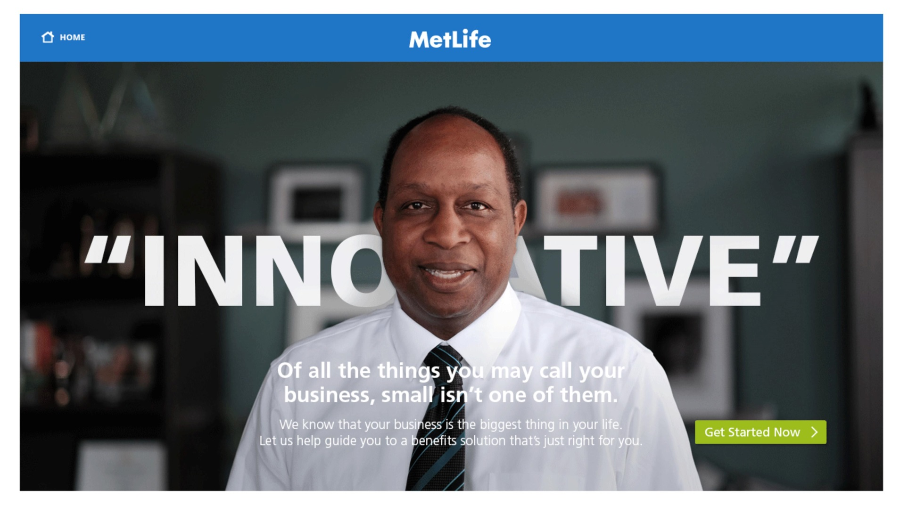
ANYTHING BUT SMALL: LANDING PAGE: metlife.com/anythingbutsmall

Slide 9
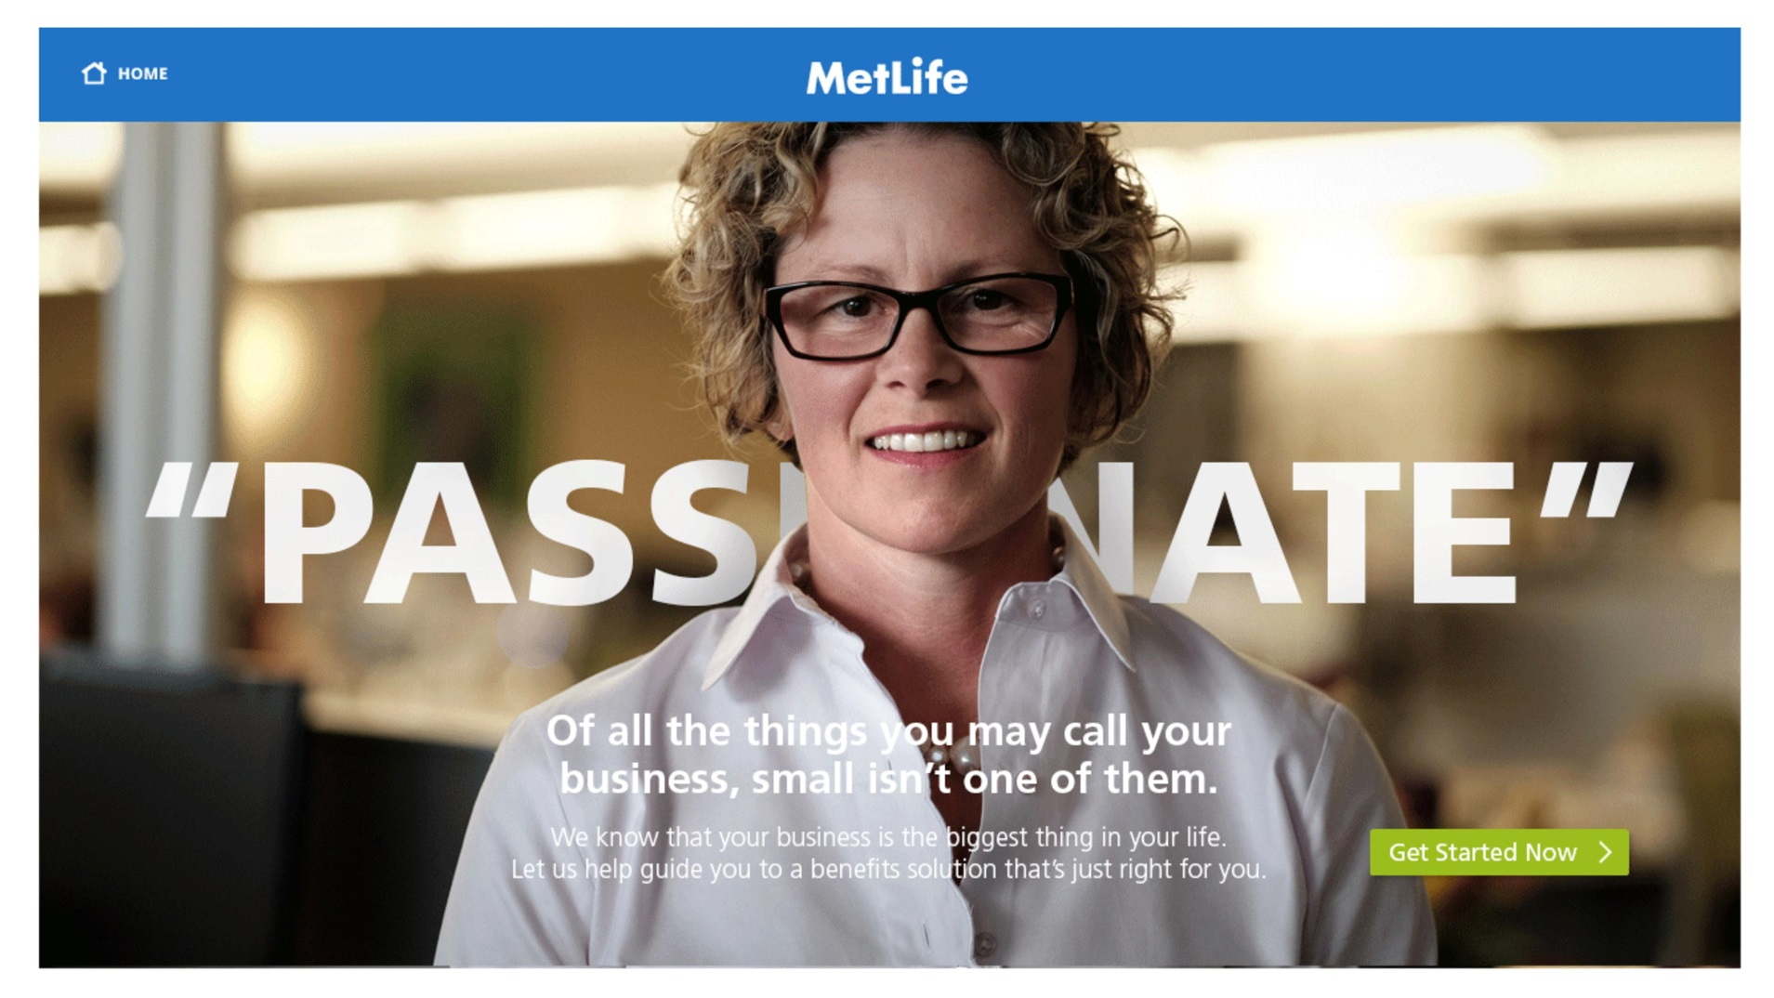
ANYTHING BUT SMALL: LANDING PAGE: metlife.com/anythingbutsmall

Slide 10
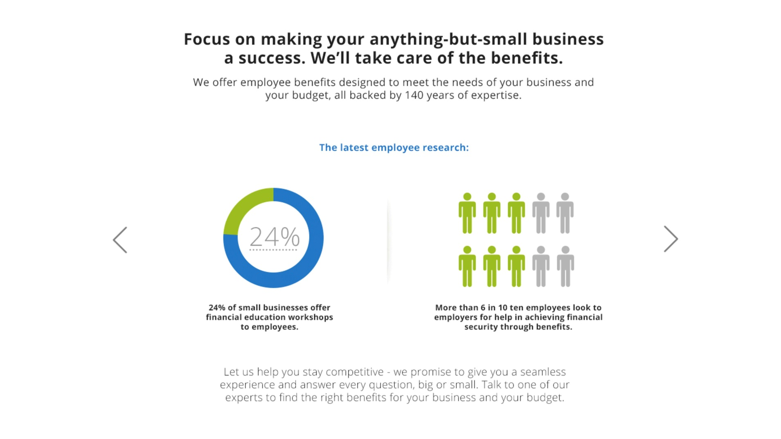
ANYTHING BUT SMALL: LANDING PAGE: metlife.com/anythingbutsmall

Slide 11
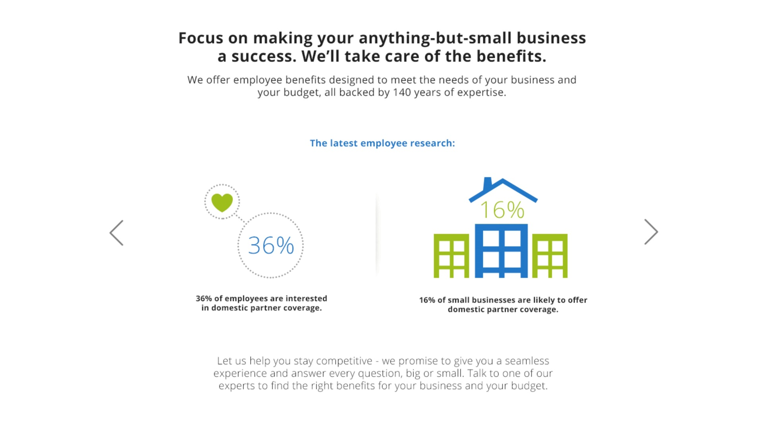
ANYTHING BUT SMALL: LANDING PAGE: metlife.com/anythingbutsmall

Slide 12
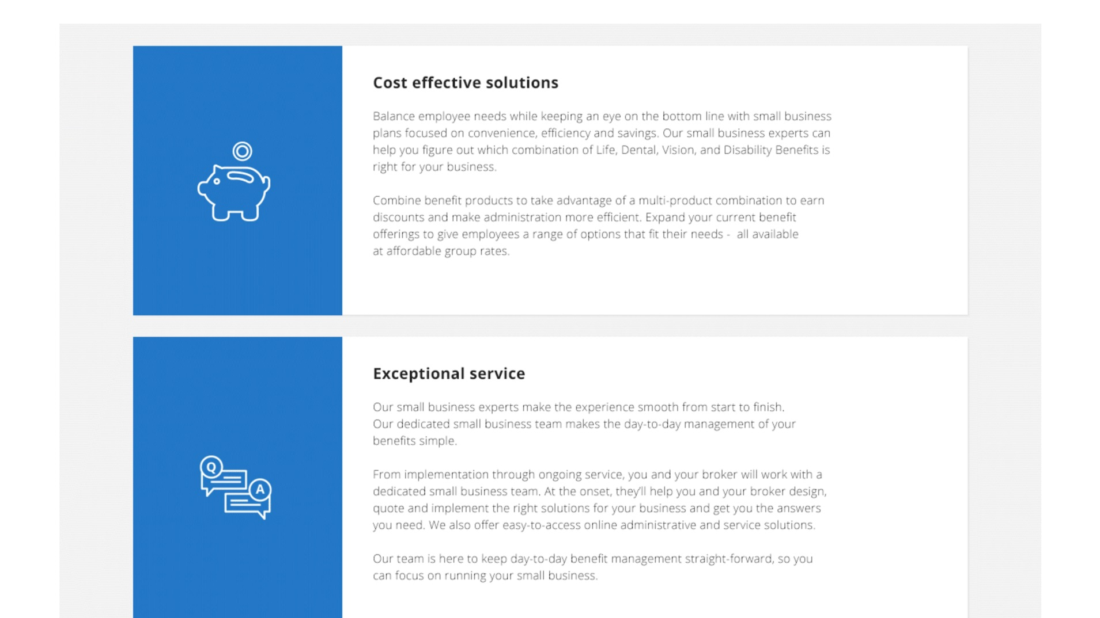
ANYTHING BUT SMALL: LANDING PAGE: metlife.com/anythingbutsmall

Slide 13
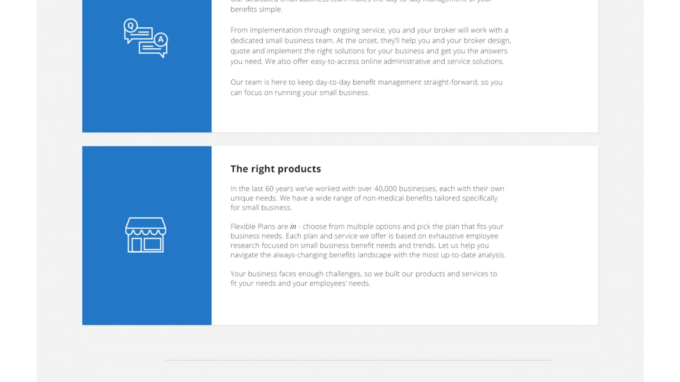
ANYTHING BUT SMALL: LANDING PAGE: metlife.com/anythingbutsmall

Slide 14
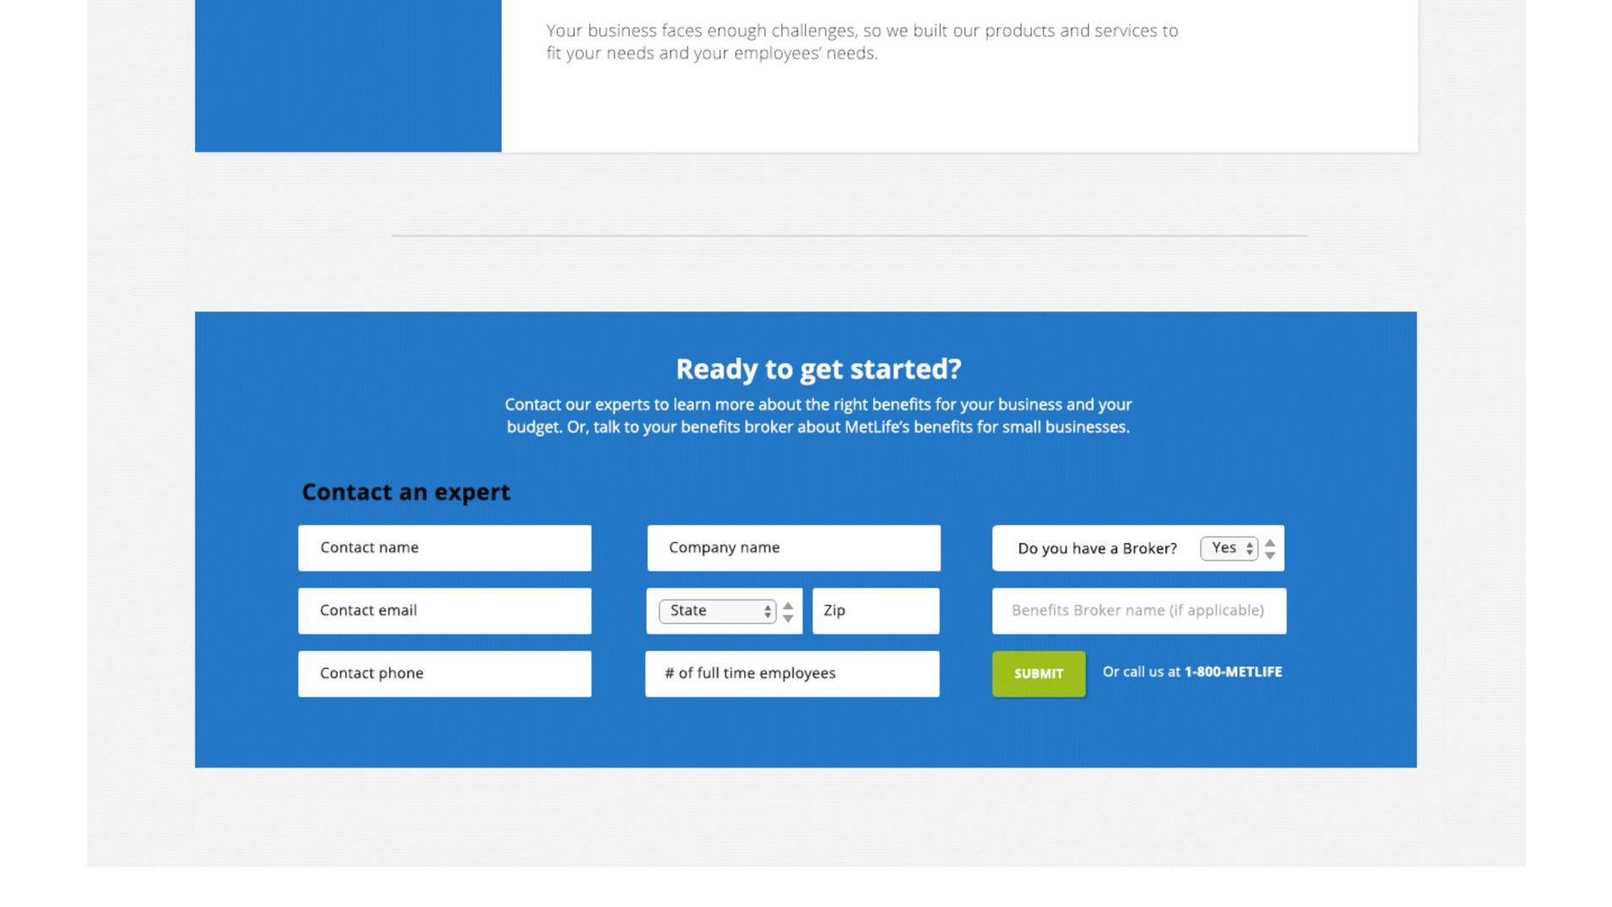
ANYTHING BUT SMALL: LANDING PAGE: metlife.com/anythingbutsmall

Slide 15
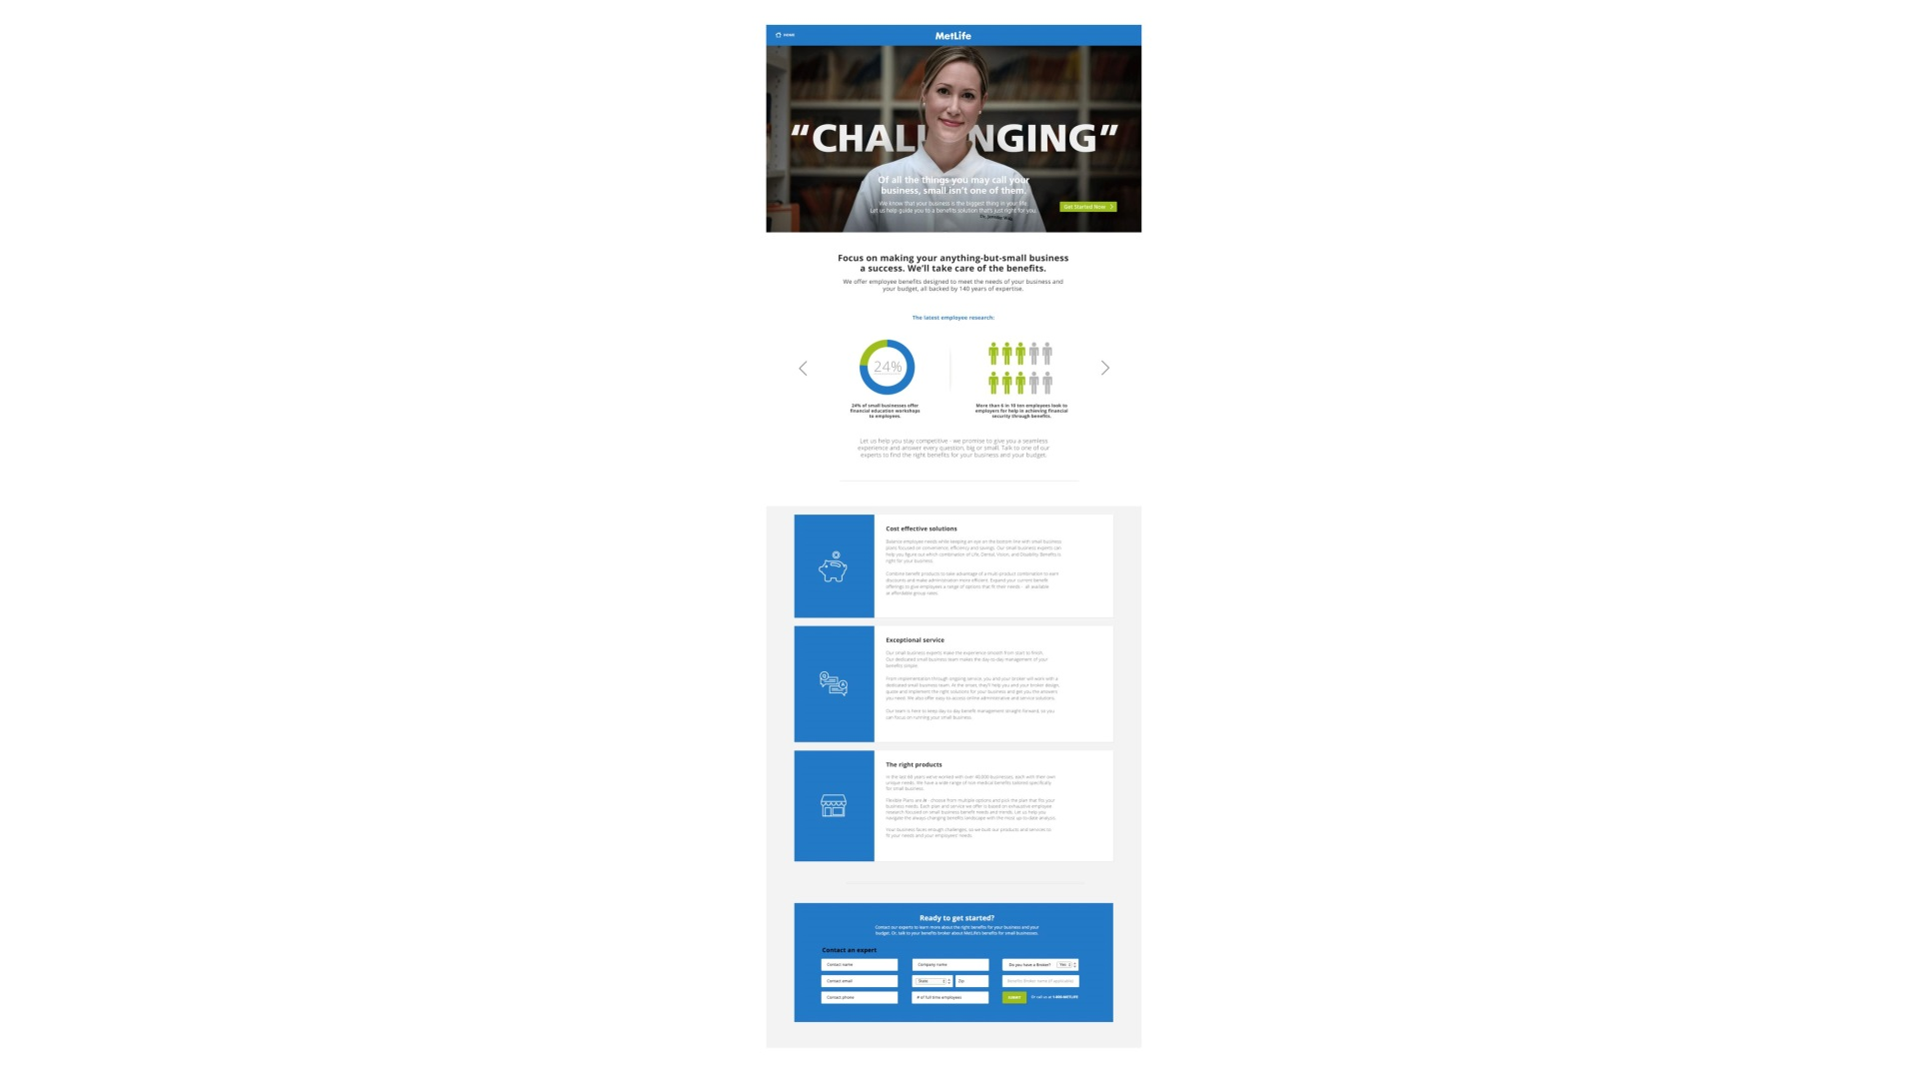
ANYTHING BUT SMALL: LANDING PAGE: metlife.com/anythingbutsmall

