Slide 1
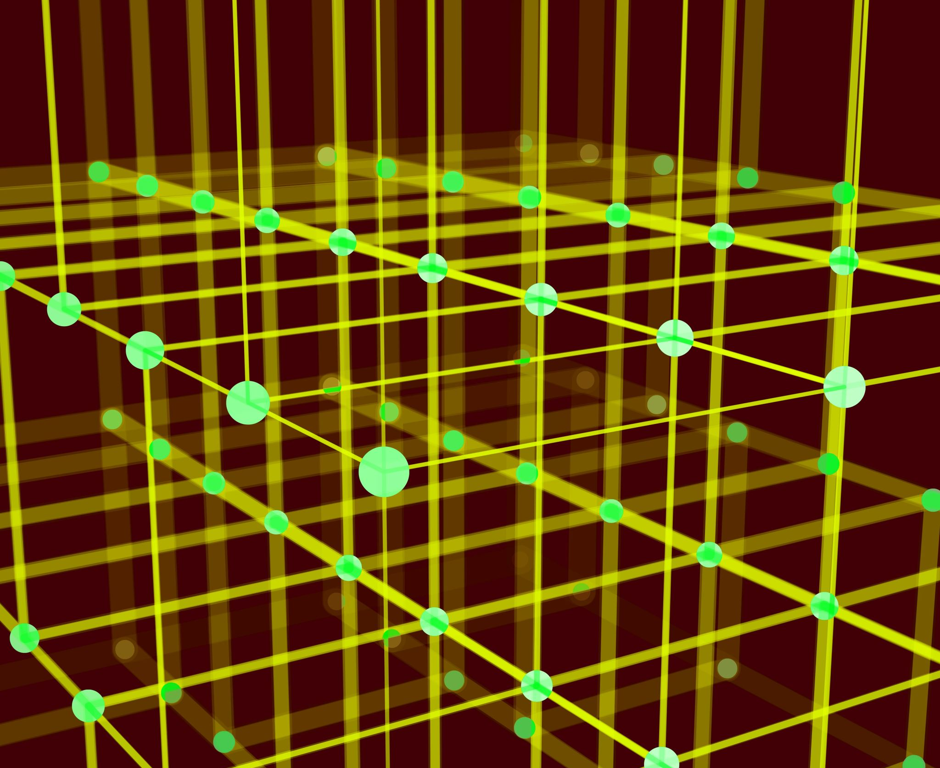
Clustering Methods

Slide 2
Introduction
Clustering is an unsupervised machine learning technique that groups data points into clusters based on their similarities.
Clustering can be used for a variety of tasks, such as customer segmentation, anomaly detection, and pattern recognition.

Slide 3
Applications of clustering
Customer segmentation
Anomaly detection
Pattern recognition
Medical diagnosis
Image processing
Fraud detection
Market research

Slide 4
Types of clustering methods
Partitioning clustering - divide the data into a predefined number of clusters.
Hierarchical clustering -create a tree-like hierarchy of clusters, where each cluster is a subset of the parent cluster
Density-based clustering -group data points that are close together in space
Model-based clustering -assume that the data is generated from a mixture of statistical distributions

Slide 5
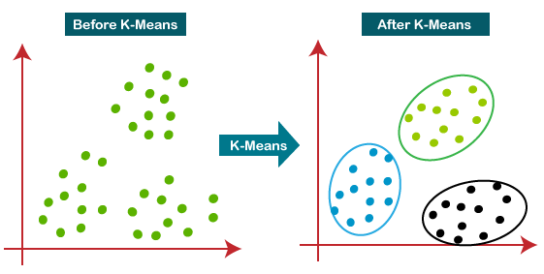
K-means clustering
K-means clustering is a partitioning clustering algorithm that divides the data into a predefined number of clusters.
K-means clustering works by randomly initializing cluster centroids and then iteratively assigning data points to the cluster with the closest centroid.
K-means clustering is a simple and efficient algorithm, but it is sensitive to the initialization of cluster centroids.

Slide 6
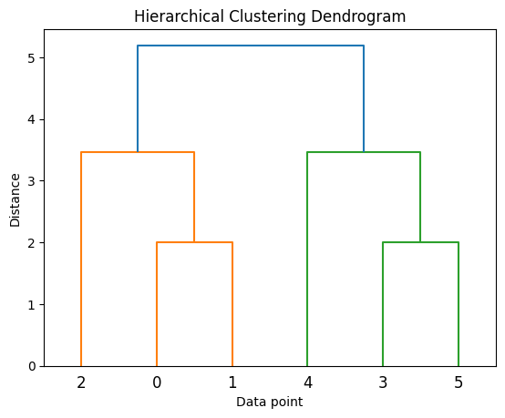
Hierarchical clustering
Hierarchical clustering is a clustering algorithm that creates a tree-like hierarchy of clusters.
Hierarchical clustering works by merging or splitting clusters based on a distance metric.
Hierarchical clustering is a more flexible algorithm than k-means clustering, but it can be computationally expensive for large datasets.

Slide 7
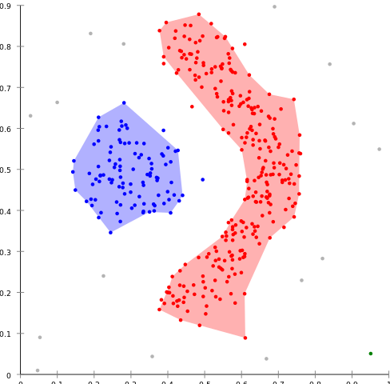
Density-based clustering
Density-based clustering is a clustering algorithm that groups data points that are close together in space.
DBSCAN works by identifying core points, which are data points that have a minimum number of neighbors within a certain radius.
DBSCAN then groups all of the neighbors of a core point into a cluster.
DBSCAN is a robust algorithm that is insensitive to noise and outliers.

Slide 8
Model-based clustering
Model-based clustering is a clustering algorithm that assumes that the data is generated from a mixture of statistical distributions.
GMMs work by fitting a mixture of Gaussian distributions to the data.
GMMs can be used to identify clusters of different shapes and sizes.
GMMs are more computationally expensive than other clustering algorithms, but they can be more accurate for complex datasets.

