Slide 1
Artificial Intelligence BCS-701

Slide 2
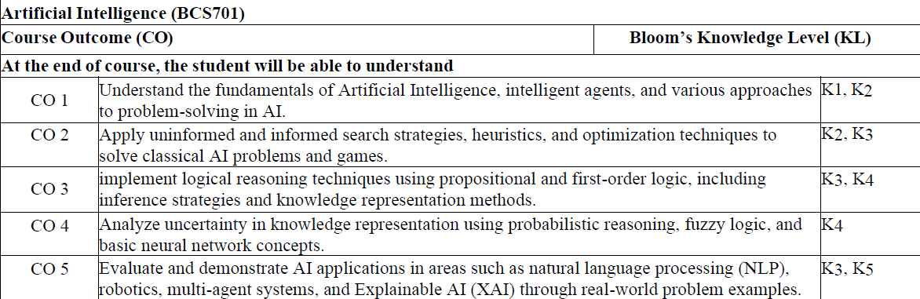

Slide 3
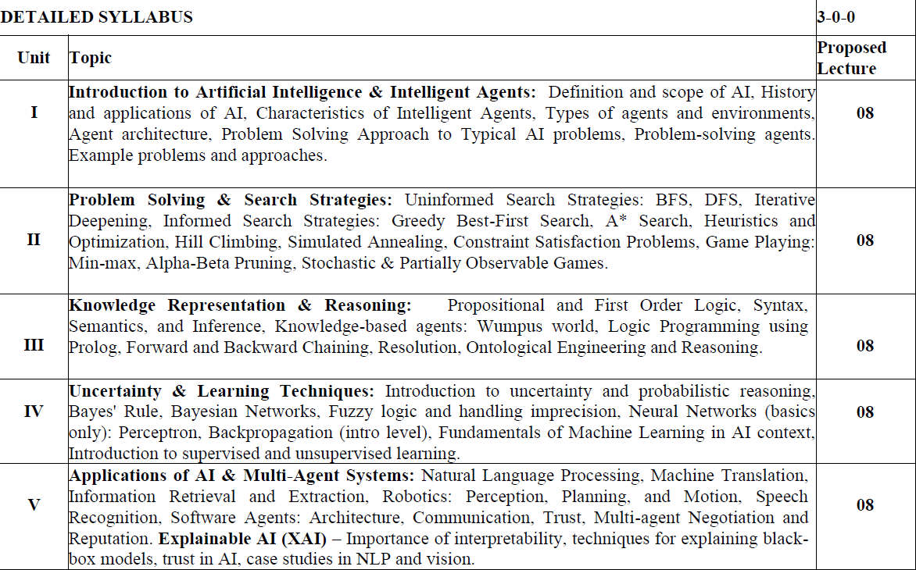

Slide 4
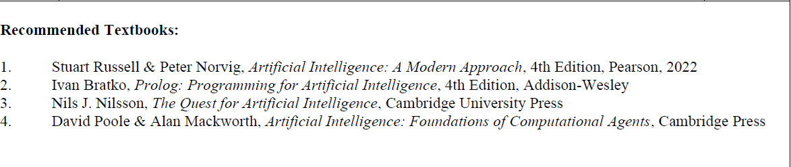

Slide 5
AI Introduction
Artificial Intelligence is composed of two words Artificial and Intelligence,
where Artificial defines "man-made," and intelligence defines "thinking power", hence AI means "a man-made thinking power."
So, we can define AI as:
It is a branch of computer science by which we can create intelligent machines which can behave like a human, think like humans, and able to make decisions."

Slide 6
Intelligence in AI
Intelligence in AI refers to a machine's capacity to perform tasks that typically require human-level cognitive abilities, such as learning, reasoning, decision-making, and problem-solving, by processing large amounts of data, identifying patterns, and adjusting to new inputs to achieve specific goals.
This is often achieved through machine learning and deep learning, where systems train on vast datasets to improve their performance and accuracy over time, enabling them to understand and generate language, recognize images, and provide insightful recommendations.

Slide 7
Intelligence is an intangible part of our brain which is a combination of Reasoning, learning, problem-solving perception, language understanding, etc.
To achieve the above factors for a machine or software Artificial Intelligence requires the following discipline:
o Mathematics
o Biology
o Psychology
o Sociology
o Computer Science
o Neurons Study
o Statistics

Slide 8
Key Aspects of AI Intelligence
Human-like Behavior:
AI aims to enable machines to exhibit human-like behaviors and carry out tasks that have historically demanded human intelligence.
Learning from Data:
A core component of AI intelligence is the ability to learn from vast amounts of data, recognize patterns, and make predictions or decisions without being explicitly programmed for every scenario.
Reasoning and Problem-Solving:
AI systems can analyze complex information and apply logical reasoning to solve problems, such as optimizing resource allocation or finding solutions in a search space.
Adaptability:
Intelligent AI systems can adapt to new inputs and improve their performance over time, much like humans learn from experience.
Decision-Making:
Based on the patterns and insights derived from data, AI can make informed decisions, whether it's a computer deciding if an image contains a cat or a business determining market trends

Slide 9
Why Artificial Intelligence?
With the help of AI, you can create such software or devices which can solve real-world problems very easily and with accuracy such as health issues, marketing, traffic issues, etc.
With the help of AI, you can create your personal virtual Assistant, such as Cortana, Google Assistant, Siri, etc.
With the help of AI, you can build such Robots which can work in an environment where survival of humans can be at risk.
AI opens a path for other new technologies, new devices, and new
Opportunities.

Slide 10
Goals of Artificial Intelligence:
Replicate human intelligence
2. Solve Knowledge-intensive tasks
3. An intelligent connection of perception and action
4. Building a machine which can perform tasks that requires human intelligence such as:
o Proving a theorem
o Playing chess
o Plan some surgical operation
o Driving a car in traffic
5. Creating some system which can exhibit intelligent behavior, learn new things by itself, demonstrate, explain, and can advise to its user.

Slide 11
Advantages of Artificial Intelligence:
Following are some main advantages of Artificial Intelligence:
o High Accuracy with less errors: AI machines or systems are prone to
less errors and high accuracy as it takes decisions as per pre-experience
or information.
o High-Speed: AI systems can be of very high-speed and fast-decision
making, because of that AI systems can beat a chess champion in the
Chess game.
o High reliability: AI machines are highly reliable and can perform the
same action multiple times with high accuracy.

Slide 12
Useful for risky areas: AI machines can be helpful in situations such as
defusing a bomb, exploring the ocean floor, where to employ a human
can be risky.
Digital Assistant: AI can be very useful to provide digital assistant to
the users such as AI technology is currently used by various Ecommerce
websites to show the products as per customer requirement.
Useful as a public utility: AI can be very useful for public utilities such
as a self-driving car which can make our journey safer and hassle-free,
facial recognition for security purpose, Natural language processing to
communicate with the human in human-language, etc.

Slide 13
disadvantages of AI:
o High Cost: The hardware and software requirement of AI is very costly
as it requires lots of maintenance to meet current world requirements.
o Can't think out of the box: Even we are making smarter machines with
AI, but still they cannot work out of the box, as the robot will only do
that work for which they are trained, or programmed.
o No feelings and emotions: AI machines can be an outstanding
performer, but still it does not have the feeling so it cannot make any
kind of emotional attachment with human, and may sometime be
harmful for users if the proper care is not taken.
o Increase dependency on machines: With the increment of technology,
people are getting more dependent on devices and hence they are losing
their mental capabilities.
o No Original Creativity: As humans are so creative and can imagine
some new ideas but still AI machines cannot beat this power of human
intelligence and cannot be creative and imaginative

Slide 14
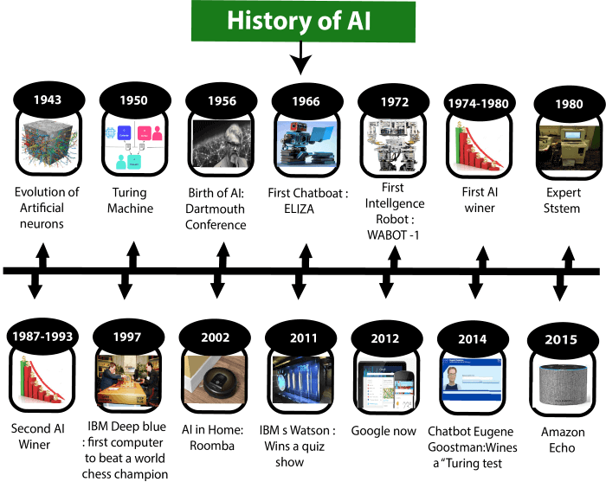

Slide 15
Foundations of AI and sub areas of AI:
AI into five distinct research areas
Machine Learning – learning from data
Expert Systems – emulate human experts
Computer Vision – interpret images/videos
NLP – understand/generate human language
Robotics – design & operate robots

Slide 16
Applications of AI
E-commerce: recommendation, fraud detection
Navigation: route optimization, traffic analysis
Robotics: industrial, medical robots
Healthcare: diagnosis, drug discovery
Agriculture: crop monitoring, soil analysis
Gaming: smart NPCs, behavior prediction
Automobiles: self-driving cars, safety systems
Social Media: content recommendations, moderation
Marketing: personalized ads, chatbots

Slide 17
Agents in AI
An artificial intelligence (AI) agent is a software program that can interact with its environment, collect data and use that data to perform self-directed tasks that meet predetermined goals. Humans set goals, but an AI agent independently chooses the best actions it needs to perform to achieve those goals.
Key Features of AI Agents
Autonomous: Act without constant human input and decide next steps from past data like a bookstore bot flags missing invoices.
Goal‑driven: Optimize for defined objectives like a logistics AI balancing speed, cost and fuel use.
Perceptive: Gather info from sensors, inputs or APIs like a cybersecurity agent tracking new threats.
Adaptable: Adjust strategies when situations change.
Collaborative: Work with humans or other agents toward shared goals like healthcare agents coordinating with patients and doctor.

Slide 18
How do AI Agents Work?
Persona: Each agent is given a clearly defined role, personality and communication style along with specific instructions and descriptions of the tools it can use. A well‑crafted persona ensures the agent behaves consistently and appropriately for its role, while also evolving as it gains experience and engages with users or other systems.
Memory: Agents typically have multiple types of memory:
Short‑term memory for the current interaction
Long‑term memory for storing historical data and conversations
Episodic memory for recalling specific past events
Consensus memory for sharing knowledge among multiple agents
Memory enables an agent to keep context, learn from experience and adapt its behaviour over time.

Slide 19
3. Tools: These are functions or external resources the agent can use to access information, process data, control devices or connect with other systems. Tools may involve physical interfaces, graphical UIs or programmatic APIs. Agents also learn how and when to use these tools effectively, based on their capabilities and context.
4. Model: Agents use large language model (LLM) which serves as the agent’s “brain”. The LLM interprets instructions, reasons about solutions, generates language and orchestrates other components including memory retrieval and tools to use to carry out tasks.

Slide 20
Architecture of AI Agents
There are four main components in an AI agent’s architecture:
Profiling Module: This module helps the agent understand its role and purpose. It gathers information from the environment to form perceptions. For example: A self-driving car uses sensors and cameras to detect obstacles.
Memory Module: The memory module enables the agent to store and retrieve past experiences. This helps the agent learn from prior actions and improve over time. For example: A chatbot remembers past conversations to give better responses.
Planning Module: This module is responsible for decision-making. It evaluates situations, weighs alternatives and selects the most effective course of action. For example: A chess-playing AI plans its moves based on future possibilities.
Action Module: The action module executes the decisions made by the planning module in the real world. It translates decisions into real-world actions. For example: A robot vacuum moves to clean a designated area after detecting dirt.

Slide 21
AI Agent Classification
An agent is a system designed to perceive its environment, make decisions and take actions to achieve specific goals. Agents operate autonomously, without direct human control and can be classified based on their behavior, environment and number of interacting agents.
Reactive Agents: Respond to immediate environmental stimuli without foresight or planning.
Proactive Agents: Anticipate future states and plan actions to achieve long-term goals.
Single-Agent Systems: One agent solves a problem independently.
Multi-Agent Systems: Multiple agents interact, coordinate or compete to achieve goals; may be homogeneous (similar roles) or heterogeneous (diverse roles).
Rational Agents: Choose actions to maximize expected outcomes using both current and historical information.

Slide 22
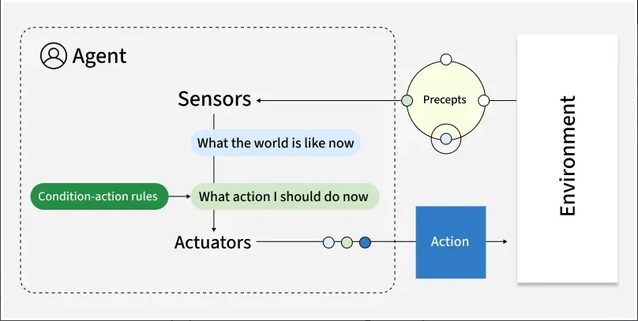
Types of Agents
Simple Reflex Agents
Simple reflex agents act based solely on current perceptions using condition-action rules. These agents respond directly to stimuli without considering past experiences or potential future states. They operate on basic "if-then" logic: if a specific condition is detected, execute a corresponding action.
Key Features:
No memory of past states
No model of how the world works
Purely reactive behavior
Function best in fully observable environments
For Example, Traffic light control systems that change signals based on fixed timing.

Slide 23
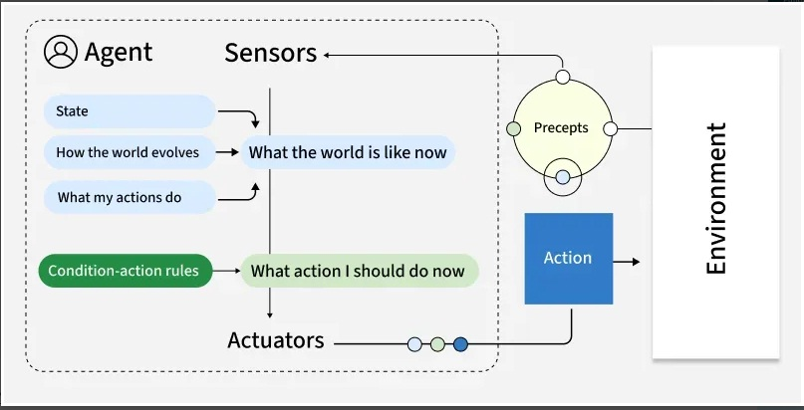
2. Model-Based Reflex Agents
Model-based reflex agents maintain an internal representation of the world, allowing them to track aspects of the environment they cannot directly observe. This internal model helps them make more informed decisions by considering how the world evolves and how their actions affect it.
Key Features:
Track the world's state over time
Infer unobserved aspects of current states
Function effectively in partially observable environments
Still primarily reactive, but with contextual awareness
For example, Robot vacuum cleaners that map rooms and tracks cleaned areas.

Slide 24
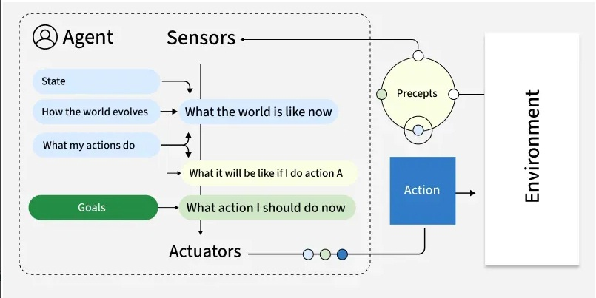
3. Goal-Based Agents
Goal-based agents plan their actions with a specific objective in mind. Unlike reflex agents that respond to immediate stimuli, goal-based agents evaluate how different action sequences might lead toward their defined goal, selecting the path that appears most promising.
Key Features:
Employ search and planning mechanisms
Evaluate actions based on their contribution toward goal achievement
Consider future states and outcomes
May explore multiple possible routes to a goal
For example, Logistics routing agents that find optimal delivery routes based on factors like distance and time. They continually adjust to reach the most efficient route.

Slide 25
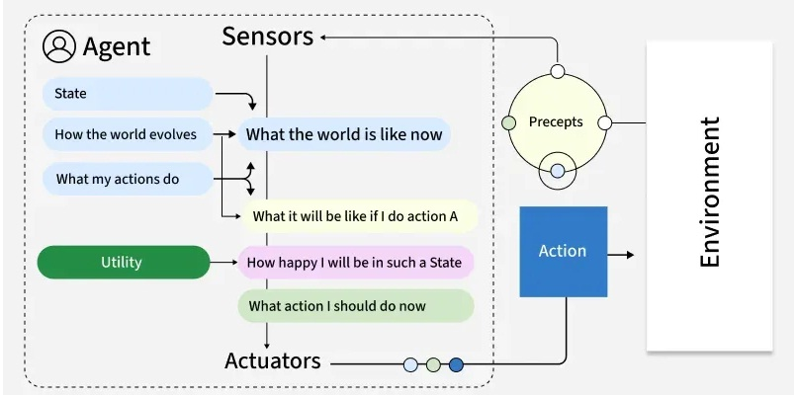
4. Utility-Based Agents
Utility-based agents extend goal-based thinking by evaluating actions based on how well they maximize a utility function—essentially a measure of "happiness" or "satisfaction." This approach allows them to make nuanced trade-offs between competing goals or uncertain outcomes.
Key Features:
Balance multiple, sometimes conflicting objectives
Handle probabilistic and uncertain environments
Evaluate actions based on expected utility
Make rational decisions under constraints
For example, Financial portfolio management agents that evaluate investments based on factors like risk, return and diversification operate by choosing options that provide the most value.

Slide 26
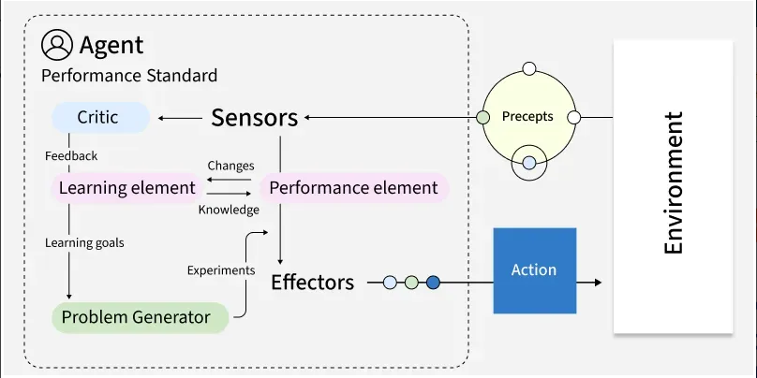
5. Learning Agents
Learning agents improve their performance over time based on experience. They modify their behavior by observing the consequences of their actions, adjusting their internal models and decision-making approaches to achieve better outcomes in future interactions.
Key Features:
Adapt to changing environments
Improve performance with experience
Contain both a performance element and a learning element
Generate new knowledge rather than simply applying existing rules
For example, Customer service chatbots can improve response accuracy over time by learning from previous interactions and adapting to user needs.

Slide 27
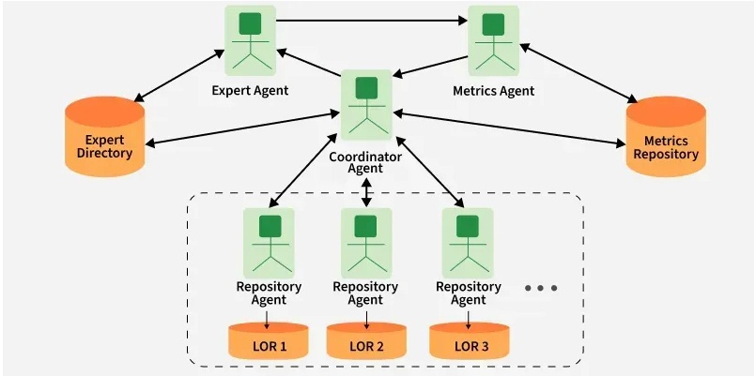
6. Multi-Agent Systems (MAS)
Multi-agent systems consist of multiple autonomous agents that interact with each other within an environment. These agents may cooperate toward common goals, compete for resources or exhibit a mix of cooperative and competitive behaviors. Types of multi-agent systems:
Cooperative MAS: Agents work together toward shared objectives.
Competitive MAS: Agents pursue individual goals that may conflict.
Mixed MAS: Agents cooperate in some scenarios and compete in others.

Slide 28
Key Features:
Agents act independently and control their own state.
Agents align, collaborate or compete to reach goals.
The system remains resilient if individual agents fail.
Decisions are distributed; there’s no single controller.
For example, a warehouse robot might use:
Model-based reflexes for navigation
Goal-based planning for task sequencing
Utility-based decision-making for prioritizing tasks
Learning capabilities for route optimization

Slide 29
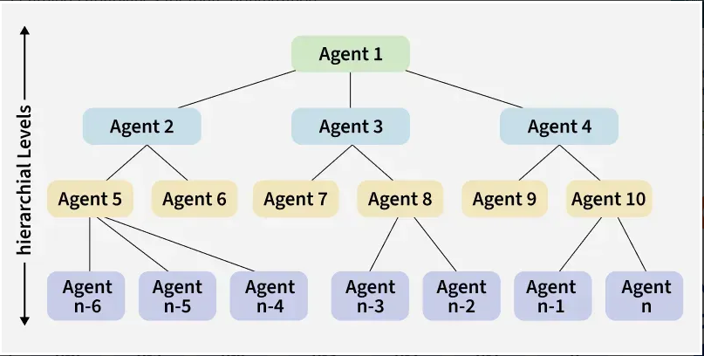
7. Hierarchical agents
Hierarchical agents organize decision-making across multiple levels, with high-level agents making strategic decisions and delegating specific tasks to lower-level agents. This structure mirrors many human organizations and allows for managing problems at appropriate levels of abstraction.
Key Features:
Division of responsibilities across multiple levels
Abstract decision-making at higher levels
Detailed execution at lower levels
Simplified information flow (higher levels receive summarized data)
For example, Drone delivery systems in which fleet management is done at top level and individual navigation at lower level.

Slide 30
Use Cases of AI Agents
Agents are used in a wide range of applications in artificial intelligence, including:
Robotics: Agents can be used to control robots and automate tasks in manufacturing, transportation and other industries.
Smart homes and buildings: They can be used to control heating, lighting and other systems in smart homes and buildings, optimizing energy use and improving comfort.
Healthcare: They can be used to monitor patients, provide personalized treatment plans and optimize healthcare resource allocation.
Finance: They can be used for automated trading, fraud detection and risk management in the financial industry.
Games: They can be used to create intelligent opponents in games and simulations, providing a more challenging and realistic experience for players.

Slide 31
Benefits of AI Agents
Fast and efficient operations.
Adapt and learn from experience.
Scalable for large or complex problems.
Operate autonomously with minimal human input.
Consistent, reliable task performance.
Limitations:
Struggle with complex or unpredictable environments.
High computational needs for learning and planning.
Communication issues in multi-agent setups.
Risk of bias or unintended actions.
Challenges in designing clear goals and utility functions.

