Slide 1
Steps of the Divine Liturgy
Part 4

Slide 2
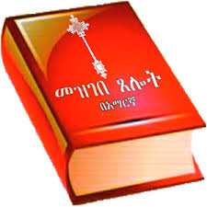
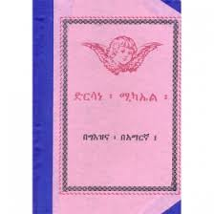
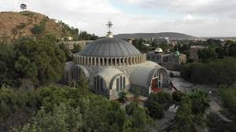
Before the Divine Liturgy
There are different preparations before the Divine Liturgy. These include different prayers,
The Prayer of Incense,
The prayers over holy Liturgical Items,
Preparation of the Altar,
Reading of
The Miracles of Jesus,
The Virgin Mary, and
other holy books according to the patron saint of the church and the commemoration of the day’s saint.

Slide 3
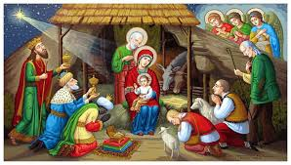
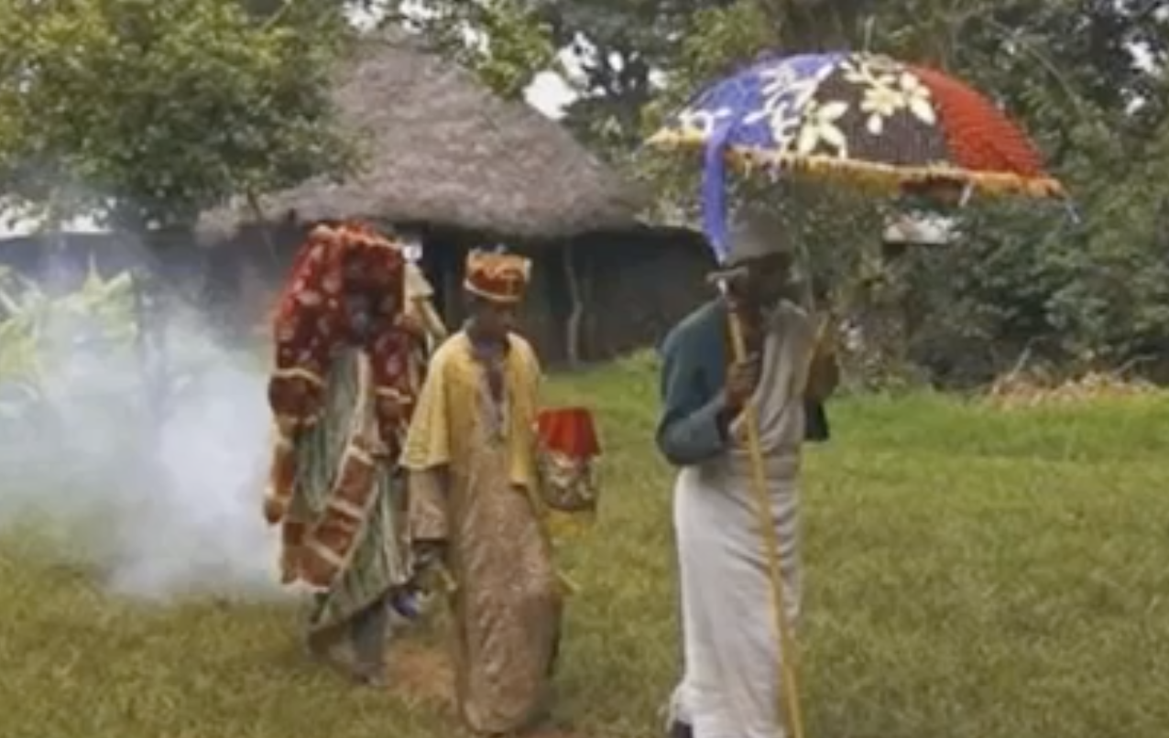
we are going to cover only most of the major parts the Divine Liturgy from the Procession of the Lamb, to the end of the Liturgy.
Preparation of the sacrifice in Bethlehem.
Bethlehem is the birth - place of Jesus Christ (Matthew 2:1). The place where the sacrifice is prepared is called Bethlehem because it is symbolic of this city, which is also known as the city of David.

Slide 4
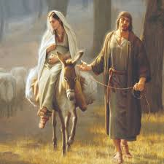
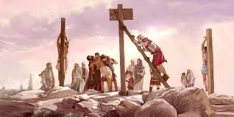
Procession of the Lamb and Entry into the Holy of Holies
The procession of priests and deacons carrying the sacrificial bread and wine from Bethlehem to the
Holy of Holies is called Procession of the Lamb. The priests and deacons take the sacrifice prepared in
Bethlehem to the holy of holies. There are many symbolisms in this procession:
The sacrificial lamb is carried in what we call Mesobe Worq, which is a symbol of the Virgin Mary, who carried Jesus Christ in her womb for nine months and five days.
The procession from “Bethlehem” to the Holy of Holies symbolizes the life of Jesus Christ from His birth in Bethlehem to His crucifixion at Golgotha. The Holy of Holies, where the sacrifice is offered, symbolizes Golgotha.

Slide 5

Continues
This procession also symbolizes Entry into the holy of holies - symbolic of our Lord’s triumphant entry into Jerusalem, and ultimately to His crucifixion at Golgotha
A deacon goes in the front ringing a bell during the procession. and another deacon carries an umbrella.
The umbrella is a symbol of the glory of God that was manifested through Jesus Christ.
The umbrella also is a symbol of the glory of God that appeared to the Israelites in the form of a cloud.
It also symbolizes God’s protection over us. (Exodus 13:21-22; 16:10; 33:10; 40:34-38)

Slide 6
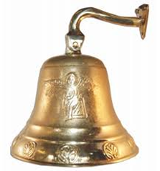
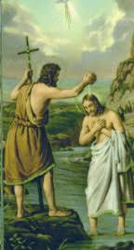
Cont:-
The bell is called Kalle-Awadi in Geez, which means Voice of Declaration. It is a symbol of the voice of John the Baptist: “I am the voice of one calling in the desert, Make straight the way for the Lord.”(John1:23). As John the Baptist declared the coming of the kingdom of God, and called the people into repentance,
Also, the ringing of the bell is a declaration of the beginning of the Divine Liturgy, and an
entrance into an angelic presence, and it also is a call for all in the congregation to repent and come into this divine presence to receive the body and blood of Jesus Christ.
Once inside the curtains are closed and there are certain symbolical steps that take place before it is placed on the altar.
The priest and deacons stand on opposite sides.
They symbolize the two angels who were seen in the tomb after the resurrection of Jesus Christ. (John 20:11-20)

Slide 7
Worship and prayer
During the divine liturgy

Slide 8
Worship and prayer
1. Priests pray for each other.
2. Deacons proceeds by saying.
        Deacon: Stand up for prayer.
        People: Lord have Mercy.
        Priest: Peace be unto you.
        People: With Thy Spirit (Let it be done unto us.)
3. Prayer of St. Basil.
4. Prayer of Oblation.
5. Prayer of Absolution of the Son.
6. Litany and Petitions
7. Reading
8. Prayer of the Covenant ( Kidan)
9. Hymn from the Psalm (Misbak)
10.Reading from Gospel
11.Litany of Clergy men.
12. The Nicene Creed ( Tselote Haymanot)
13. Washing of hands by the priest.

