Slide 1
Angelic Worship
Part 2

Slide 2
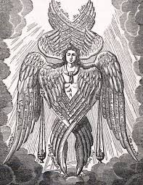
The Divine Liturgy is set in the image of the Heavenly Worship of Angels.
The prophet Isaiah explains his vision of angelic worship (Isaiah 6:1-3)
The angels praising God the same way we do in our Liturgy, saying, "Holy, Holy, Holy is the Lord of hosts. The whole earth is full of His Glory." The angels say these words covering their feet with two wings, their face with two wings, and flying with the other two. These are symbolic acts that indicate the following:
They cover their feet to indicate that they are not worthy to stand in His presence.
They cover their face to indicate they cannot see his glory.
They fly with the other two wings to indicate that they cannot go anywhere where He is not.

Slide 3
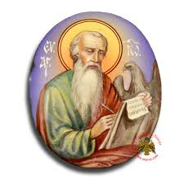
Angelic worship according to the Revelation of John the apostle:
“I was in the spirit: and, behold, a throne was set in heaven, and One sat on the throne. ... And round about the throne were four and twenty seats: and upon the seats I saw four and twenty elders sitting, clothed in white raiment; and they had on their heads crowns of gold. ... And in the midst of the throne, and round about the throne, were four beasts full of eyes before and behind. ...
And the four beasts had each of them six wings about him; and they were full of eyes within: and they rest not day and night, saying, Holy, Holy, Holy, Lord God Almighty, which was, and is, and is to come. And when those beasts give glory and honor and thanks to him that sat on the throne, who lives for ever and ever, The four and twenty elders fall down before Him that sat on the throne, and worship Him that lives for ever and ever, and cast their crowns before the throne, saying, You are worthy, O Lord, to receive glory and honor and power: for You have created all things, and for your pleasure they are and were created.”
Revelation 4:2-11

Slide 4
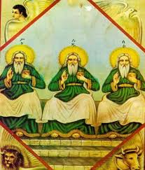
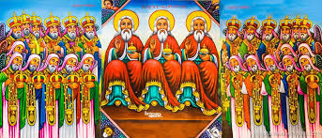
On both verses we have above there is a throne, with God sitting on it. The twenty-four elders and the four beasts are angels. We can see here also the angels worshiping Him with the same words we say in our liturgy. We also worship God in the same manner in our Liturgy. We have the body of Jesus Christ, God incarnate on a throne in the holy of holies, and the entire congregation, dressed in white, worship Him falling down before him like the angels.

Slide 5
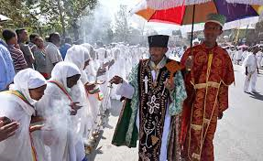
Our use of censer and incense
“And another angel came and stood at the altar, having a golden censer; and there was given unto him much incense, that he should offer it with the prayers of all saints upon the golden altar which was before the throne. And the smoke of the incense, which came with the prayers of the saints, ascended up before God out of the angel’s hand.”
Revelation 8:3-4

Slide 7
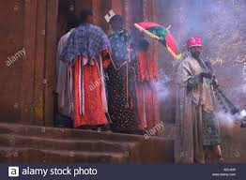
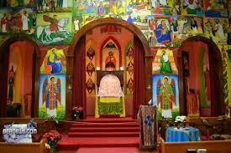
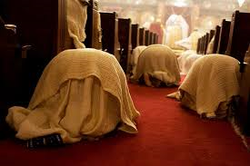
Similarities between the angels and our worship
There is a temple in heaven, as there is a church on earth.
There is an altar in heaven and also in our church.
There is a tabernacle of testimony in both, and
There is a throne with God on it.
We fall down in front of God as the angels do in worship.
We also offer incense with our prayers as angels do.
Therefore, when we worship God in the Divine Liturgy, we are in the same presence of the glory of God, as the angels.

Slide 8
There are few differences though:

Slide 9
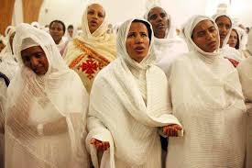
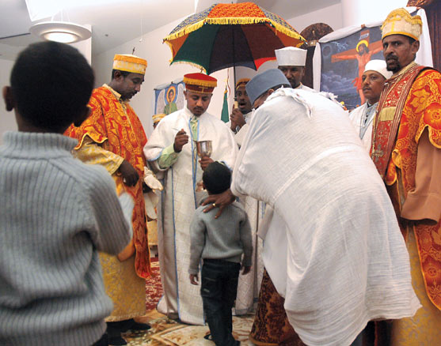
Few differences
The angels can’t look upon God, for no one can see him in his glory.
The Apostle John describes how God is manifested on the throne: “out of the throne, proceeded lightening and thundering and voices.”
But, we look upon him and touch him through the priest, and also receive Him, because He gave us His body and His blood for our Salvation.
Angels carry the throne of God, but God has made our body His temple.
That is why the apostle Paul wrote, “Don’t you know that you are the temple of God ?”
1 Corinthians 3:16.

Slide 10
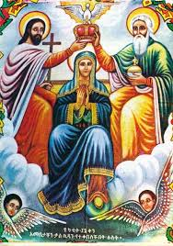
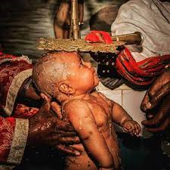
God gave, His merciful love allows us to worship him in the Divine Liturgy like the angels, yet presented something greater upon us for He manifested Himself in body for us, and gave us His body and blood so that we may receive Him and have communion with Him.
The apostle John marvels and describes the love of God by saying, “Behold, what manner of love the Father has bestowed upon us, that we should be called the sons of God.”
1 John 3:1

Slide 11
If God has given us such love, what should we do in return for the grace of such angelic presence?

