Slide 1
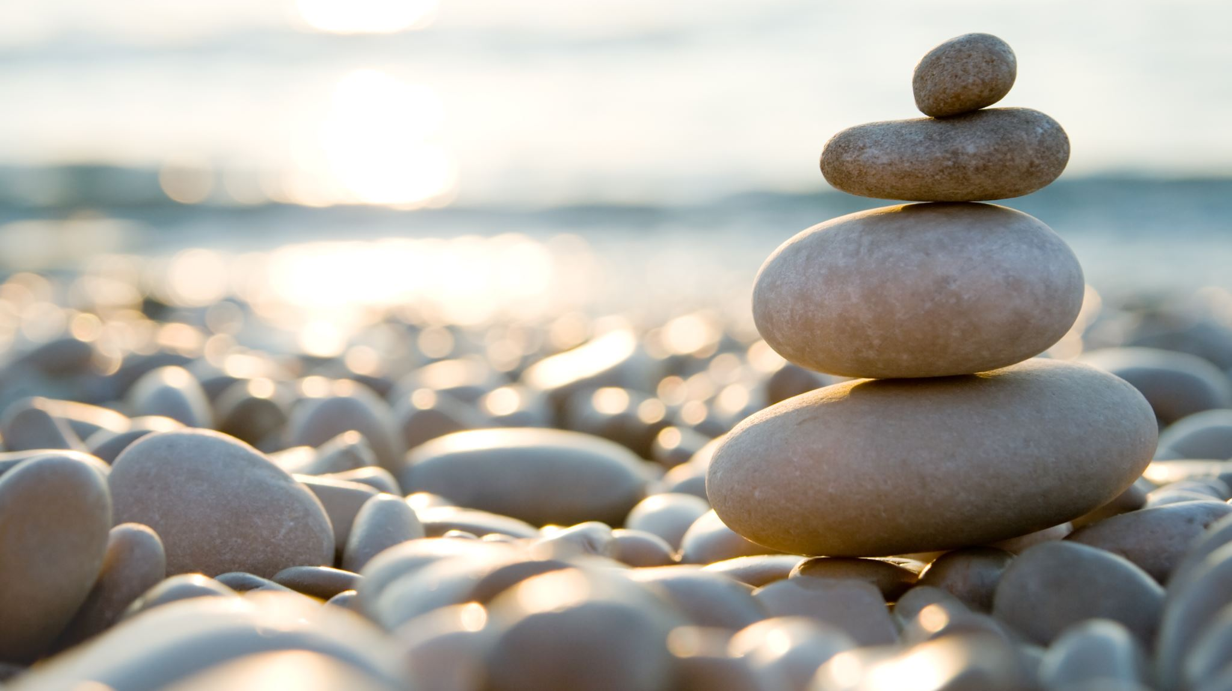
How to prepare ourselves for the Divine Liturgy. part 3
St. Abanoub

Slide 2
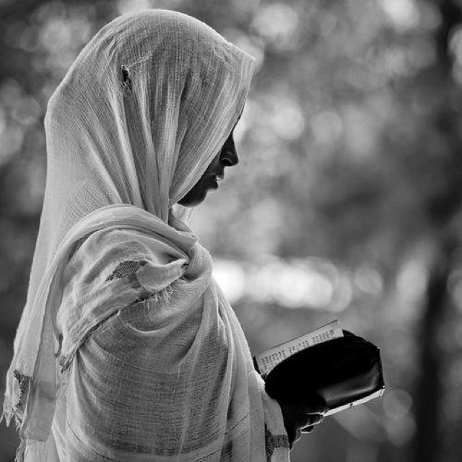
Two ways to prepare ourselves
Spiritually
Spiritual preparation before coming to Liturgy begins with the knowledge of what the Divine Liturgy is. So it is important that we understand the importance of the Divine Liturgy, as discussed in the previous section.
Spiritual preparation involves submitting our will to the will of God, repentance and confession.

Slide 3
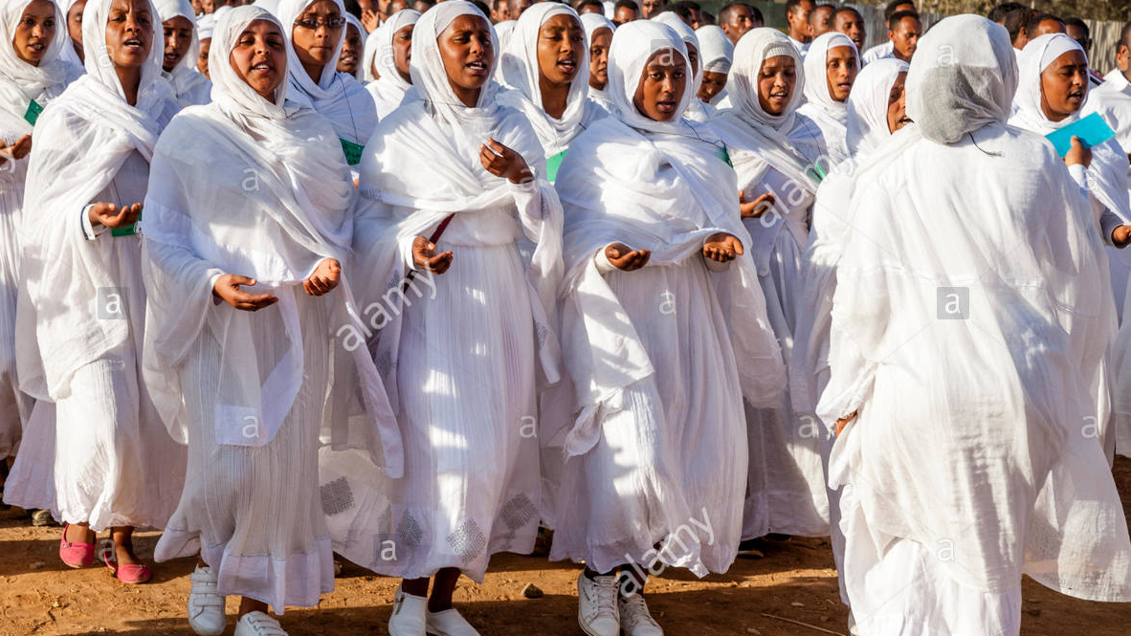
2. Physical Preparation
1. We should be clean and wear clean clothes.
God ordered Moses to sanctify the people and have them wash their clothes before He came down in the presence of the congregation:
"And the Lord said unto Moses, Go unto the people, and sanctify them today and to morrow, and let them wash their clothes, And be ready against the third day: for the third day the Lord will come down in the sight of all the people upon mount Sinai." Exodus 19:10-11
Likewise, we should be especially clean and wear clean clothes to present ourselves in front of God. This in turn reminds us of the spiritual purity with which we should present ourselves to God.

Slide 4
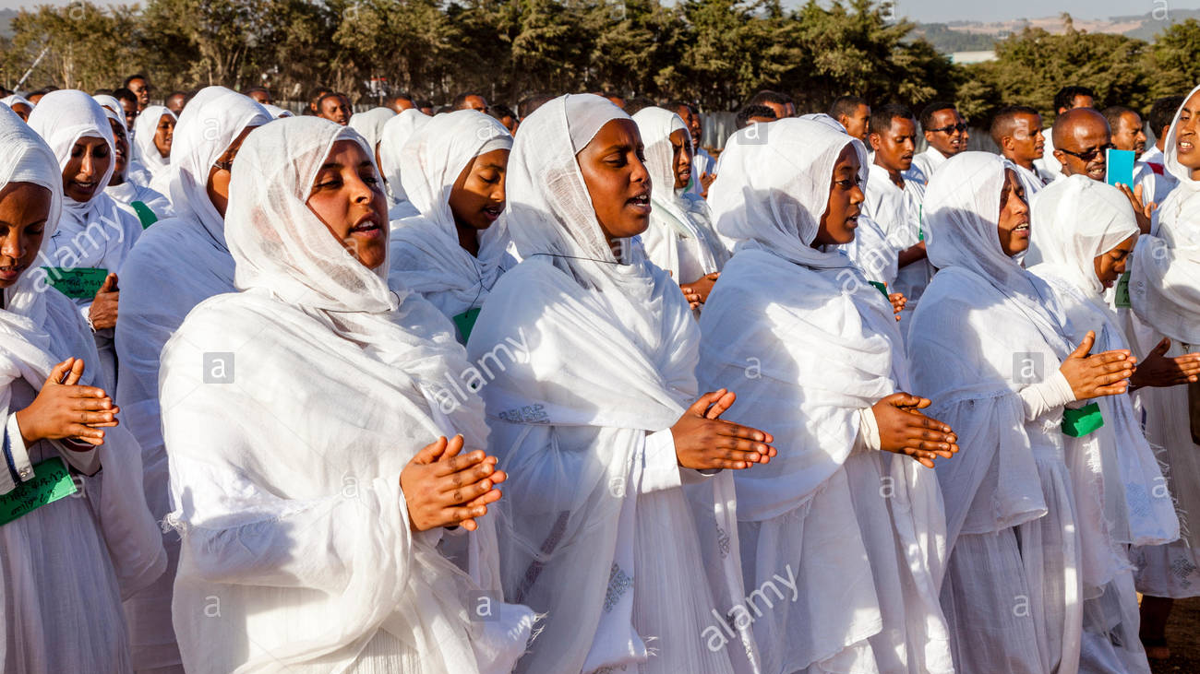
2. We should be dressed appropriately when we come to the Divine Liturgy.
Women should wear decent dresses, and men should wear decent pants. Remember in the Divine Liturgy, we are in the presence of God, with the host of angels.
When the apostle John explained how the angels worshipped God, he also gave details of their clothing, because appropriate appearance is part of divine worship: "I saw four and twenty elders sitting, clothed in white raiment." (Rev. 4:2)
Wearing white raiment (Netsela) reminds us of our angelic presence. White is also a symbol of spiritual purity. So, we are reminded of the need to have spiritual purity, and to examine our spiritual life

Slide 5
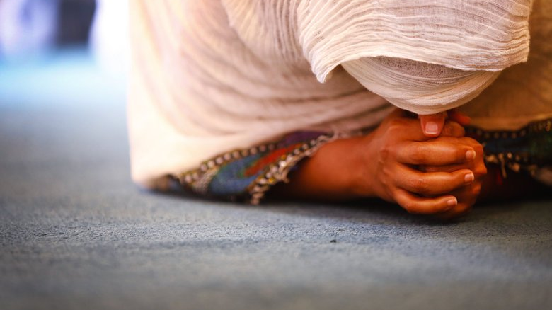
3. We should humble ourselves like the angels.
We should prostrate ourselves with the cross sign and worship Him when we enter the church.

Slide 6
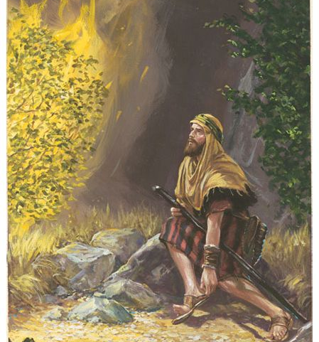
Lastly
4.We should take off our shoes inside the church for the place where we worship him is Holy.
God commanded Moses, "Take the shoes of your feet for the ground on which you stand is holy." Exodus 3:5. This by itself is an act of worship and humbling oneself before God.

