Slide 1
Abel and Cain
St. Abanoub

Slide 2
Memory verse
“By faith Abel offered to God a more excellent sacrifice than Cain”

Slide 3
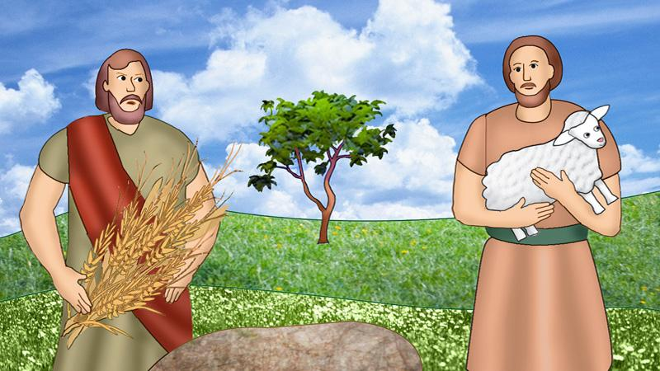
Who are they?
Adam and Eve had two sons.
Their names were Abel and Cain.
Abel was a keeper of sheep. Cain was a tiller of the ground. Abel was a good boy who obeyed God and his family.

Slide 4
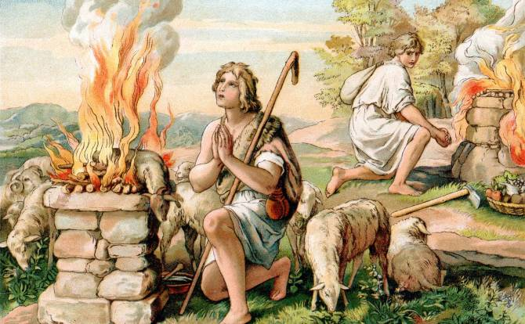
Abel’s Offering
• One day Cain brought of the fruit of the ground for an offering to God. And, Abel brought the best and the finest of his flock.
• And the Lord had respected unto Abel and his offering. Because Abel was careful in choosing what to offer to God and he also offered it in faith. He chose the finest of his sheep. God was pleased by Abel and accepted his offer

Slide 5
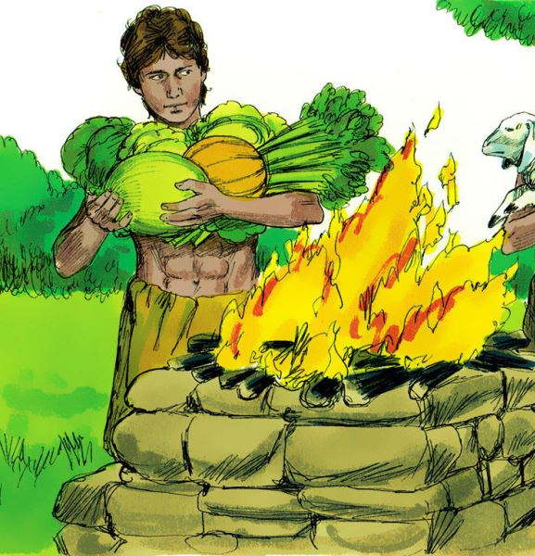
Cain’s Offering
But Cain was careless when he select fruits to offer to God. He presented to God imperfect gifts, reserving to himself the better part of the produce of the land. Cain didn’t make his offering to God by faith.
Saint Paul wrote about Abel’s and Cain’s offering saying, “By faith Abel offered to God a more excellent sacrifice than Cain” (Hebrew 11:4)

Slide 6
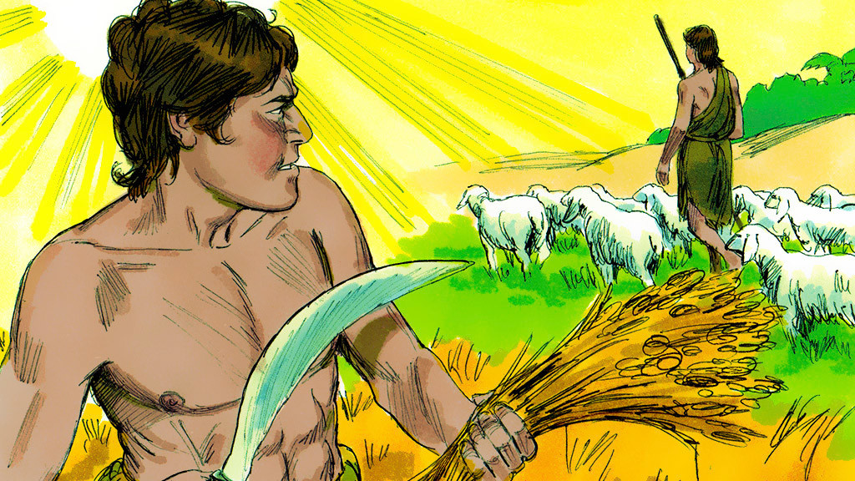
Cain was sad that Lord God did not accept his offering. God said to Cain,” why are you sad? If you do well your face would shine, but if you don’t do well sin crouches at the door...” /Genesis 4:6-7/
Cain was sad and jealous of Abel, for the Lord God had respect unto Abel and accepted his offering.

Slide 7
What happened next ?

Slide 8
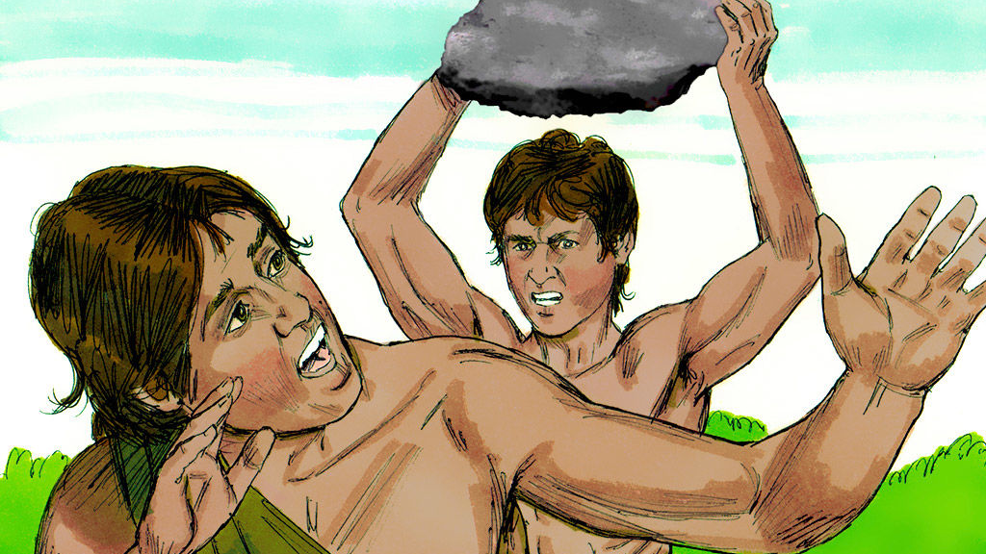
Out of jealousy, Cain asked his brother to go out to the field and then he killed Abel.
The Lord God knew what Cain did and told him that he would be cursed from the earth because of what he did.

Slide 9
Questions ?

