Slide 1
The Tower of Babel
Genesis 11

Slide 2
“Let us go down, and there confound their language, that they may not understand one another's speech.” /Gen. 11:7/
MEMORY VERSE:

Slide 3
After the great flood, the children of Noah multiplied on earth.
Do you remember Noah and his family?
How many children did he have? And name them?
So today’s lesson is about
What the descendants of Noah did after the great flood, when they multiplied and grew in number.

Slide 4
Learn about the consequence of uniting for the wrong purpose
From the beginning of creation until shortly after the great flood, all the people on earth spoke the same language.
All the people on earth spoke one language and were one race until they started to build this tower.
After the great flood, the descendants of Noah agreed to build a city and a tower, “whose top will reach to heaven.”
They said, “let us make a name for ourselves.”

Slide 5
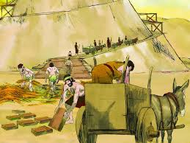
Uniting for the wrong purpose
They wanted to build a tower, the top of which reaches to heaven, but for those who seek the Lord God, He is near, who could be reached not with a tower but a pure heart.
They were all one race and one language, but instead of praising the Lord God in unity, they instead were united in rebellion.
What do you do to reach out to God?

Slide 6
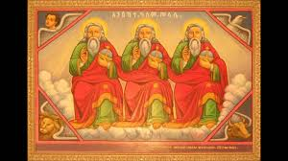
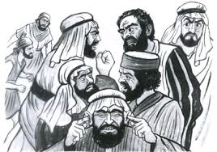
Did they finish the tower?
The Lord God came and saw the city and the tower they built, and said, “Come, let us go down and confuse their language, so they may not understand one another’s speech.” /Gen 11:7/
So, the Lord God mixed up their languages and they could not communicate to build the tower and the city they imagined of building. Instead, they were scattered over the face of all the earth.
The place where they had started to build a tower was called Babel.
Because of their rebellion God mixed up their language, and they couldn’t understand each other to finish what they started.
God said, “Come let us go down…” So us refer to?

Slide 7
To conclude They wanted to build the tower to reach the heaven and to make a name for themselves. Trying to make a name for oneself is a kind of self-worship, that is dangerous to live in faith. When we care much about making a name for ourselves, we forget glorifying the name of the Lord God. But if we keep God’s commandments and glorify His name, He will make a name for us. In everything we do, we should ask how to glorify God’s name, for He is the one who gives us the strength, the will and the health to do all that. When we come together, speaking the same language or not, our unity should be for the glory of God, and not for personal glory or name. Otherwise, even speaking the same language, we may not understand each other and may scatter without doing anything that is good in the eyes of the Lord God.

