Slide 1
Jacob’s Ladder
Genesis 28:15

Slide 2
Memory Verse: “I am with you and will watch over you wherever you go. I will not leave you until I have done what I have promised you.”
Genesis 28:15

Slide 3
Do you remember who Jacob is?
The second born of Isaac.
What is his brother’s name?
Esau
Esau and Jacob are Isaac kid but who is Isaac’s father?
Abraham

Slide 4
The lesson is about a dream Jacob had while sleeping in a certain place.
After Jacob took his brother’s blessings’, his brother Esau was so mad and tried to kill him. However
Rebecca, their mother, told Jacob to go away from the house so that his brother wouldn’t kill him.
So Jacob went away to his uncle. On the way, he was so tired that he decided to rest in certain place.
He found a stone and used it as his pillow and fell asleep.

Slide 5
/Genesis 28:13-15/
In a dream, he saw a ladder from Heaven to the ground. On the ladder, he saw Angels going up and down the on it.
Then, at the top of the ladder was God. God spoke to him and said “I am the Lord, the God of your father Abraham and Isaac. I will give you and your children this land. Your children will be like the dust of the earth and all peoples of the earth will be blessed through you and your people. I am with you and will watch over you wherever you go. I will not leave you until I have done what I have promised.”

Slide 6
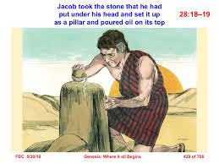
j
Then Jacob woke up and said that this place was truly blessed because the Lord was in it. In the morning, he took his stone pillow and made it into a pillar. After that he named the place Bethel, which means the House of God.

Slide 7
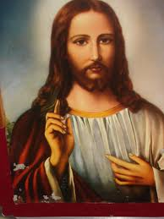
Conclusion
This lesson teaches us that God is always with those who follow and obey him. Every day, God is watching over us and we should not be afraid. We have to remember whenever we are scared that the Lord will protect us from any harm. Moreover, the Lord always does what he promised us. He never forgets.
Always remember whether you doing good or bad God is watching you.

