Slide 1
Welcome Saint Abanoub Students

Slide 2
Divine Liturgy Qidassie

Slide 3
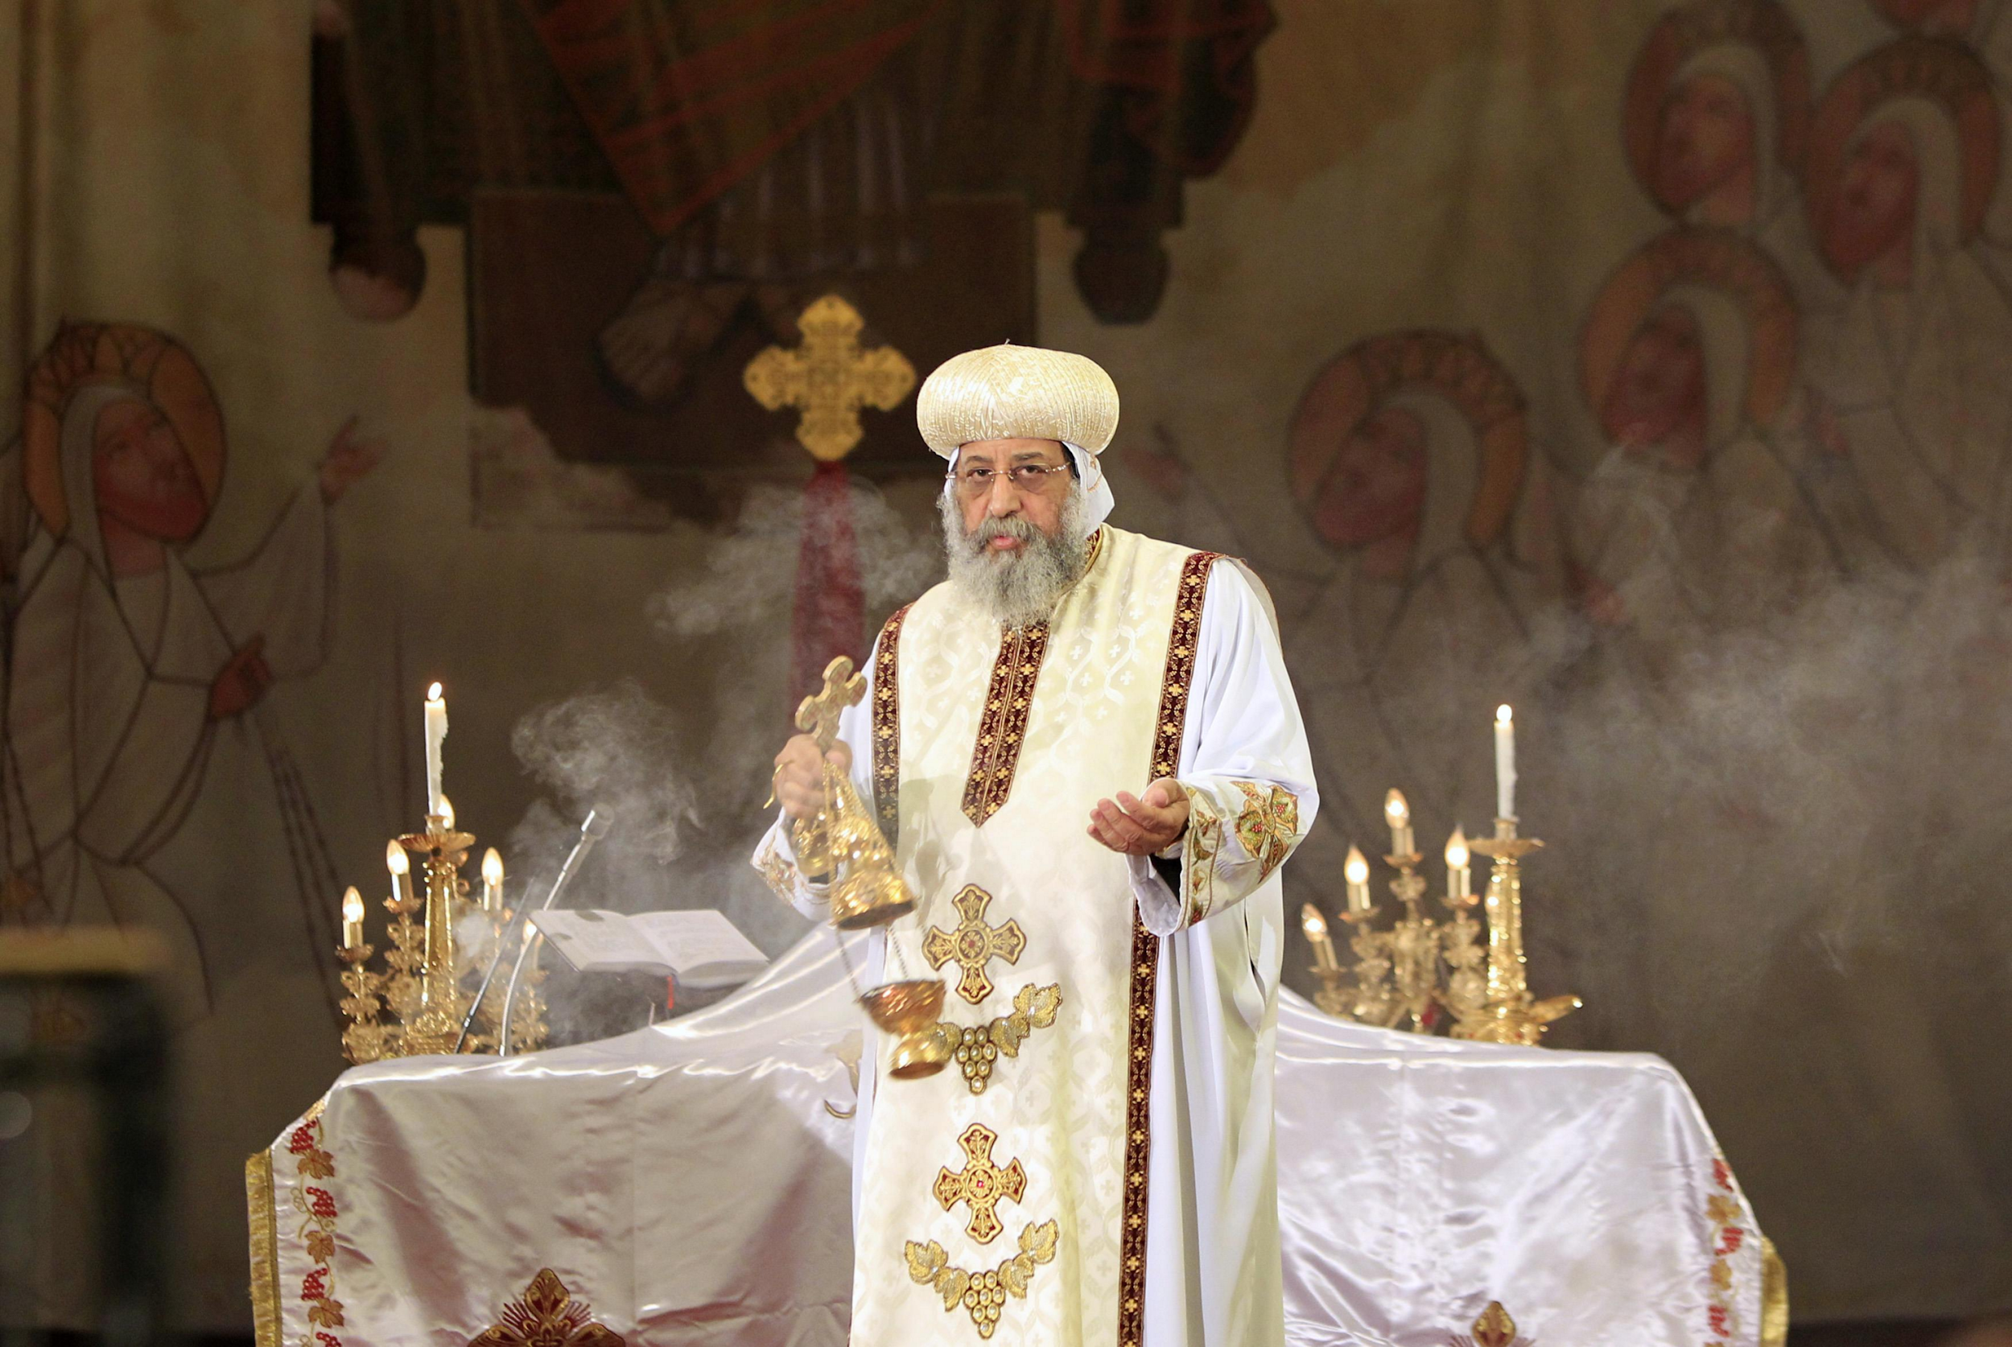

Slide 4
What is Qidassie???

Slide 5
The word Qidassie in itself means to Praise.
It is a special type of a mass prayer.
It is a sacrificial prayer.
Notes:
We have a lot of mass prayers in our church.

Slide 6
Why is it called a sacrificial prayer ?
Because Holy body and Holy blood of our Lord Jesus Christ is sacrificed.
“I am the living bread which comes down from heaven; if any man eat of this bread he shall liveforever: and the bread that I give is my flesh which I will give for the life of the world” (John 6:51)
When was the sacrifice instituted?

Slide 7
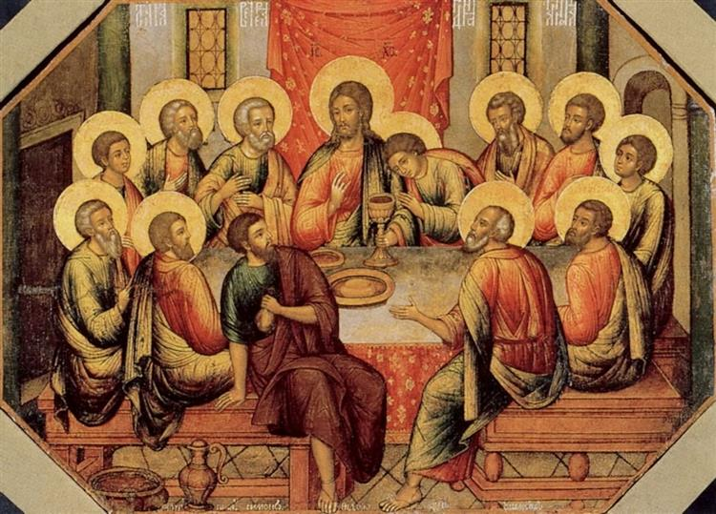
Memory Verse
The sacrifice was instituted by Jesus Christ himself on the Thursday before His crucifixion on the Cross on Friday.
"Jesus took the bread, blessed and broke it, and gave thanks and gave it to the disciples and said, 'Take, eat; this is My body.' Then He took the cup, and gave thanks, and gave it to them, saying, 'Drink from it, all of you. For this is My blood of the new covenant, which is shed for many for the remission of sins." Matthew 26:26- 29

Slide 8
To be continued…
In the next lesson we will look at Angelic Worship

