Slide 1
The Parable of the Ten Virgins
This lesson is about one of many parables the Lord Jesus Christ told His disciples.

Slide 2
MEMORY VERSE: “Watch therefore, for you know neither the day nor the hour when the Son of man comes” /Matt. 25:1/
OBJECTIVE: Learn about the importance of being prepared with spiritual virtues

Slide 3
The Parable of the Ten Virgins
After His glorious entry into Jerusalem, the Lord Jesus Christ taught His disciples about the kingdom of heaven in parables. He said, “The kingdom of heaven may be likened unto ten virgins.”
The ten virgins took their lamp to meet the bridegroom. Five of them were wise and five were foolish.
The wise virgins took extra oil with them for their lamps, but the foolish virgins did not.

Slide 4
The Parable of the Ten Virgins
The bridegroom was delayed and did not come on time, so they all slept. But at midnight, it was announced that the bridegroom had arrived, and everyone was called to come out and meet him.
So, they all arose to meet the bridegroom and prepared their lamps, but the foolish virgins could not light up their lamps for they were out of oil and did not have any extra with them.
They asked the wise virgins to give them some, but there wasn’t enough to share with them.

Slide 5
The Parable of the Ten Virgins
So, the foolish virgins went out to buy oil for their lamps. But, while they were still out, the bridegroom came.
All those that were ready went in with him to the marriage and the door was shut.
The five foolish virgins came back late, after the door was shut, and said, “Lord, Lord, open for us.” But he answered and said, “I do not know you.”

Slide 6
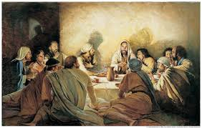
After this parable, the Lord Jesus Christ told His disciples the moral of the parable saying, “Watch therefore, for you know neither the day, nor the hour wherein the Son of man comes.”
The Parable of the Ten Virgins

Slide 7
Conclusion
The parable of the Ten Virgins is a story that teaches about the need to be prepared for the coming of the Lord.
The Ten Virgins did not know when the bridegroom was coming, but they had to be prepared for his arrival at any moment. The five wise virgins were prepared with extra oil for their lamps, but the five foolish virgins came unprepared.
When the bridegroom came, the five foolish virgins were out to buy oil for their lamps. But by the time they came back the door was already shut, and they could not go in.
In our lives, we have to be prepared with spiritual virtues, which are symbolized by the extra oil.
These are faith, obedience, love, prayer, fasting, almsgiving, and the works of the spirit in general.
We do not know at what age the Lord calls us to Him. Therefore, we should live prepared for the coming of the Lord any moment.
Otherwise, it may be too late for us like the five foolish virgins, and the Lord will say to us, “I do not know you.”

Slide 8
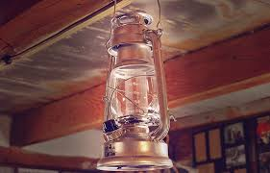
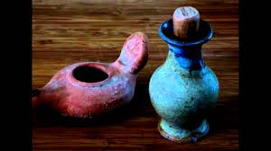
What is it?
Lamp

Slide 9
Thank you
For listening

